Slide 1
IM Simulation
Mediated Binding Version
Modelling Jacob’s experiments on consolidation time with simultaneous and sequential presentation

Slide 2
Model Variant: Rapid Consolidation
All items are consolidated; in simultaneous presentation consolidation is carried out rapidly so that all items can be consolidated quickly. Release of binding units is still slow, and accounts for the proactive benefit of time

Slide 3
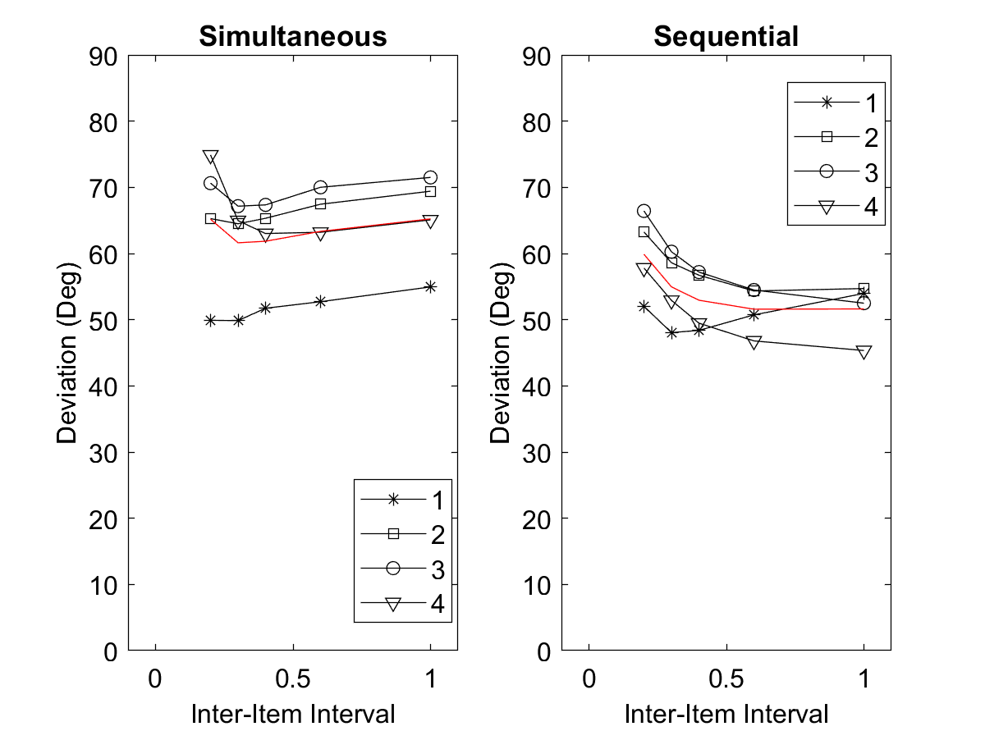
Rapid consolidation, slower release, both proceed until time is over in seq. condition (i.e., C.seqVariant = 3); P(ballistic) = 1.
Every new display onset reduces FX to 0.25% of its strength. Consolidation rate = 40

Slide 4
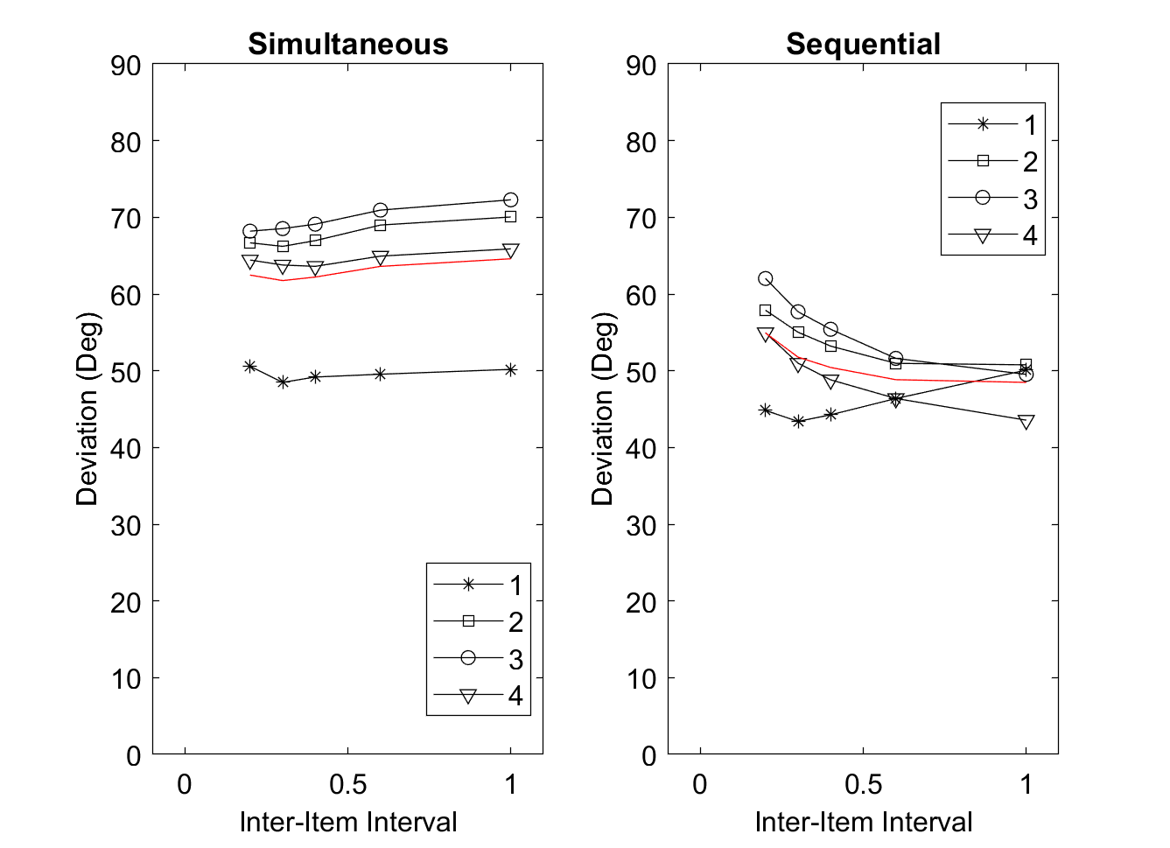
Same as before; consolidation rate increased to 400

Slide 5
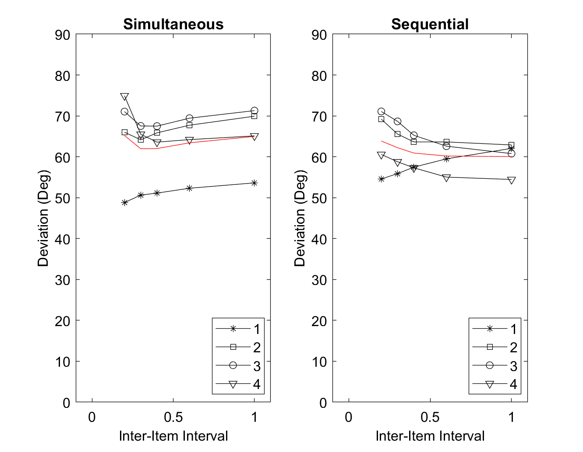
Rapid consolidation, slower release, consolidation stops when criterion is reached, whereas release proceeds until time is over in seq. condition (i.e., C.seqVariant = 2); ballistic = 1.
New stimuli reduce FX to 0.25%. Consolidation rate = 40

Slide 6
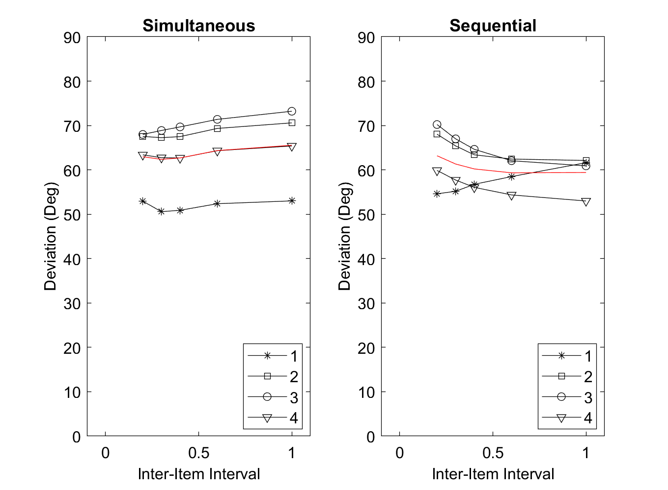
Same as preceding, with consolidation rate increased to 400

Slide 7
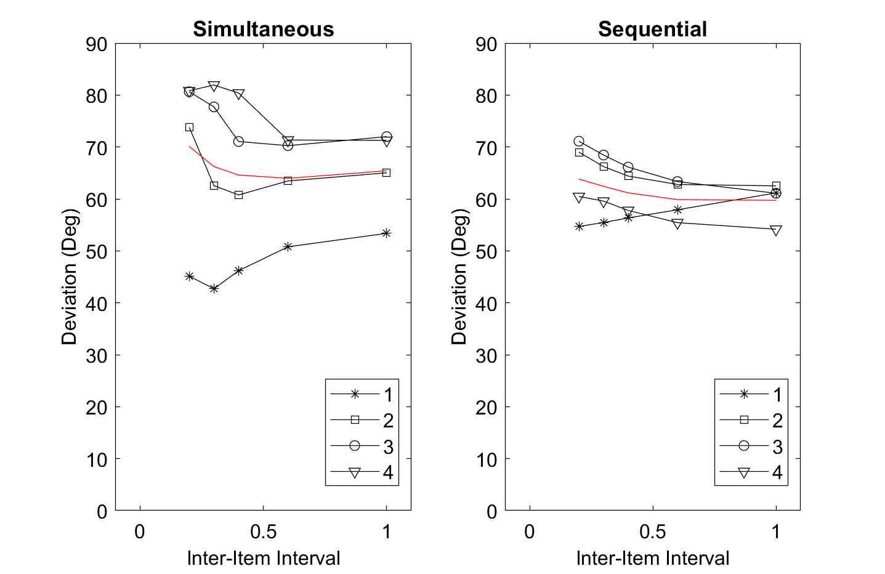
Same as preceding, with consolidation rate reduced to 15

Slide 8
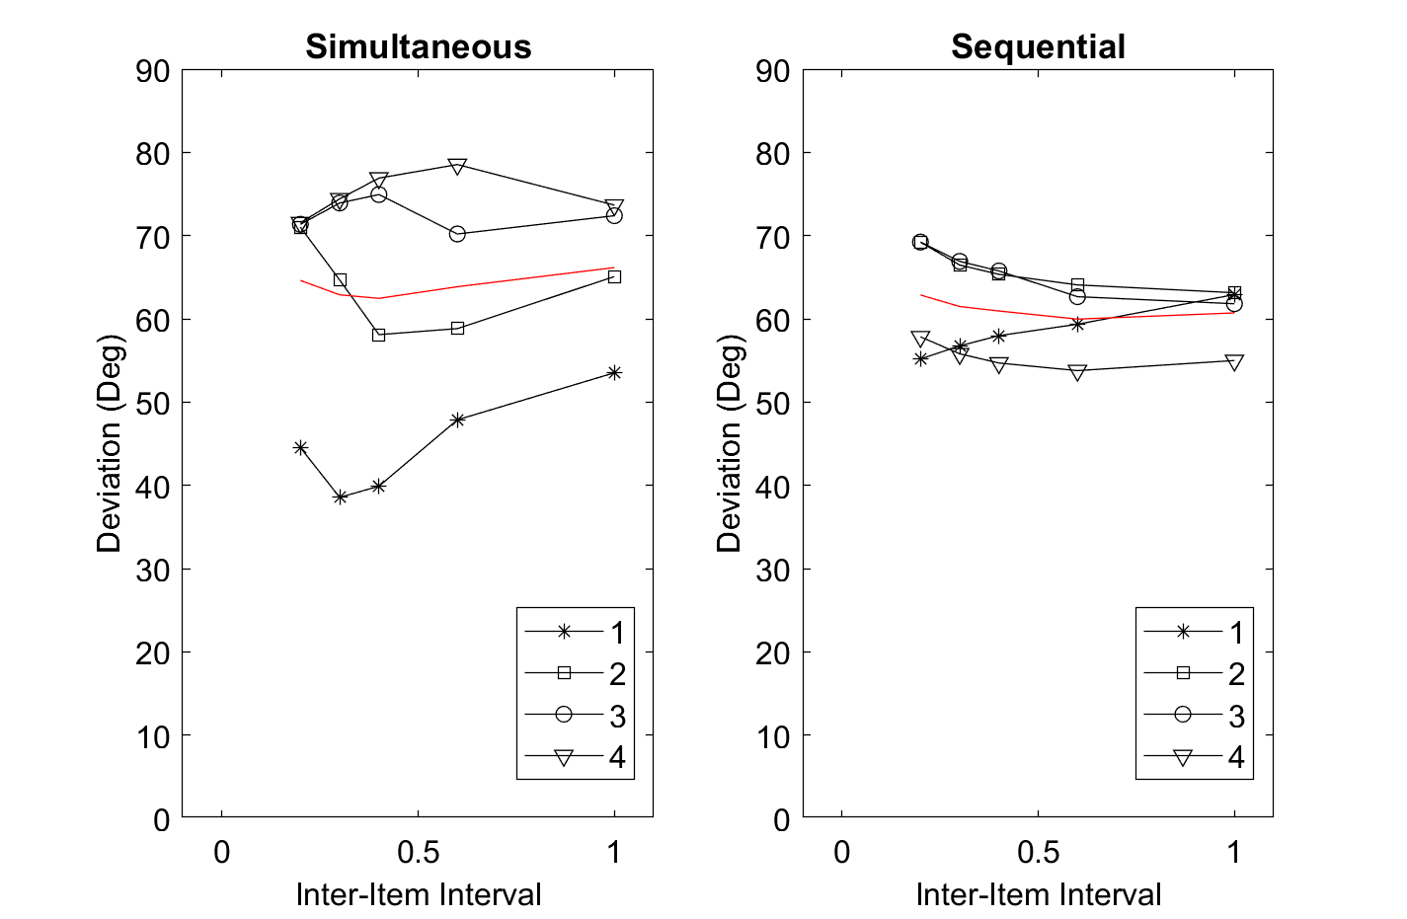
Same as preceding, with consolidation rate reduced further to 10, and FX reduced to 40% by each new display so that more is lost by decay of FX at longer intervals.

Slide 9
Model Variant: Selective Consolidation
In simultaneous presentation condition, participants try to consolidate only a subset of items (or no item)

Slide 10
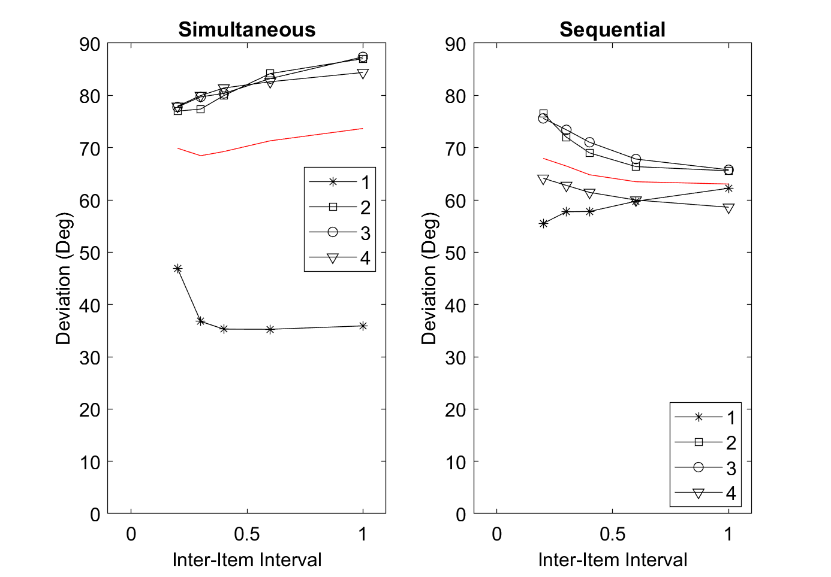
Consolidation of 1 item in simultaneous condition.
Consolidation rate = 10. FX is degraded to 30% with each new display
Consolidation stops when criterion is reached, whereas release proceeds until time is over in seq. condition (i.e., C.seqVariant = 2)

Slide 11
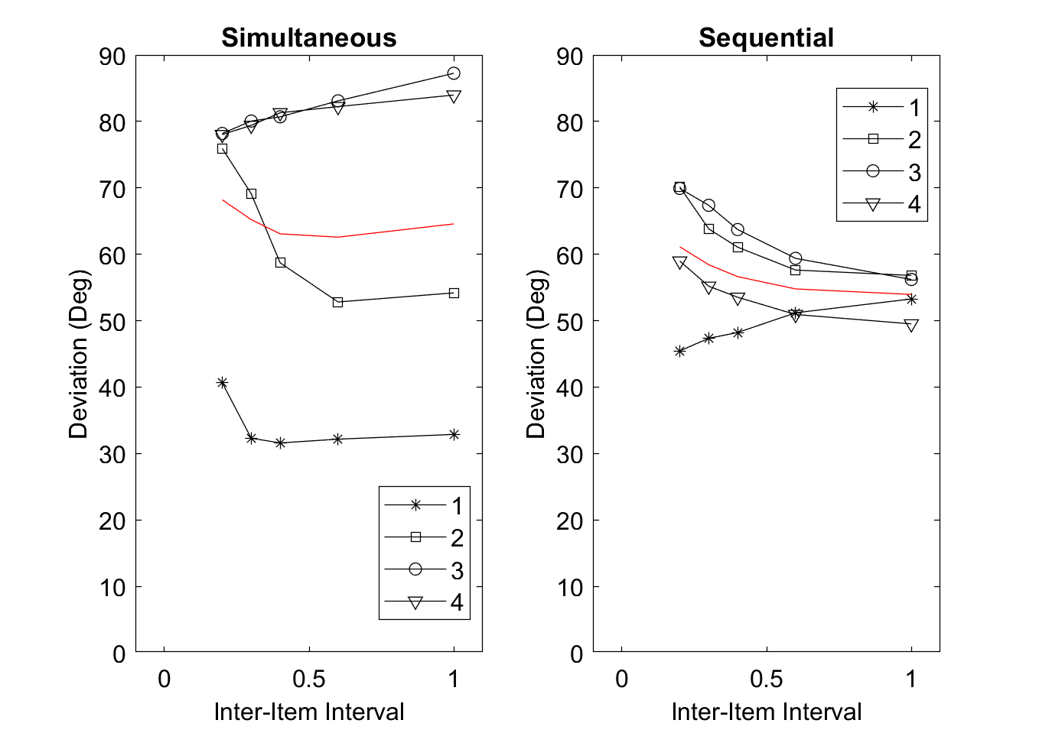
Same as preceding, now consolidation of 2 items in simultaneous condition.

Slide 12
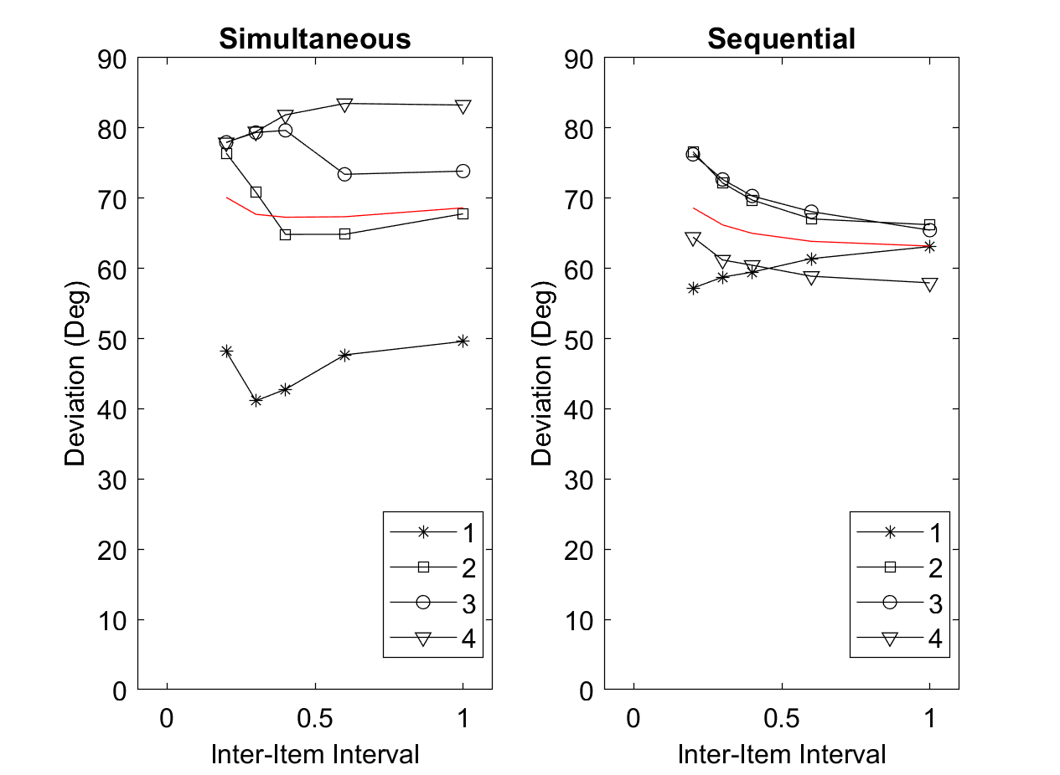
Same as preceding, now consolidation of 3 items in simultaneous condition.

Slide 13
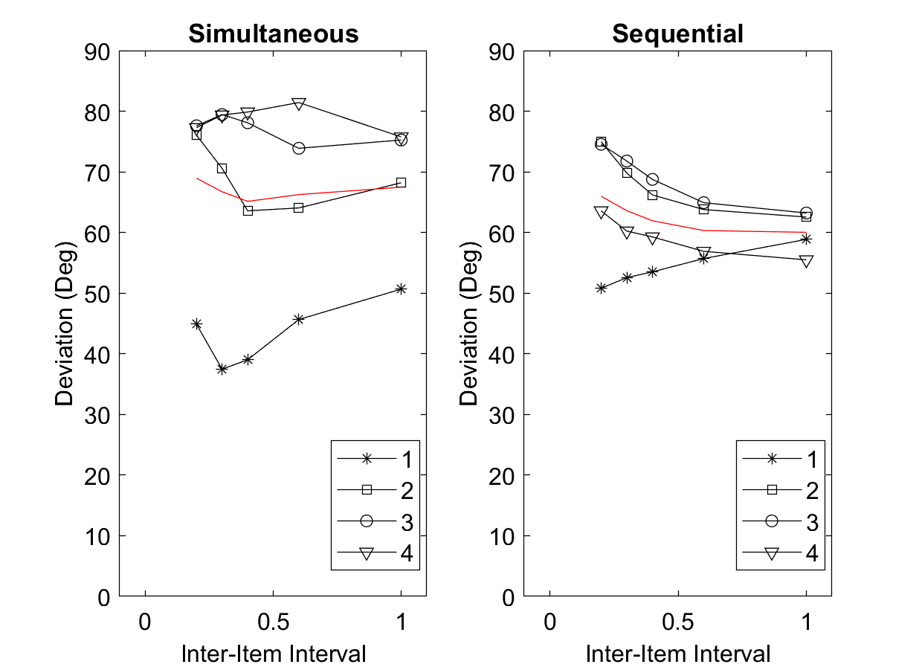
Same as preceding, now consolidation of 4 items in simultaneous condition.

Slide 14
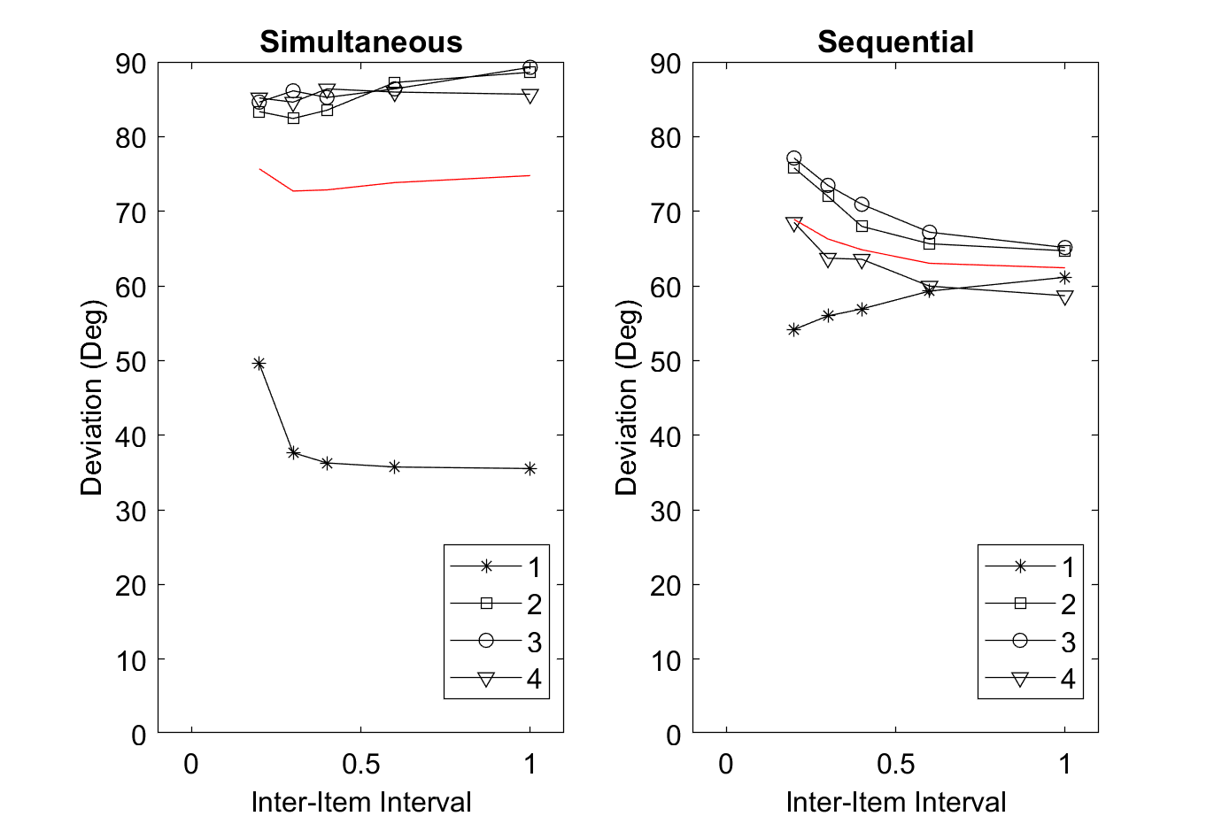
Consolidation of 1 item in simultaneous condition.
Consolidation rate = 10. FX is degraded to 15% with each new display

Slide 15
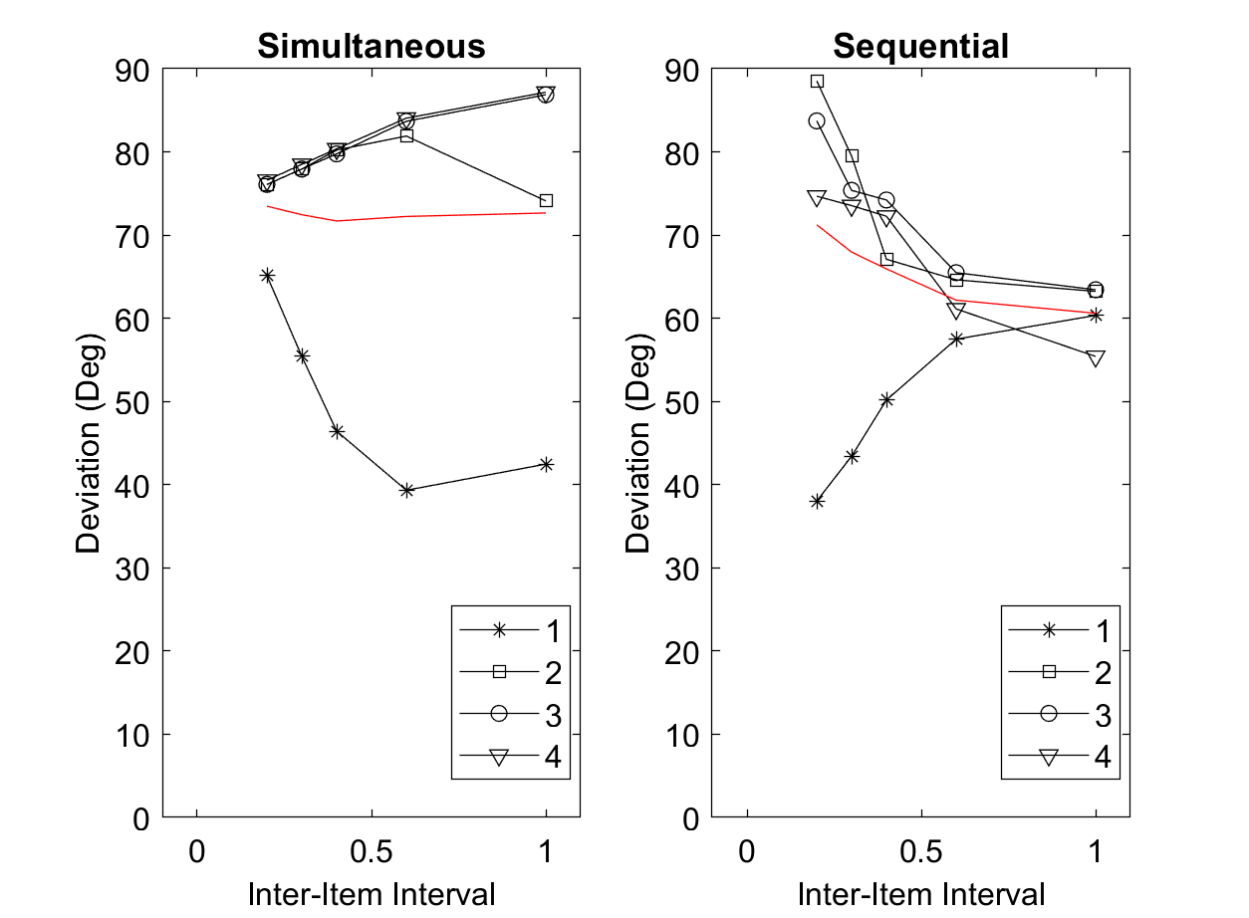
Consolidation of 4 items in simultaneous condition.
Consolidation rate = 3. FX is degraded to 30% with each new display

Slide 16
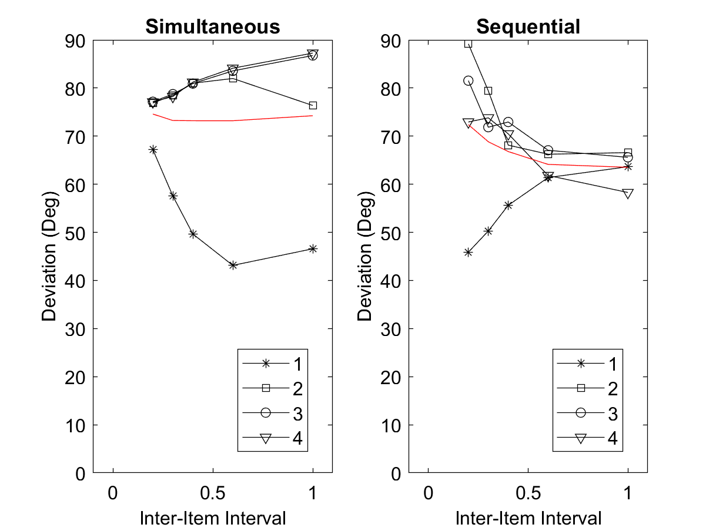
Same as before, but with consolidation and replenishment only continuing until strength criterion is reached (C.seqVariant = 1)

Slide 17
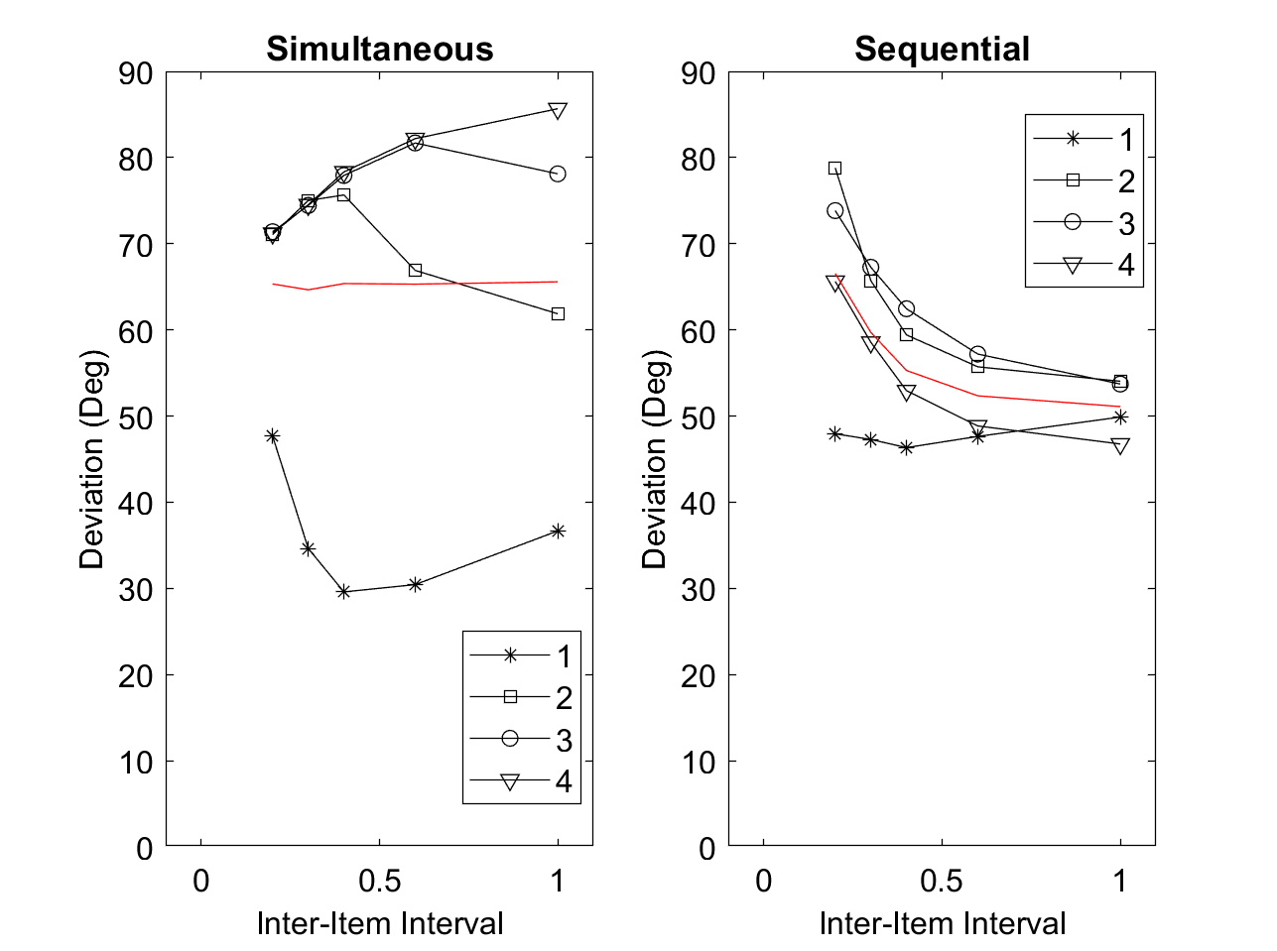
Consolidation stops when criterion is reached, whereas release proceeds until time is over in seq. condition (i.e., C.seqVariant = 2)
Probability of consolidation being ballistic = 0.65.
Attempt to consolidate all 4 items in sim. condition.
Consolidation rate = 5.
Release rate = 3.
Reduction of FX with each display: 30%.

Slide 18
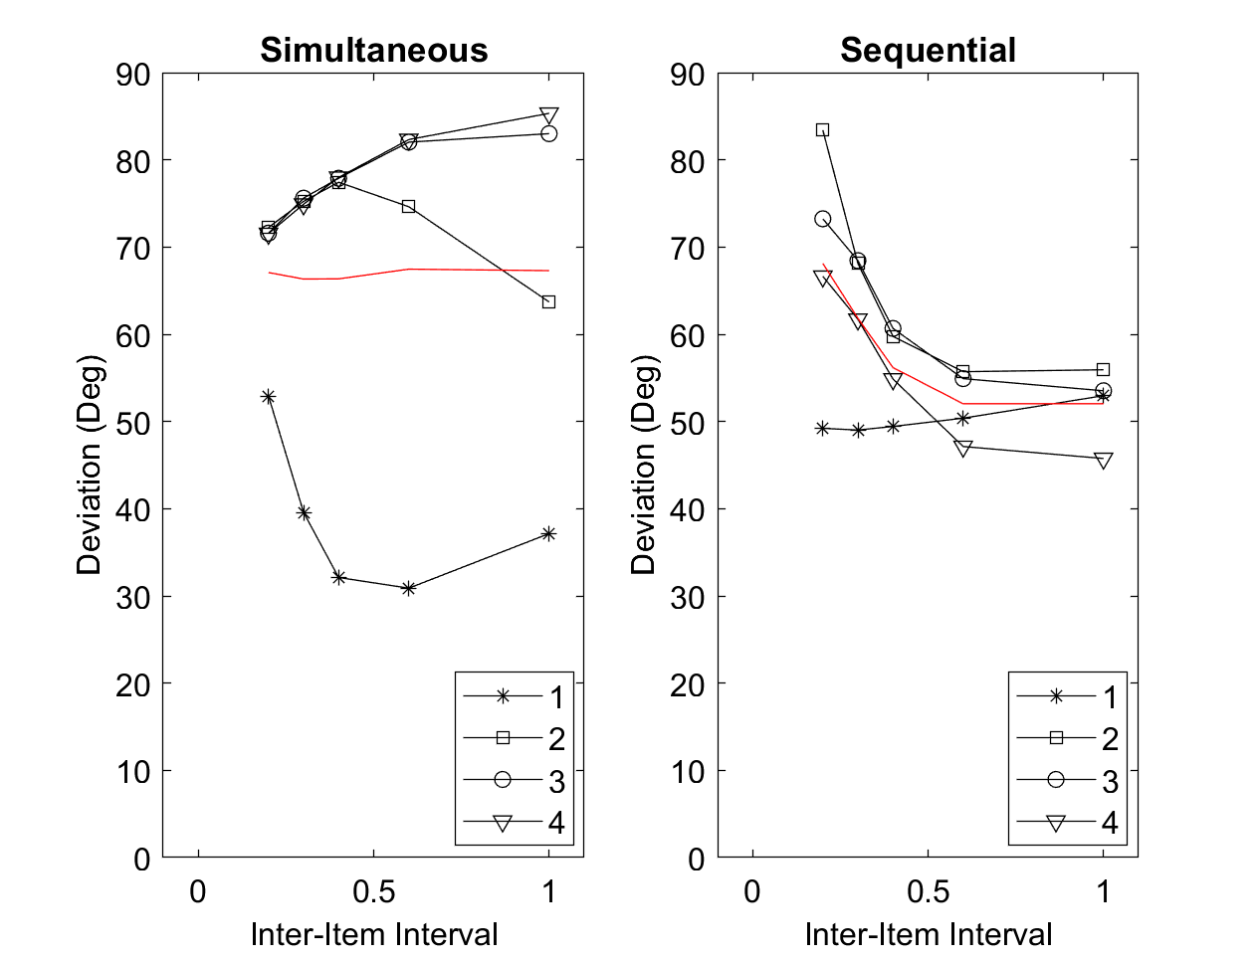
Same as preceding, with consolidation rate = release rate = 4

Slide 19

same with consolidation and replenishment finishing when the strength criterion is reached (C.seqVariant = 1)

Slide 20
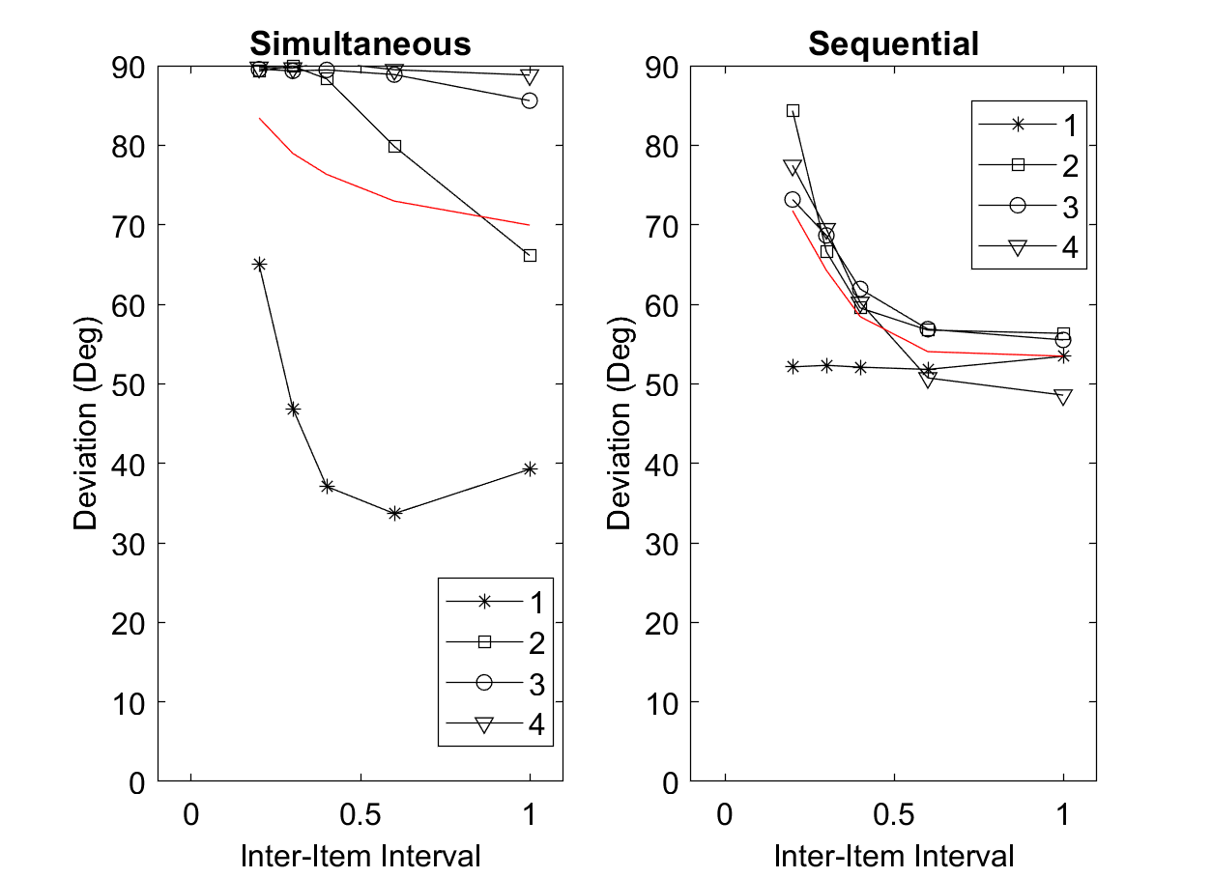
same with erase-FX set to 0% (C.seqVariant = 1)
Conclusion: The prediction that performance gets better with longer RI in simultaneous presentation can be neutralized by letting about 30% of FX survive the test display

Slide 21
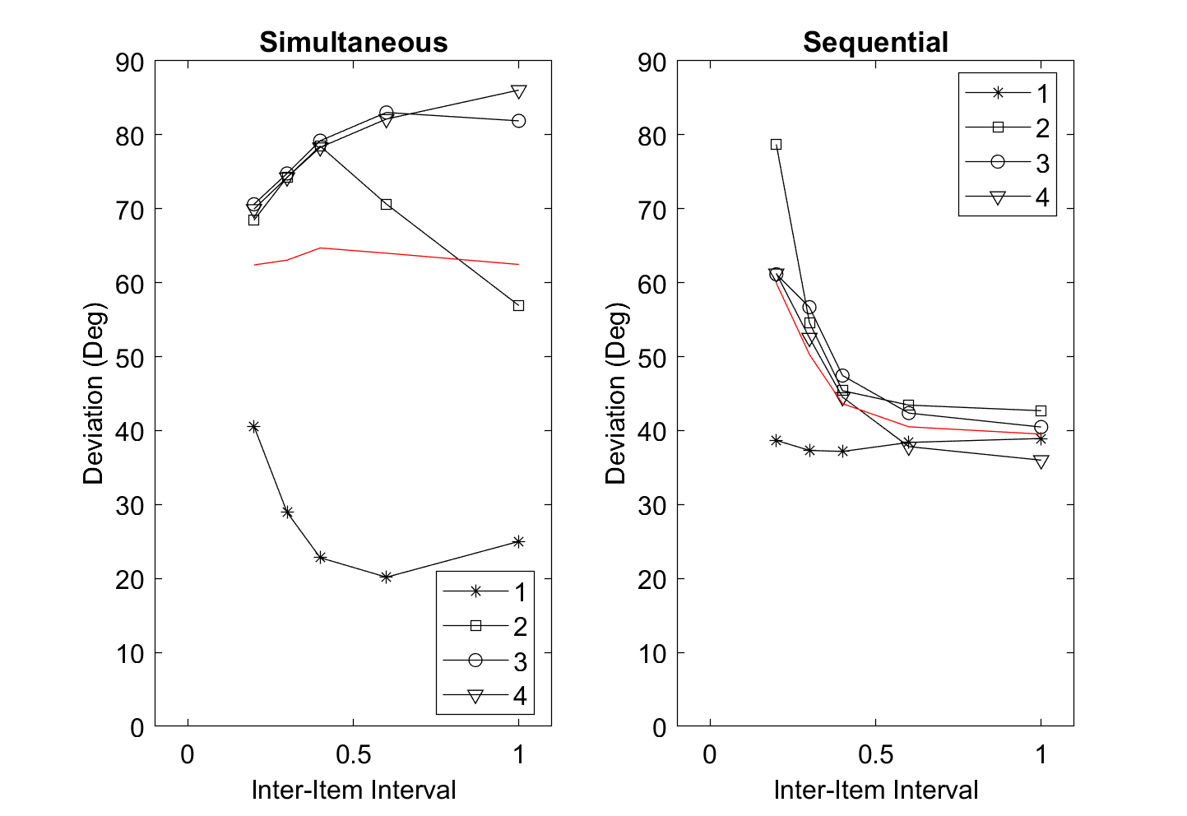
back to erase-FX = 30% (C.seqVariant = 1); now with masks (if attended) also erasing FX down to 30% (in addition to being encoded into FX)

Slide 22
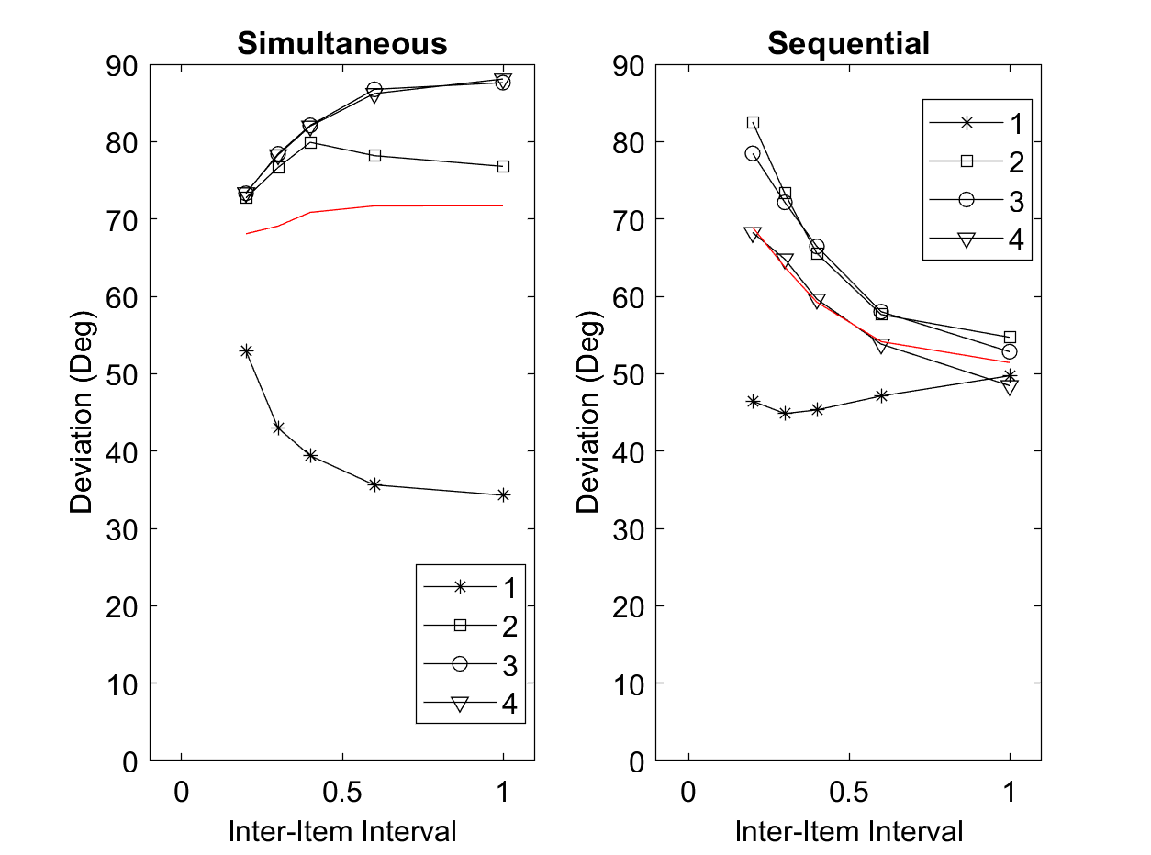
Same as before (though C.seqVariant = 2, which makes little difference); now with decay rate increased to 4

Slide 23
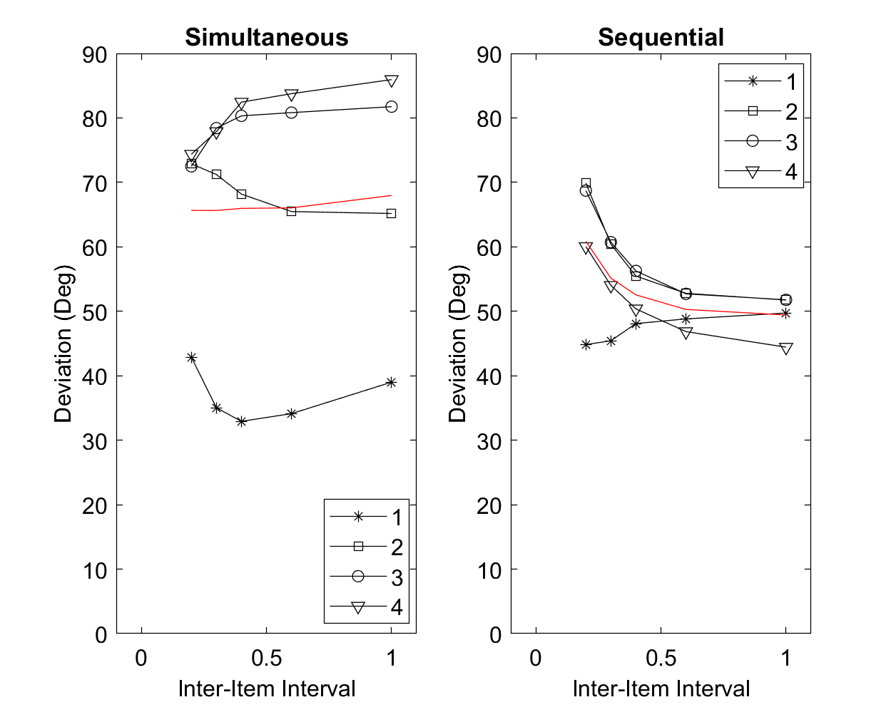
Same as preceding, with decay rate still at 4, and cRate and rRate increased to 8

Slide 24
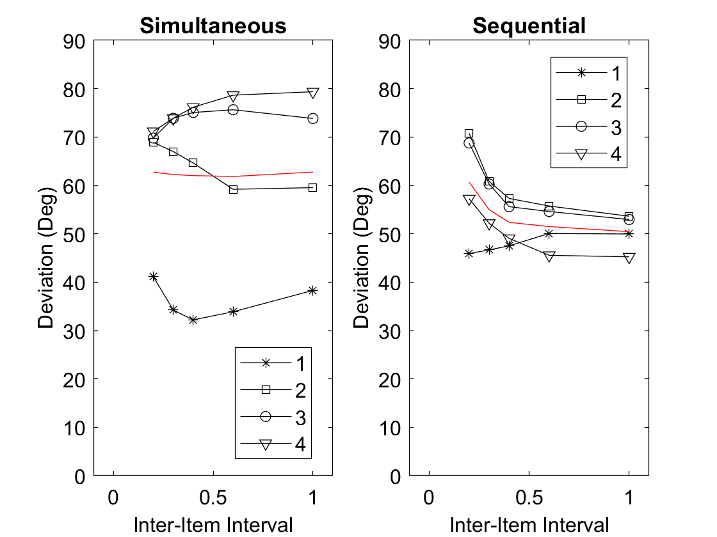
Same as preceding, now with decay rate reduced to 2, and cRate and rRate still elevated at 8

Slide 25
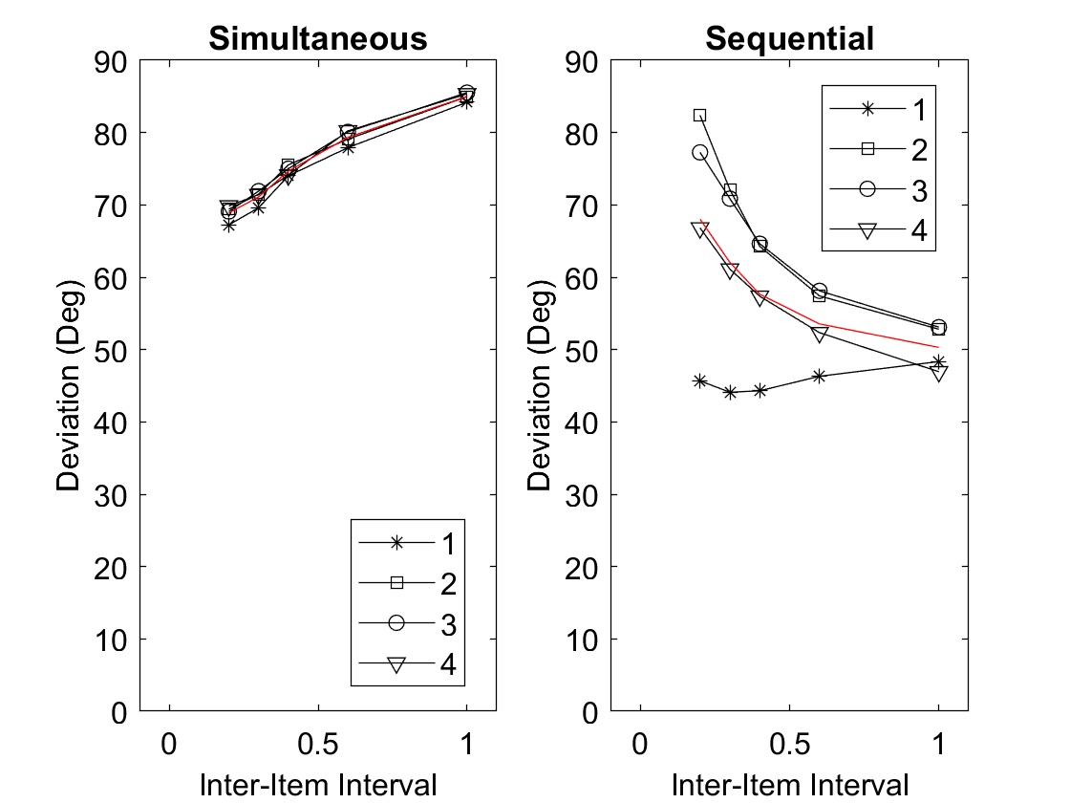
Variation of Number of Consolidation Attempts in Simultaneous Condition
Parameters:
C.seqVariant = 2
cRate = rRate = 4
decay = 2
eraseFX = 0.3
cBallistic = 0.65
Consolidation Attempts: 0

Slide 26
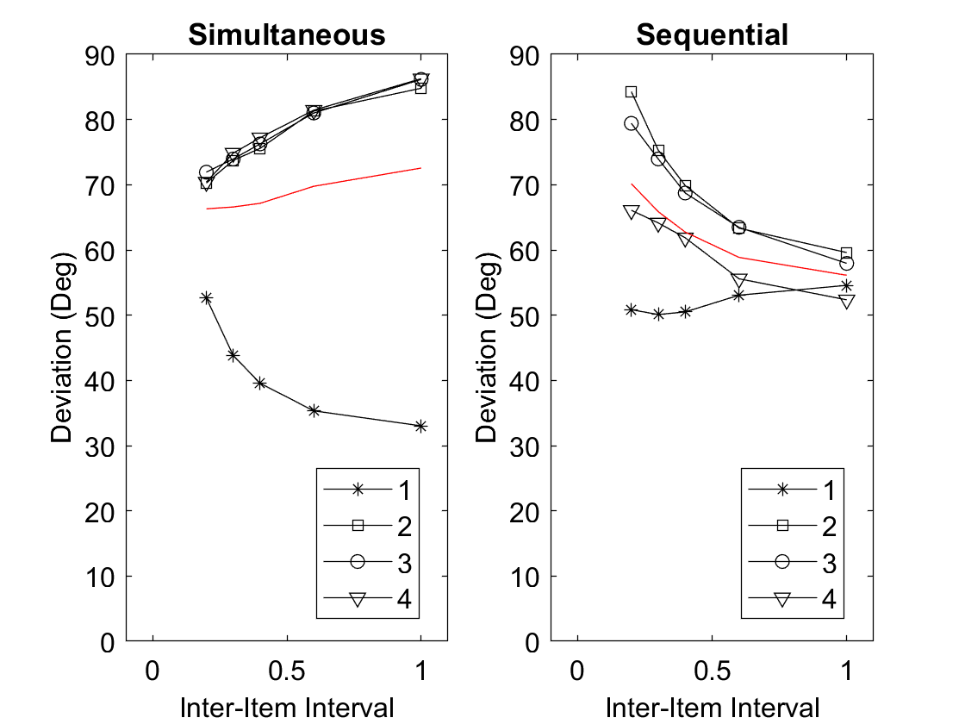
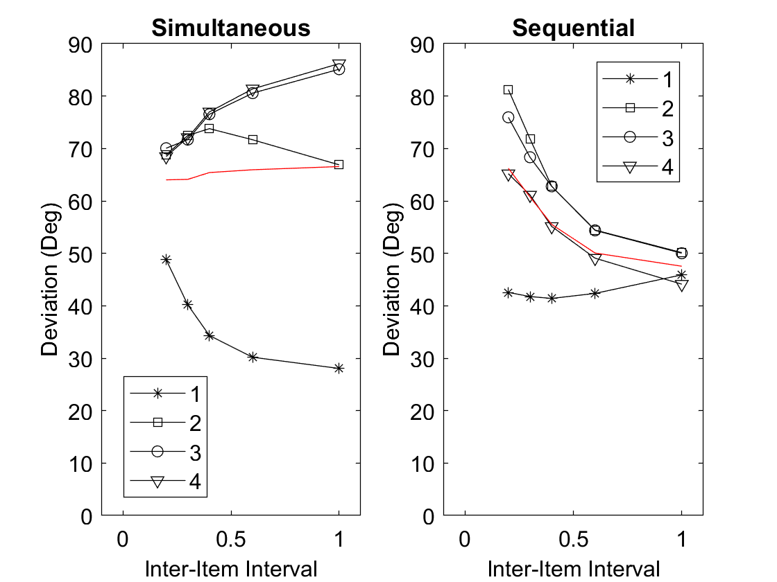
Consolidation Attempts: 1
Consolidation Attempts: 2

Slide 27
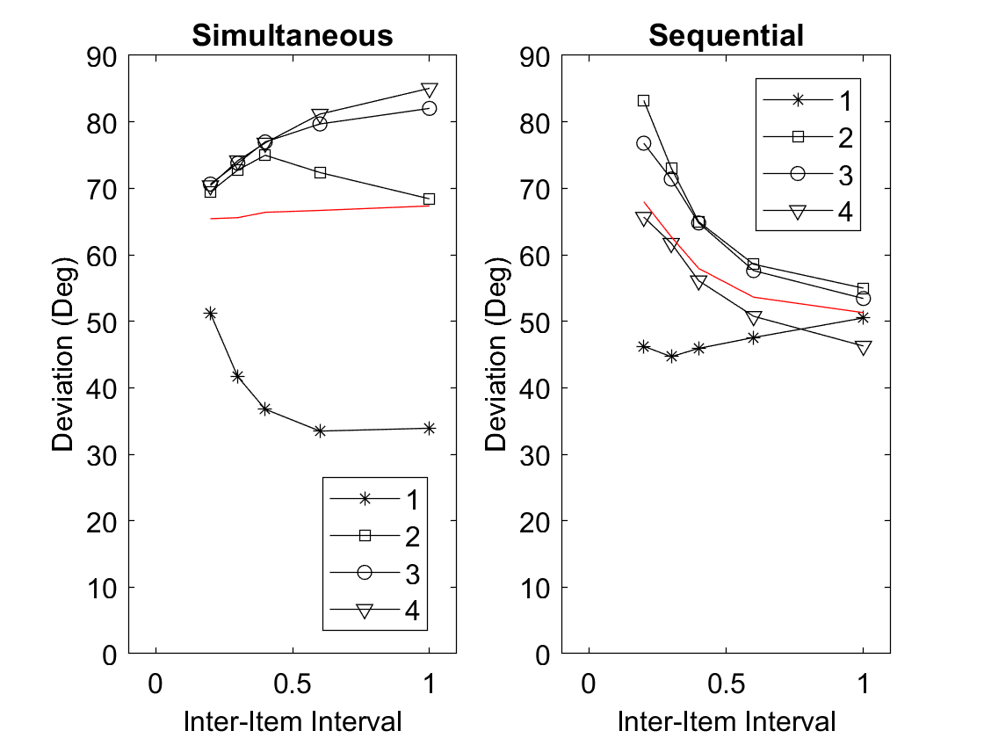
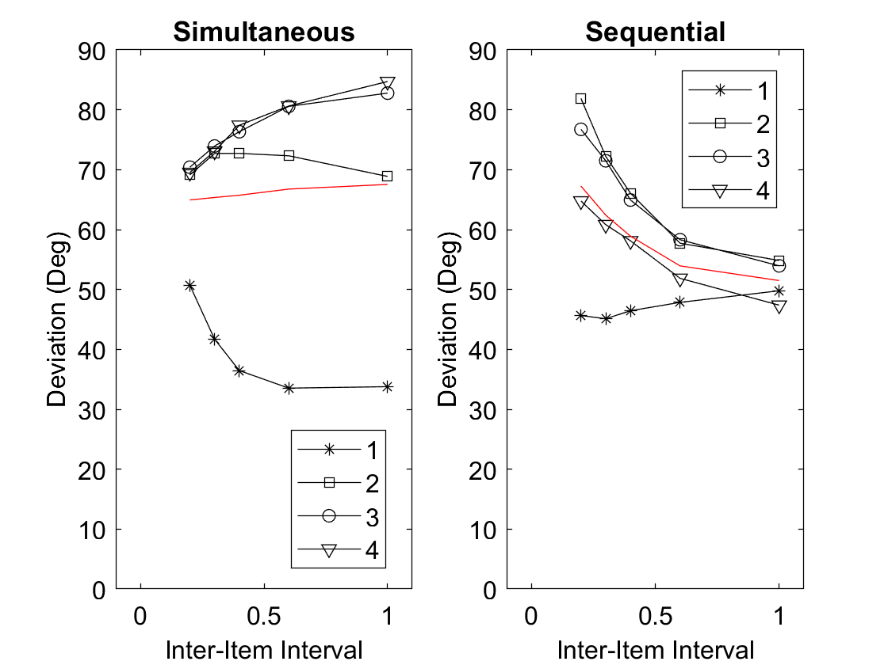
Consolidation Attempts: 3
Consolidation Attempts: 4

Slide 28
Trying to bring back the free-time benefit in the simultaneous condition

Slide 29
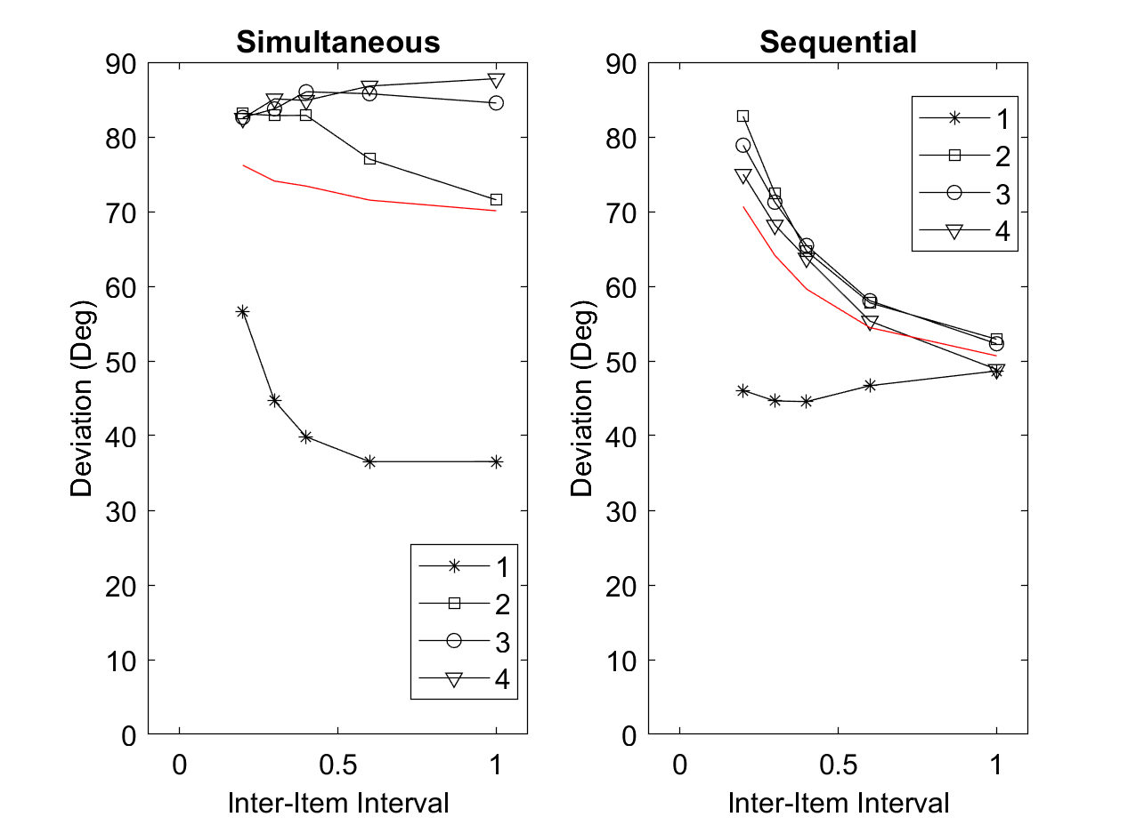
Like the preceding:
C.seqVariant = 2
cRate = rRate = 4
decay = 2
cBallistic = 0.65
Here, eraseFX is reduced to 0.1

Slide 30
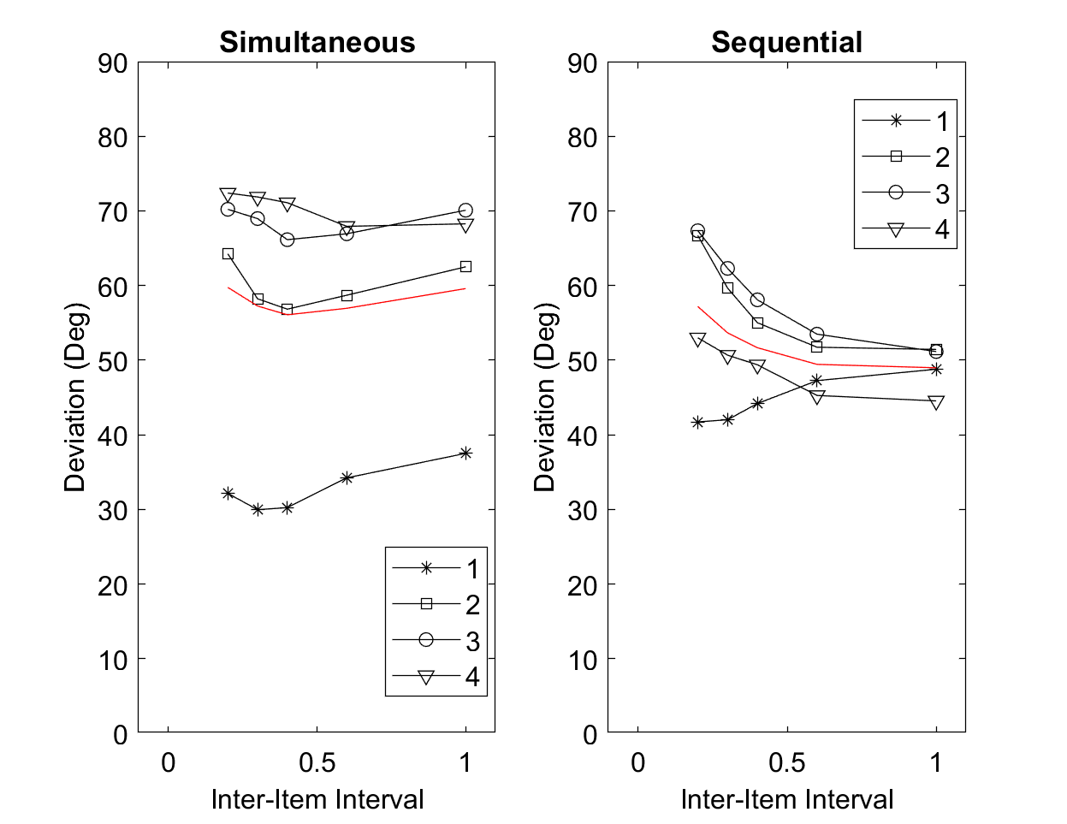
Like the preceding:
C.seqVariant = 2
rRate = 4
decay = 2
cBallistic = 0.65
eraseFX = 0.3
Here, cRate is increased to 20

