Slide 1
PCAP processing
John Oberlin
DATA603 UMBC

Slide 2
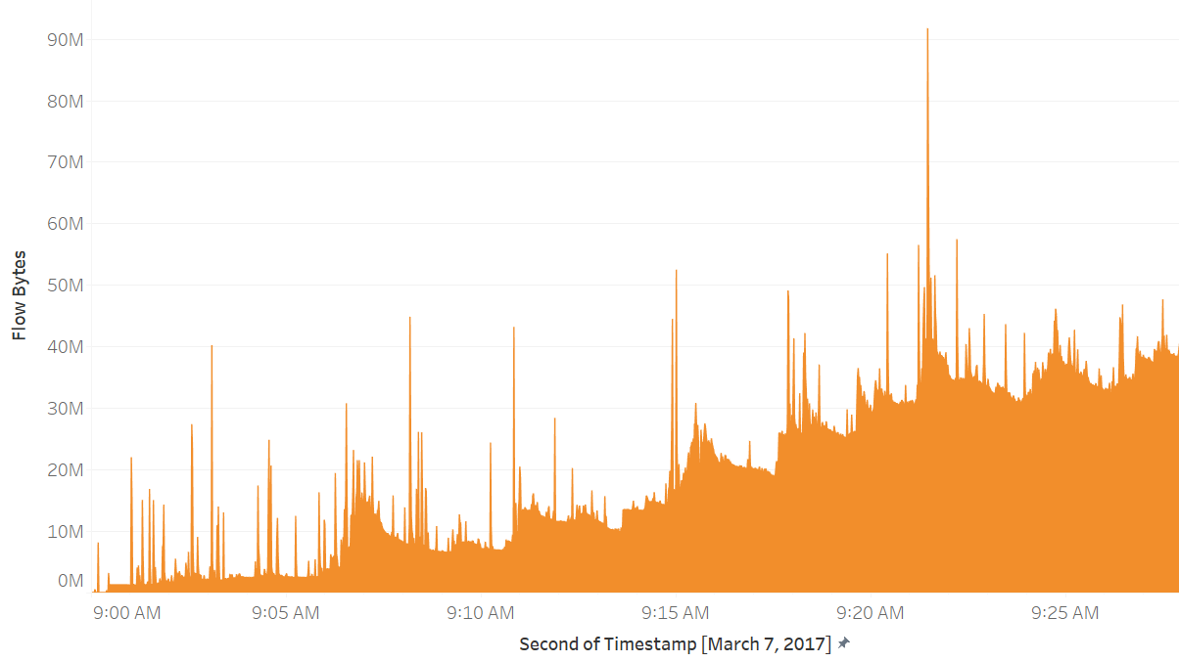
Proof of concept of real-time parsing and storage of enterprise network traffic.
Processing network traffic flow is an unstructured data problem, in which 10's or 100's of megabytes may pass a sensor per second.
Exploring such technical infrastructure is important for real-time machine learning applications for detecting cyber exploits.

Slide 3
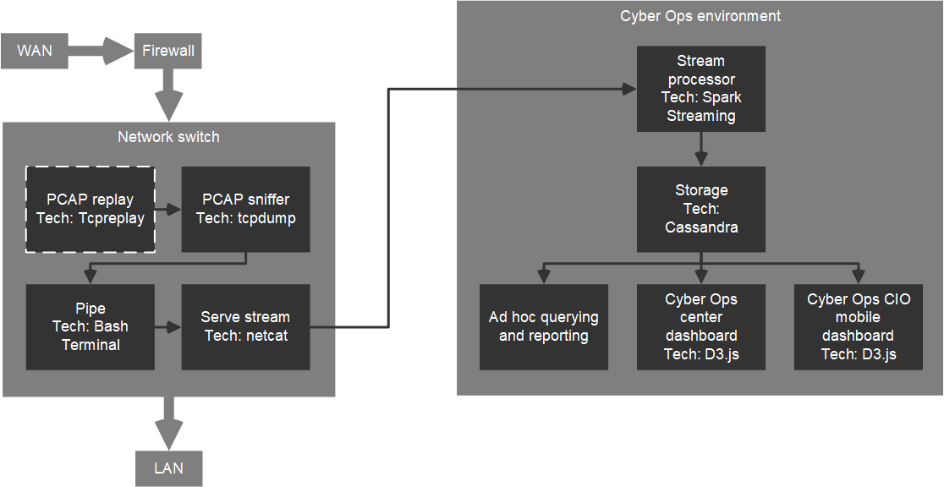
Goals
Simulate network traffic on the interface.
Capture network traffic.
Publish the stream on a Kafka topic.
Consume topic and parse packet data in Spark Streaming.
Store in a Cassandra DB.

Slide 4
Data sources
smallFlows.pcap for testing
Monday-WorkingHours.pcap (10GB, benign)
Wednesday-WorkingHours.pcap (12GB, DDoS attack)
http://205.174.165.80/CICDataset/CIC-IDS-2017/Dataset/PCAPs/

Slide 5
Expected outcome
Kafka topic consumption.
~10 PCAP data elements extracted per packet.
Dstream to Cassandra storage.
Reality
Hack netcat solution as stdout served on port.
Only 4 PCAP data elements extracted per packet due to verbosity levels on tcpdump creating multiple lines per packet.
Dstream to JSON text document workaround.

Slide 6
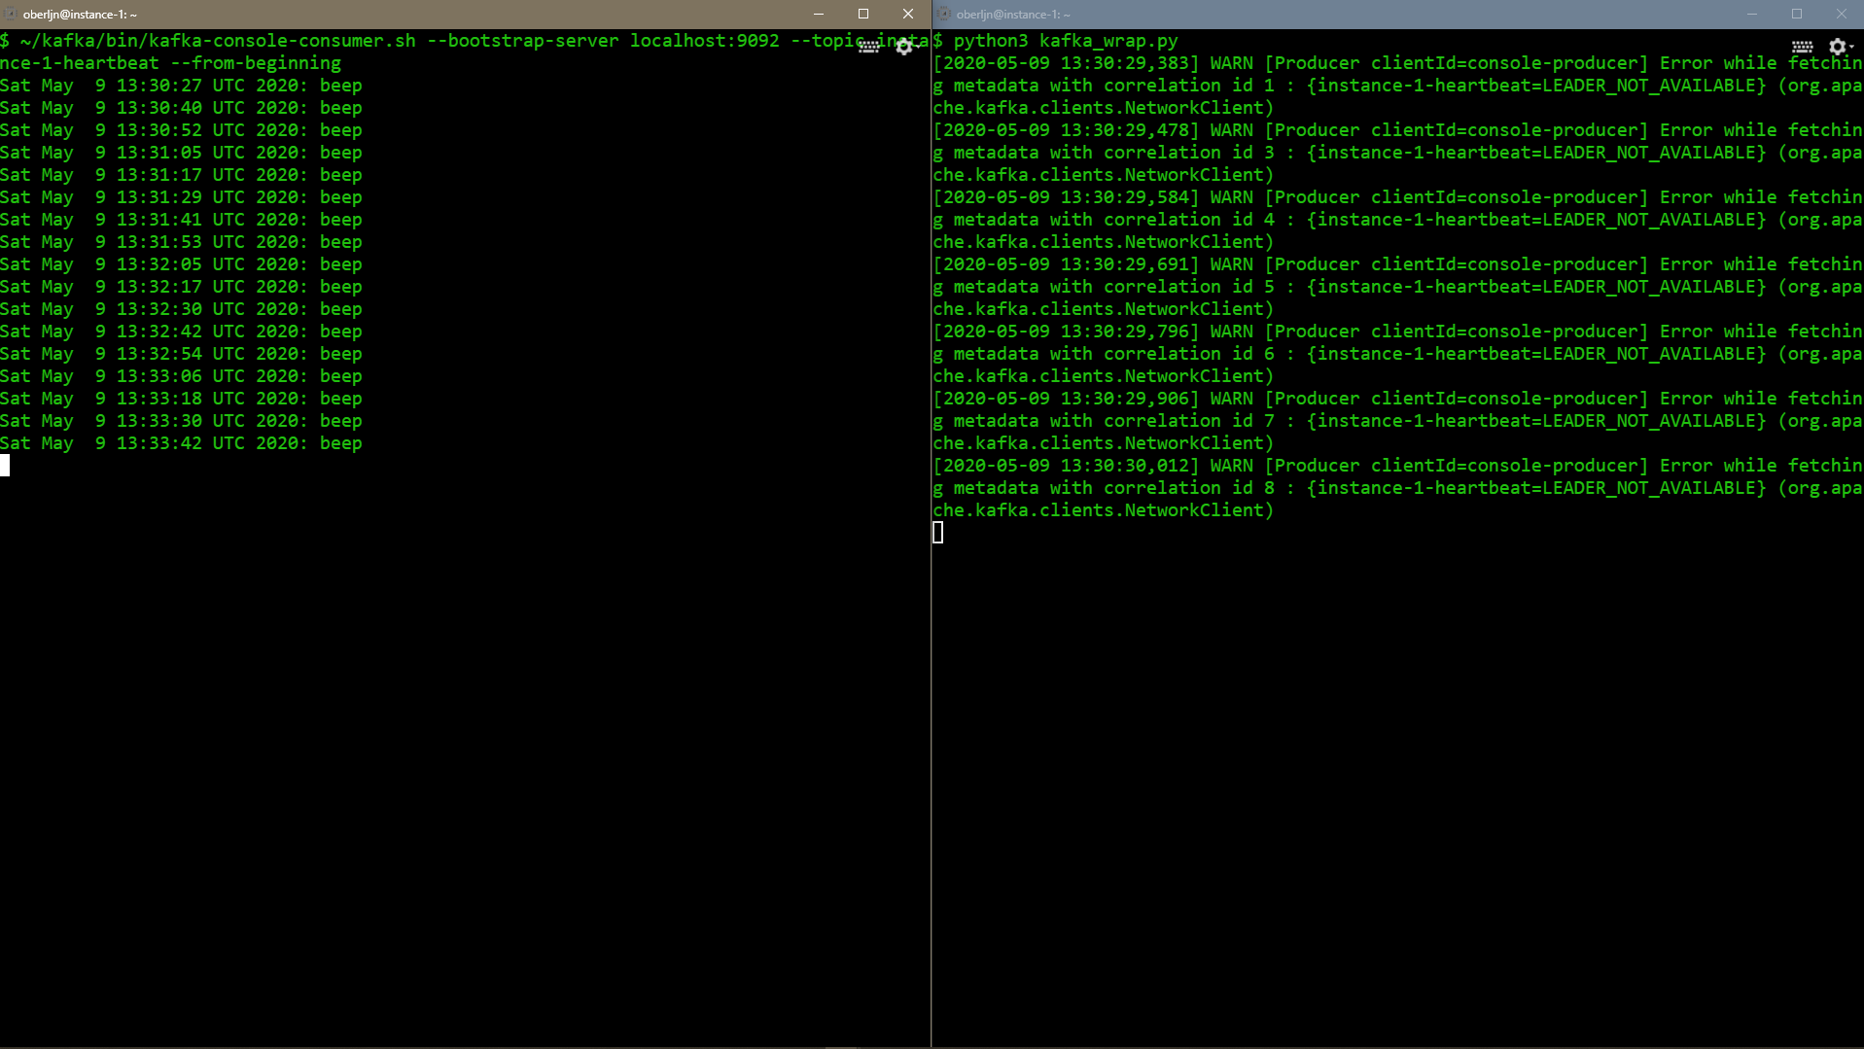
Server heartbeat via Kafka (local)

Slide 7
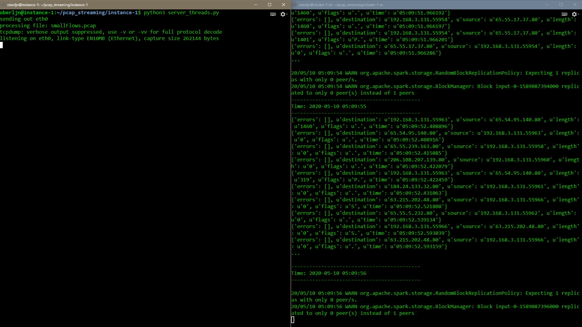
Spark PCAP processing

Slide 8
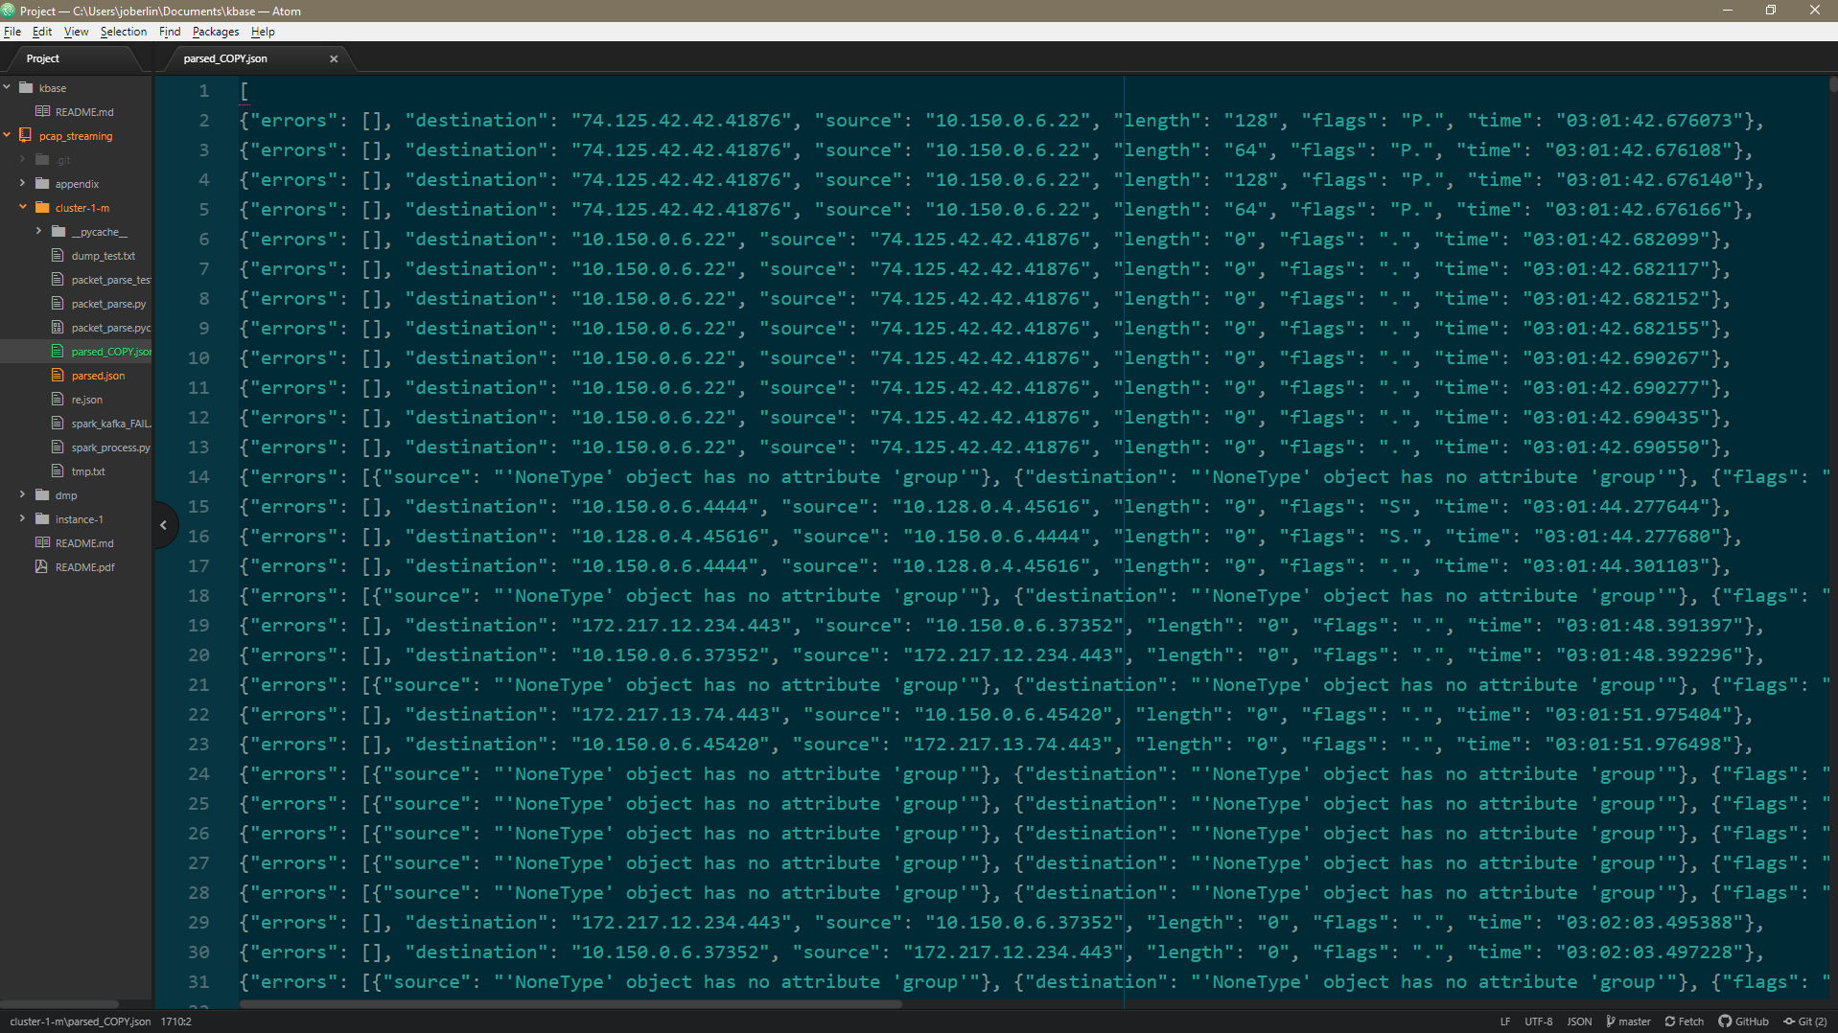
Spark PCAP processing

Slide 9
Conclusion
Hope to mature this project by:
Fully integrating Kafka.
Creating a more robust parser.
Creating some aggregations to produce key network metrics.
Defining the ideal data structure (dict?, list?).
Integrating a distributed storage.
Designing real-time dashboard for displaying key metrics.

