Slide 1
Netflow Project Progress Report
John Oberlin
2020-04-13
UMBC DATA 603

Slide 2
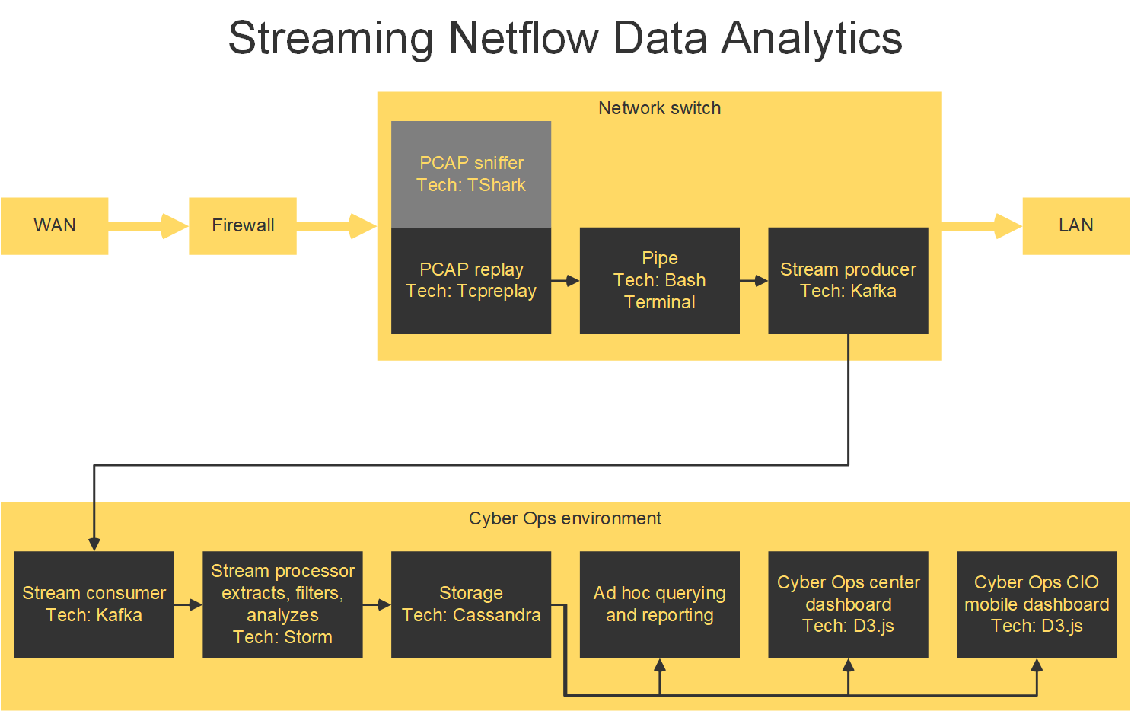
Progress Project architecture: Researched and tested parts of an architecture

Slide 3
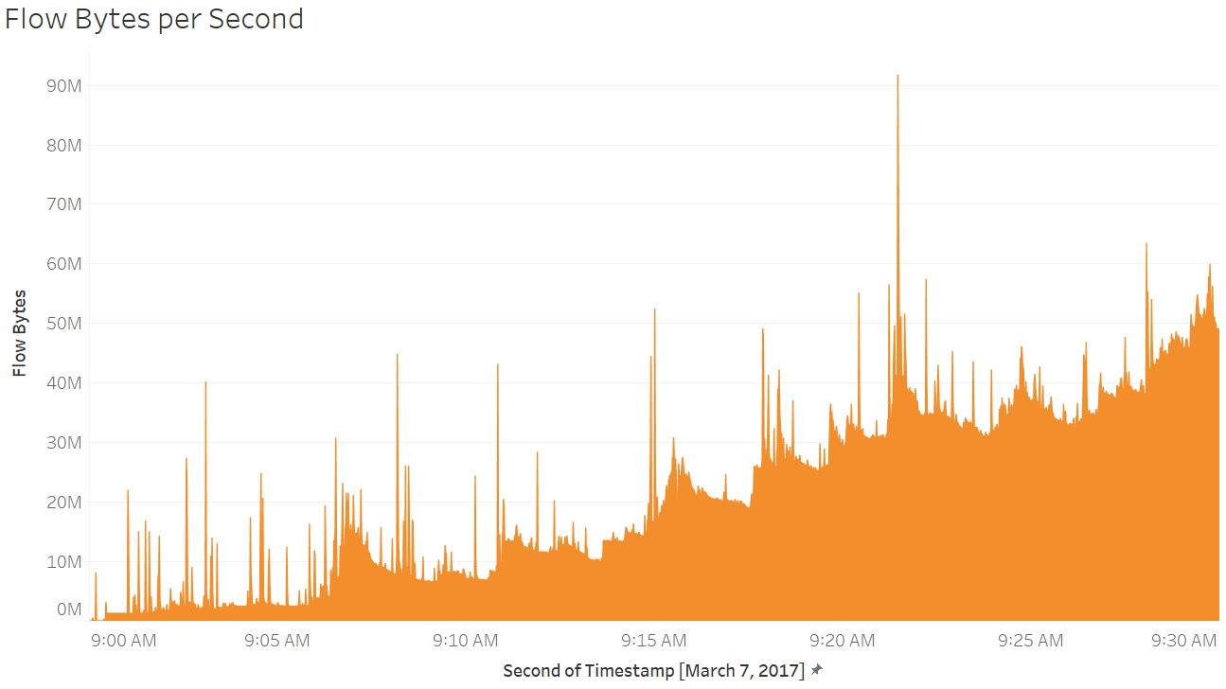
Progress Project test data: Explored PCAP data from the Canadian Institute for Cybersecurity*
*Iman Sharafaldin, Arash Habibi Lashkari, and Ali A. Ghorbani. "Toward Generating a New Intrusion Detection Dataset and Intrusion Traffic Characterization". 4th International Conference on Information Systems Security and Privacy (ICISSP), Portugal, January 2018.

Slide 4
Changes
Considering the effort that the implementation will take, I may not apply machine learning to the data for analysis.
Replaying PCAP netflow, producing and consuming it via Kafka, extracting key features via Storm, storing the features, and visualizing them is my first goal.
If that is implemented successfully within time limits, I would like to use Storm for ML processes on the features.
Achieving results
With the focus on implementation of the pipeline, as described above and in previous slides, I think I can achieve streaming feature extraction, storage, and visualization.

