Slide 1

CS 5100 Fall 2020
Jonathan Corzo
Xavier Hubbard
AI’s

Slide 2
Problem Statement
Can an AI successfully play the game of Chess?
Chess presents many challenges to AI due to the amazing complexity of the game as well as the very large state space (over 288 Billion possible positions after just 4 moves)
The purpose of our project was to explore what design techniques could be used to surmount the challenges presented by Chess while increasing our understanding of the game

Slide 3
Attempt 1: Minmax with α/β-Pruning
Negamax implementation of minmax
Quiescent search to avoid Horizon-Effect problem
Evaluation Function consisting of material advantage and piece placement
Problems:
State Space of Chess moves and boards is too large!
Evaluation Function was too computationally intensive
Depth = 2 took many minutes to generate single moves
Depth = 3 was never able to generate a move
Heavy reliance on human intuition for design
Optimizations:
Opening Tables
Transposition Tables
Custom Move Ordering Function
Incremental Evaluation
Results:
Significant improvement in speed!
Depth = 4 search now only takes a couple minutes to generate a move
Resulting ELO

Slide 4
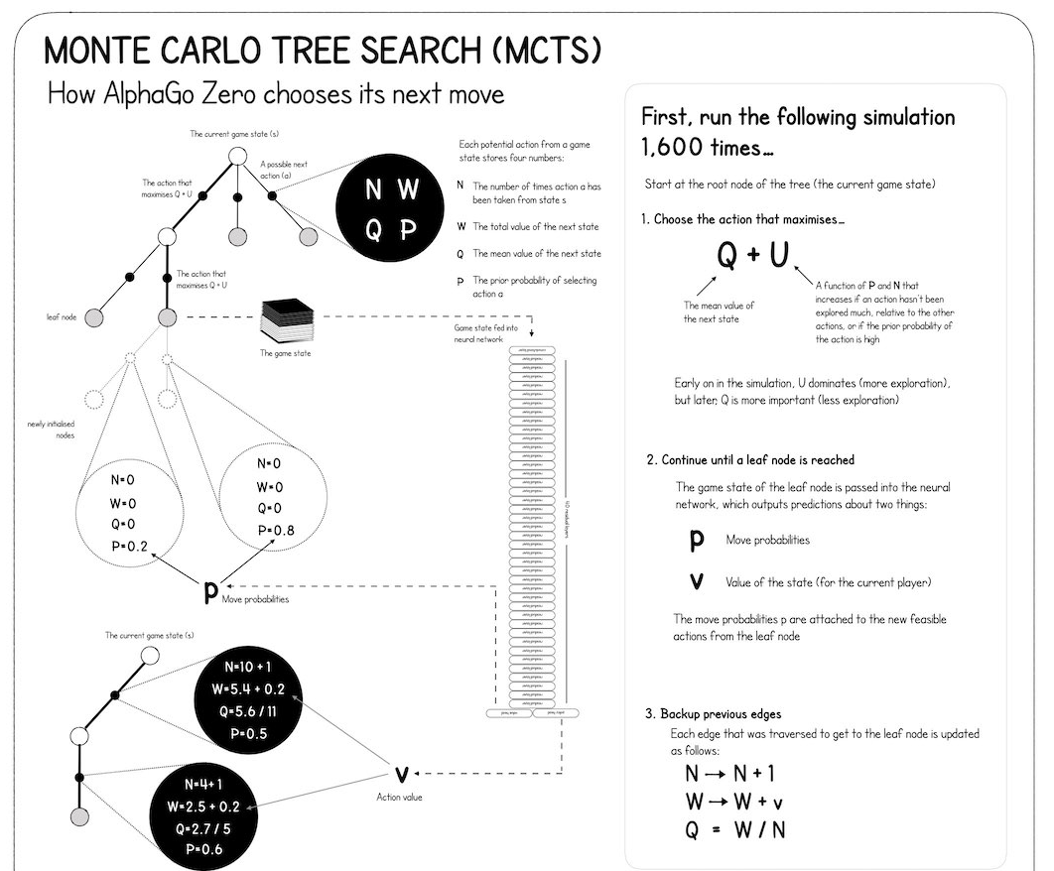
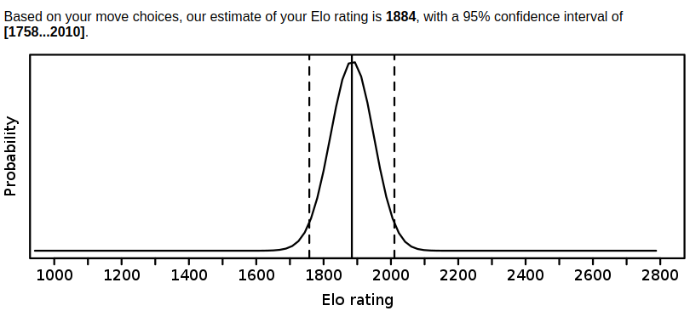
Attempt 2: Reinforcement Learning

