Slide 1
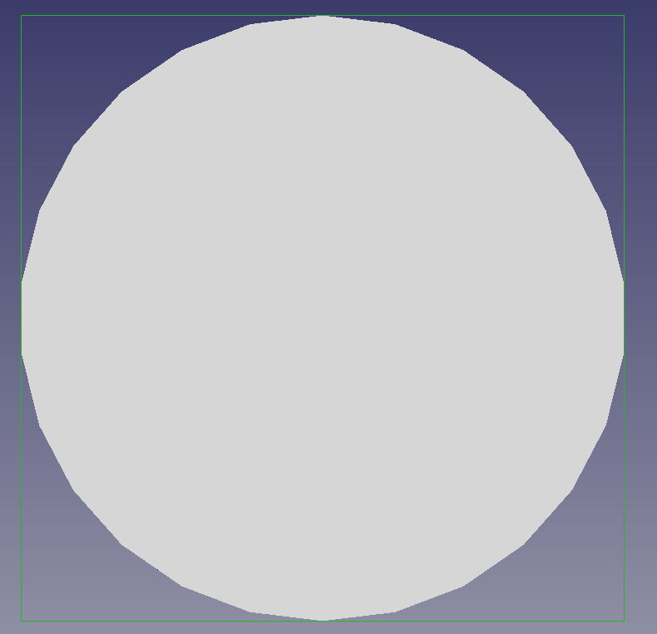
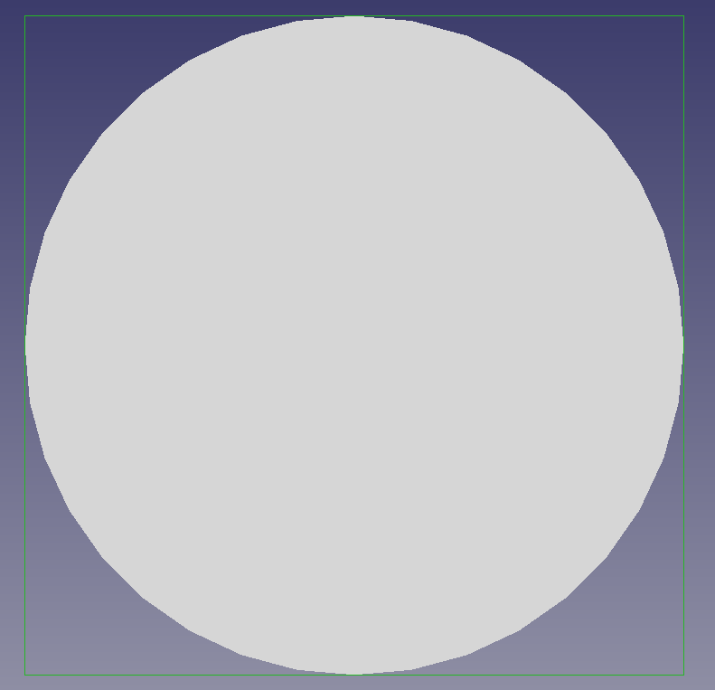
STL Export: Angular Deflection
Method 1 (standard export) Angular Deflection 28.5°
Method 2 (mesh export) Angular Deflection 20°

Slide 2
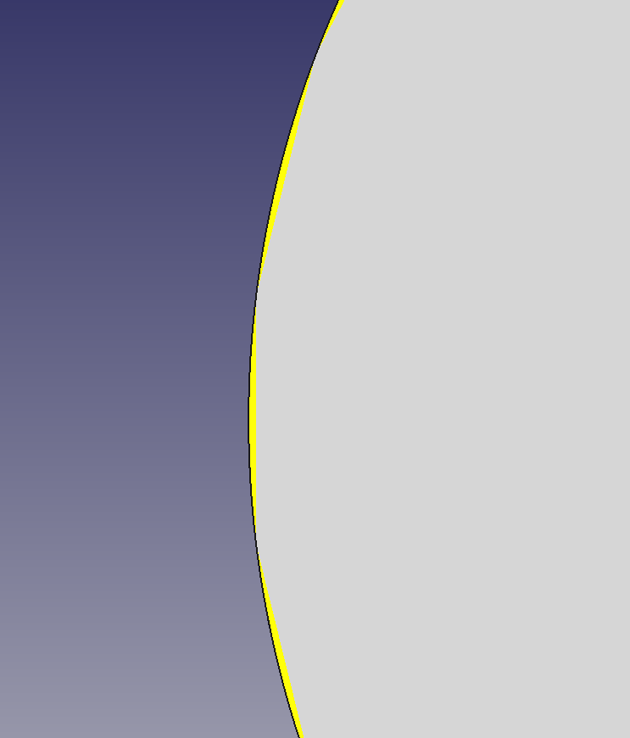

Slide 3
