Slide 1
Webscrape of Metacritic Analysis of TV Series
Tang Kim Sin

Slide 2
Outline
Background of the Data
Questions to Answer
Why is this important?
What would I add if I had more time?

Slide 3
Background of the Data

Slide 4

Website containing aggregate reviews of movies, tv series, video games, and music.
Reviews and Votes divided into two types: Critics and Users
Critics 0-100
LA Times, New York Magazine (Vulture), Indiewire, Rolling Stone
Users 0-10

Slide 5
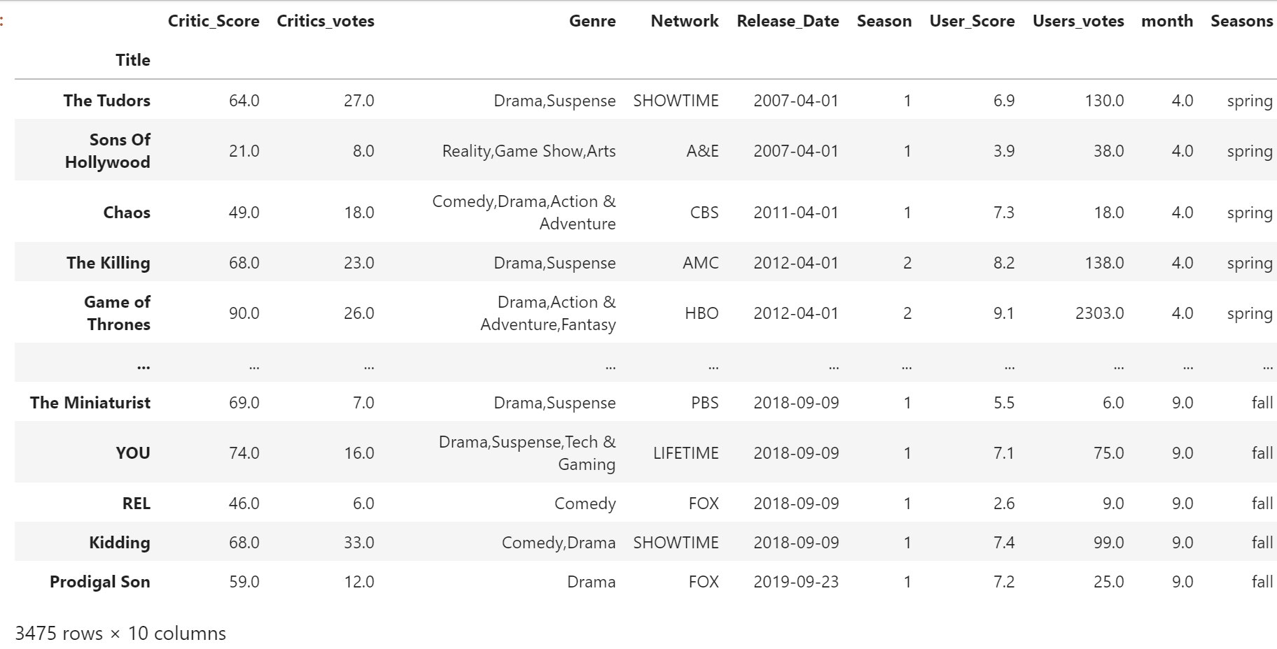
Raw Data

Slide 6
Questions to Answer:
Is there a pattern between popular* television shows?
Is there a pattern between popular networks?
Is there a significant difference between the season of the year and the users scores?
*5 seasons and above

Slide 7
Is there a pattern between popular* television shows?
Shows to look at:
House of Cards (6 seasons)
Archer (11 seasons??)
Nurse Jackie (6 seasons)
True Blood (7 Seasons)
The Walking Dead (10 seasons++)
Game of Thrones (8 seasons)*
Breaking Bad (5 seasons)*
Marvel on Netflix*

Slide 8
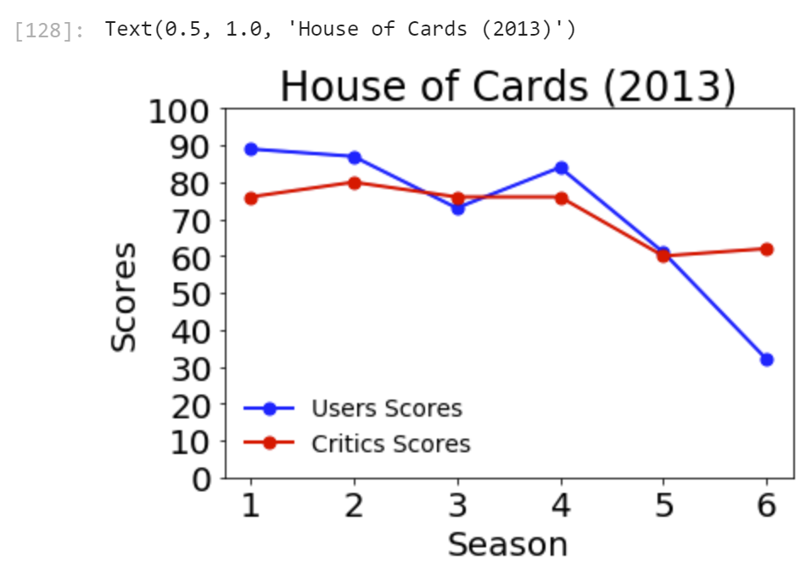
House of Cards

Slide 9
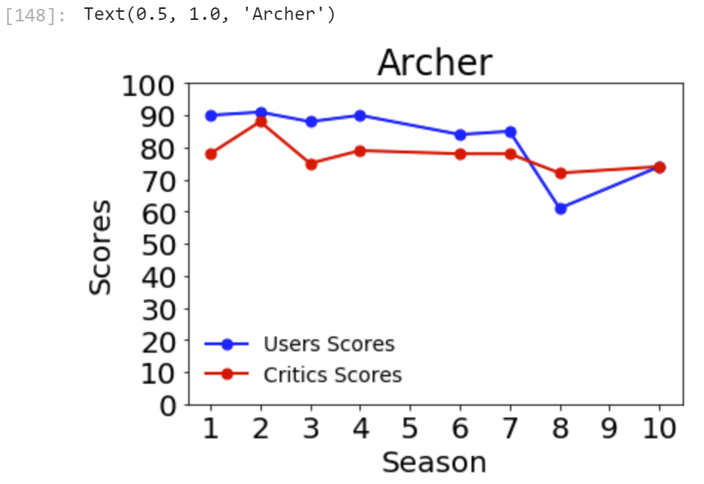
Archer

Slide 10
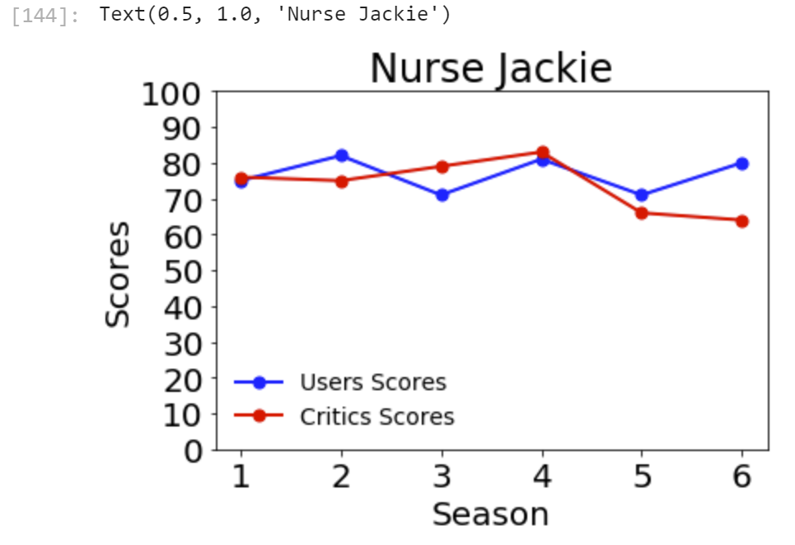
Nurse Jackie

Slide 11
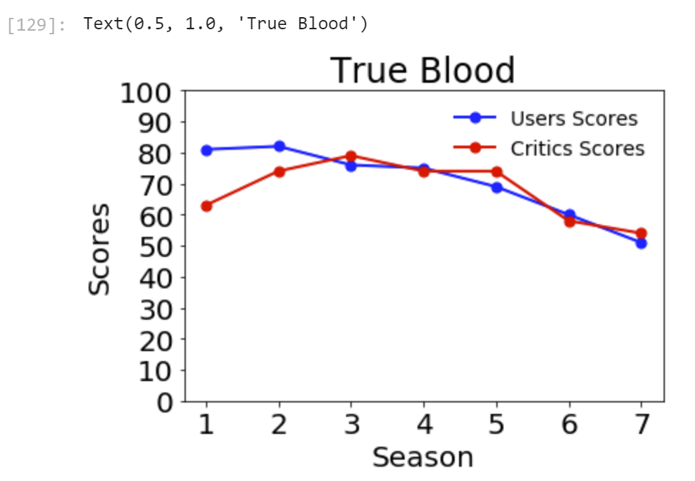
True Blood

Slide 12
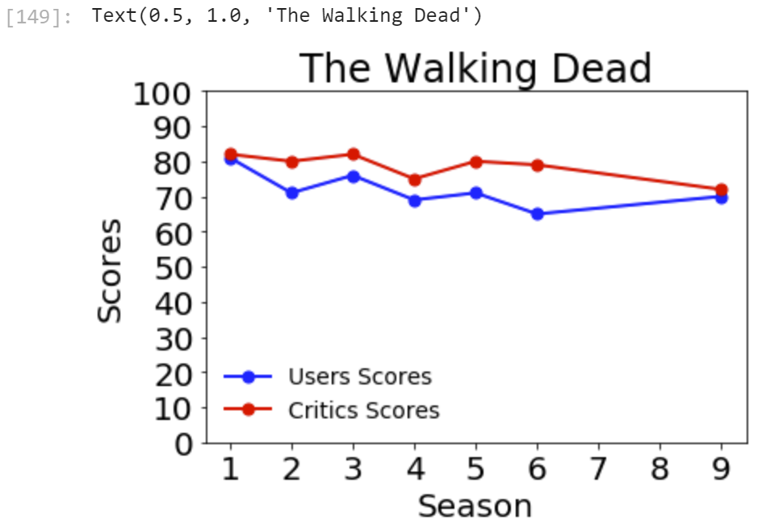
The Walking Dead

Slide 13
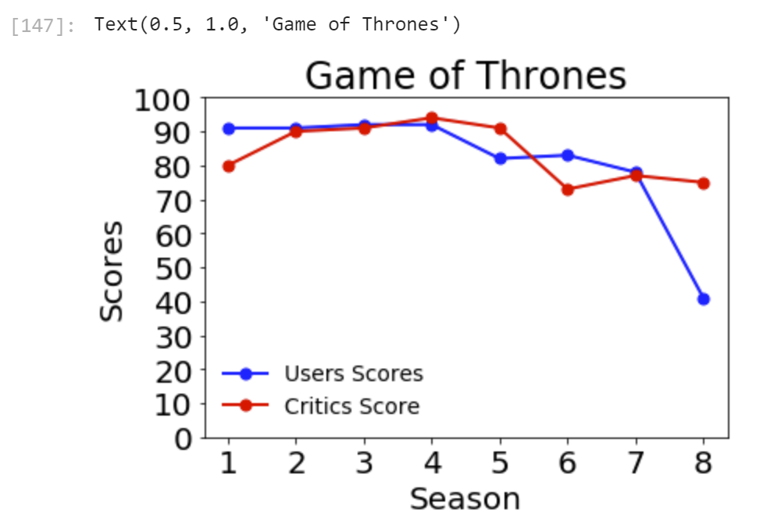
Game of Thrones*

Slide 14
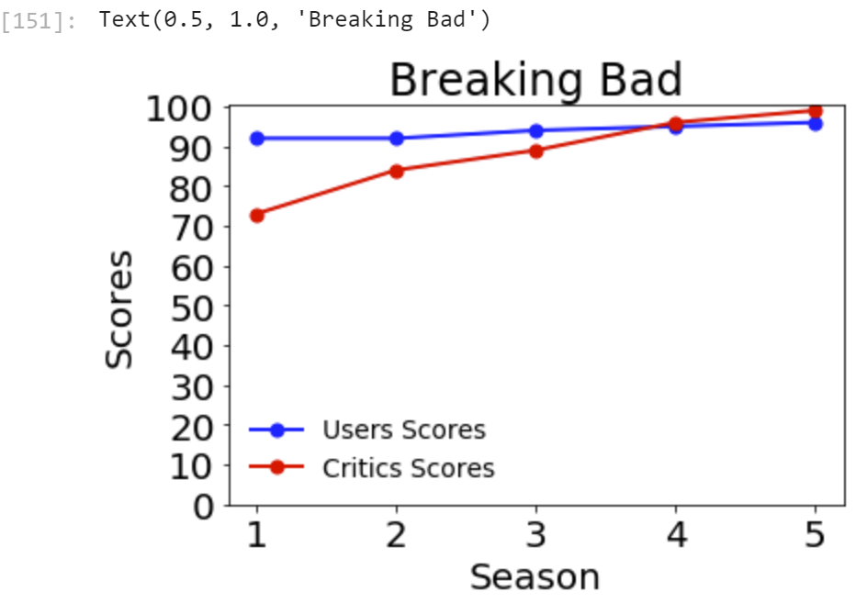
Breaking Bad*

Slide 15
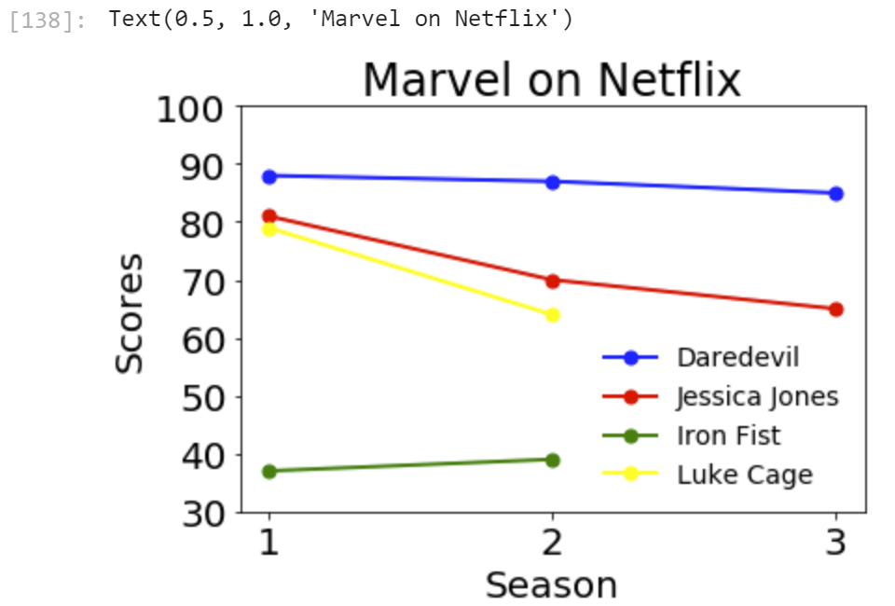
Marvel

Slide 16
Into the Future

Slide 17
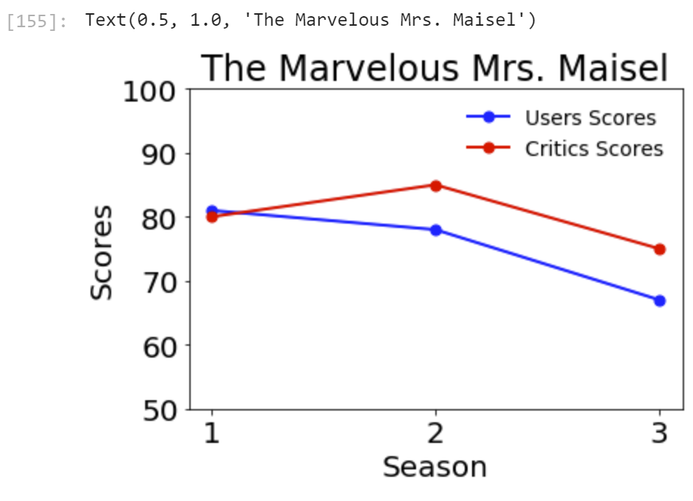
The Marvelous Mrs. Maisel

Slide 18
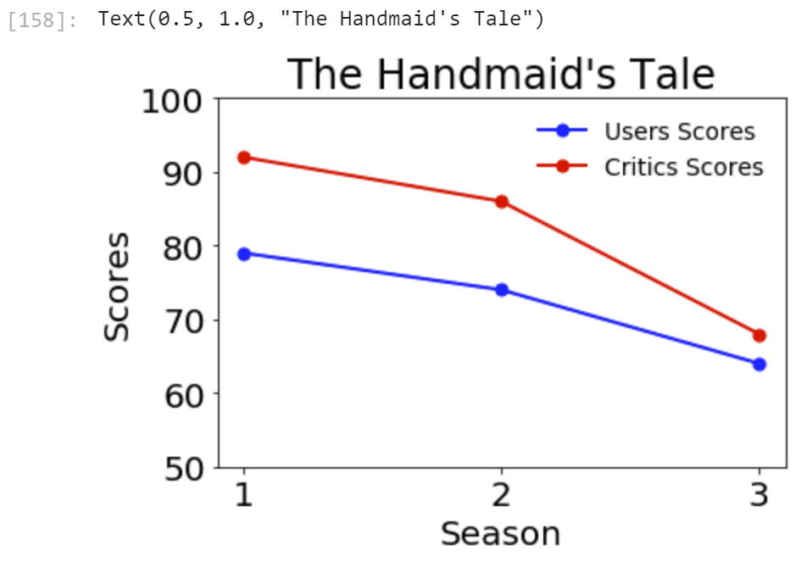
The Handmaid’s Tale

Slide 19
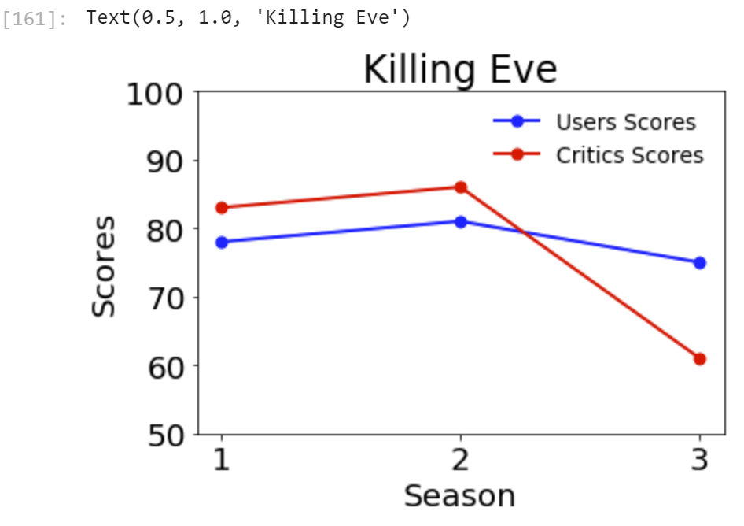
Killing Eve

Slide 20
Is there a pattern between popular networks?
HBO
ABC
NBC
Netflix
FOX

Slide 21
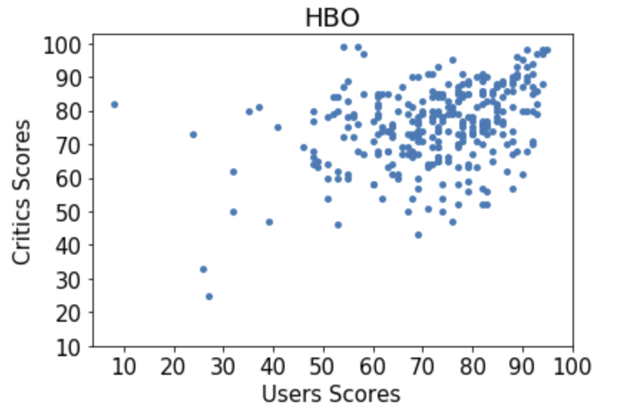
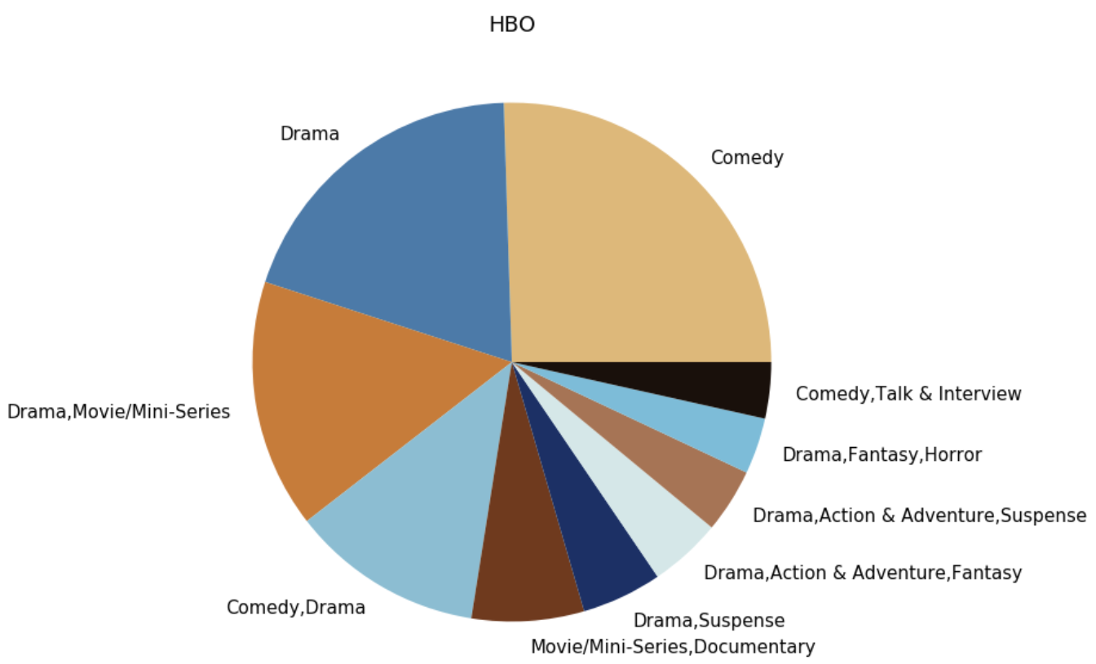
HBO

Slide 22
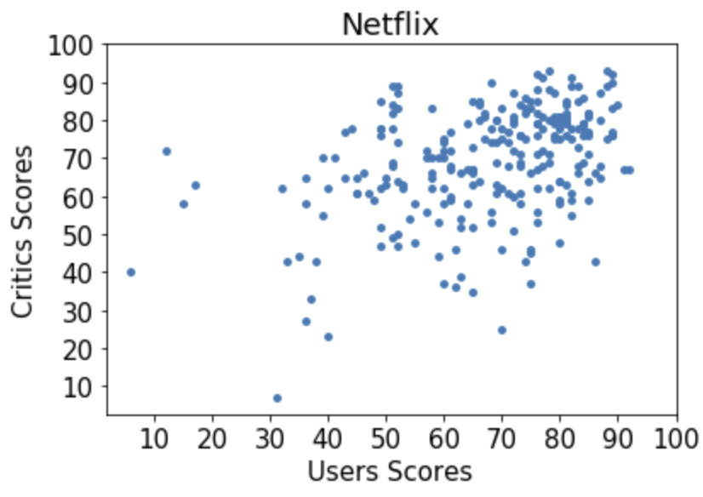
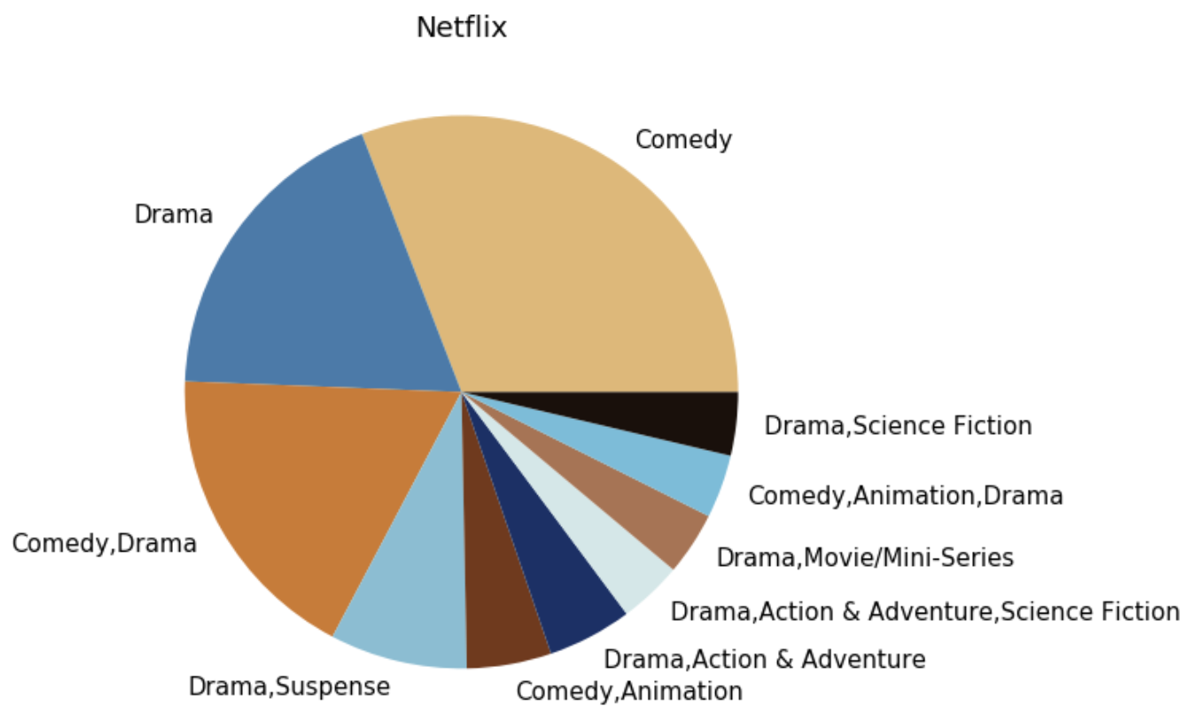
Netflix

Slide 23
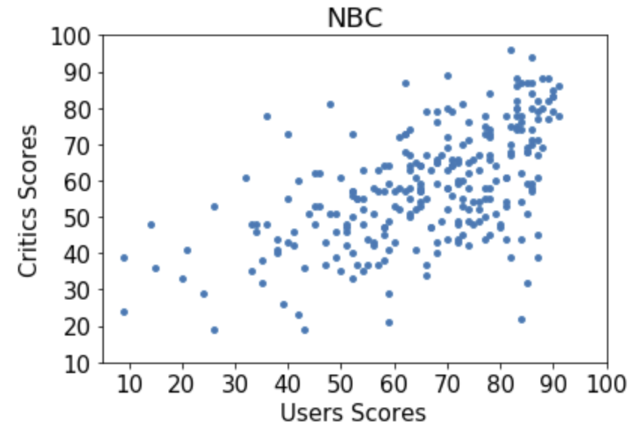
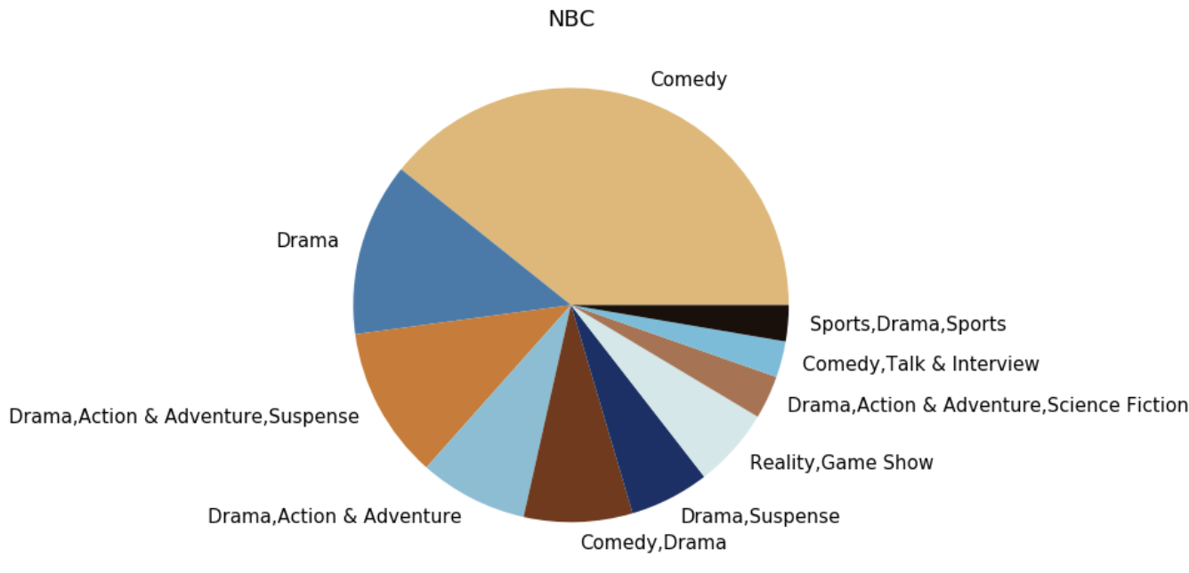
NBC

Slide 24
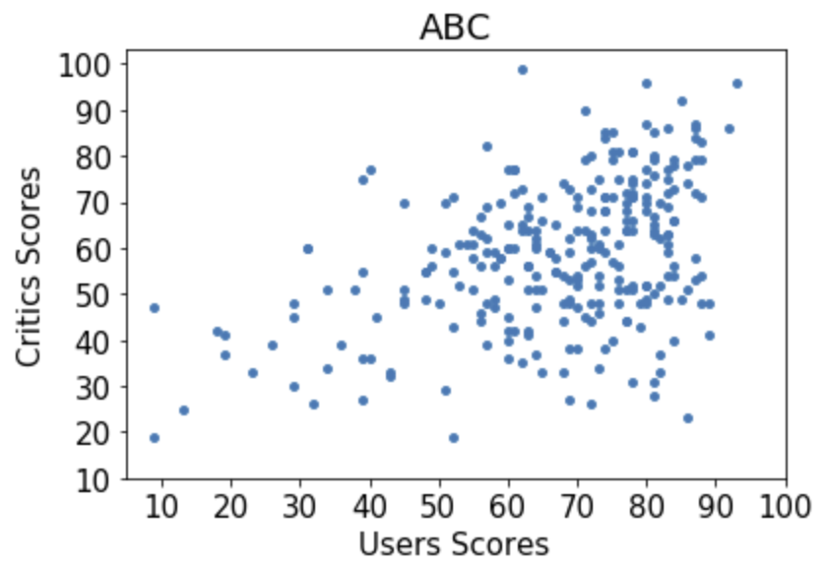
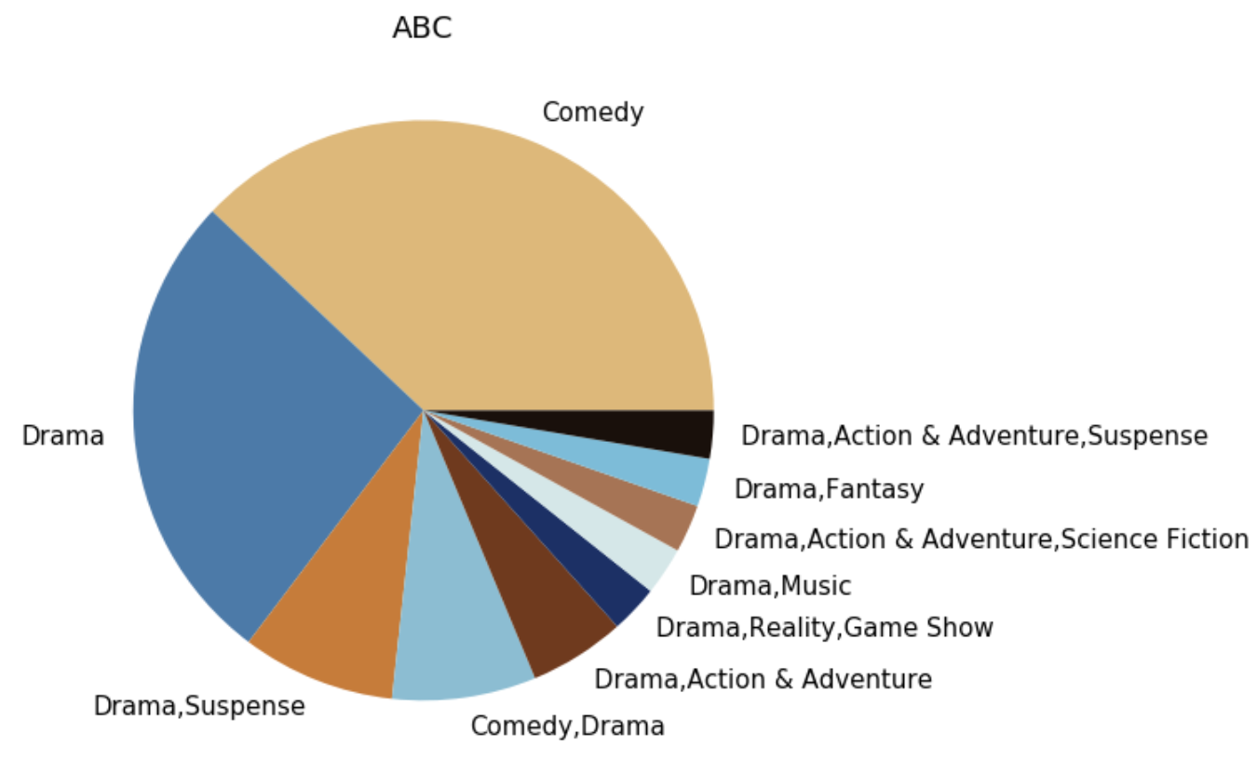
ABC

Slide 25
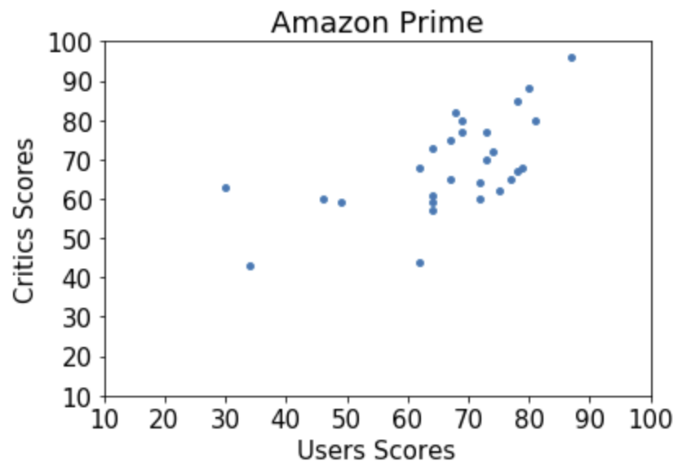
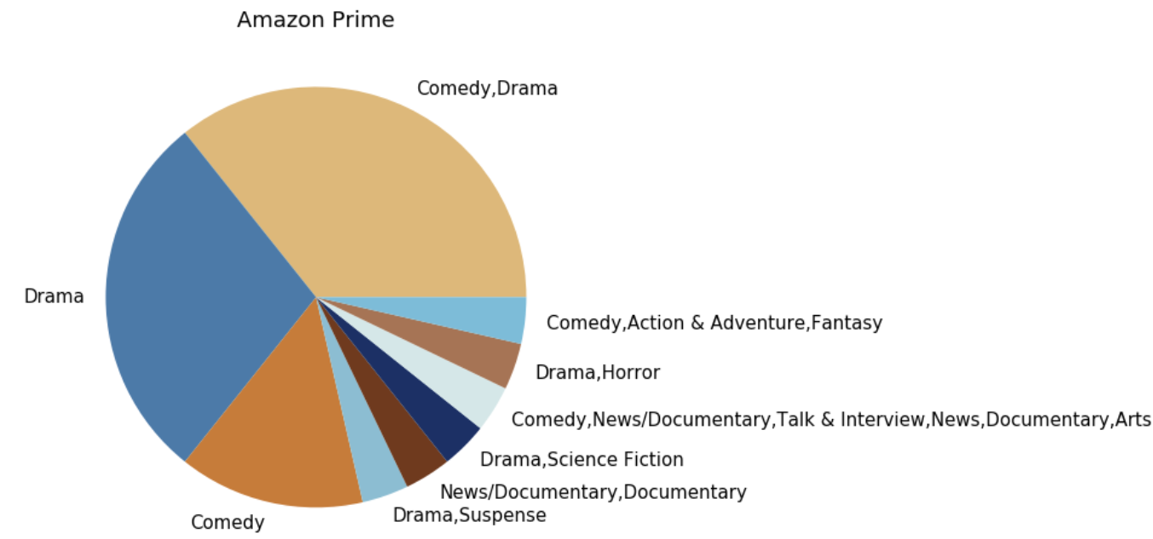
Amazon Prime

Slide 26
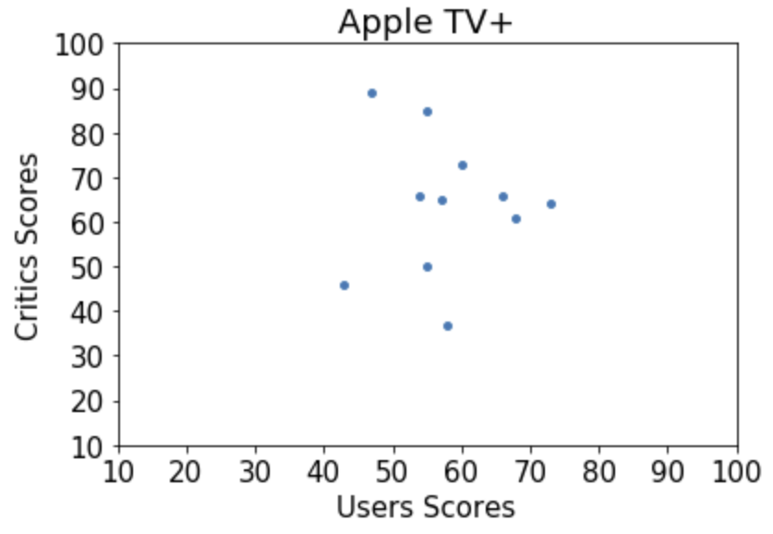
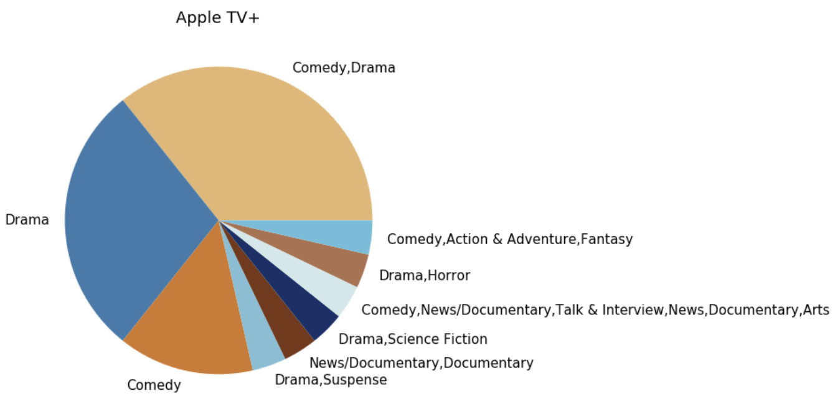
Apple TV+

Slide 27
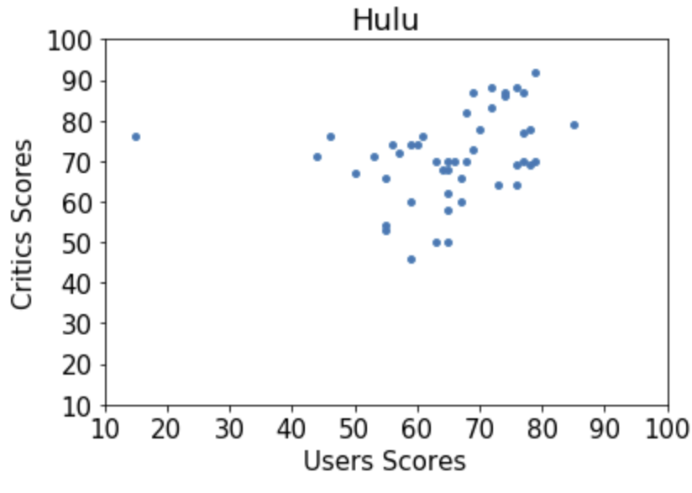
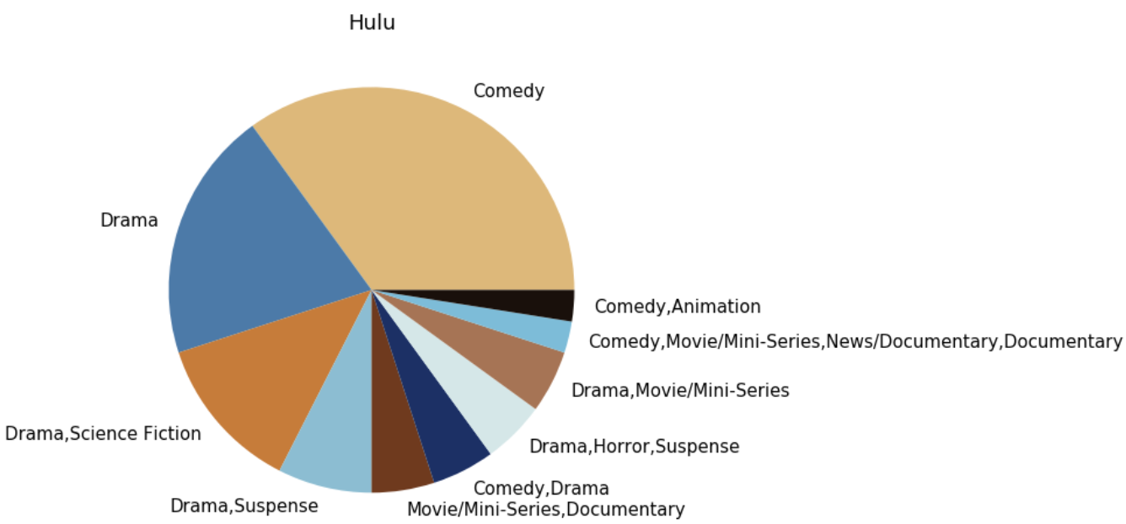
Hulu

Slide 28
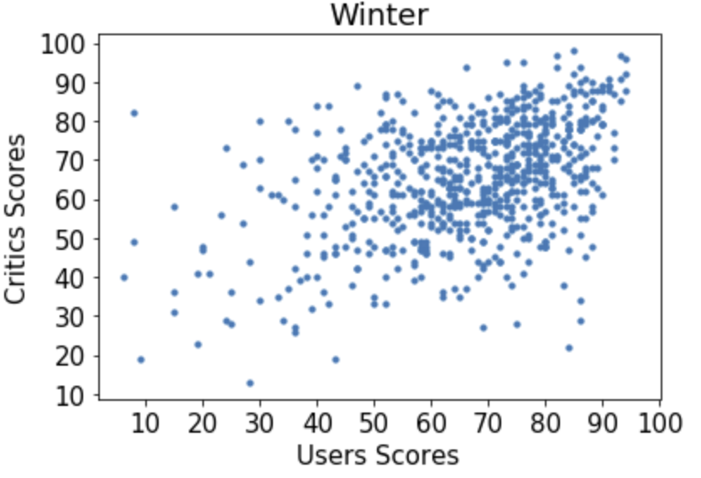
Winter

Slide 29
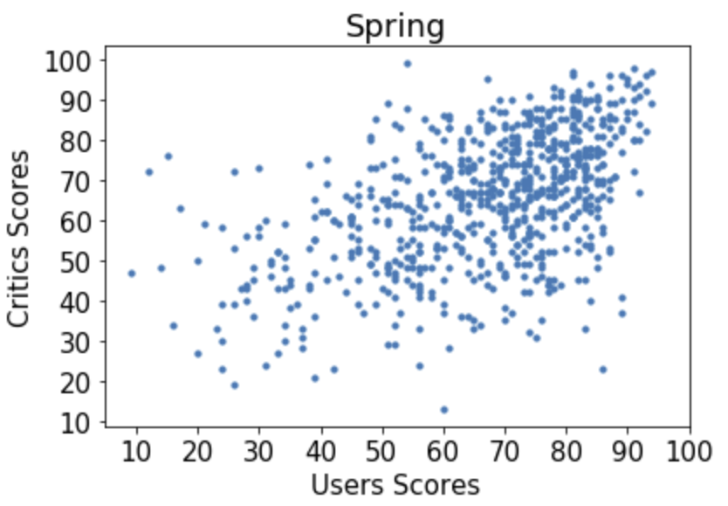
Spring

Slide 30
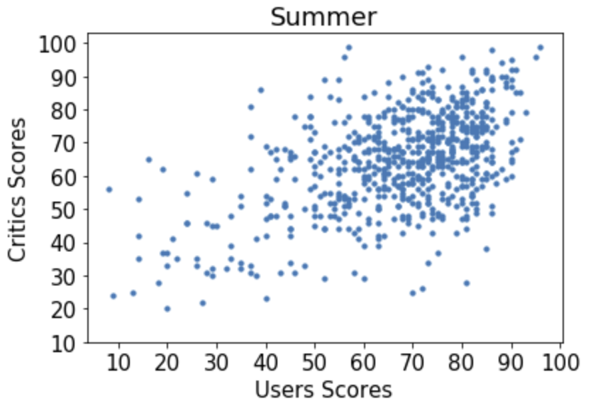
Summer

Slide 31
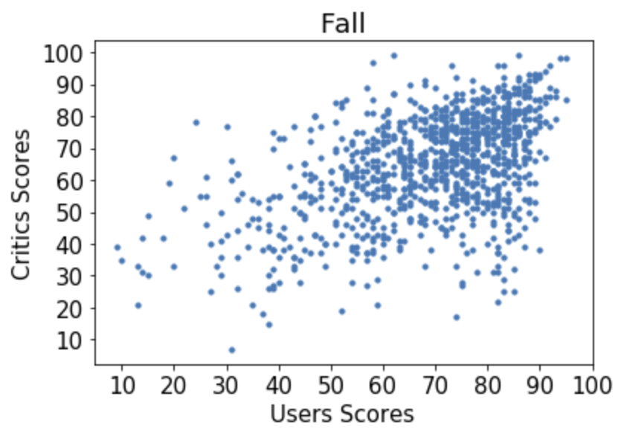
Fall

Slide 32
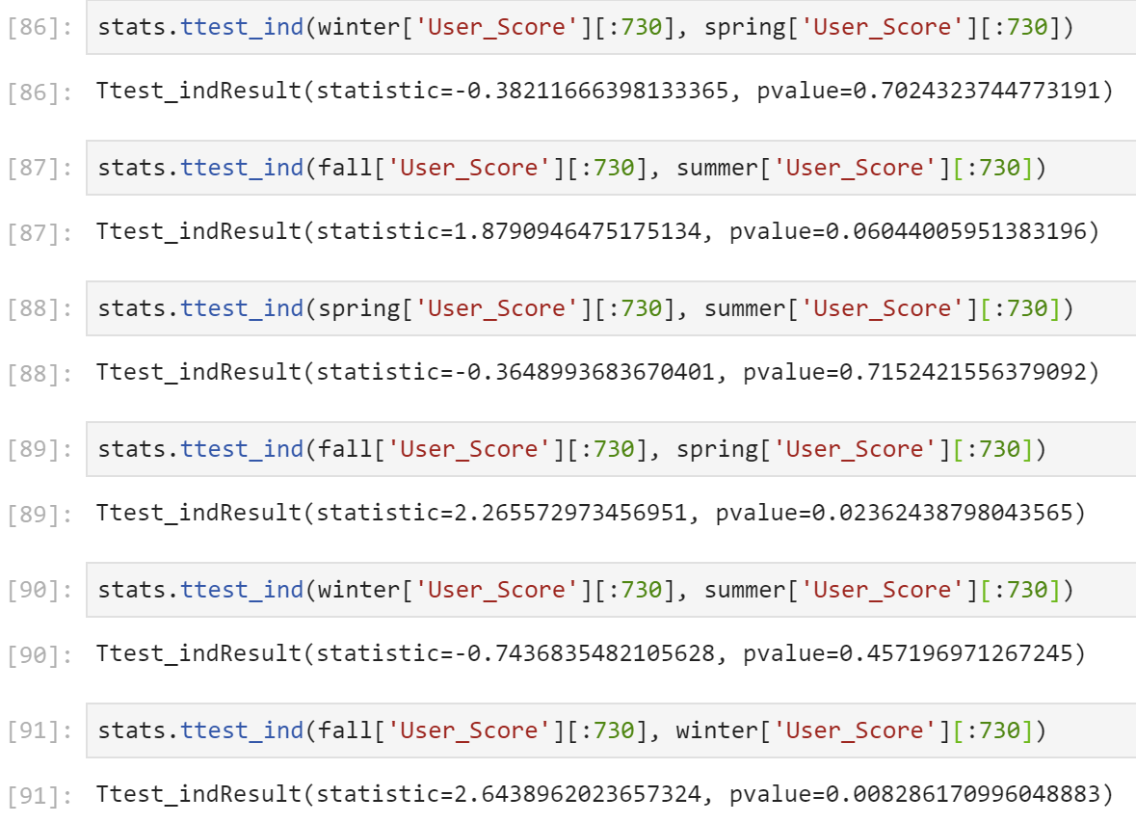
Two-Sample T-Test
Null Hypothesis:
There is not significant difference between the user scores and seasons of the year
Reject Null Hypothesis:
Fall and Winter
Fall and Spring

Slide 33
Why is this important?

Slide 34
Industry (Metacritic)
User traffic vs competition (Rotten Tomatoes, IGN, etc.)
User engagement

Slide 35
Industry (Network/Streaming Service)
Formula for successful for network and viewer engagement
Corporate Strategy
Increasing market share of viewers
Acquiring more programs
When to diversify in genres
Acquire new networks

Slide 36
Personal Investment
What shows to invest time in?

Slide 37
If I had more time…

Slide 38
Add more information
Total viewership for each season (Wikipedia)
Reconcile missing data from Rotten Tomatoes or different sites.
Expand search to different countries (BBC One, ABC (Australia), etc) to see if the pattern matches their most watched shows as well.

