Slide 1
Enabling Systems Genetics to Translational Medicine:
The PATO approach
George Gkoutos
Department of Genetics
University of Cambridge

Slide 2
Exploring the Phenome
Key EU/NIH missions:
  integration and analysis of disease data within and across species → diagnostic and therapeutic advances at the clinical level
  identification of causative genes for Mendelian orphan diseases

Slide 3
Power of the Phenotype
  The meaningful cross species translation of phenotype is essential → phenotype-driven gene function discovery and comparative pathobiology
  Goal - “A platform for facilitating mutual understanding and interoperability of phenotype information across species and domains of knowledge amongst people and machines” …..

Slide 4
Phenotype And Trait Ontology (PATO)
phenotypes may be described in many different dimensions, e.g.
  the biochemical ('alcohol dehydrogenase null')
  the cellular ('cell division arrested at metaphase’)
  the anatomical ('eye absent')
  the behavioral (‘hyperactive’)
  etc.
in whatever dimension and granularity, however, there is a commonality so that phenotypic descriptions can be decomposed into two parts
  An entity that is affected. This entity may be an enzyme, an anatomical structure or a complex biological process.
  The qualities of that entity.

Slide 5
Type and Sources
Type of data
  Behaviour and cognition, Clinical chemistry and haematology, Hormonal and Metabolic Systems, Cardiovascular, Allergy and Infectious diseases, Sensory Systems, Central/Peripheral Nervous and Skeletal Muscle Systems, Cancer Phenotyping, Bone, Cartilage, Arthritis, Osteoporosis, Necropsy Exam, Pathology, Histology, etc. etc. etc.
Source of phenotype information
  Literature
  Experimental data
  Various representation methodologies
  Complex phenotype data

Slide 6
PATO today
PATO is now being used as a community standard for phenotype description
  many consortia (e.g. Phenoscape, The Virtual Human Physiology project (VPH), IMPC, BIRN, NIF)
  most of the major model organism databases, (e.g. example Flybase, Dictybase, Wormbase, Zfin, Mouse genome database (MGD))
  international projects

Slide 7
PATO’s Semantic Framework
Conceptual Layer
Semantic Components Layer
Unification Layer
Formalisation Layer
Integration Layer

Slide 8
PATO’s Conceptual Layer
Core Ontologies
(e.g. anatomy, biological process, chemistry)
PATO
Species Independent
PATO
Species Independent
Entity (E)
Quality (Q)
EQ
Phenotype Description
EQ
Phenotype Description

Slide 9
Mouse Body weight
Mouse Anatomy (MA)
PATO
Species Independent
PATO
Species Independent
Body(E)
Weight(Q)
EQ
Phenotype Description
EQ
mouse body weight

Slide 10
Semantic Components Layer
Behavior
  NeuroBehavior Ontology
  Behavioral Phenotype Ontology
Pathology
Physiology
  Cerebellar ataxia
  Create links to behavioral observation to physiology manifestations
Cell Phenotype
Quantitative measurement (Units Ontology)

Slide 11
PATO’s Unification Layer
Following the GO paradigm, several examples of attempts to formalize species specific phenotype description have been adopted:
  e.g. Mammalian Phenotype Ontology (MP), Plant & Trait Ontology, Human Phenotype Ontology (HPO), etc.
Advantages
  Easy for annotation
  Control
  Complex phenotypic information
Disadvantages
      lack of rigidity e.g. quantitative data
      ontology management e.g. expansion
      incapable of bridging different phenotype descriptions (for either the same or separate species)

Slide 12
Pregnancy related premature death
HELLP syndrome
Hypertension
Hypertension
Thrombocytopenia
Thrombocytopenia
Renal Failure
Renal failure
Hepatic necrosis
Acute and subacute liver necrosis
Hepatic failure
Liver failure
MP
HPO
Abnormal glomeruli
Glomerular vascular disorder
Haemolytic anaemia
Anaemia haemolytic
Proteinuria
Proteinuria

Slide 13
PATO-based definitions
Aristotelian definitions (genus-differentia)
A <Q> *which* inheres_in an <E>
[Term]
id: MP:0001262
name: decreased body weight
namespace: mammalian_phenotype_xp
Synonym: low body weight
Synonym: reduced body weight
def: " lower than normal average weight “[]
is_a: MP:0001259 ! abnormal body weight
intersection_of: PATO:0000583 ! decreased weight
intersection_of: inheres_in MA:0002405 ! adult mouse

Slide 14
Pregnancy related premature death
HELLP syndrome
Hypertension
Hypertension
Thrombocytopenia
Thrombocytopenia
Renal Failure
Renal failure
Hepatic necrosis
Acute and subacute liver necrosis
Hepatic failure
Liver failure
MP
HPO
Abnormal glomeruli
Glomerular vascular disorder
Haemolytic anaemia
Anaemia haemolytic
Proteinuria
Proteinuria

Slide 15
Pregnancy related premature death
HELLP syndrome
Hypertension
Hypertension
E: Blood (MA)
Q: Increased pressure (PATO)
E: Blood (FMA)
Q: Increased pressure (PATO)
Thrombocytopenia
Thrombocytopenia
E: Platelet(CL)
Q: Decreased number
(PATO)
E: Platelet (CL)
Q: Decreased number
(PATO)
Renal Failure
Renal failure
E: Renal system process (GO)
Q: disfunctional (PATO)
E: Renal system process (GO)
Q: disfunctional (PATO)
Hepatic necrosis
Acute and subacute liver necrosis
E: Liver (MA)
Q: Necrosis (MPATH)
E: Liver (FMA)
Q:Necrotic (PATO)
Hepatic failure
Liver failure
E: Hepatocobiliary
system process (GO)
Q: disfunctional (PATO)
E: Hepatocobiliary
system process (GO)
Q: disfunctional (PATO)
Abnormal glomeruli
Glomerular vascular disorder
E: Glomerulus (MA)
Q: abnormal ( PATO)
E: Glomerulus (FMA)
Q: abnormal ( PATO)
Haemolytic anaemia
Anaemia haemolytic
Proteinuria
Proteinuria
E: Urine(MA)
Q: Increased concentration
E2:Protein( CheBI)
E: Urine(FMA)
Q: Increased concentration
E2:Protein( CheBI)

Slide 16
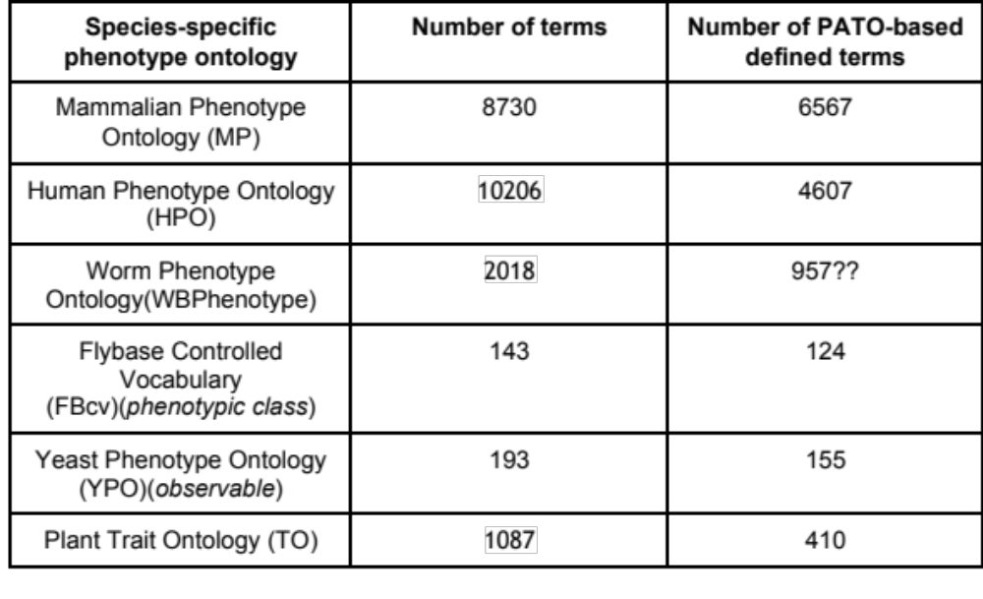
Progress to date

Slide 17
Comparative Phenomics

Slide 18
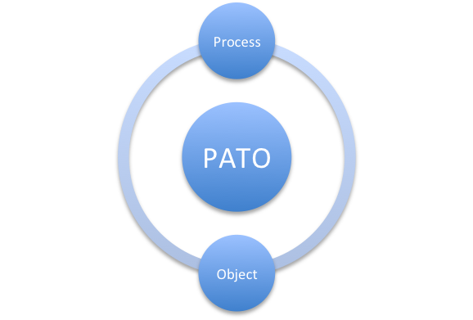
PATO Conceptual Layer
EQ
EQ Model
link Entities (E) from GO, CheBI, FMA etc. to Qualities (Q) from PATO →
EQ statements

Slide 19
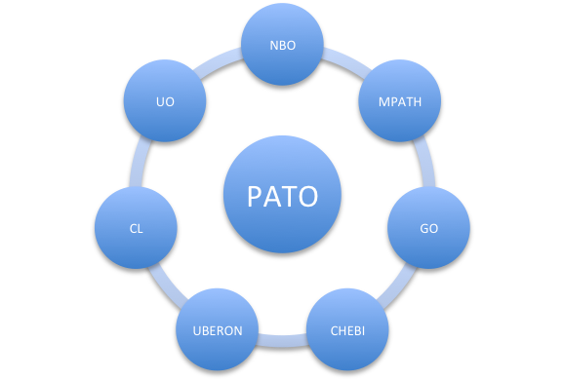
Semantic Components Layer
EQ
Behavior
Pathology
Physiology
UBERON
Cell Phenotype
Measurements
(Units Ontology)

Slide 20
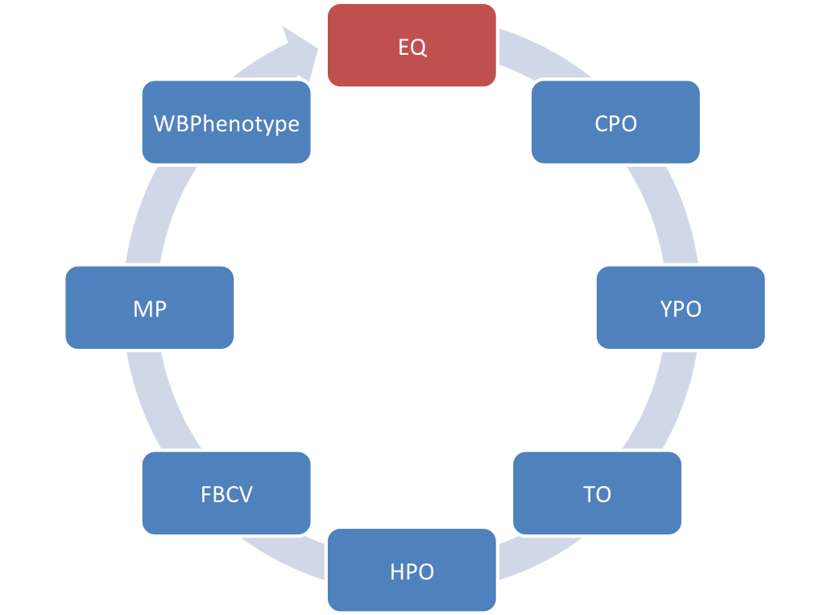
Unification Layer
Provision of PATO based equivalence definitions

Slide 21
UBERON-Integrating Species-Centric Anatomies

Slide 22
Formalisation Layer
transform OWL ontologies into OWL EL → enable tractable reasoning

Slide 23




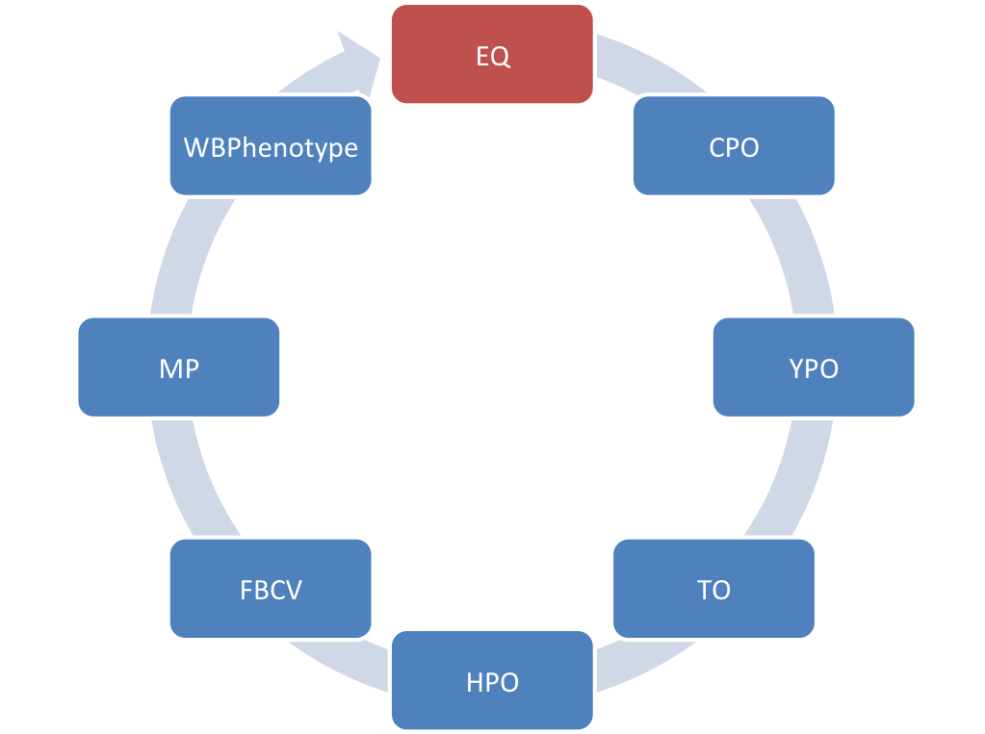
















Integration Layer

Slide 24
Cross Species Data Integration

Slide 25
Cross species integration framework
A PATO-based cross species phenotype network based on experimental phenotype data for 5 model organisms yeast, fly, worm, fish, mouse and human
integration of anatomy and phenotype ontologies
  exploit through OWL reasoning
  more than 500,000 classes and 1,500,000 axioms
  PhenomeNET forms a network with more than 111.000 complex phenotype nodes representing complex phenotypes

Slide 26
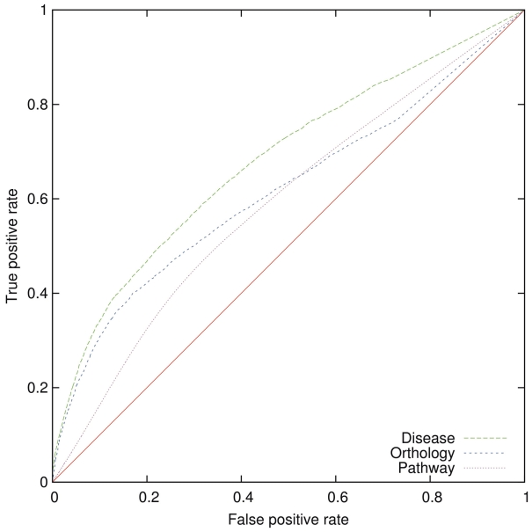
PhenomeNet
quantitative evaluation based on predicting orthology, pathway, disease
Receiver Operating Characteristic (ROC) Curve analysis
Area Under Curve (AUC) = 0.7

Slide 27
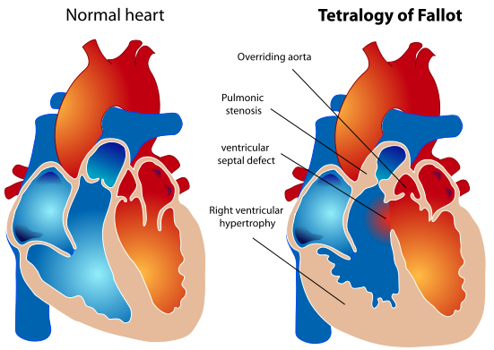
Candidate disease gene prioritization
E1: Aorta(FMA)
Q: overlap with (PATO)
E2: Membranous part of the interventricular septum (FMA)
Predict all known human and mouse disease genes
Adam19 and Fgf15 mouse genes
using zebrafish phenotypes - mammalian homologues of Cx36.7 and Nkx2.5 are involved in TOF

Slide 28
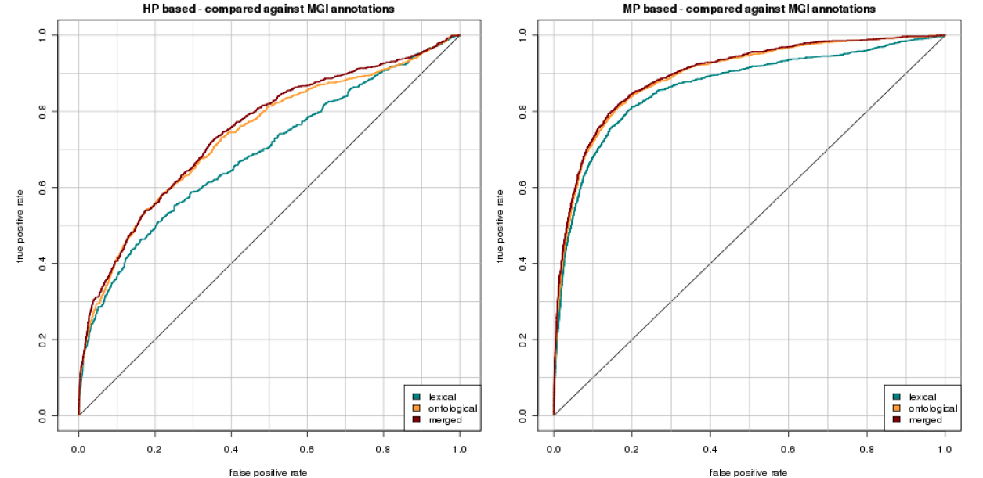
AUC = 0.9
Enhance the network e.g.
  Semantics e.g Behavior and pathology related phenotypes etc.
  Methods e.g. text mining, machine learning etc.
PhenomeNET now significantly outperforms previous phenotype-based approaches of predicting gene–disease associations
Performance matches gene prioritization methods based on prior information about molecular causes of a disease

Slide 29
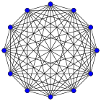

Slide 30
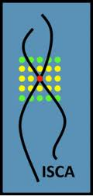




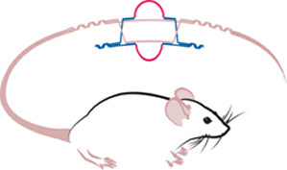
IRDiRC

Slide 31
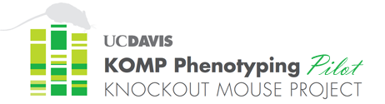
ClinVar
dbGAP
IRDiRC
dbSNP

Slide 32
Translational Research

Slide 33
The power of phenotype
Candidate disease gene prioritization
Copy number variations
Rare and orphan diseases
Functional validation of human variation studies (e.g GWAS)
  identification of pathogenicity of human mutations
  new therapeutic strategies

Slide 34
Novel drug discovery and repurposing

Slide 35
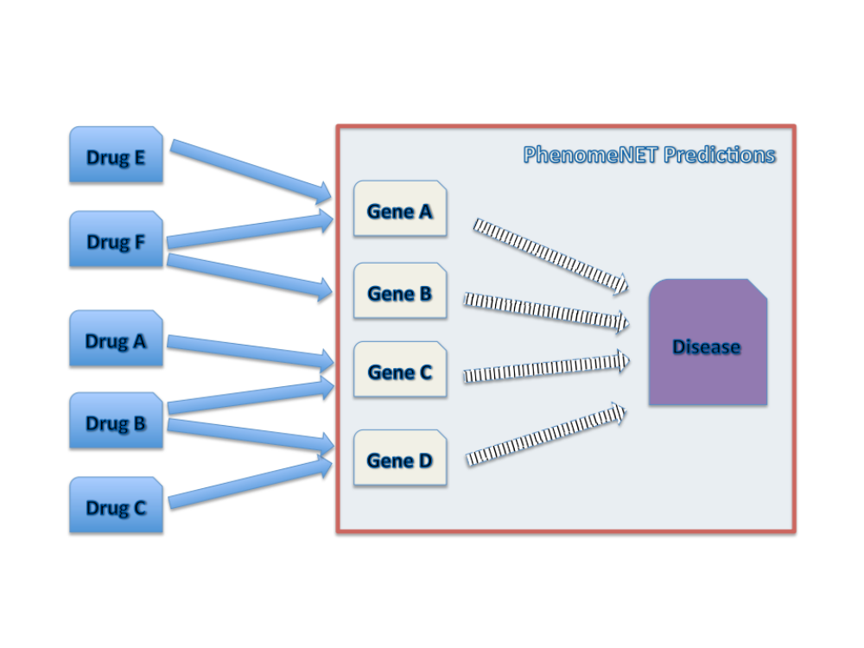
Phenotype-based drug discovery and repurposing
Variety of methods successfully being applied for drug repositioning and the suggestions of potentially novel drugs
Can a phenotype of gene which the drug interacts be used to predict diseases in which the drug is active?

Slide 36
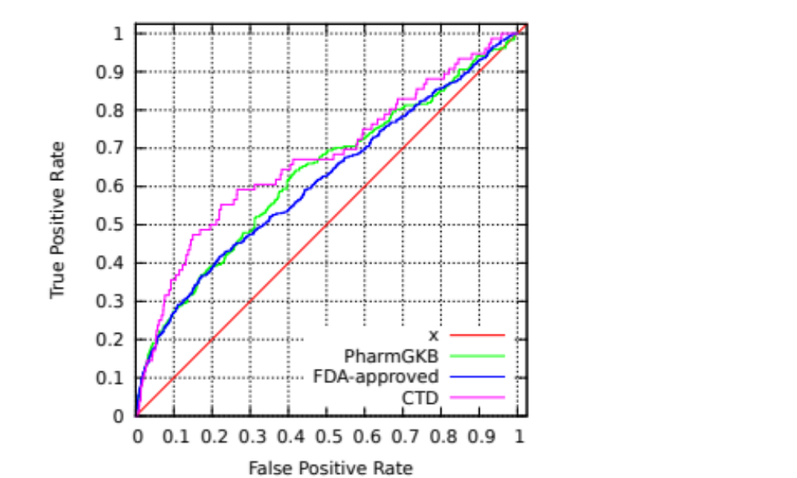
Results
AUC =
0.65 PharmGKB
0.63 FDA
0.69 CTD
Notes:
There are kind of similar there is some signal but as we can see from the AUCs is not very strong

Slide 37
Future work
integrated system for the analysis and prediction of drug–disease associations with emphasis on orphan diseases
include other drug resources such DrugBank and CTD
combine them with other methods such as:
  drug response
  gene expression profiles
  drug–drug similarity
  drug–disease similarity
  text mining of known associations
employ other computational approaches (machine learning approach, statistical testing, semantic similarity)

Slide 38
Mathematical Modelling

Slide 39
Model-based investigation of optimal cancer chemotherapy
mathematical modelling of cancer progression and optimal cancer chemotherapy
cancer dynamics, pharmacokinetic and drug-related toxicity models
→ study the effect of widely used anti-cancer agents irinotecan (CPT-11) and 5-fluorouracil (5-FU)
include drug related side-effects categorised in terms of undesirability of the side-effect as well as the frequency of appearance

Slide 40
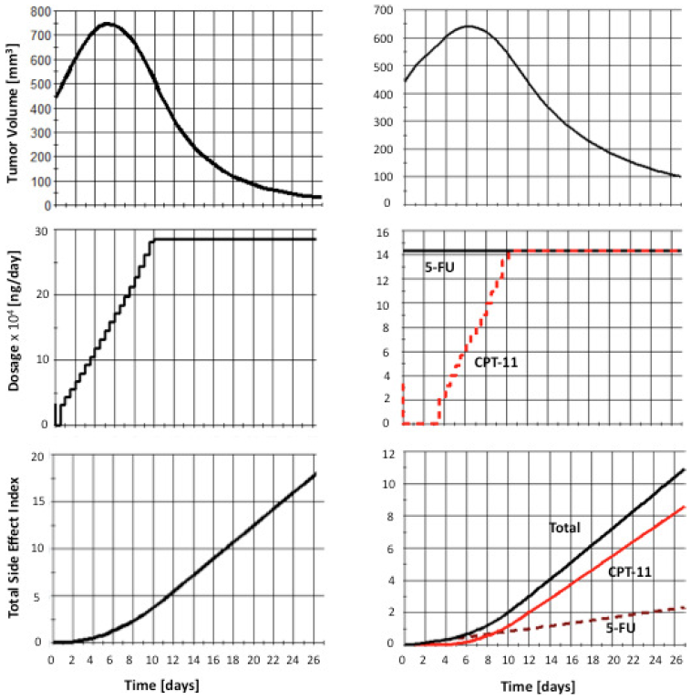
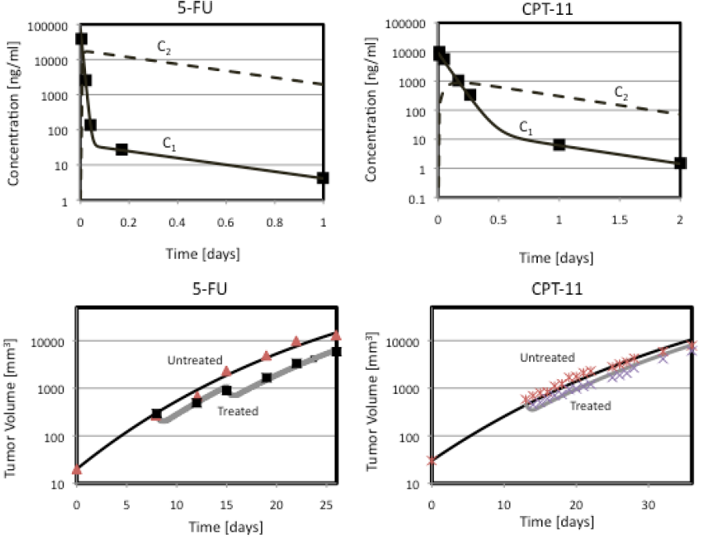
a) Model predictions alongiside experimental data
b) Optimal control
models replicate animal data successfully
optimal administration: ⬆5-FU  ⬇CPT-11
future directions
  experimental validation
  specific cancer characteristics, drug resistance, metastasis and cell-cycle

Slide 41
RICORDO - Towards Physiology knowledge representation
Virtual Physiology Human (VPH) - “A major challenge for the future how is to integrate physiology knowledge into robust and fully reliable computer models and "in silico" environments”
The RICORDO approach (www.ricordo.eu)
  ontology based framework for the description of VPH models and data
  connect distributed repositories with software tools
  standardization of the minimal information content
Goal - qualitative representation of physiology

Slide 42
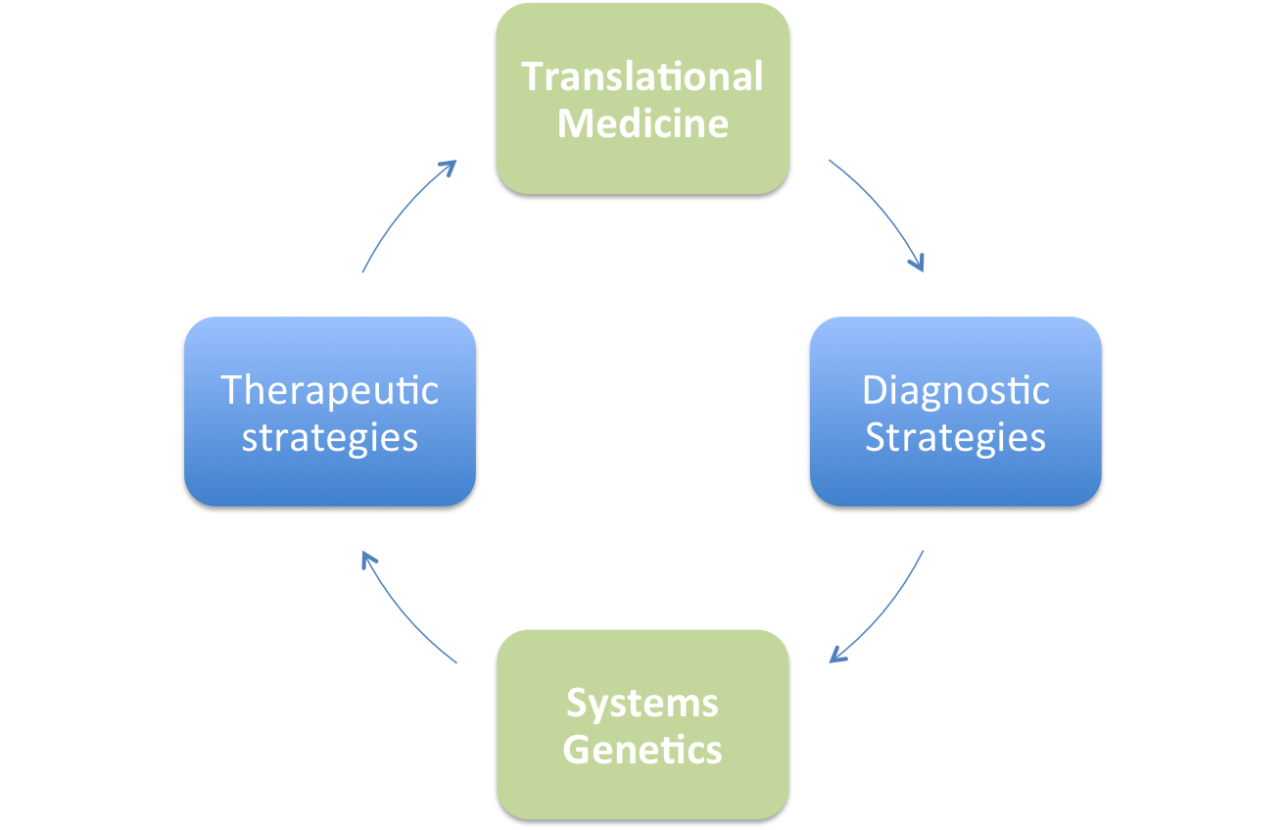
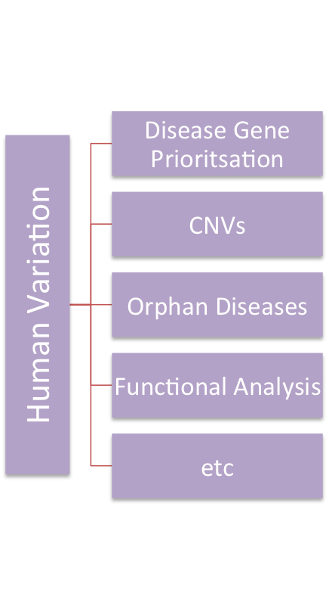
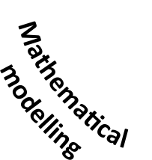
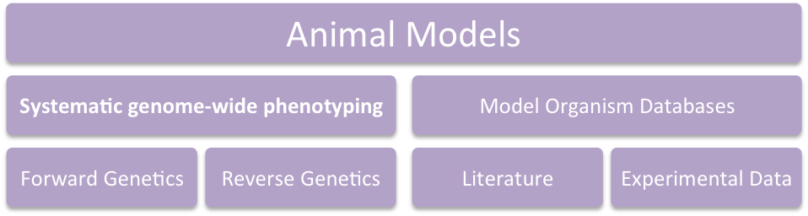
Personalised Medicine
Translational Medicine
translation
Cross Species
Integration

