Slide 1
Introduction to Ontologies or Why Ontology Is Such a Pain Gary H. Merrill Phenotype RCN Meeting Feb. 23, 2012 Raleigh

Slide 2
Goals of this presentation
Introduce a number of critical concepts and fundamental distinctions necessary to understanding ontologies.
Provide different ways of construing what an ontology is – together with associated jargon.
Indicate through some simple examples how these things matter and can influence your ontology development – and lead you to make mistakes.
Raise some practical questions about ontology design and how addressing these may lead to alternative approaches.

Slide 3
High-level advice
Do not confuse words with things. If you think you’re talking about things when you’re really talking about words, then things will go bad – and so will the words.
If you want to talk about – or make use of – concepts in your ontology, be as clear as you can about what a concept is (or at least what your formal model of a concept is). Similarly for any other abstract entity you may want to employ such as a universal, a kind, a type, etc. Do not assume that a clear understanding of such things is shared by all ontology developers and will be shared by ontology users.
If you do not know – with a fairly high degree of precision – what you are trying to do and what you are not trying to do, then almost certainly what you end up doing will be of questionable value.
Remember: You are attempting to build a model of reality. But the ontology is only one component of that model. (The other components are one or more languages and one or more theories.)

Slide 4
What is an ontology?
(Lexical/Linguistic View )
(Metaphysical/Semantic View )
A set of related terms
A set of related categories
Consequences:
An ontology is a language, vocabulary, thesaurus, or terminology
Relations among ontology members are linguistic relations (“is synonymous with”, “is broader than”, “is narrower than”)
If two sets of ontology terms are different, then they comprise or represent different ontologies.
Consequences:
An ontology is a set of related abstract entities – essentially an algebra of a certain sort.
Entities in the ontology are surrogates of (and are thought of as) things in the world.
Relations among ontology entities are relations among things (not words): “is part of”, “is connected to”, “surrounds”, “reacts with”, …).
Questions:
Where are the things (biological entities, atoms, molecules, compounds, etc.)?
How is the ontology related to the world?
Questions:
How are the categories related to one another?
How is the ontology related to a language used to describe and use it?

Slide 5
What is an ontology for?
Why are you creating an ontology? | What are your goals? How are these related?
Classification
Search / Retrieval
Pedagogy
Knowledge Representation
Design/Manufacturing
Knowledge Exploration
Knowledge/Data Integration
Prediction
Administrative Support
Knowledge Discovery

Slide 6
A cluster of critical terms and concepts …
Dictionary
Ontology
Theory
Law
Term
Semantic Relation
Nomic Relation
Thesaurus
Empirical Relation
Coding Scheme
Reference Relation
Principle of Individuation
Class
Meaning Relation
Relational Structure
Property/Attribute
Definition
Principle of Classification
Model
Concept

Slide 7
Problems and questions: some simple examples
A really important question: Are ontologies about terms or things?
Answer: “Yes” (but mostly things as referred to by terms)
But: When you are arguing about including something in your ontology,
Are you arguing about what a term means?
Or are you arguing about what term should be adopted in your ontology language to represent a well-characterized entity or concept?
These are terminological questions, and not ontological questions. 1 is a purely linguistic dispute; 2 is primarily a practical question.
The ontological questions are:
What kind of things should we recognize in our ontology?
(Never mind, for the moment, what we might choose to call them.)
What are their relations to one another?
(Not: What are the relations of their terms/names to one another?)

Slide 8
An incomplete and crude example: Ontology of wind instruments
Wind Instrument
Woodwind
Brasswind
High Brass
Low Brass
Trombone
Tuba
Other
Trumpet- Cornet
Trumpet
Cornet
French Horn
Unvalved Horn
Valved Horn
Single Horn
Double Horn

Slide 9
A Bad Ontology of Low Brass Instruments
Low Brass
Trombone
Tuba
Other
Tenor
Baritone
Bass
Contrabass
?
Valve Trombone
Slide Trombone
F
Eb
CC
BBb
Soprano
Alto
Tenor
Bass
Contrabass
Comp
Uncomp
Comp
Uncomp
Baritone
Euphonium
Comp
Uncomp

Slide 10
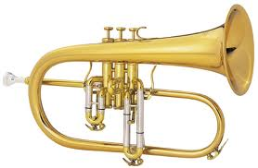

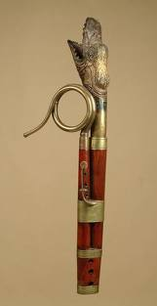
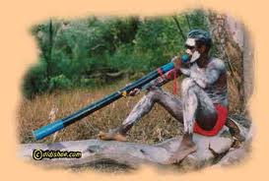
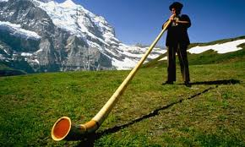
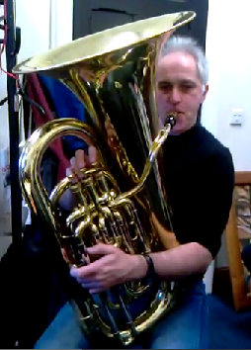
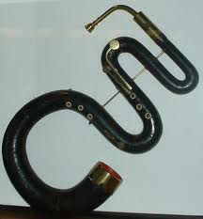
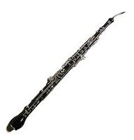
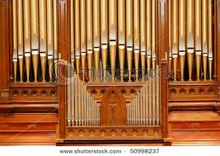
Some potential ontological/terminological embarrassments

Slide 11
It’s always more complicated than you think (Terms, Ontologies, and Theories)
What did Joseph Priestley discover in 1774?
Possible answers (some of these are dangerously wrong!):
He discovered oxygen.
He did not discover oxygen, but did discover dephlogisticated air.
He discovered both oxygen and dephlogisticated air. They are the same thing but different terms are used to describe it – as in the case where a preferred term and its synonym represent the same thing in a thesaurus.
He discovered two different things: dephlogisticated air and oxygen, but they are closely related.
How can we decide the answer to this question and decide which of the possible answers are good and which are bad?
How does this example illustrate the manner in which an ontology and a terminology are related to a theory?
Can phlogiston theory be integrated with oxidation theory? What would that take? How would an ontology help?

Slide 12
Some references
“A New Approach to the Classification of Sound-Producing Instruments”, R. Lysloff and J. Matson, Ethnomusicology, Vol. 29, No. 2, 1985, 213-236.
“Knowledge Representation Issues in Musical Instrument Ontology Design”, S. Kolozali, M. Barthet, G. Fazekas, M. Sandler, 12th International Society for Music Information Retrieval Conference (ISMIR 2011), 465-470.
“Ontology, ontologies, and Science”, G. Merrill, Topoi, Vol. 30, 2011, 71-83. Addressed primarily to philosophers, this paper distinguishes ontology (as a discipline) from the study and development of ontologies (as systems of classification), and argues that philosophers should devote their skills and training to the latter in working closely with scientists. Although it has been read and referenced by several in the areas of biomedical informatics and computer science, it seems to have been read by a significant number of philosophers and ignored.
“The MedDRA Paradox”, G. Merrill, AMIA Annual Symposium Proceedings, 2008 Nov 6, 470-474. An illustration of the incoherence that can result when you try to treat a dictionary as though it is an ontology.
“Concepts and Synonymy in the UMLS Metathesaurus”, Discovery and Collaboration (online),
Vol 4, 2009. A lengthy and in places tediously formal analysis of the Metathesaurus and the degree to which it can be construed as an ontology.

