Slide 1
Reasoning over Phenotypes
Chris Mungall
Lawrence Berkeley Laboratory

Slide 2
ontology
applications
quality
control
classification
indexing
search
retrieval
pedagogy
knowledge engineering
prediction
data
mining
cross-species comparisons

Slide 3
ontology
language-centered
logic-centered
reasoning
applications
quality
control
classification
indexing
search
retrieval
pedagogy
knowledge engineering
prediction
data
mining
cross-species comparisons

Slide 4
Reasoning supports query answering and data mining
Find all genes expressed in odontogenesis
Find all phenotypes affecting structures with some contribution from the neural crest
Show all images of malformed autopod epiphyses
Find model organism strains (or evolutionary specimens) with phenotypes similar to those found in brachydactyly

Slide 5
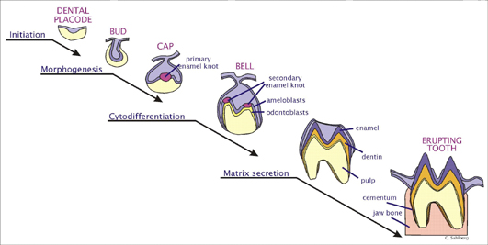
dental placode
D
tooth bud
D
tooth
tooth SubClassOf develops_from some tooth bud
tooth bud SubClassOf develops_from some tooth placode

Slide 6
dental placode
D
tooth bud
D
D
tooth
tooth SubClassOf develops_from some tooth bud
tooth bud SubClassOf develops_from some tooth placode
develops_from is transitive
➔ tooth develops SubClassOf from some tooth placcode
assertions
inference

Slide 7
Composition of relationships
Basic: transitivity, symmetry, …
Advanced: property chains
  E.g
    If X has_part Y
    and Y develops_from Z
    then X has_developmental_contribution_from Z

Slide 8
neural crest
D
tooth
has part
dentine

Slide 9
neural crest
has contribution from
D
tooth
has part
dentine

Slide 10
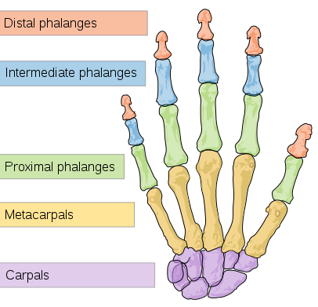
Biology is modular

Slide 11
Biology is modular
phalanx
distal
phalanx
proximal
phalanx
repetition at different levels
{distal,proximal} phalanx of {foot,hand}
autopod
{distal,proximal} phalanx [1-5] of {foot,hand}
foot
hand

Slide 12
Automatic classification
phalanx
p
distal
phalanx
proximal
phalanx
pf
ph
dp
pp
autopod
foot
hand
dpf
ppf
dph
pph

Slide 13
Composition of descriptions
phalanx
OWL
Representation
distal
phalanx
proximal
phalanx
“distal phalanx of finger” =
“distal phalanx” and part_of some “finger”
“distal phalanx of autopod” =
“distal phalanx” and part_of some “autopod”
“finger” SubClassOf part_of some autopod
➔
“distal phalanx of finger”
SubClassOf “distal phalanx of autopod”
autopod
foot
hand

Slide 14
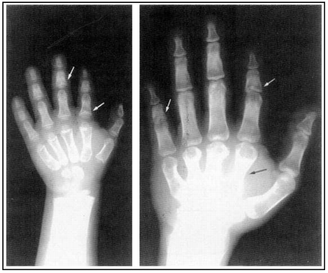
Composition of phenotypic descriptions
image002 Type depicts some
(“distal phalanx of finger” and has_quality some “cone-shaped”)

Slide 15
Composition of phenotypic descriptions
image002 Type depicts some
((“distal phalanx” and part of some “finger”) and has_quality some “cone-shaped”)

Slide 16
Pre and post
pre
“distal phalanx of finger” = “distal phalanx” and part_of some “finger”
anatomy
ontology
“cone-shaped distal phalanx of finger” = “distal phalanx of finger” and has_quality some “cone-shaped”
phenotype
ontology
image001 Type depicts some “cone-shaped distal phalanx of finger”
annotation
post
image001 Type depicts some ((“distal phalanx” and part_of some finger) and has_quality some “cone-shaped”)
annotation
query
depicts some ((“distal phalanx” and part_of some finger) and has_quality some “cone-shaped”)
returns
image001

Slide 17
Pre and post
pre
“distal phalanx of finger” = “distal phalanx” and part_of some “finger”
anatomy
ontology
“cone-shaped distal phalanx of finger” = “distal phalanx of finger” and has_quality some “cone-shaped”
phenotype
ontology
image001 Type depicts some “cone-shaped distal phalanx of finger”
annotation
post
image001 Type depicts some ((“distal phalanx” and part_of some finger) and has_quality some “cone-shaped”)
annotation
query
depicts some “cone shaped distal phalanx of finger”
returns
image001

Slide 18
Managing pre-composed descriptions
Pre-composed
  Argument against
    annotation bottleneck
    low granularity
  Argument for
    manage complexity centrally
    E.g
      hypertelorism
      situs inversus

Slide 19
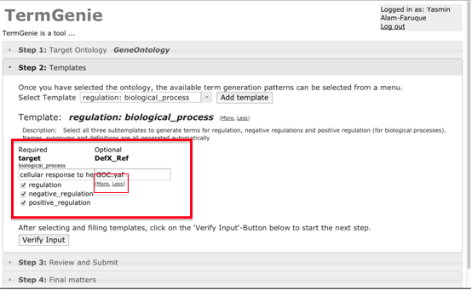
Instant classes with TermGenie
Web-based
Templates defined in advance by ontology authority
Annotators get instant classes
  fill in template
  classes have labels, definitions
  automated ontology placement using reasoning
Ontology editors can handle more complex cases
http://termgenie.org

Slide 20
Reasoning is not a panacea
You can’t always say what you want
Even if you say what you want you won’t always be able to reasoning with it

Slide 21
Expressivity
First Order Logic
OWL2-DL
OWL2-EL
OBO-Format
RDFS
SQL

Slide 22
Expressivity and Reasoning
First Order Logic
Fact++
HermiT
OWL2-DL
Pellet
OWL2-EL
OBO-Format
RDFS
Elk
JCel
SQL
Relational Database

Slide 23
Using Reasoners
Programmatic
  Manchester OWLAPI
    Allows access to main reasoners
  OWLLink
    http protocol for accessing reasoners
  OWLTools
    wrapper onto OWLAPI
    http://owltools.googlecode.com
User
  Protégé 4
    built on OWLAPI

Slide 24
Deploying reasoners in your workflow
Ontology Building
  DL reasoner
Querying annotations
  Millions of datapoints
  EL reasoning
  Precompute over ontology using DL reasoner
Querying/analyzing large datasets
  billions
  precompute over annotations using DL reasoner
  relational database or RDF triplestore or NoSQL store

Slide 25
Beyond reasoning
Reasoning typically used during ontology development cycle
  classification
  consistency checking
Increasing uses for end-user querying
  Virtual Fly Brain
  Phenoscape
Beyond reasoning
  Data mining

Slide 26
Semantic Similarity
What genes are similar to Phox2a?
Phox2a
Phox2b
Sox10

Slide 27
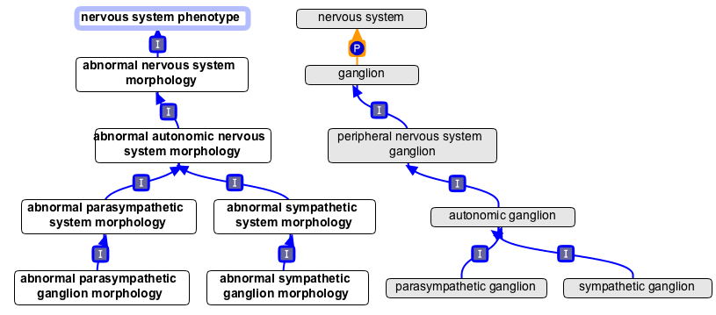
Semantic Similarity
What genes are phenotypically
similar to Phox2a?
Phox2a
Sox10
Phox2b
Phox2b

Slide 28




Graph Similarity
  SimJ(a,b) =
  |a b| / |a U b|
What genes are similar to Phox2a?
  SimJ(Phox2a,Sox10) = 3/7 = 0.42
U
U
U
U
Phox2a
Sox10

Slide 29
Graph Similarity
  SimJ(a,b) =
  |a b| / |a U b|
What genes are similar to Phox2a?
  SimJ(Phox2a,Sox10) = 3/7 = 0.42
  SimJ(Phox2a,Phox2b) = 1
U
U
U
U
Phox2a
Sox10
Phox2b

Slide 30
Information Content
freq
IC
300
4.7
  IC(t) = -log(p(t))
  MaxIC(Phox2a,Sox10) = 6.8
  MaxIC(Phox2a,Phox2b) = 8.8
ffff
200
5.3
d
6.8
72
25
8.3
18
8.8
Phox2a
Sox10
Phox2b
Phox2b

Slide 31
Limitations of standard approach
Underlying statistics computed using graph based approach
  least common named subsumer
Limited to granularity of single pre-composed ontology
  most specific composed description

Slide 32
Leveraging other ontologies
MP
MA
Phox2a
Sox10
=
^
Phox2b
Phox2b
abnormal morphology

Slide 33

MP
MA
on-the-fly least
common subsumers
abnormal autonomic
ganglion morphology
Phox2a
Sox10
Phox2b
Phox2b
http://owlsim.org

Slide 34
delaminated enamel
abnormal dental pulp
abnormal sympathetic ganglion morphology
absent Meckel’s cartilage
athyroidism
tooth abnormality

Slide 35
delaminated enamel
abnormal dental pulp
abnormal sympathetic ganglion morphology
absent Meckel’s cartilage
athyroidism
abnormality of
NC derivative
abnormality of
structure with
contribution from
NC

Slide 36
Other applications of phenotype ontologies to data mining
“Phenologs”
  Co-occurrence of phenotypes
    within species
    across species
      Systematic discovery of non-obvious human disease models through orthologous phenotypes
      Kriston L. McGary, Tae Joo Park, John O. Woods, Hye Ji Cha, John B. Wallingford, and Edward M. Marcotte, Proc Natl Acad Sci USA 2011
Term enrichment
  Given a set of genes/genotypes/organisms
    what are the common phenotypes

Slide 37
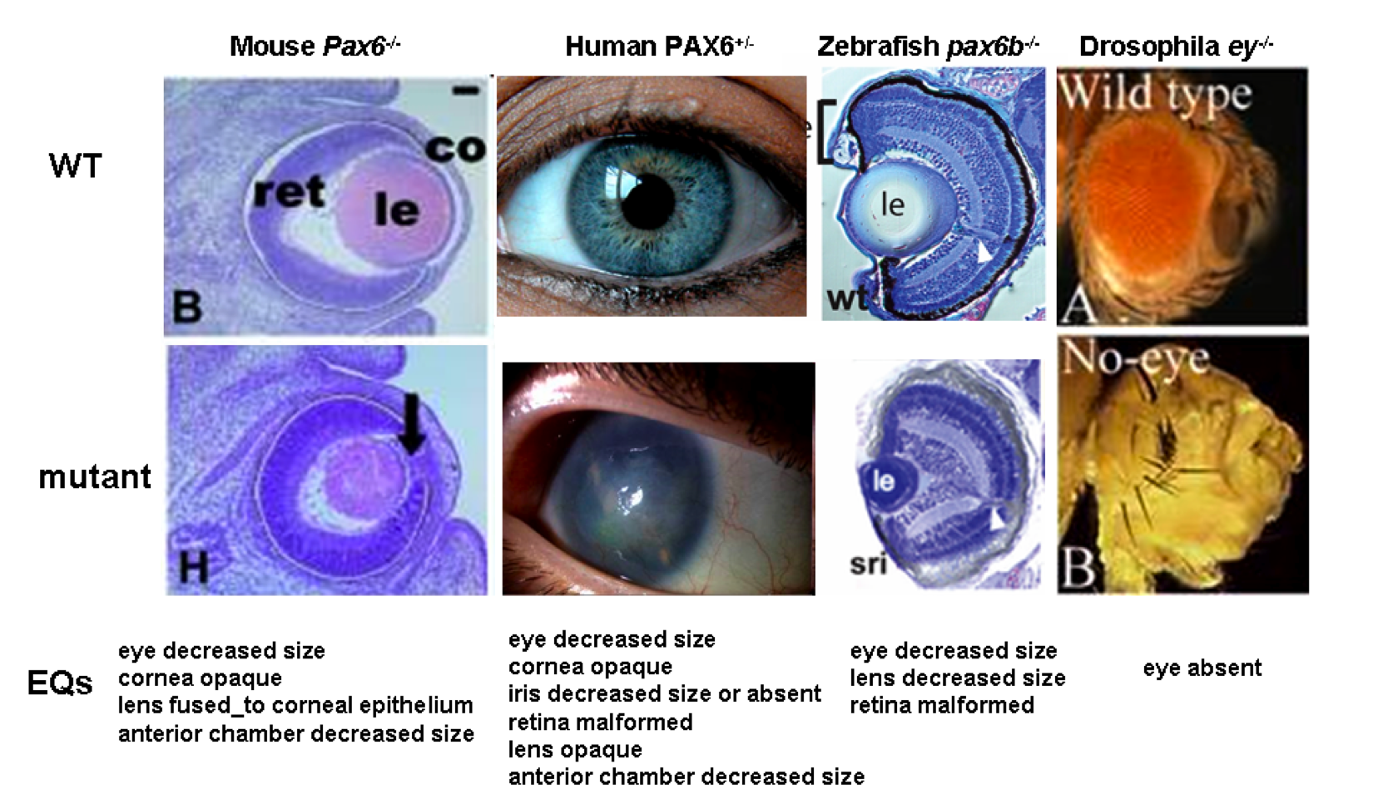
human diseases to animal models
NL Washington, MA Haendel, CJ Mungall, M Ashburner, M Westerfield, and SE Lewis. Linking Human Diseases to Animal Models using Ontology-based Phenotype Annotation. PLoS Biology, 7(11), 2009
SimJ: 0.42
MaxIC: 13.4
SimJ: 0.17
MaxIC: 6.2
SimJ: 0.32
MaxIC: 12.1

Slide 38
Learning More
Subscribe
  obo-phenotype
  obo-anatomy
  obo-discuss
  http://obofoundry.org
Tools
  http://owlsim.org
  http://owltools.googlecode.com
  http://owlapi.sf.net
Time to change how we describe biodiversity AR Deans MJ Yoder JP Balhoff Tree 2012
Uberon, an integrative multi-species anatomy ontology CJ Mungall, C Torniai, GV Gkoutos, SE Lewis, MA Haendel
Genome Biology 13 (1), R5
MouseFinder: candidate disease genes from mouse phenotype data CK Chen, CJ Mungall, GV Gkoutos, SC Doelken, S Köhler, BJ Ruef, C Smith, et al Human Mutation
Integrating phenotype ontologies across multiple species CJ Mungall, GV Gkoutos, CL Smith, MA Haendel, SE Lewis, M Ashburner
Genome biology 11 (1), R2
Linking human diseases to animal models using ontology-based phenotype annotation NL Washington, MA Haendel, CJ Mungall, M Ashburner, M Westerfield, SE Lewis
PLoS biology 7 (11), e100024
A common layer of interoperability for biomedical ontologies based on OWL EL R Hoehndorf et al Bioinformatics 2011

