Slide 1
Biomaterial
Biomaterial branch – OBI WS – 2009/02
By Biomaterial Branch

Slide 2
Biomaterial branch – OBI WS – 2009/02
Hierarchy
material entity
--------- organism
--------- organization
--------- molecular entities
--------- chemical entities in solution (mixtures)
--------- environmental matter
--------- macroscopic part of multicellular organism
--------- artifact object
--------------- EOO (entity of organismal origin)

Slide 3
Dependencies to other terms
Biomaterial branch – OBI WS – 2009/02
- external resources:
NCBI taxonomy
CHEBI
ENVO
…
- material
organism
mac. part of org.
- roles
reagent, subject specimen
- relations
has_role
part_of
is_specified_output
derives_from
- processes
artifact material creation

Slide 4
1. material entity
Biomaterial branch – OBI WS – 2009/02
Is defined as union of the 3 types of BFO objects
We don't have to deal with granularity (e.g. aggregates, part of objects)
Status:
has been moved to IAO, but will be part of BFO 1.2
term stable

Slide 5
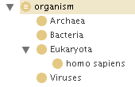
2. organism
Biomaterial branch – OBI WS – 2009/02
MIREOT import from NCBI
'natural person' is an
alternative term to 'homo sapiens’
Future: add strains etc. (source JAX, others) as subclasses under most appropriate taxon, in a separate file
dead and alive : definition is outside of the scope of OBI
dead organism = corpse, is not an organism. Proposed definition: a body/corpse is the integral physical material of an individual, derived from a living organism (add to file?)
eukaryotic cell taken from a multicellular organism is not an organism (cell which was part of that multicellular organism)
Status: term stable

Slide 6

3. organization
Biomaterial branch – OBI WS – 2009/02
Definition: An organization is a material entity (BP:no – compromise for now to be continuant entity) which can play roles, has members, and has a set of organization rules. Members of organizations are either organizations themselves or individual people. Members can play specific organization member roles that are determined in the organization rules. The organization rules also determine how decisions are made on behalf of the organization by the organization members
outstanding: if this should really be material, but decided to leave it here until other consensus would arrive.
should have logically constrained that restricted to people
Added example instance: Affymetrix and subclass regulatory agency
Status: term mid-stable

Slide 7
4. molecular entity
Biomaterial branch – OBI WS – 2009/02
Imported from ChEBI, and everything should end up in ChEBI
We will however have to hold some chemical entities for practical reasons
Process of adding new subclasses to molecular entities case of "huge" resources e.g. Melanie has a list of 600 fluorochromes and Bjoern a list of 1000 peptides
> Proposal is to store these very specific resources in external files (Bjoern may not want to get 600 fluorochromes when downloading OBI)
AI for AR: create “branch”right now
Status: term stable

Slide 8
5. mixtures / chemicals in solution
chemical entities in solution (mixtures) concentration proposal from BP and AR and discussed in Karlsruhe with Stefan Schulz, Marijke Keet.
  A molecular concentration is a relational quality that inheres in a material entity towards a scattered molecular aggregate that is part of it, by virtue of some ratio of masses of the two or the counts of the grains of the two or volume occupied by the larger material entity relational quality, inheres_in some 'material entity' and towards some 'scattered molecular aggregate'
  A scattered molecular aggregate is a material entity that consists of all the molecules of a specific type that are part of a more massive material entity that has parts that are other such aggregates. material entity, 'has grain' some 'molecular entities', 'has grain' only 'molecular entities'
  has_grain: the relation of the cells in the finger of the skin to the finger, in which an indeterminate number of grains are parts of the whole by virtue of being grains in a collective that is part of the whole, and in which removing one granular part does not necessarily damage or diminish the whole. Ontological Whether there is a fixed, or nearly fixed number of parts—e.g., fingers of the hand, chambers of the heart, or wheels of a car— such that there can be a notion of a single one being missing, or whether, by contrast, the number of parts is indeterminate—e.g., cells in the skin of the hand, red cells in blood, or rubber molecules in the tread of the tire of the wheel of the car. (from Granularity, scale and collectivity: When size does and does not matter, Alan Rector, Jeremy Rogers, Thomas Bittner, Journal of Biomedical Informatics 39 (2006) 333–349) – work needed on definition
  Example: Salt water: bears "concentration 2%" and towards (scattered aggregate and has_grain only Na+)

Slide 9

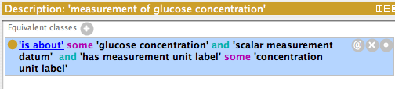
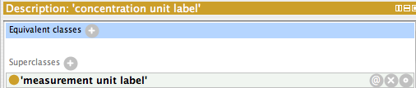
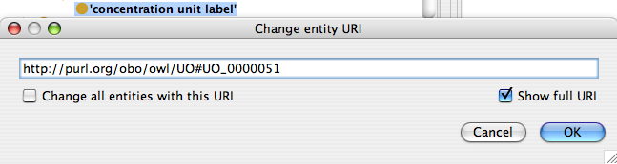
Biomaterial branch – OBI WS – 2009/02

Slide 10
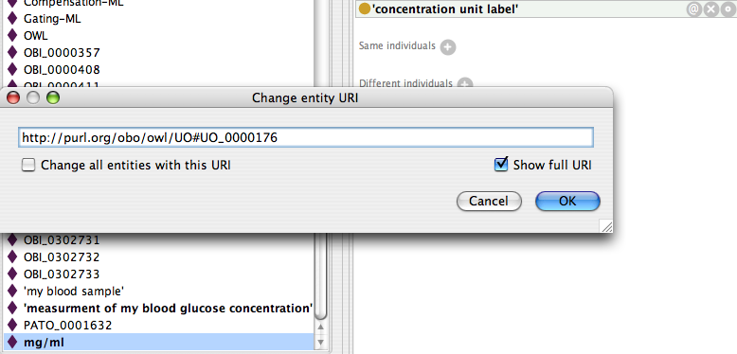
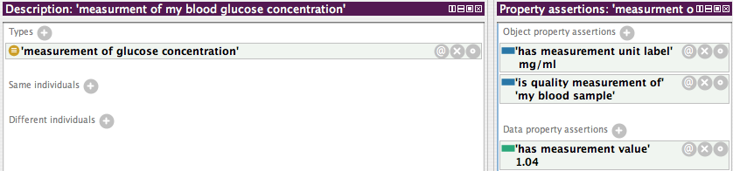
Biomaterial branch – OBI WS – 2009/02

Slide 11
6. environmental matter
Biomaterial branch – OBI WS – 2009/02
Interaction with ENVO:
ENVO will place their terms under 'material entity' instead of 'environmental matter’
- They will use a quality / role that indicates that a given material entity is a 'living environment'.
We can import now ENVO terms under material entity (rocks / oil / soil /...)
Susanna/ Philippe/ James in discussion with Norman
Status: no core term for now?
We will toss that term for now

Slide 12
7. macroscopic part of organism
Biomaterial branch – OBI WS – 2009/02
Def: A macroscopic part of a multicellular organism is a material entity that is part of a multicellular organism, and which is large enough so that it forms an identifiable structure in the organism. Specifically, it excludes granular parts of the organism, such as atoms, molecules, cells, which can be removed from the organism without affecting it.
-- distinction micro/macro hard: definition specifically excludes some cases – special edge cases
-- instead of macroscopic, convey sense of multicellular – special cases like fluids
Issues:
parasites are not macroscopic part or organism.
fetus is_a macroscopic part (but add editor note that this is up for dicusssion)
Status: definition stable – uncertainty about ‘extracted’ parts

Slide 13
Multicellular part of multicellular org would be subclass of macroscopic part

Slide 14
8. EEOO (extracted entity (of organismal origin))
Biomaterial branch – OBI WS – 2009/02
Definition: An entity of organismal origin is a biomaterial entity which is obtained from one or more multicellular organism,
- which consists primarily of organism parts
- which allows to study some aspects of the original organisms parts (is proxy for)
Needs updated logical definition
- Editor note shoe doesn’t have purpose of investigation
Status: needs work, in liaison with PA branch, relatively to artifact objects.

Slide 15
Policy issues
Biomaterial branch – OBI WS – 2009/02
Renaming of labels during import? 'molecular entities'
- ask ChEBI to change?
- use multiple labels?
Separate files for huge number of subclasses; Could eventually end up in resources outside of OBI. Reason: practicality to work with file + responsiveness of outside resources
- Peptides
- Fluorophores
- Jax mouse strains etc.

Slide 16
Biomaterial branch – OBI WS – 2009/02
Hierarchy – status summary
material entity
--------- organism
--------- organization
--------- molecular entities
--------- chemical entities in solution (mixtures)
--------- environmental matter
--------- macroscopic part of multicellular organism
--------- artifact object
--------------- EOO (entity of organismal origin)

