Slide 1
Modeling Phenotype Annotation

Slide 2
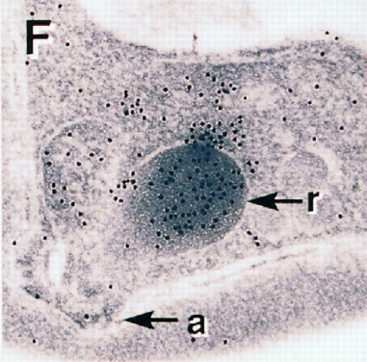
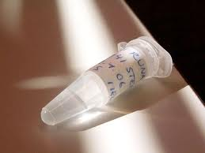
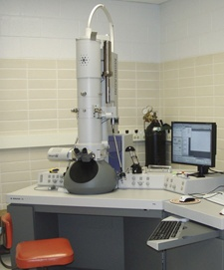

OBI and ECO (simple example)
ECO: Direct
Assay result
Evidence
based_on
Phenotypic assertion
AMA-1 protein
is located in rhoptry
OBI:Conclusion
Textual Entity
transfected P. berghei
parasite specimen
with AMA-1 expressed
under control of
the dhfr-ts promoter
OBI:Specimen
image
OBI:Data Item
is_input
is_output
is_output
is_input
immunogold labeling
experiment
OBI:Assay
OBI: Interpreting
Data
Kocken et al, JBC Vol.273: 24, pp15119-15124

Slide 3
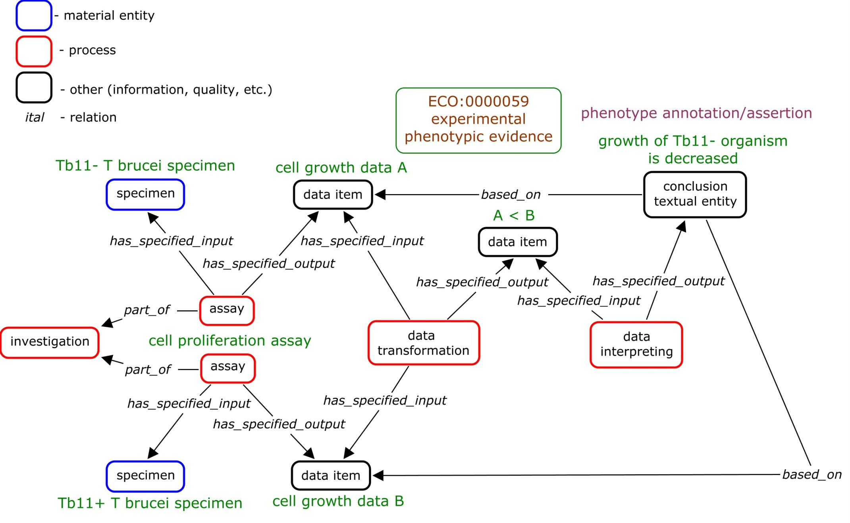
OBI and ECO (complicated example)

Slide 4
Phenotype Annotation/Assertion
located in rhoptry
decreased growth
absent enzyme activity
GO: cellular component
PATO
GO: biological process
GO: molecular function

Slide 5
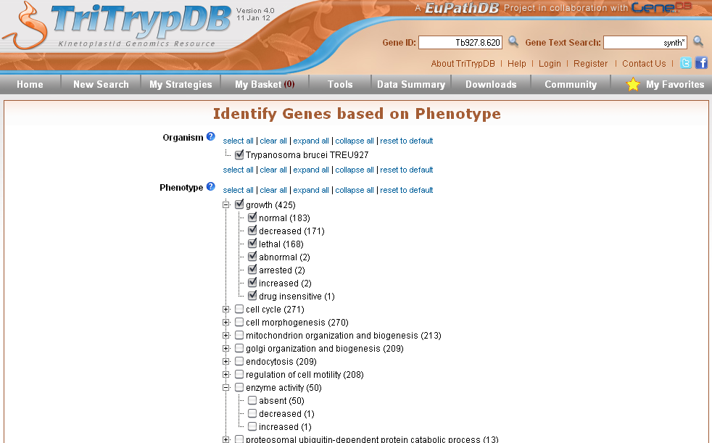
Applying to Queries

Slide 6
How to Represent phenotype using OWL?
Located in rhoptry
  inheres_in SOME (located_in SOME rhoptry (GO))
Decreased growth
  E: cell growth (GO), has_quality Q: decreased (PATO)
  decreased (PATO) THAT inheres_in SOME
  (has_disposition AND is_realized_by SOME cell growth (GO))
Absent enzyme activity
  E: enzyme activity (GO), has_quality Q: absent (PATO)
  Absent (PATO) THAT inheres_in SOME
  ( has_function enzym activity (GO))
Drug insensitive cell growth
  E: cell growth (GO), has_quality Q: insensitive (PATO)
  insensitive (PATO) THAT towards SOME drug AND
  inheres_in SOME (has_disposition AND is_realized_by cell growth (GO) )
Notes:
Representing Phenotypes in OWL
Chris Mungall, Georgios Gkoutos, Nicole Washington and Suzanna Lewis
Paper_40.pdf

