Slide 1
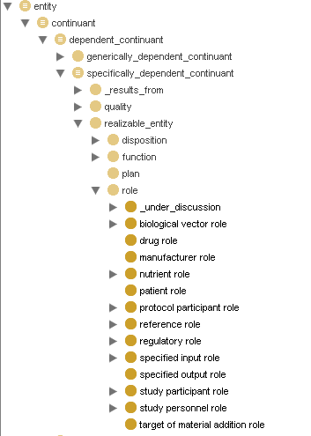
Role branch
Plan to re-name Study Personnel Role
to Investigation Personnel Role
and include manufacturer role

Slide 2
Role definition
Role XX is a role X which inheres in bearer Y and is realized in process Z or concretization of plan Z.

Slide 3
Specified input / output role
Specified output role is a role which inheres in an entity present at the end of a planned process and which is specified as output of the planned process.
Specified input role is a role which inheres in an entity present at the beginning of a planned process and which is specified as input to the planned process.
Causes issue for non-independent continuants, eg data.
Needs a process?

Slide 4
Protocol participant role
Protocol participant role is a role of entities that is realized in the implementation of a protocol.
Specified input and output are siblings but can also inhere in entity with protocol participant role. Can have input and output to processes other than protocols.
Made it a defined class
Realized_by only (is_concretezation_of some protocol)

Slide 5
Evaluant/analyte roles
Evaluant role is a specified input role which inheres in an entity and realized in an assay such that the output data describes a feature of the material entity playing the evaluant role
Analyte role is a protocol participant role borne by a molecular entity and realized by implementation of an analyte measuring assay with objective to detect the magnitude/concentration/ amount of the analyte in the entity bearing evaluant role
Model: measuring glucose (analyte role) in blood (evaluant)
Possible to determine that the level of the analyte entity is below limit of detection by the assay methodology.
Analyte is realized by only analyte assay
Evaluant realized by only assay

Slide 6
Reagent role
Reagent role is a protocol participant role played by a molecular entity and realized in the production of a chemical reaction used to detect, measure, or produce other substances
Need process: produce a chemical reaction to detect, measure, or produce other substances

Slide 7
Reference role
Reference role is a role of an entity that is realized in a process of using the bearer to support the observation of similarities, differences, relative magnitude or change
Includes positive and negative controls, “gold standards”, calibration standards, etc.
Need a process of “comparing”

Slide 8
Investigation agent role
Investigation agent role is a role borne by an agent (person or organization of humans or robot or organizations of robots) which realizes any of the following processing: planning, overseeing, funding, reviewing, reporting, implementing part of an investigation
Not “patients” except in self-administered drug instances. not donors to tissue banks or …
One who is realizing the plan = agent
Need processes: planning, overseeing, funding, reviewing, reporting, documenting, implementing part of an investigation

Slide 9
Study participant
Study participant is a role of entities that is realized through the implementation of a study design.
Defined class, parallel to protocol participant
Not agents
Realized_by only study design execution

Slide 10
Study subject role
Study subject role borne by an entity and realized through the execution of a study design in which the entity participates by being that which the results are about (necessary)
Data items as subjects?
Thing specified to be observed bears the study subject role

Slide 11
Specimen role
Specimen role is a role borne by a specimen and realized in a process of implementing a study design specifying the collection of a specimen

