Slide 1
Using OBI Links Genotype to Phenotype
JieZheng, Chris Stoeckert

Slide 2
Genotype -> Phenotype
has_part
Organism
or Cell
bearer_of
Specimen
Genotype
has_specified_input
OBI: Assay
bearer_of?
has_specified_output
Data
is about
Phenotype

Slide 3
Example
has_part
Genetically
Modified organism
bearer_of
Specimen
Genotype
has_specified_input
OBI: Assay
bearer_of?
has_specified_output
Data
is about
Phenotype
Assertion of gene function

Slide 4
Use Cases
Phenotype of genetically modified protozoon parasite
Growth normal
Growth decreased
Growth lethal
Growth drug insensitive
Cell cycle arrested
Enzyme activity absent
Enzyme activity increased
Chromosome abnormal
Mitochondrial DNA decreased

Slide 5
What is Phenotype (Textual definition)?
Definition in Gene extend ontology (GEO)
Any observed quality of an organism, such as its morphology, development, or behavior, as opposed to its genotype - the inherited instructions it carries, which may or may not be expressed. [http://en.wikipedia.org/wiki/Phenotype]
subclass of a non-physical continuant
According to the definition, Phenotype is a Quality
Definition in Ontology for General Medical Science (OGMS)
A (combination of) quality(ies) of an organism determined by the interaction of its genetic make-up and environment that differentiates specific instances of a species from other instances of the same species.
subclass of quality
Definition discussed at Penn meeting
an independent continuant with a particular quality or disposition is the output of a process that realizes genotype in the environment
(based on Marcus provided definition)

Slide 6
Question 1:
Phenotype Refers to:
Organism
Feeding behavior, height
Organ
Eye color
Cell
Muscle cell morphology
Molecular
Enzymatic activity

Slide 7
Question 2
How to link genotype to phenotype?
Definition of genotype
A collection of sequences in SO
It is generically dependent continuant based on SO definition
Cannot use ‘realizes / is_realized_by’ relation, because none is process

Slide 8
Question 3
What is Phenotype in the view of ontologists?
Dependent Continuant:
Quality?
color, shape, size
Realizable entity, like Deposition?
Cell: no mobility
Output of some process:
Independent Continuant?
Dependent Continuant?
Output of feeding behavior -> normal feeding behavior
Output of motility -> decreased cell motility
Output of development -> eye color

Slide 9
Question 4
How to link phenotype to quality, molecular functions, cell components, biological processes, etc.?
Growth normal
GO biological_process: growth
PATO quality: normal
Phenotype of organism or cell
Enzyme activity absent
GO molecular_function: enzyme activity
PATO quality: absent
Phenotype of molecular_entity? eg. peptide?
Chromosome abnormal
GO cellular_component: chromosome
PATO: abnormal
Red eye
Anatomical entity: eye
PATO: red
Can we define: ‘red eye phenotype’ = red inheres in some eye ?
If phenotype is quality, does it mean: ‘red eye phenotype’ = intersection of red and ‘eye phenotype’?

Slide 10
Some previous work to consider
Melissa Haendel

Slide 11
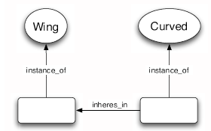
Entity-quality model of phenotype representation
Entity
Quality
Mungall OWLED 2007

Slide 12
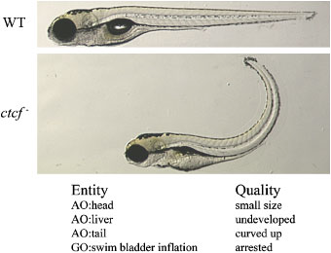
EQ examples

Slide 13
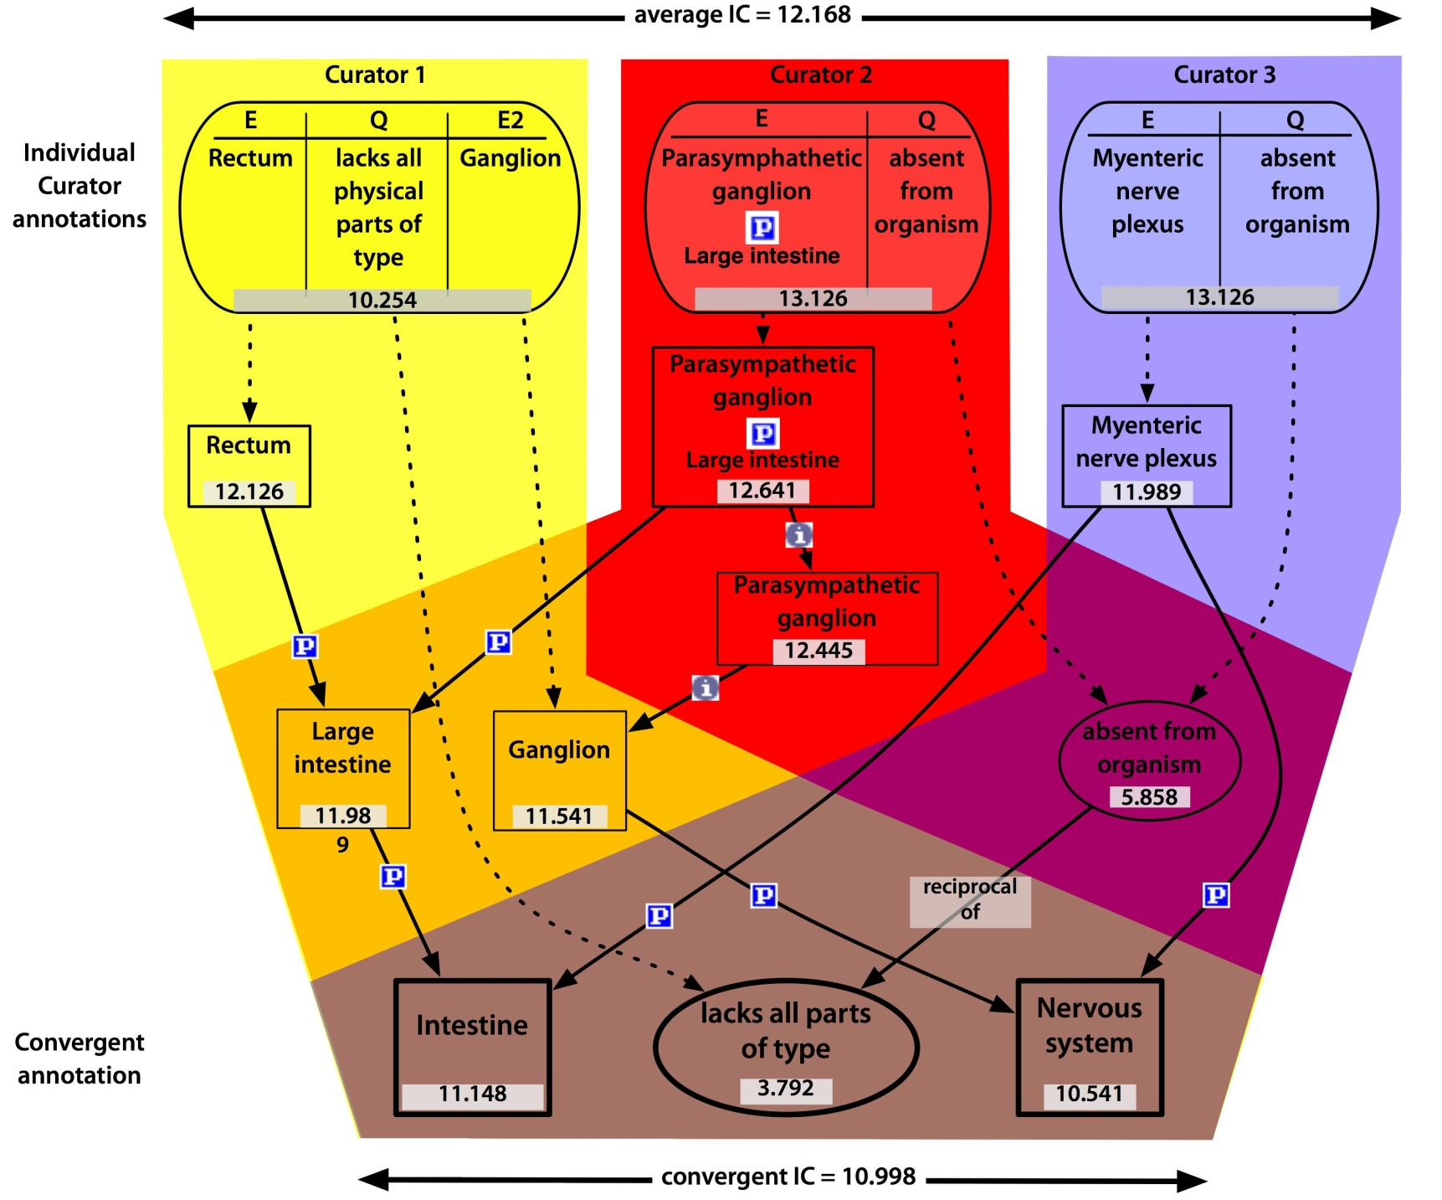
EQ subsumption

Slide 14
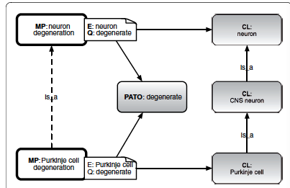
Relating precomposed phenotype ontology classes with EQ model
Mungall MP 2010

Slide 15
The phene approach
Phenes are attributive entities which are existentially dependent on a bearer, and phenescharacterize the properties of their bearer.
Therefore, we formally define phenes as the properties that are possessed by ‘entities which are Y’, and express Y as class-membership in description logic, or as a unary predicates in first-order logic. We call Y the defining property of a phene.
The defining property of a phene characterizes the phene’s bearer, and therefore we can distinguish different kinds of phenes based on the relations that are necessary to formulate this characteristic.
Hoehndorf 2010

Slide 16
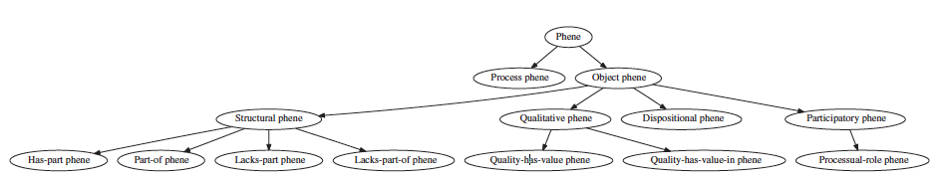
The phene approach
Fig. 1. The first distinction is drawn between phenes of objects and phenes of processes. We primarily classify phenes of objects into four main categories: structural, functional, qualitative and participatory phenes. Under the structural phenes, we show possible further classifications based on the relations we use in our method. Qualitative phenes can be further distinguished into those where only the quality is relevant and those where the quality’s value is considered
Hoehndorf 2010

Slide 17
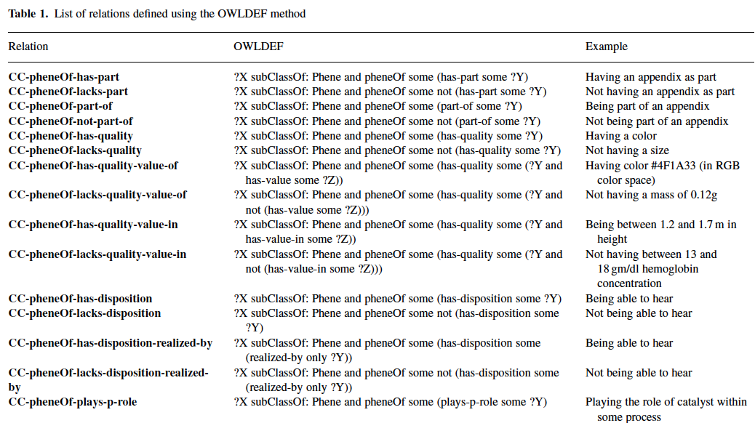
Phenotype relations
Hoehndorf 2010

