Slide 1
Material separation & analyte measuring assay: draw blood from a mouse and determine the concentration of glucose in it.
A material separation is done to obtain a blood specimen from the mouse. The blood will be used as the evaluant in the analyte measuring assay to determine the concentration of glucose in the blood. The glucose concentration in the blood specimen will then be used to describe the mouse from which the blood was taken.
Two devices are used in the material separation: a syringe and a glucometer dipstick. The syringe is used to access the blood from the mouse, contain it and transfer it to the glucometer dipstick. At the end of the process the dipstick contains the blood specimen.
The blood on the dipstick is specified as input to the glucose measuring assay. The blood bears the role evaluant in the analyte measuring assay, the material entity in which the assay measures the concentration of the analyte molecule. The analyte role inheres in the glucose molecules scattered throughout the blood specimen. The glucometer device is used to measure the concentration of glucose in the sample transferred to the dipstick, and to calculate the concentration of glucose in the evaluant. The specified output is the measurement datum giving the glucose concentration in the evaluant.

Slide 2

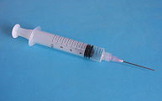

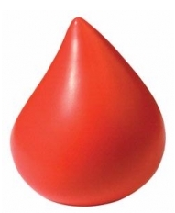
Process: Material Separation
Has specified input: mouse, syringe, dipstick
Has specified output: blood droplet on dipstick
Process: Taking sample from organism
Process: Adding a material entity into a target
bears
Specified output role
Specified input role
Specified input role
bears
bears
Realizes function: transfer function
Target of material
addition role
bears
Is_a specimen
Realizes function: contain function
Specimen role
Glucometer is not used in
Material Separation protocol

Slide 3
Process: Analyte Measuring Assay
Has specified input: blood evaluant, dipstick, glucometer
Has specified output: glucometer
Glucometer: is_a device
bears
Specified ouput role
Specified input role
bears
Evaluant role
Realizes function: measures
Analyte role inheres in scattered aggregate of glucose molecules in blood
Glucose
Measurement
Value: 100
Unit: mg/dL
Is_a
Measurement datum

