Slide 1
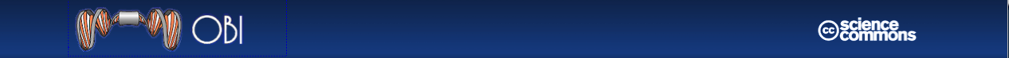
MIREOT
Minimum information to reference external ontology terms
Mélanie Courtot, Frank Gibson, Allyson L. Lister, James Malone, Daniel Schober, Ryan R. Brinkman and Alan Ruttenberg

Slide 2

Background – the OBI project
The Ontology for Biomedical Investigations (OBI) project is developing an ontology for the description of biological and clinical investigations
The domain of OBI includes
  materials made and produced for investigations
  research objectives
  experimental protocols
  roles of people in investigations
  processing and publication of data gathered in investigations

Slide 3
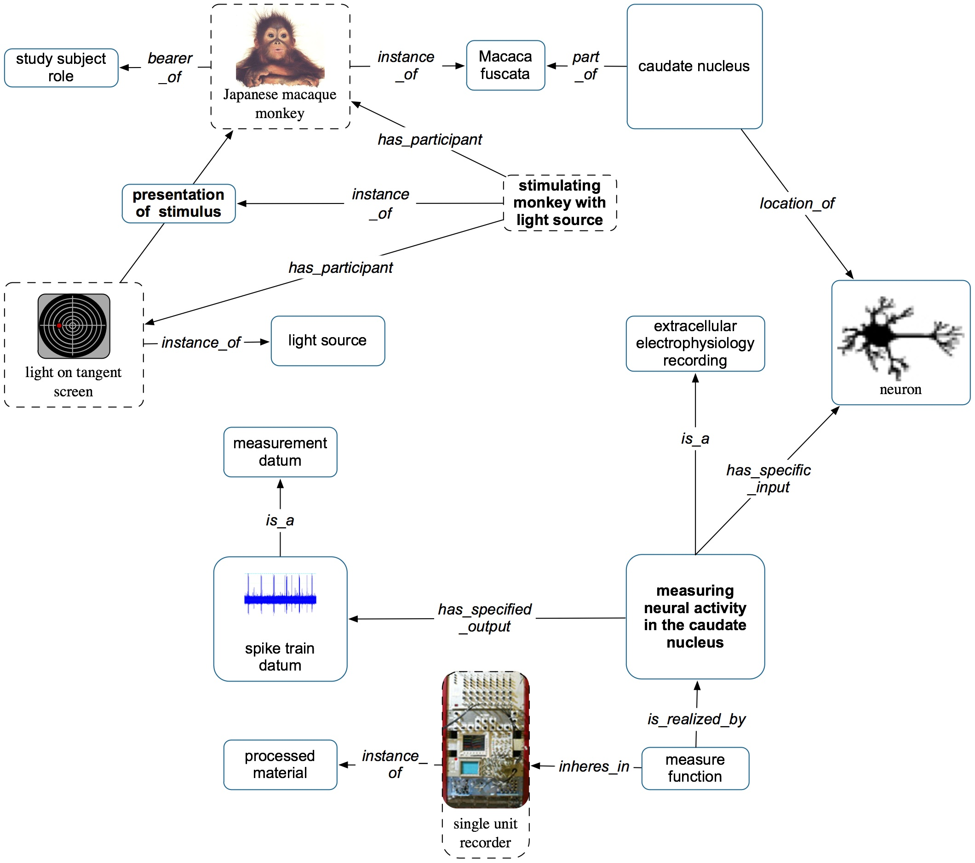
Notes:
Terms necessary for describing biomedical investigations as well as defining necessary cross-product terms are already available in a number of OBO ontologies.

Slide 4
processed material
device
organization
cell culture
chemical entities in solution
PCR product
molecular entity (ChEBI)
material entity
protein complex
(Gene Ontology)
Some material
entities in OBI
cell
(Cell Ontology)
anatomical entity (FMA, CARO)
organism
(NCBI taxonomy)
Notes:
For example, OBI's scope include materials made and produced for investigations, many of which are derived from natural entities described in the GO cellular component Ontology, Cell Ontology, and ChEBI, qualities of which can be described by terms in PATO
OBI is committed to using existing terms from other ontologies - OBI follows OBO Foundry principles

Slide 5
Ontologies that OBI uses
Chemical Entities of Biological Interest (ChEBI)
The Phenotypic Quality Ontology (PATO)
The Foundational Model of Anatomy ontology (FMA)
The Cell Type Ontology (CL)
The NCBI taxonomy (NCBITaxon)
The Information Artifact Ontology (IAO)
The Relation Ontology (RO)
The Environment Ontology (ENVO)
The Sequence Ontology (SO)
…
Notes:
ChEBI encompasses molecular entities, with focus on 'small" chemical coumpounds,
PATO is an ontology of phenotypic qualities, intended for use in a number of applications, primarily defining composite phenotypes and phenotype annotation.
the FMA is a domain ontology that represents a coherent body of explicit declarative knowledge about human anatomy.
The Cell Ontology is designed as a structured controlled vocabulary for cell types.
The NCBI Taxonomy database is a curated set of names and classifications for all of the organisms that are represented in GenBank

Slide 6
Challenges of imports
Large overhead - using large ontologies, such as NCBI Taxonomy or Foundational Model of Anatomy (FMA)
True Alignment - Ontologies constructed using a different design, or not using BFO as upper-level ontology prevents full integration
Fluid development - Resources under development
Notes:
First, some OWL tools (e.g., Protégé, SWOOP) can neither load or reason over very large ontologies, such as the NCBI Taxonomy² or the Foundational Model of Anatomy³, making direct OWL imports of such ontologies impractical. Second, different resources may have been constructed using different design principles, which may not align. Importing such ontologies as a whole could lead to inconsistencies or unintended inferences.

Slide 7
Possible Solutions
We can create our own terms and reference others
We can generate and import modules
We can import whole resources

Slide 8
1. Create our own terms
We can create our own terms and reference others
  Adding an annotation referencing the external ontology
  But duplicates efforts, creates redundancy, doesn’t comply with orthogonality principle from OBO Foundry and makes data integration more difficult
OBI: cell
CL: cell
OBI: cancer
NCI: cancer

Slide 9
2. Import modules
  A module is a subset of the external ontology, containing classes and axioms, allowing “original” reasoning
  But problem to get the modules
OBI
Cell
Ontology

Slide 10
3. Full import
We can import whole resources
  only if full axiomatic interoperability
  Large ontologies are huge overhead: current limitations in editing tools and reasoners
FMA
!
OBI

Slide 11
Observation
Terms in OBO Foundry ontologies stand on their own
If their meaning changes, they are deprecated
=> denotation of individual terms remain stable
=> they can be seen as individual units of meaning

Slide 12
Our Proposal: Import only classes that are needed
Pro: We get around the problems with the other methods
Con: Lose complete inference
But because the imported ontology might not be commensurate with OBI, we are not sure the inference would be correct

Slide 13
Implementation
Strategy: Figure out how to automate as much as possible
How to make it as easy as possible to enter, and maintain.

Slide 14
Notes:
Terms necessary for describing biomedical investigations as well as defining necessary cross-product terms are already available in a number of OBO ontologies.

Slide 15
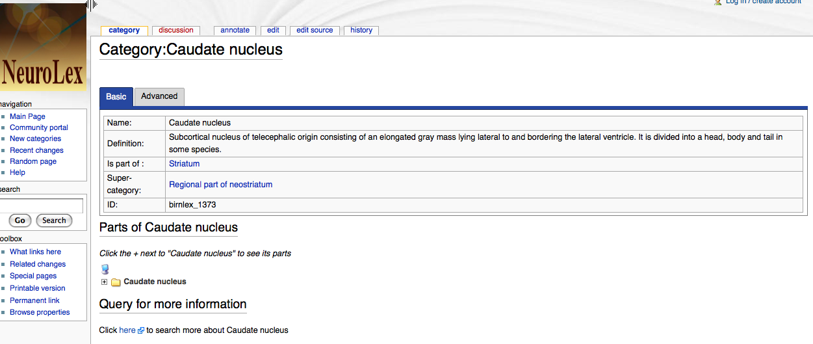
http://ontology.neuinfo.org/NIF/BiomaterialEntities/NIF-GrossAnatomy.owl#birnlex_1373

Slide 16
Define the minimal information we need
URI of the class
URI of the source ontology
Position in the target ontology
=> this minimal set allows to unambiguously identify a term

Slide 17
Additional information
We may want to capture:
  Label,
  Definition,
  Other annotations: adding “human-readable” information
  Superclasses: for example, NCBI taxonomy
  …

Slide 18
Step 1: “import” the term
Minimal information
URI of the term
URI of the source ontology
Superclass in target ontology
Perl script
external.owl

Slide 19

Step 2: add information
Use external.owl to generate SPARQL queries
external.owl
http://sparql.obo.neurocommons.org/
label
definition…
externalDerived.owl
Notes:
Script uses external.owl to create sparql queries based on templates for each resource.

Slide 20
Step 3: Plug it in
external.owl
IMPORTS
obi.owl
externalDerived.owl
Pre-release update
Notes:
Keeping files separated from the “main” ontology allows us to destroy externalDerived.owl, containing the additional information more prone to change, before each release, and we can easily regenerate it in order to distribute up to date information.
Also we hope that in the future we would be able to import whole ontologies, and the replacement would then be easy.

Slide 21
Summary
This process works very well for OBI, 1447 external classes currently imported
Other groups have expressed interest in using the same approach
OntoFox has been developed to make the process easier.

Slide 22
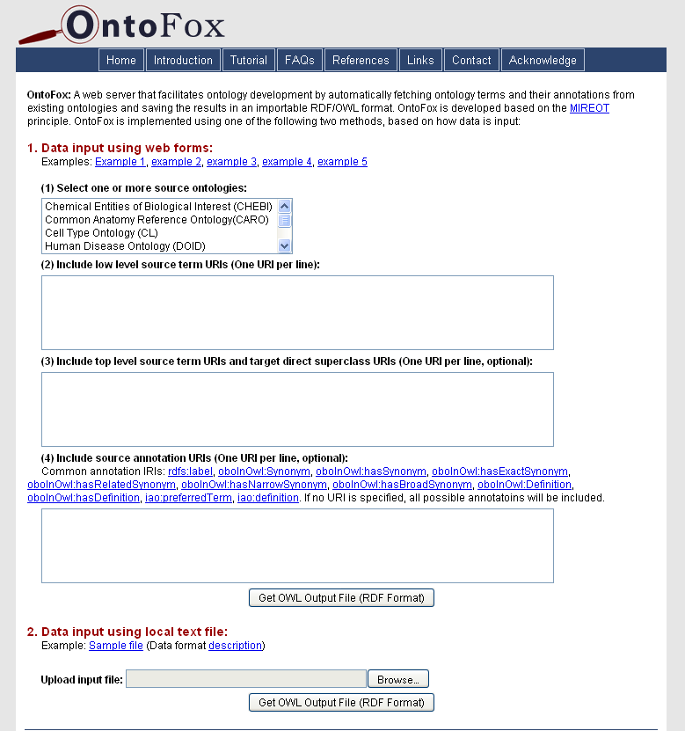
OntoFox: a Web Server for MIREOTing
Based on the MIREOT principle
Web-based data input and output
Output OWL file can be directly imported in your ontology
Easy to use
No programming needed for users
http://ontofox.hegroup.org

Slide 23
Some links
http://obi-ontology.org/page/MIREOT
Scripts are available under our SVN repository:
http://purl.obolibrary.org/obo/obi/repository/trunk/src/tools/
    add-to-external.pl
http://purl.obolibrary.org/obo/obi/repository/trunk/src/tools/build
    create-external-derived.lisp

Slide 24

Thank you
Frank Gibson
Allyson L. Lister
James Malone
Daniel Schober
Ryan R. Brinkman
Alan Ruttenberg
The OBI Consortium
PHAC/CIHR Influenza Research Network
NIH (R01EB005034), the EC EMERALD project (LSHG-CT-2006-037686),
the BBSRC (BB/C008200/1, BB/D524283/1, BB/E025080/1),
the EU FP7 DebugIT project (ICT-2007.5.2-217139),
and the Michael Smith Foundation for Health Research.

