Slide 1
Ontology of Biomedical Investigations
Workshop 4: Evidence Codes: Assay Tracking, ECO and OBI
Philippe Rocca-Serra (PhD), on behalf of OBI dev group
EMBL-EBI

Slide 2
Presentation Outline
OBI: introduction and state of the art
Assay description in OBI
Reviewing existing efforts
Possible options for evolving resources

Slide 3
Scope of OBI
Description of processes, materials and their properties in the realm of experimental work aimed at providing understanding of biological processes and biological functions of molecular entities.
Goal: Enable consistent and explicit description of experimental plans and findings, allowing for efficient information tracking and integration.

Slide 4
OBI development principles
Candidate resource to the OBO foundry
  BFO used at Top Level Ontology
  Reliance on Relation Ontology to form class restrictions
  Compliance with single asserted inheritance rule
  Interoperability with other OBO foundry resources (FMA, CHEBI, CL,IAO)
  Compliance with metadata requirements
  Independent users

Slide 5
OBI main axis
Material entity
  Molecular entity
  Processed material
  Anatomical entity
Processual entity
  Material transformation: material/material
  Assay: material/(material+)data
  Data transformation: data/data
Property
  Role
  Disposition
  Function

Slide 6
Presentation Outline
OBI: introduction and state of the art
Assay description in OBI
Reviewing existing efforts
Possible options for evolving resources

Slide 7
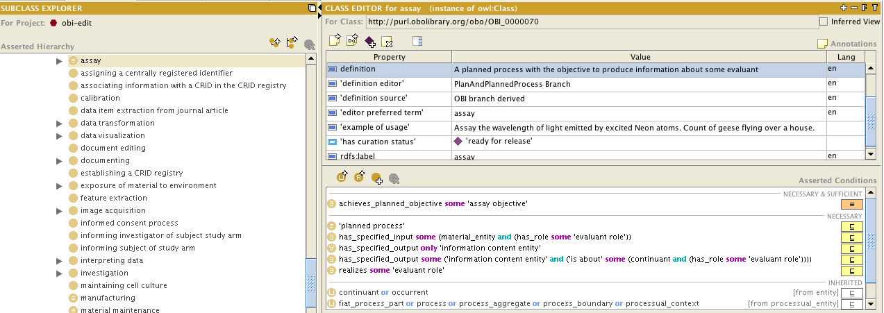
Assays in OBI
Definition: a planned process with the objective of producing information about an evaluant

Slide 8
Why using OBI assays?
Assays are defined in terms of input and outputs
  Use for validations of reports
  Use for information extraction from literatures using a combination of OBI/IAO
Unification of descriptors under phenotyping efforts
Facilitate cross species & cross domain work

Slide 9
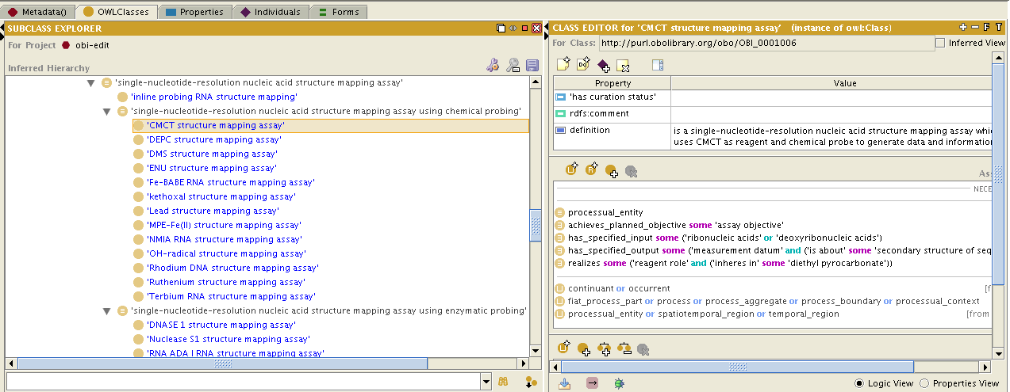
Submission to OBI
Case Study: Single nucleotide resolution assay
Reliance of Quick Term Template for fast handling

Slide 10
Presentation Outline
OBI: introduction and state of the art
Assay description in OBI
Reviewing existing efforts
Possible options for evolving resources

Slide 11
OBI and other efforts
Several resources available from OLS or NCBO Bioportal contain assay descriptions:
  PSI-MI
  ECO
  NPO
Identification of overlap between resources

Slide 12
Overlap with ECO
What is ECO ?
  a controlled vocabulary of codes covering both manual and automated annotation methods used to “rate” the reliability of genome annotation (understood as the practice of capturing data about a gene product, and GO annotations use terms from the GO ontology to do so)

Slide 13
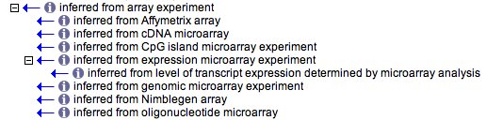
Inconsistent is_a axis
platform
objective
reagent
Credits: Richard Scheuerman
Notes:
The inferred_from_array_experiment hierarchy appears to mix terms related to platforms (Affymetrix), objectives (expression microarray), and capture reagent (oligonucleotide). Thus a microarray experiment in which gene expression levels were measured with an Affy GeneChip could be annotated with three of these terms.

Slide 14
Gains from interaction
OBI would allow automatic classification
By manufacturer
By nature of reagent
By molecular process
  Addressing some of the current limitation
  ECO: Affymetrix array, what does it mean
  Is it to insist of quality of measurement
  Its comparability
  Is it understood to be synonymous of gene expression? (wrong assertion if the case)

Slide 15
OBI coverage gaps
Absence of terminologies describing sequence alignments and similarity searches.
Causes: requirement to interact with SO which is not entirely BFO compliant
Restriction caused by OBO foundry constraints and reasoning procedure.
IAO needs to be expanded to cover some of the information artifacts being used

Slide 16
OBI coverage gaps
Absence of terms for
  Sequence alignment
  Motif
  Match
But presence of processes such as:
  Similarity calculation
  Overall data transformation lacks coverage of in the field of sequence analysis and phylogenetic methodologies which are often relied upon for deducing gene functions.
  OBI would need to address those to cover ECO needs

Slide 17
Presentation Outline
OBI: introduction and state of the art
Assay description in OBI
Reviewing existing efforts
Possible options for evolving resources

Slide 18
Avoiding duplication of efforts
Take action to resolve overlaps/duplication
  Sociological aspects
    Resource ownership
    Precedence
    Due credit
  Operational aspects
    Annotation pipelines in place
    Any change need to ensure smooth transition, with no loss of service

Slide 19
Complementarity of resources
All resources listed show overlap among each other
All resources show uniqueness and capture specific knowledge not available anywhere else
Unification of efforts would benefit annotation community
Option are creation of cross products or merger of resources.

Slide 20
Acknowledgements
OBI
OBO foundry
ECO, RNAO

Slide 21
Questions

