Slide 1

Modelling biomedical experimental processes with OBI
Bio-ontologies SIG/ ISMB'2009
June 28, 2009
The OBI consortium
presenter: Dr Larisa Soldatova, Aberystwyth University, Wales, UK

Slide 2
The OBI consortium (in alphabetical order):
Ryan Brinkman¹, Bill Bug², Helen Causton³, Kevin Clancy, Christian Cocos, Mélanie Courtot¹, Dirk Derom⁴, Eric Deutsch⁵, Liju Fan⁶, Dawn Field⁷, Jennifer Fostel⁸, Gilberto Fragoso³, Frank Gibson⁹, Tanya Gray, Jason Greenbaum¹⁰, Pierre Grenon, Jeff Grethe⁷, Yongqun He¹¹, Mervi Heiskanen, Tina Hernandez-Boussard⁷, Philip Lord, Allyson Lister¹², James Malone, Elisabetta Manduchi, Luisa Montecchi, Norman Morrison³, Chris Mungall¹³, Helen Parkinson³, Bjoern Peters¹⁰, Matthew Pocock, Philippe Rocca-Serra³, Daniel Rubin, Alan Ruttenberg¹⁴, Susanna-Assunta Sansone³, Richard Scheuermann¹⁵, Daniel Schober¹⁶, Barry Smith¹⁷, Larisa N. Soldatova¹⁸, Holger Stenzhorn, Chris Stoeckert¹⁹, Chris Taylor³, Randi Vita¹⁰, John Westbrook, Joe White, Patricia L. Whetzel⁷, Stefan Wiemann, Jie Zheng¹⁹
¹BC Cancer Agency, Vancouver, Canada; ²National Center for Microscopy Imaging Research, UCSD, CA, USA; ³The European Bioinformatics Institute, Cambridge, UK; ⁴Victoria University of Wellington, New Zealand; ⁵ISB, Seattle, WA, USA; ⁶Ontology Workshop, LLC, Columbia, MD, USA; ⁷Stanford University Medical School, Stanford, CA, USA; ⁸SRA Global Health Sector, Durham, NC, USA; ⁹Abcam plc, Cambridge, UK; ¹⁰La Jolla Institute for Allergy and Immunology, La Jolla, CA, USA; ¹¹University of Michigan, Ann Arbor, USA; ¹²Newcastle University, Newcastle upon Tyne, UK; ¹³Lawrence Berkely National Lab, Berkely, CA, USA;¹⁴Science Commons, Cambridge, MA, USA; ¹⁵Southwestern Medical Center, USA; ¹⁶IMBI, University Medical Center, Freiburg, Germany; ¹⁷University at Buffalo, Buffalo, NY, USA; ¹⁸Aberystwyth University, Wales, UK; ¹⁹University of Pennsylvania School of Medicine, Philadelphia, PA, USA

Slide 3
Introduction into the OBI (the Ontology for Biomedical Investigations) project
A candidate ontology for the OBO Foundry;
Complementary to existing bio-ontologies;
Re- using existing ontologies and integrating them;
Using BFO, RO, IAO for the interoperability.

Slide 4
The top-level classes:
material entity:
  organism (from NSBI taxonomy);
  anatomical entity (from FMA or CARO);
  molecular entitiy (ChEBI);
process:
  investigation;
  study design execution;
  assay;
  documenting;

Slide 5
The top-level classes (2):
role:
  investigation agent role;
  study participant role;
function:
  device function;
information content entity:
  hypothesis;
  protocol;
  study design;
  software.

Slide 6
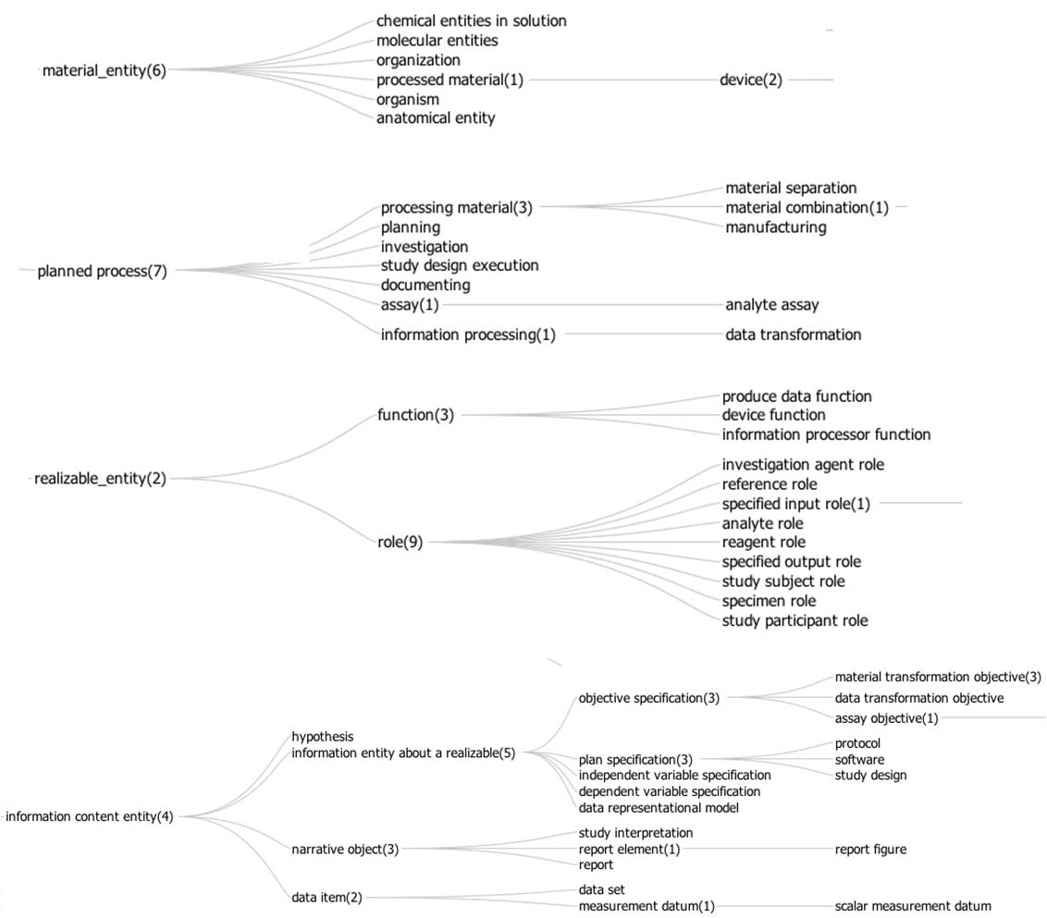


Slide 7
The relations
BFO (proposed) relations:
  is a, part of;
  specifically inheres in, generically inheres in, bearer of;
  realises;
  has_quality, has_function;
  towards;
RO relations:
  results from;
  adjacent to;
  has participant, has agent;
  located in;

Slide 8
The relations (2)
IAO relations:
  is about;
  is proxy for;
  represents;
OBI relations:
  is manufactured by;
  has supplier;
  achieves planned objective;
  has specified participant (has specified input/output).

Slide 9

Use case I: analyte measuring assay - draw blood from a mouse and determine the concentration of glucose in it
A material separation - to obtain a blood specimen from the mouse. Two devices are used in the material separation: a syringe and a glucometer dipstick. The syringe is used to access the blood from the mouse, contain it and transfer it to the glucometer dipstick. At the end of the process the dipstick contains the blood specimen.
A glucose measuring assay. The blood on the dipstick is specified as input . The blood bears the role evaluant in the analyte measuring assay, the material entity in which the assay measures the concentration of the analyte molecule. The analyte role inheres in the glucose molecules scattered throughout the blood specimen. The glucometer device is used to measure the concentration of glucose in the sample transferred to the dipstick, and to calculate the concentration of glucose in the evaluant. The specified output is the measurement datum giving the glucose concentration in the evaluant.

Slide 10
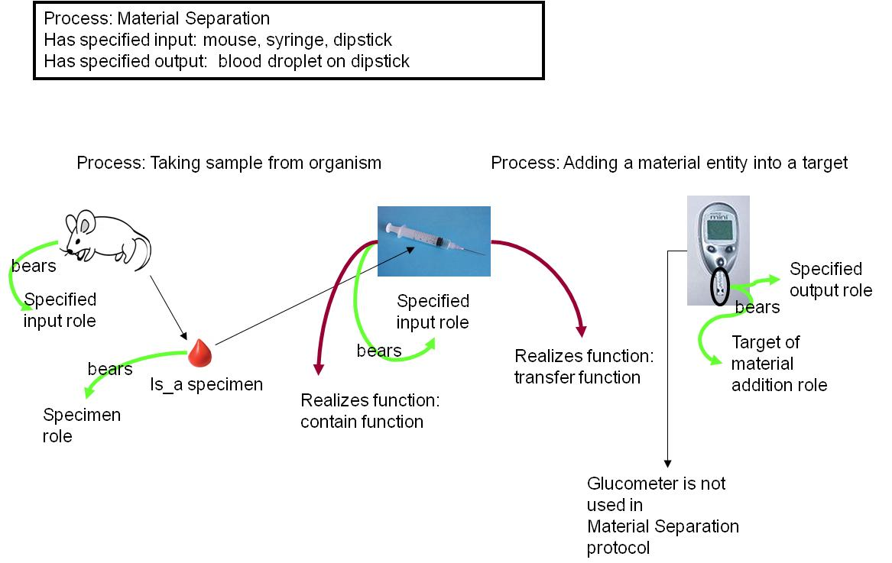

Slide 11
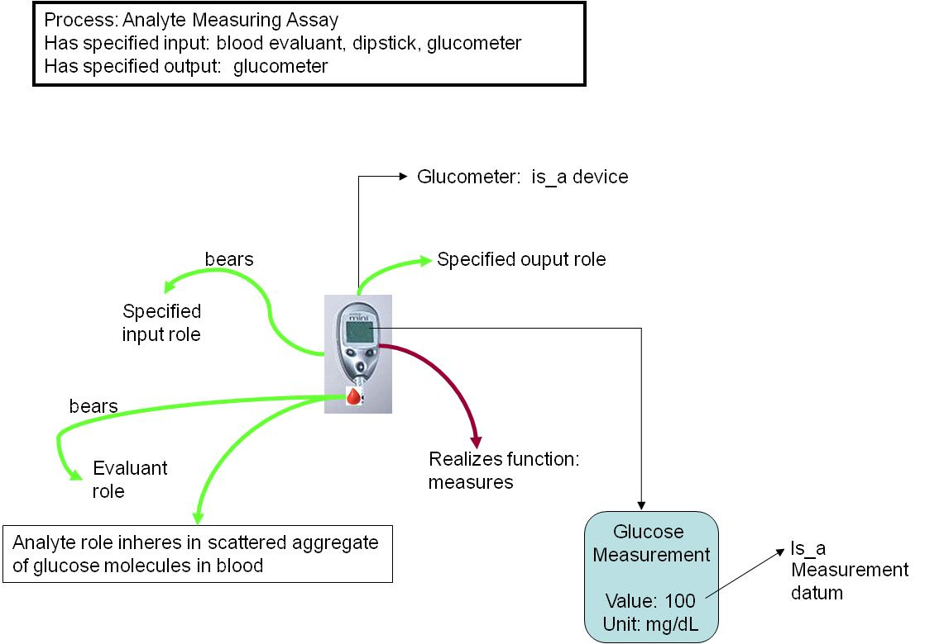
glucose measurement

Slide 12

Use case II: vaccine protection study - how efficiently a vaccine induces protection against virulent pathogen infection in vivo
Vaccination - administering substance in vivo that realizes some ‘material to be added role’ borne by some ‘vaccine’ (e.g., VacX) and bears some ‘target of material role’ borne by some ‘organism’ that bears some ‘host role’ (e.g., mouse).
Pathogen challenge - is another ‘administering substance in vivo’ that realizes some ‘material to be added role’ borne by some ‘organism’ and bears some ‘pathogen role’ (e.g., Influenza Virus) and realizes some ‘target of material role’ borne by some ‘organism’ that bears some ‘host’ (e.g., mouse).
Survival assessment is a common protection efficiency assay that has specified input some organism (e.g., mouse) and has specified output some survival measurement, in this case, 75% of mice survived from pathogen challenge.

Slide 13
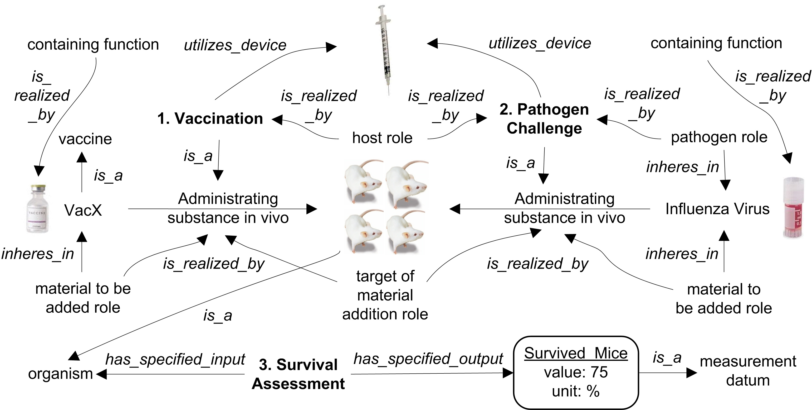

Slide 14
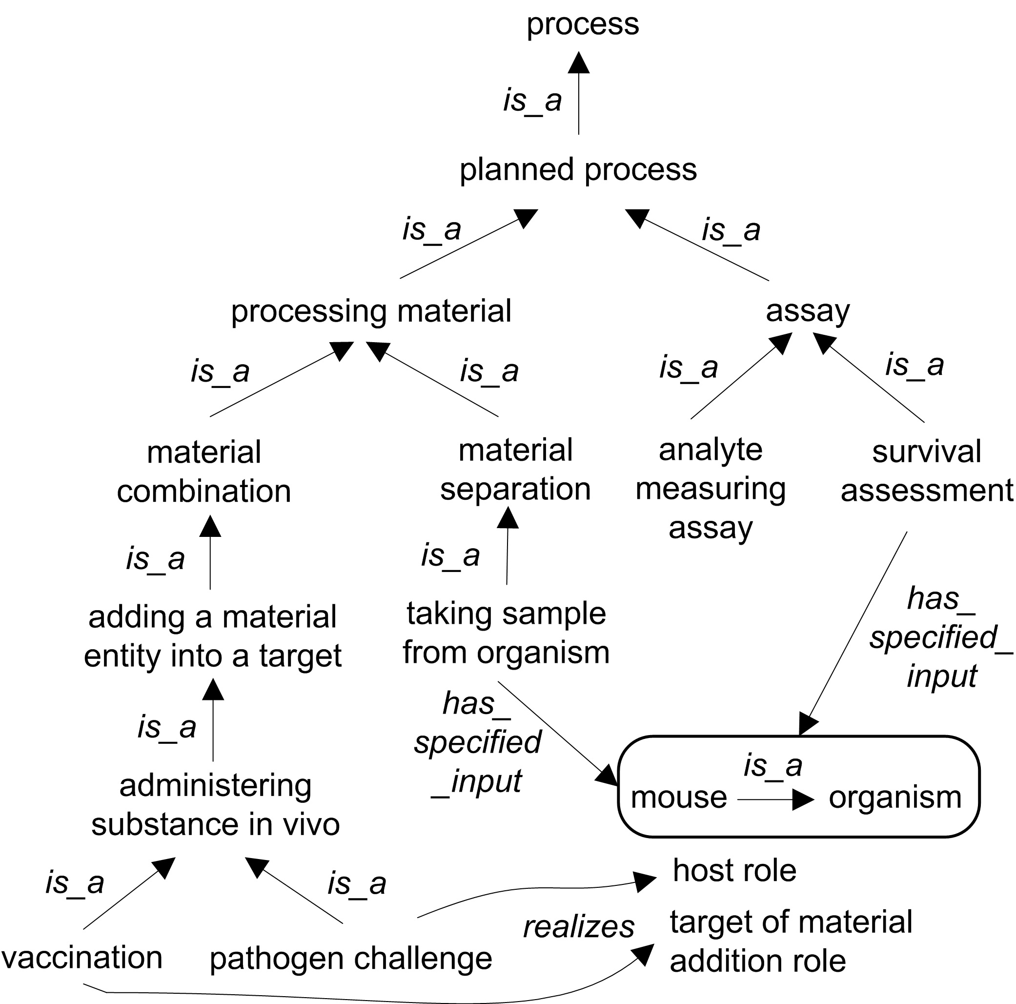

Slide 15
Acknowledgments
This work is partially supported by grant funding from the National Institute of Biomedical Imaging and Bioengineering, National Human Genome Institute, NIH (R01EB005034, NIH P41 HG003619), EC EMERALD project (LSHG-CT-2006-037686), EC FELICS, MUGEN, BBSRC (BB/E025080/1, BB/C008200/1), NERC-NEBC, EU IP CarcinoGenomics (PL 037712), EU NoE NuGO (NoE 503630), CARMEN project EPSRC (EP/E002331/1), the Michael Smith Foundation for Health Research, RCUK.

