Slide 1
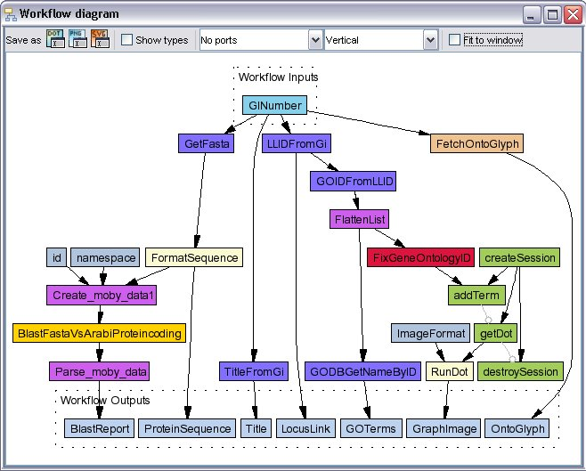
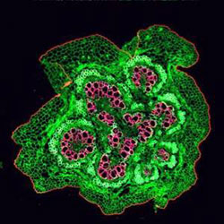

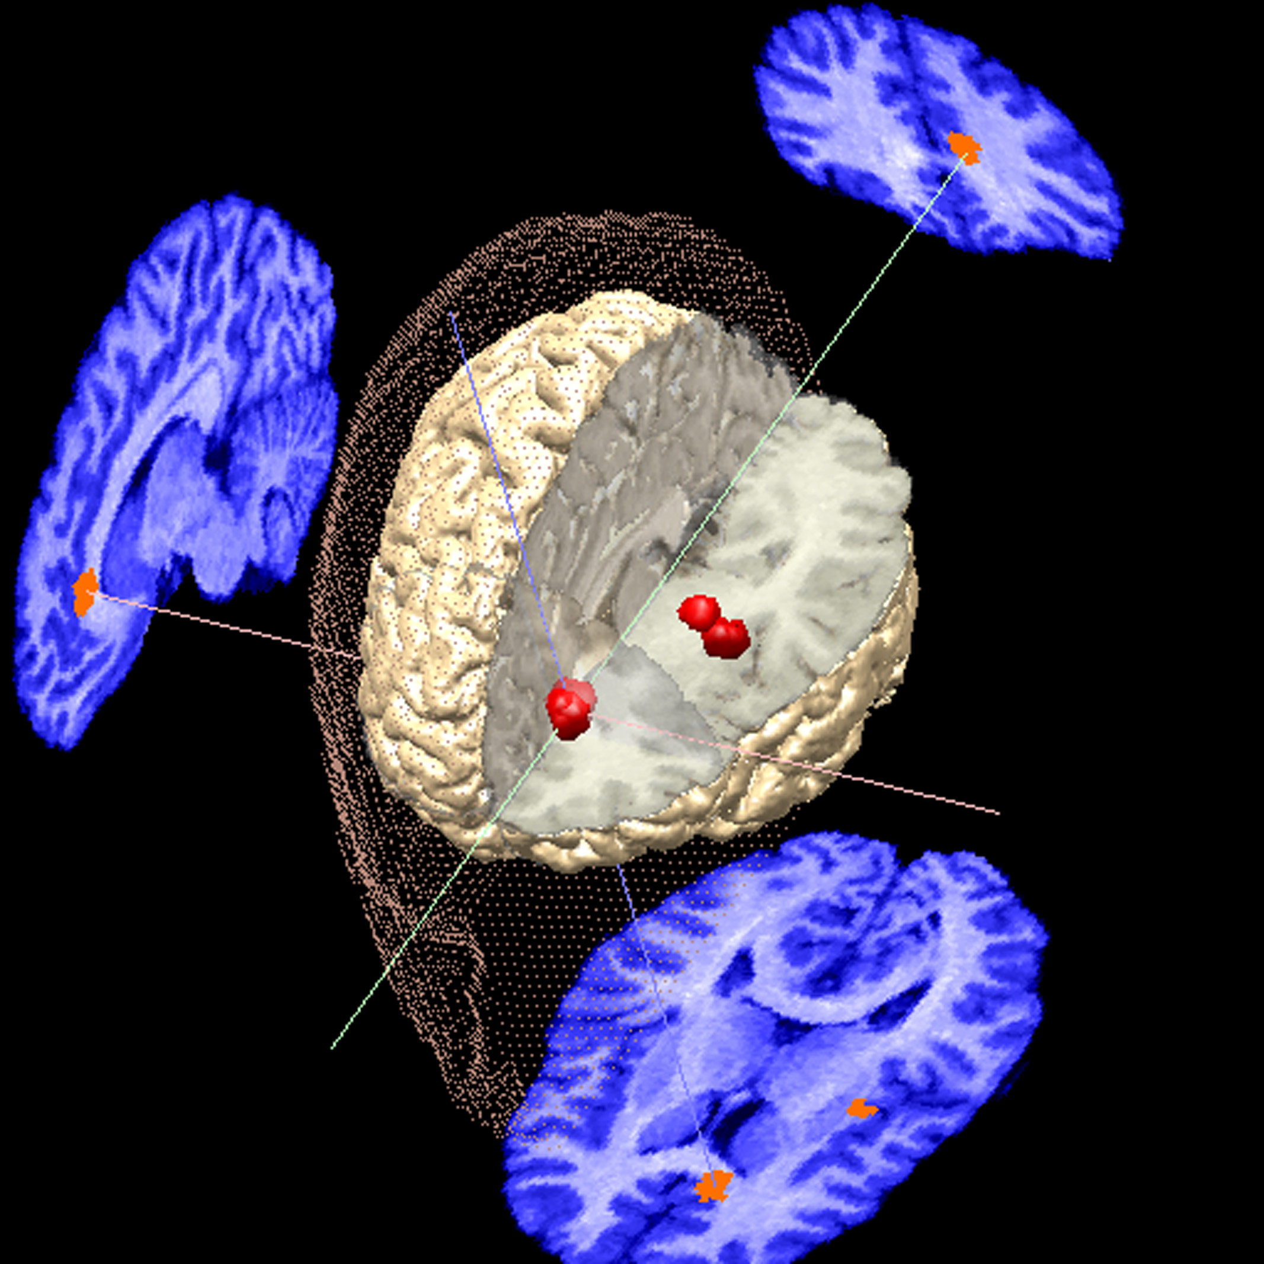

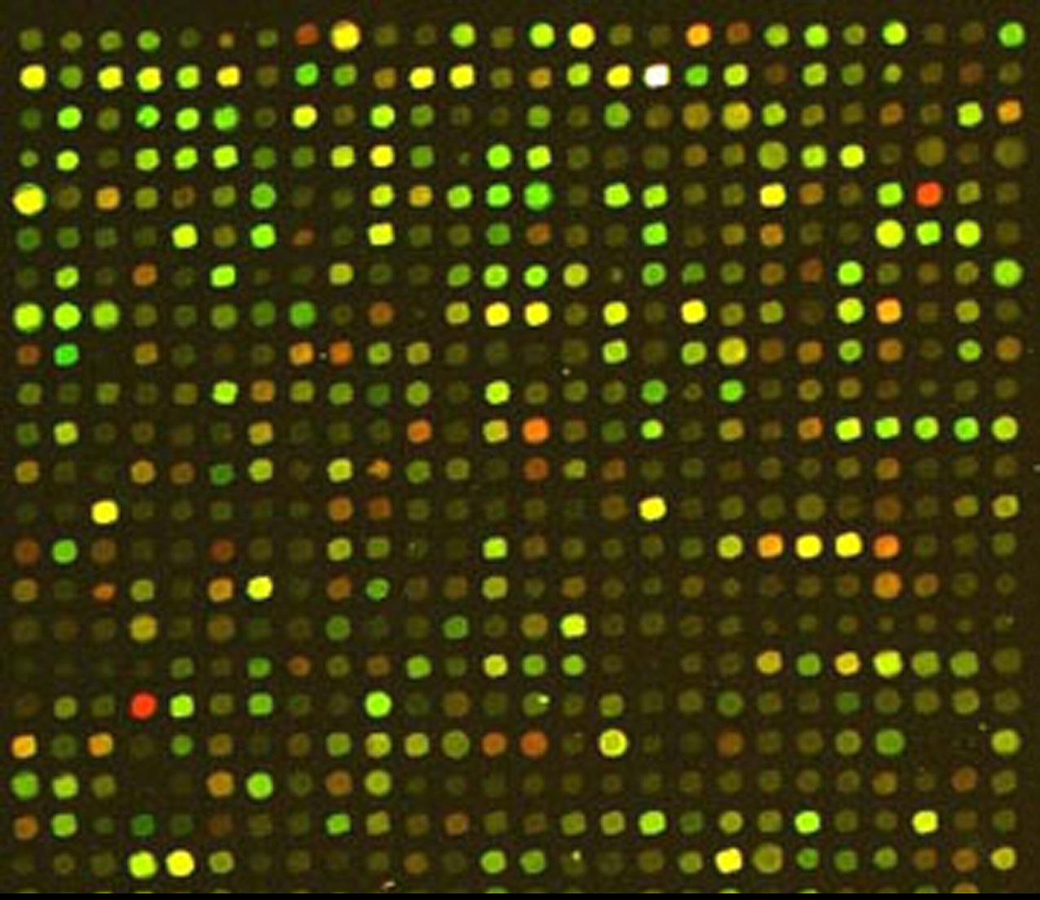
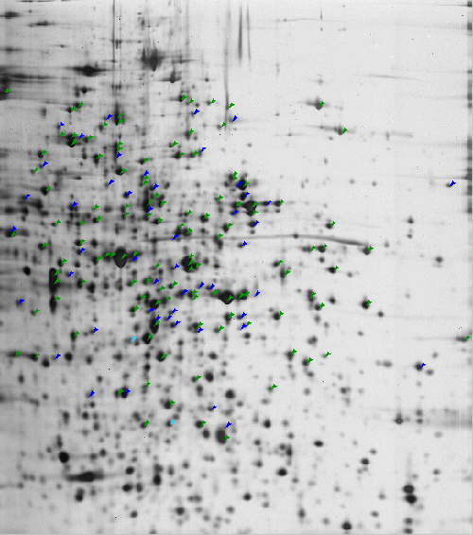

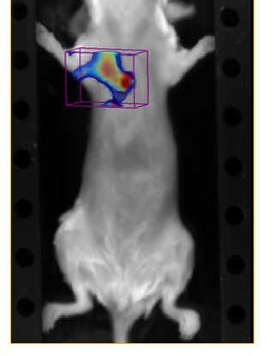
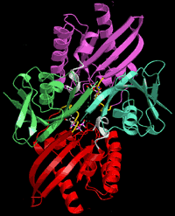
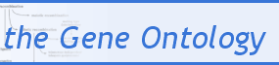

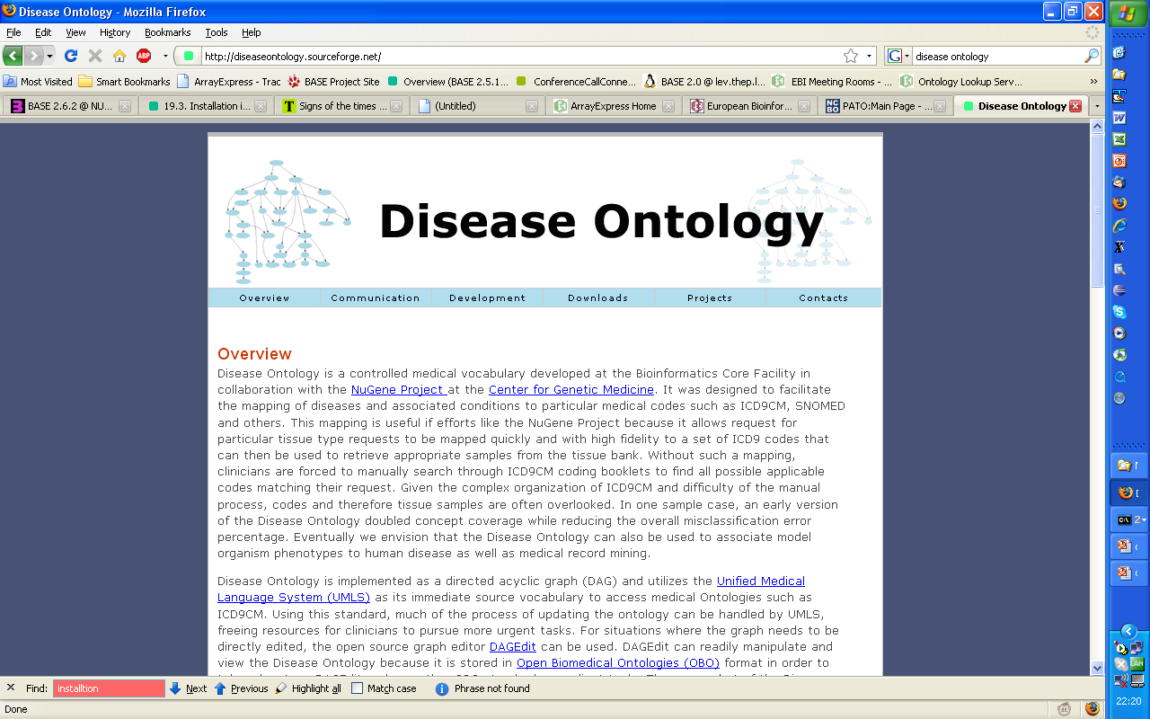

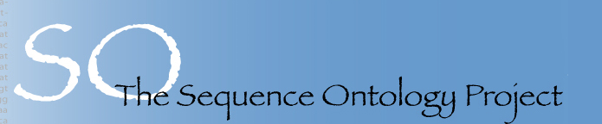
OBI: The Ontology for Biomedical Investigations
OBI, The Ontology for Biomedical Investigations (http://purl.obofoundry.org/obo/obi), is being developed by a large collaborative group of domain experts and developers encompassing a wide array of biomedical science disciplines and technologies. The work aims to provide a set of 'universal' terms, applicable across biological and technological domains, as well as domain-specific terms to support the consistent annotation of biomedical investigations. The ontology models experimental design, protocols, instrumentation, biological material, data and types of analysis performed on it. Developed under the OBO Foundry initiative, OBI endorses the foundry principles. Those guidelines have positively impacted the work. First, by encouraging an open and inclusive approach, OBI proactively seeks partners and may act as an accretion point, avoiding work duplication. Second, by insisting on documentation, OBI makes explicit its working practices for a decentralized yet consistent development. OBI selected and has used BFO as its top level ontology. As a result, OBI is being developed following 3 main axes: process (subclass of bfo:occurrent) covering protocol application with 240 classes, material (subclass of bfo: independent continuant) encompassing instrument and material entities holding 223 classes, and finally bfo:dependent continuant, (with subclasses such as quality, role and disposition) which holds 266 classes used to possibly qualify elements of the first two dimensions. OBI is being developed in Protégé-OWL and a series of working groups tackle specific sub-domains. Procedures have been devised to ensure consistent work across branches. Thus, OBI developers have agreed on a naming convention for representational artifacts, a minimal set of metadata to supply when submitting terms or creating classes and methods both for merging branch outputs and for cross referencing other OBO foundry ontologies (e.g. CHEBI, CL, SO, GO). OBI is currently being evaluated against competency questions collected from its members.
a diversity of communities
from Nutrition to Metabolomics, from Environmental to genomics to Immunology, Imaging and Data analysis
occurant/process
OBI branches:
development work
Protocol application branch
Data Transformation branch
Instrument branch
Biomaterial branch
Role branch
Function branch
Digital entity branch
continuant/material
Import Mechanism towards OBI requires harmonization of:
        -Minimal Metadata
        -Naming Conventions
Molecular entities
dependent continuant
/ quality
Interoperability with sister ontologies developed under the:
OBO Foundry framework
Qualities
PATO
GO
CHEBI
CL
ENVO
SO
*OBI Consortium (in alphabetical order): Ryan Brinkman, Bill Bug, Helen Causton, Kevin Clancy, Christian Cocos, Mélanie Courtot, Eric Deutsch, Liju Fan, Dawn Field, Jennifer Fostel, Gilberto Fragoso, Frank Gibson, Tanya Gray, Jason Greenbaum, Pierre Grenon, Jeff Grethe, Mervi Heiskanen, Tina Hernandez-Boussard, Allyson Lister, James Malone, Elisabetta Manduchi, Luisa Montecchi, Norman Morrison, Chris Mungall, Helen Parkinson, Bjoern Peters, Matthew Pocock, Philippe Rocca-Serra, Daniel Rubin, Alan Ruttenberg, Susanna-Assunta Sansone, Richard Scheuermann, Daniel Schober, Barry Smith, Holger Stenzhorn, Chris Stoeckert, Chris Taylor, John Westbrook, Joe White, Trish Whetzel, Stefan Wiemann
Funding: This work is partially supported by grant funding from the National Institute of Biomedical Imaging and Bioengineering, National Institutes of Health (R01EB005034, NIH P41 HG003619) and EC EMERALD project (LSHG-CT-2006-037686).

