Slide 1
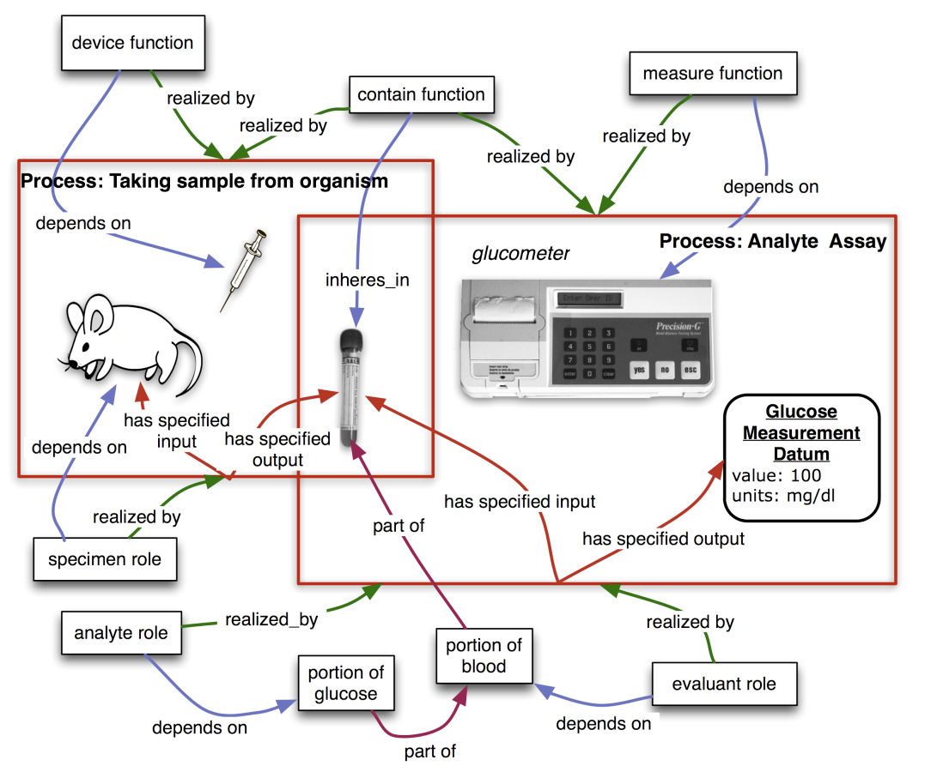

inheres in
inheres in
has
specified input
has
specified input
inheres in
inheres in
inheres in
inheres in
inheres in

