Slide 1

Data Transformation Core Terms
OBI DT Branch

Slide 2
Data Transformation
Ontology: OBI
Definition: A data transformation is a protocol application which produces output data from input data - e.g. the application of a clustering protocol to microarray data or the application of a statistical testing method on a primary data set to determine a p-value.
Status: Complete and stable
James Malone <malone@ebi.ac.uk>
OBI Workshop Vancouver 2009

Slide 3
Data Transformation Objective
Ontology: OBI
Definition: A data transformation objective is an objective specification that a data transformation may have towards which the realization of that transformation is directed.
Status: Complete though dependency on ‘objective specification’ from IAO
James Malone <malone@ebi.ac.uk>
OBI Workshop Vancouver 2009

Slide 4
achieves_planned_objective
(formerly has_objective)
Ontology: OBI – may change given that objective specification is in IAO
Definition: This relation links a process that realizes a plan which is a concretization of a plan specification with an objective specification that is part of the plan specification. The criteria specified in the objective specification are met at the end of the process.
Status: Now complete and used to relate data transformation with data transformation objective
James Malone <malone@ebi.ac.uk>
OBI Workshop Vancouver 2009

Slide 5
has_specified_input_data
Ontology: OBI
Definition: A relation between a process and a participant in that process, that consumes a data set . The process is the realization of a concretization of a realizable information entity (objective specification or plan specification). In general, not all data present at the beginning of the process are specified_data.
Links occurrent to an ICE
Status: We are about to start using this to link DTs to the input data where possible (see ‘roles on data’)
James Malone <malone@ebi.ac.uk>
OBI Workshop Vancouver 2009

Slide 6
has_specified_output_data
Ontology: OBI
Definition: A relation between a participant in a process, that produces a data set . The process is the realization of a concretization of a realizable information entity (objective specification or plan specification). In general, not all data present at the end of the process are specified_data.
Links occurrent to an ICE
Status: As with input data, we are about to start using this to link DTs to the output data where possible (see ‘roles on data’)
James Malone <malone@ebi.ac.uk>
OBI Workshop Vancouver 2009

Slide 7
Data Item
Ontology: IAO
Definition: Not complete
Status: Is this what we link to from DTs when talking about input and output data?
James Malone <malone@ebi.ac.uk>
OBI Workshop Vancouver 2009

Slide 8
Data Set
Ontology: IAO
Definition: A data set is an information content entity that is an aggregate of other information_content_entities that have something in common and are considered to form a unit.
James Malone <malone@ebi.ac.uk>
OBI Workshop Vancouver 2009

Slide 9
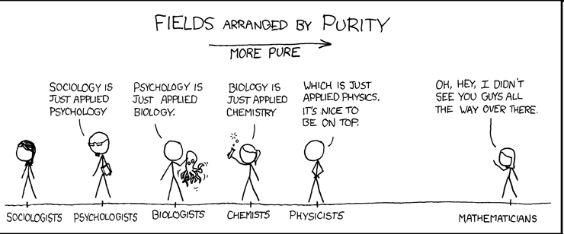


Interlude
Image: xkcd.com
Axis of evil
ONTOLOGISTS
“All science is essentially the same; the real skill is loading it all into Protégé”
PHILOSOPHERS
“’Axis of evil’, is that a disposition or a quality?”
James Malone <malone@ebi.ac.uk>
OBI Workshop Vancouver 2009

Slide 10
Report Figure
Ontology: IAO
Definition: A report figure is a report display element that has some aspect of illustration, but may be a composite of figures, images, and other elements
Status: definition seems to be ok though need a relation to link the rendering of data to a report figure
James Malone <malone@ebi.ac.uk>
OBI Workshop Vancouver 2009

Slide 11
Software
Ontology: IAO
Definition: Series of encoded instructions that can be directly executed by a CPU, or transformed in to a form that can be. For programming texts that are syntactically correct and which are in a language that can be executed by an interpreter this would correspond to the tokenized version of the text stripped of comments.
Status: For our GenePattern use case we require some software modules and probably require some guidance
We will likely add software as instances into a separate file – need to think of intermediate nodes.
James Malone <malone@ebi.ac.uk>
OBI Workshop Vancouver 2009

Slide 12
Variables and Roles for Data
Ontology: OBI?
Definition:
Status: Need to tackle issue of independent variable, dependent variable and the like (has been raised by JM, MC and Gully on IAO list). Ongoing issue.
We will likely add software as instances into a separate file – need to think of intermediate nodes.
James Malone <malone@ebi.ac.uk>
OBI Workshop Vancouver 2009

