Slide 1

GenePattern Use Case
Do not reuse GenePattern slides without permission

Slide 2
Background
DT workshop in November 2008
Some of our potential users attended and presented some of their use cases
GenePattern is a free software package developed at the Broad Institute for analysis of genomic data.
Contains separate analysis modules such as for data preprocessing, gene expression analysis
These modules can be put together to form workflows
GenePattern would like to use OBI soon
James Malone <malone@ebi.ac.uk>
OBI Workshop Vancouver 2009

Slide 3

Case Study: GenePattern Software
Image Courtesy of Ted Liefeld
GeneCluster
Perl
Excel
dChip
Cluster/Treeview
Bioconductor
MATLAB
James Malone <malone@ebi.ac.uk>
OBI Workshop Vancouver 2009

Slide 4
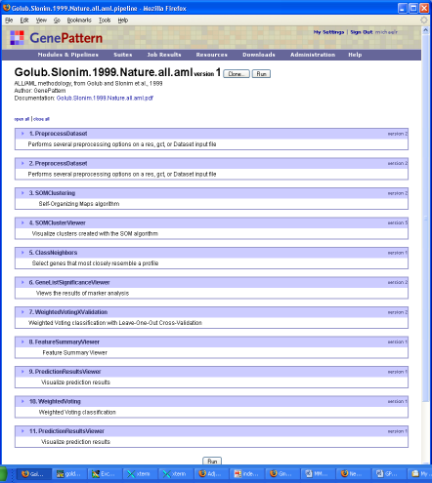

CaseStudy: GenePattern Workflows
Pipeline Environment
all_aml_train
all_aml_test
Image Courtesy of Ted Liefeld
Preprocess
Preprocess
SOM Clustering
Class
Neighbors
Weighted
Voting
Cross-Val
Weighted
Voting
Train/Test
SOM Cluster Viewer
Marker Selection
Viewer
Prediction
Results
Viewer
Prediction
Results
Viewer
James Malone <malone@ebi.ac.uk>
OBI Workshop Vancouver 2009
Notes:
The pipeline is a rather natural temporal organization of the tasks usually performed, starting from the
Experimental design: which involves the determination of the number of samples, what experimental conditions to be included, the number of replicates per condition, whether to collect time series, etc.
Data acquisition: involves the actual profiling of the selected samples by means of the microarray platform of choice (Affy in our case)
Data preprocessing: aimed at producing data cleaned as much as possible of unwanted sources of noise
The actual analysis, aimed at generating hypotheses that will need to be tested/validated

Slide 5
GenePattern Use Case for protocol
Slide courtesy of Ted Liefeld
Define generic protocols referencing OBI identifiers instead of specific Life Science Identifiers (LSIDs)
e.g.
Preprocess data
  User selects from preprocessing options
Cluster
  User selects from clustering options
Display results
  Tool selects appropriate display based on step 2
Such protocols could be potentially tool-independent, with different tools (or different GenePattern servers) using the ontology to select which clustering algorithms to present.
James Malone <malone@ebi.ac.uk>
OBI Workshop Vancouver 2009

Slide 6
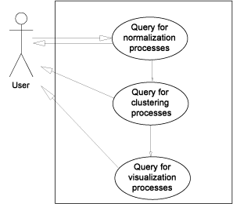
GenePattern Use Case
James Malone <malone@ebi.ac.uk>
OBI Workshop Vancouver 2009

Slide 7
GenePattern Use Case
Data transformation classes are defined by the following elements;
  the input data;
  the process that is undertaken, i.e. the actual data transformation;
  the output data produced from this process;
  and by the objective to which the data transformation is used to achieve.
  Note, within OBI, data transformations can have more than one objective, reflecting the fact that a single process can be used to achieve different goals.
Step 1: Query for normalization processes:
query for data transformations with objective normalization
b transformation
biexponential transformation
box-cox transformation
cosine transformation
eh transformation
exponential transformation
hyperlog transformation
linlog transformation
loess transformation
mean centering
median centering
pareto scaling
quantile transformation
replicate analysis
s transformation
sine transformation
SIMCA
total intensity transformation paired
total intensity transformation single
unit-variance scaling
variance stabilizing transformation
James Malone <malone@ebi.ac.uk>
OBI Workshop Vancouver 2009

Slide 8
GenePattern Use Case
Step 2: Query for clustering processes:
With extra clause about previous step (normalization)
query for data transformations with objective “class discovery” and has input “normalized data”
discriminant function analysis
hierarchical clustering
k-means clustering
linear discriminant functional analysis
principal component regression
James Malone <malone@ebi.ac.uk>
OBI Workshop Vancouver 2009

Slide 9
GenePattern Use Case
Step 3: Query for visualization processes:
query for visualization processes with input “clustered data”
dendogram
heatmap
scatterplot
histogram
James Malone <malone@ebi.ac.uk>
OBI Workshop Vancouver 2009

Slide 10
GenePattern Pipeline with Ontology
Quickly build up a pipeline for your data using generic analysis terms.
Ontology deals with the interoperability issues between modules
Once specific processes can be reverse engineered as it is explicitly captured information
James Malone <malone@ebi.ac.uk>
OBI Workshop Vancouver 2009

Slide 11
GenePattern Use Case for Software and Inputs/Outputs
Use inputs/outputs specifications to aid users as they wish to create a new pipeline and suggesting software.
i.e. select first step
  optional subsequent steps shown to user
  relate to protocol to limit next step choices
  relate to software that has relevant modules
Slide courtesy of Ted Liefeld
James Malone <malone@ebi.ac.uk>
OBI Workshop Vancouver 2009

Slide 12
GenePattern Use Case for reverse engineering
From details of an analysis (recorded in MAGE-TAB output files), reverse engineer a pipeline that represents all of the (recorded) steps
  include parameter values
  map analyses from other systems
  software, inputs and outputs covered
Modified from
Ted Liefeld’s slide
James Malone <malone@ebi.ac.uk>
OBI Workshop Vancouver 2009

Slide 13
Conclusion: What we Can and Can’t Do
Can:
  Data input and output
  Data transformations
  Objectives for usage
  Software (maybe)
Can’t
  ‘workflow’ (synonym for process or specialisation?)
  Linking DTs, or rather data output from a DT to a visualization
  Variables (not important for the 3 use cases discussed here, but appear in others)
James Malone <malone@ebi.ac.uk>
OBI Workshop Vancouver 2009

Slide 14
Acknowledgements
EMERALD Consortium (www.microarray-quality.org)
OBI Consortium (http://obi.sourceforge.net/)
  Especially Tina Boussard, Ryan Brinkman, Melanie Courtot, Elisabetta Manduchi, Monnie McGee, Helen Parkinson, Philippe Rocca-Serra, Richard Scheuermann, Robert Stevens and Ricardo Pietrobon
Ted Leifeld, Broad Institute of MIT and Harvard
James Malone <malone@ebi.ac.uk>
OBI Workshop Vancouver 2009

