Slide 1

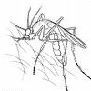
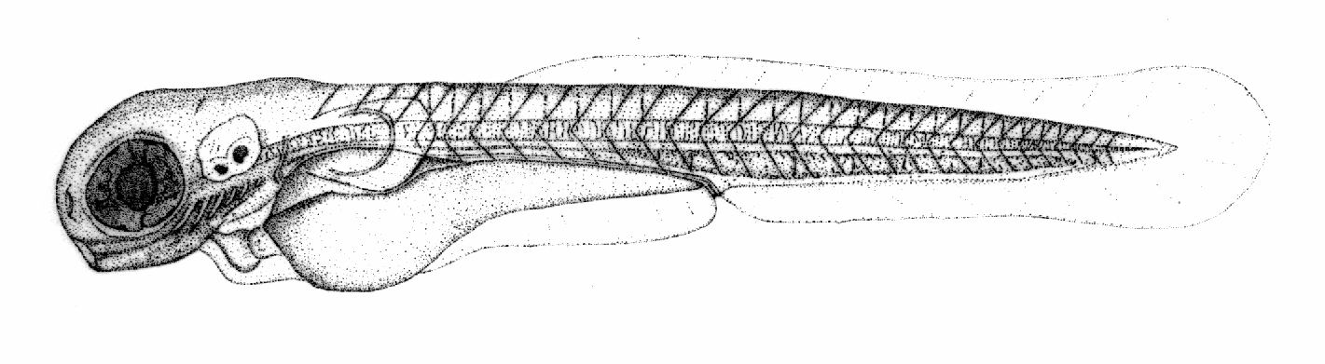

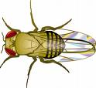

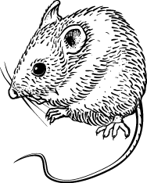
An Introduction to Anatomy Ontologies Phenotype RCN Feb 23, 2012
Melissa Haendel
Notes:
Slides prepared by melissa, marcus, jie, philippe, bjoern and james

Slide 2
Anatomical evidence: what is it, and why do we care about it?

Slide 3

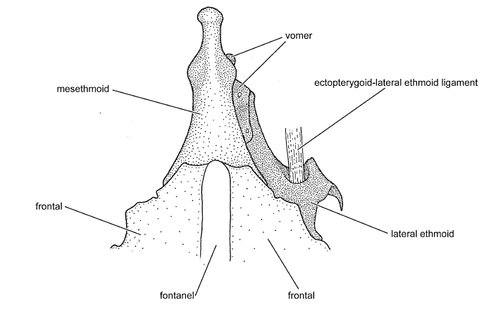
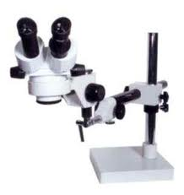

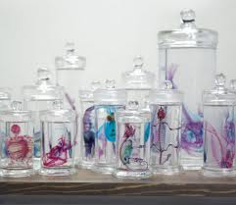
What is evidence?
ECO:000000X
Imaging assay evidence
Synaptolaemus cingulatus
AMNH 91095
Phenotype (character) annotation:
S. Cingulatus: mesethmoid
narrow
OBI:Specimen
Drawing about anatomical entity
OBI:Conclusion
(textual entity)
OBI:Image
material_processing
is_output
is_output
is_input
Draw prepared specimen
OBI:imaging assay
Brian, 2008, maybe in Venezuela
cleared and stained for
cartilage and bone
OBI: Interpreting Data-
phenotypic assessment
is_input
OBI:processed specimen
Sidlauskas and Vari, Zoological Journal of the Linnean Society, 2008, 154, 70–210

Slide 4
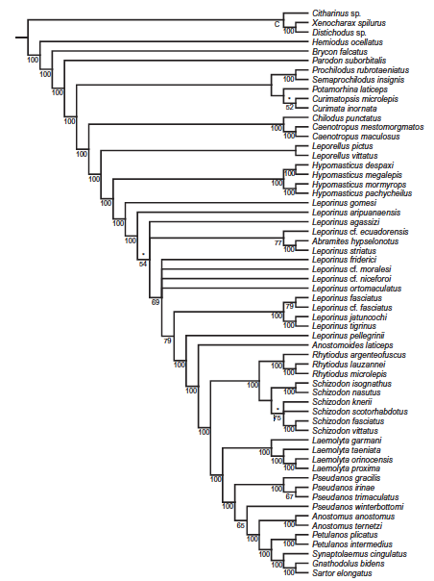
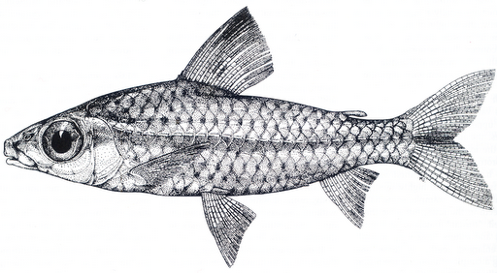
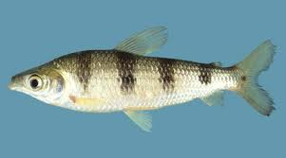
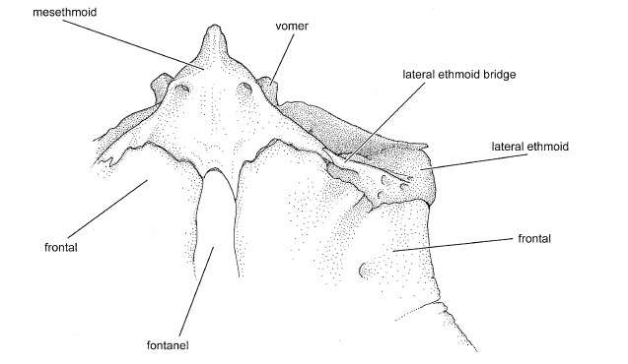
Anatomical evidence is cumulative and synergistic
Synaptolaemus cingulatus
AMNH 91095
mesethmoid
narrow
ECO:0000080
phylogenetic evidence
ECO:0000071
morphological similarity evidence
Caenotropus maculosus
USNM 231545
mesethmoid
narrow
.
is_input
is_output
Schizodon fasciatus
INPA 21606
mesethmoid
wide
.
phylogeny
.
Brian, 2008
.
OBI:Conclusion
Phylogeny construction using PAUP* 4.0 Beta 10
OBI: Interpreting Data

Slide 5
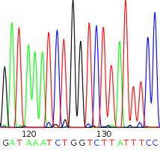
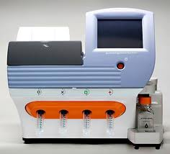
The means to the end matters
Synaptolaemus cingulatus
AMNH 91095
Mesethmoid
ECO:0000080
phylogenetic evidence
ECO:0000071
sequence similarity evidence
Caenotropus maculosus
USNM 231545
mesethmoid
narrow
.
is_input
is_output
Schizodon fasciatus
INPA 21606
mesethmoid
wide
.
phylogeny
.
Brian, 2008
.
OBI:Conclusion
Phylogeny construction using PAUP* 4.0 Beta 10
OBI: Interpreting Data

Slide 6
So what should one do about evidence?
Keep in mind that as you record your phenotype data, the means by which you obtained it can matter later one
Others may want to use your data, and they too will care
You may find that how you know what you know depends on the means to the end
You can work with ECO and OBI to get the terms you need for your work

