Slide 1


Ontology representation and ANOVA analysis of vaccine protection investigation
Yongqun “Oliver” He
Unit for Laboratory Animal Medicine
Department of Microbiology and Immunology
Center for Computational Medicine and Bioinformatics
University of Michigan Medical School
Ann Arbor, MI 48109
Notes:
http://obi-ontology.org/page/Workshop_OBI_Vancouver_2010_Mar#Use_Case_.2B_Issues_Proposals

Slide 2
Outline
√
Introduction of OBI, VO, and vaccine protection use case
Ontological representation of ANOVA
Ontological representation of Brucella vaccine protection investigation
Ontology-based ANOVA analysis of Brucella vaccine protection investigation
Conclusion and Discussion

Slide 3
OBI: Ontology for Biomedical Investigations
19 communities trying to solve the same or related problems
5 year effort
2 phone calls per week, 2 meetings per year
First stable release (Philly / 1.0) in Oct. 2009
Release manuscript in revision

Slide 4
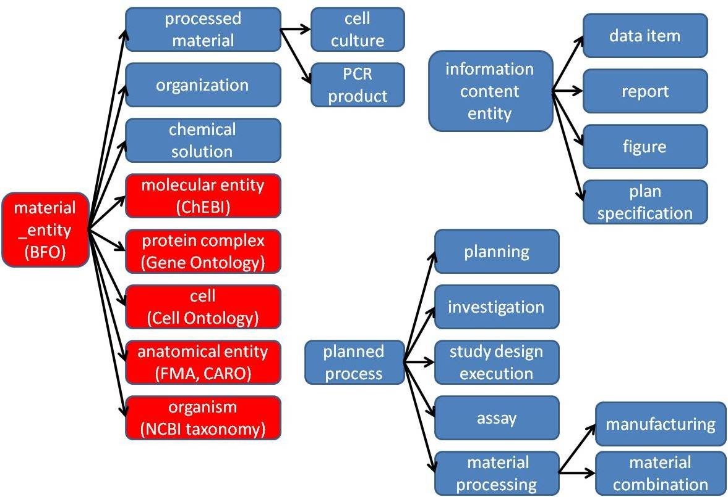
OBI High Level Class Hierarchy

Slide 5

The Vaccine Ontology (VO)
Aim: An ontology of the vaccine domain.
Utilize the Basic Formal Ontology (BFO) as the top-level ontology
Use OBI as another upper level ontology for vaccine investigation
Follow OBO Foundry principles
Multi-community and institutional collaboration
http://www.violinet.org/vaccineontology

Slide 6
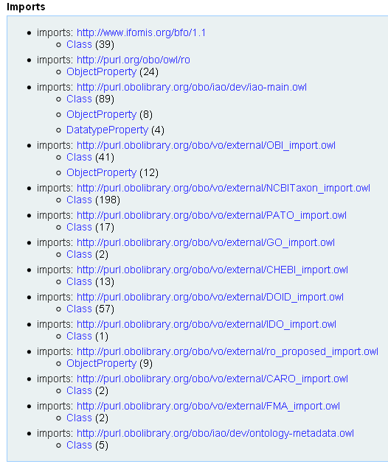

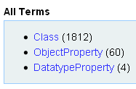
VO Statistics
VO Browser: SPARQL supported VO visualization
http://www.violinet.org/vaccineontology/vobrowser

Slide 7
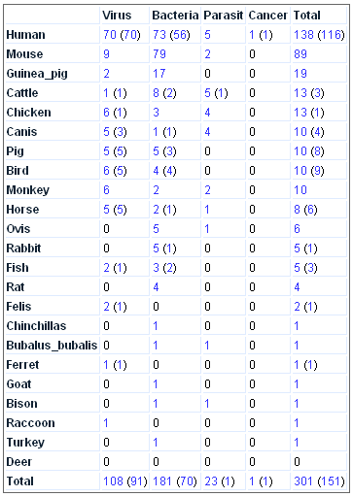
Vaccines Curated in VO
-- In total 301 vaccines
(leaf nodes in VO)
-- 151 licensed vaccines
-- 23 host species
-- Pathogens:
viruses, bacteria, parasites
-- Cancers: More coming
-- Others: allergy, autoimmune disease, …

Slide 8
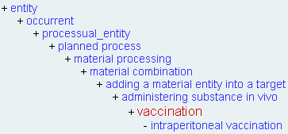
VO Imports >500 OBI and 13 Other Ontology Terms
Import is better than reinvent existing terms. E.g.,
Model ANOVA in OBI, then import to VO.
How to import individual terms to VO? → OntoFox
OntoFox: inspired by MIREOT & ontology modularization
Reference: Xiang Z, Courtot M, Brinkman RR, Ruttenberg A, He Y. OntoFox: web-based support for ontology reuse. BMC Research Notes. 2010, 3:175. [PMID: 20569493]
http://ontofox.hegroup.org/

Slide 9
Influenza Vaccine Protection Investigation
Three processes as described in the OBI JBMS paper:
vaccination: a kind of administering substance in vivo process that realizes some material to be added role, borne by a vaccine (e.g., VacX) as well as a target of material role borne by an organism that also bears a host role (e.g., mouse).
pathogen challenge: a kind of administering substance in vivo process. It realizes a number of roles - a pathogen role and material to be added role borne by the challenge organism (e.g., Influenza Virus), and a target of material role and host role borne by another organism (e.g., mouse).
survival assessment: an assay that measures the survival rate (occurrence of death events) in one or more organisms that are monitored over time.
Reference: Brinkman RR, Courtot M, Derom D, Fostel JM, He Y, Lord P, Malone J, Parkinson H, Peters B, Rocca-Serra P, Ruttenberg A, Sansone S, Soldatova LN, Stoeckert Jr. CJ, Turner J, Zheng J, the OBI consortium. Modeling biomedical experimental processes with OBI. Journal of Biomedical Semantics. 2010, 1(Suppl 1):S7.

Slide 10
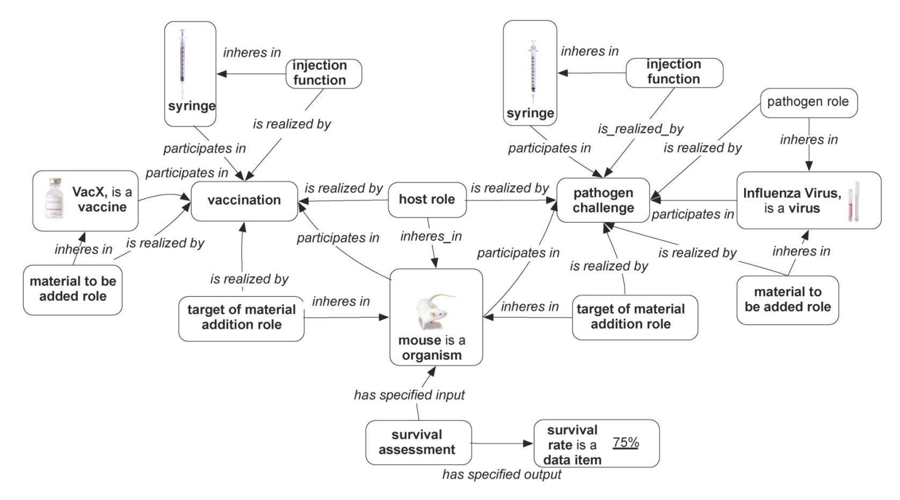
Vaccine protection investigation representation in JBMS OBI paper
Reference: Brinkman RR, Courtot M, Derom D, Fostel JM, He Y, Lord P, Malone J, Parkinson H, Peters B, Rocca-Serra P, Ruttenberg A, Sansone S, Soldatova LN, Stoeckert Jr. CJ, Turner J, Zheng J, the OBI consortium. Modeling biomedical experimental processes with OBI. Journal of Biomedical Semantics. 2010, 1(Suppl 1):S7.

Slide 11
Questions:
-- How to represent statistical analyses using ontology?
-- How to use ontology to represent instance data of biological investigations, e.g., vaccine protection investigation?
-- How to analyze instance data using ontology-based statistical analyses?

Slide 12
Outline
Introduction of OBI, VO, and vaccine protection use case
Ontological representation of ANOVA
Ontological representation of Brucella vaccine protection investigation
Ontology-based ANOVA analysis of Brucella vaccine protection investigation
Conclusion and Discussion
√

Slide 13
Ontological Representation of Statistical Analyses
OntoDM:
  Ontological representation of data mining tasks and complex data types.
  Align with OBI
OBI statistical analysis:
  Provide general top structure
  Continuous efforts towards more details and deeper hierarchy

Slide 14
ANOVA: Analysis of Variance
Aim: Test if the means of several groups are all equal.
Includes statistical models, e.g., linear models.
ANOVA runs F-test
Data for ANOVA analysis:
  Measurable data (e.g., time interval, vaccination dose)
  Output of discretization of non-measurable data (e.g., mouse strains, gene mutants)
ANOVA output: p-value
Data sources:
  Do experiments by ourselves
  Extract data from journal articles

Slide 15
Ontology Representation of ANOVA
ANOVA is_a subclass of data transformation
F-test is part_of ANOVA
ANOVA has_specified_input of data item
The data item can be an output of a discretization process that descretizes non-measurable data
To get data: data item extraction from journal article (IAO_0000443)
ANOVA is concretization of ANOVA protocol
ANOVA protocol includes a predictive model that specifies a testable hypothesis model

Slide 16
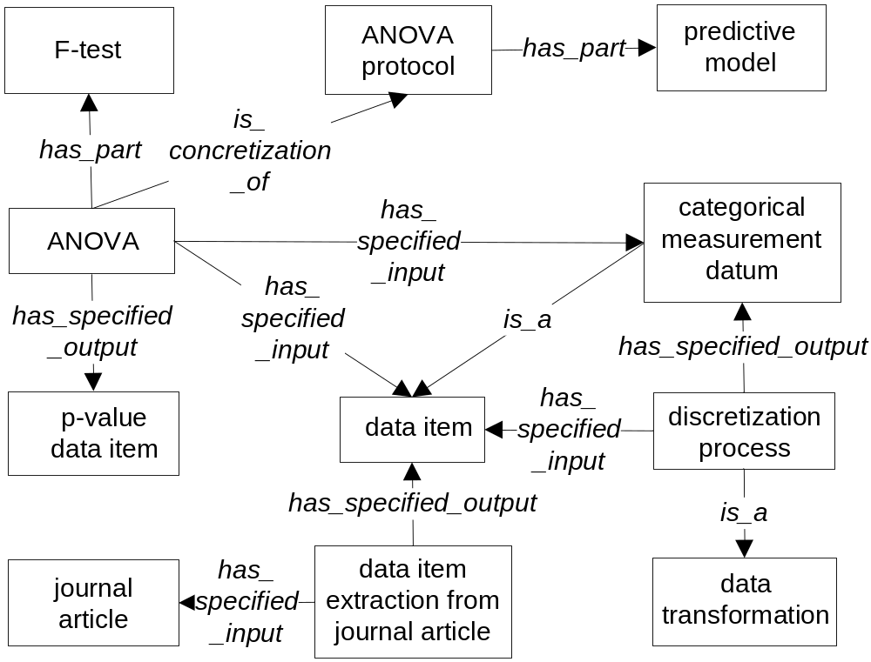
Ontology Design Pattern of ANOVA

Slide 17
Outline
Introduction of OBI, VO, and vaccine protection use case
Ontological representation of ANOVA
Ontological representation of Brucella vaccine protection investigation
Ontology-based ANOVA analysis of Brucella vaccine protection investigation
Conclusion and Discussion
√

Slide 18
Use case study: Brucella vaccine protection investigation
Brucella spp. is intracellular, Gram negative bacteria that cause brucellosis, the most common zoonotic disease in the world, with 0.5 million new human cases yearly. It’s a even bigger problem for animals.
No Brucella human vaccine available.
Brucella cattle vaccines: RB51, strain 19, …
Search PubMed “Brucella vaccine”
→ more than 300 publications.
The efficacy of a Brucella vaccine candidate can be measured using a mouse model

Slide 19
Use case study: Brucella vaccine protection investigation
Brucella does not kill mouse, so a mouse survival assay do not work.
Brucella vaccine efficacy is measured by the reduction of colony forming units (CFU) of live Brucella in spleens of vaccinated mice compared to non-vaccinated mice.
Question: What parameters (e.g., vaccination dose, mouse age) contribute to Brucella vaccine efficacy, and what not?

Slide 20
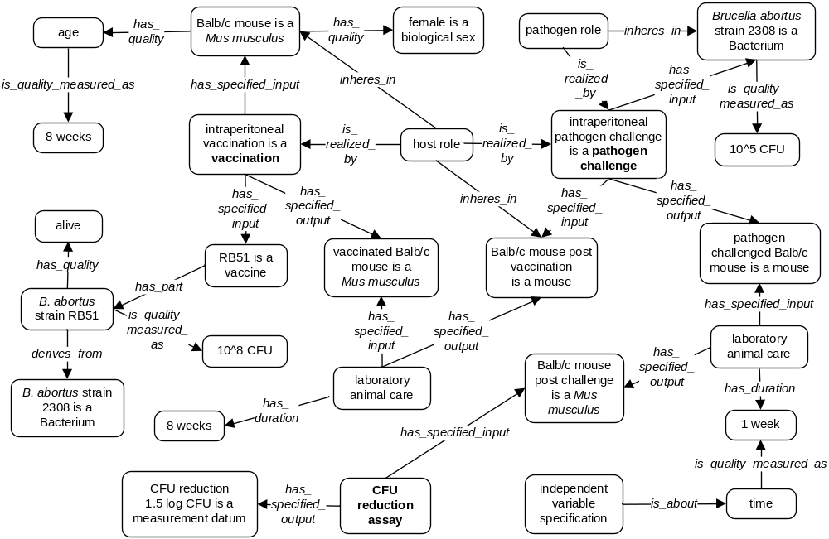
Example: Brucella Vaccine RB51
Q: What parameters are critical to RB51 vaccine efficacy?

Slide 21
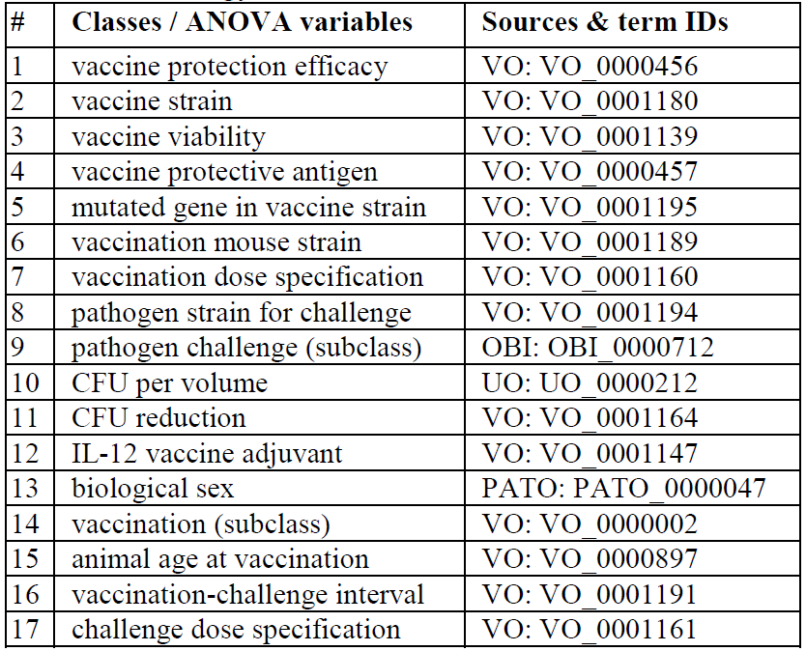
17 Tested Parameters
Q: What parameters are critical to Brucella vaccine efficacy?
Notes:
Do we need the term “species” or the actuarial species like “brucella abortus str 19”

Slide 22
Outline
Introduction of OBI, VO, and vaccine protection use case
Ontological representation of ANOVA
Ontological representation of Brucella vaccine protection investigation
Ontology-based ANOVA analysis of Brucella vaccine protection investigation
Conclusion and Discussion
√

Slide 23
Hypothesis
Some parameters in vaccine protection studies are critical in determining the result of Brucella vaccine protection efficacy in a mouse model, and some not.

Slide 24
Methods
Parameter selection and ontology representation
Data item extraction from journal articles
Data transformation: Discretization of non-measureable instance data
ANOVA analysis
Ontology representation of ANOVA output
Notes:
153 instance data.
Input data are often discretized data from ontology classes or instances
Ontology classes: mouse strain, mouse species, mouse sex, vaccine viability,
Ontology instances: age at vaccination, age at challenge, CFU reduction
Discretization methods:
Category variable
Quantitative variable:
Equal interval
Equal count
Customization: decided by users
How to represent in ontology? Or, do we need to?

Slide 25
17 Tested Parameters
Dependent variable
Independent
variables
Notes:
Do we need the term “species” or the actuarial species like “brucella abortus str 19”

Slide 26
Instance Data
151 instance data were curated from 43 peer-reviewed papers.
Each instance contains data for all 17 parameters.
Non-measurable data (e.g., vaccine strain, vaccination route) are transformed to descretized data.

Slide 27
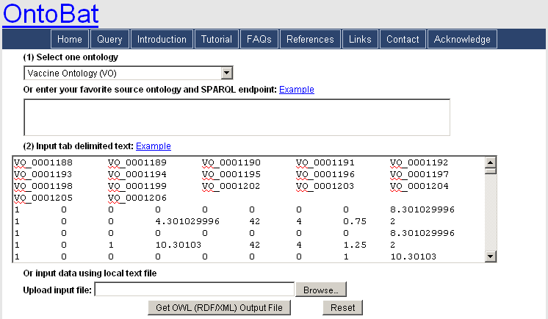
Instance Data in VO OWL file
Instance data in correct VO ontology hierarchy
Only related ontology terms are included
OntoBat: http://ontobat.hegroup.org/

Slide 28
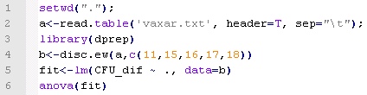
ANOVA Analysis
One-way ANOVA: a planned comparison
  Compare “Significance level” with others
R code for ANOVA analysis:
disc.ew(): discretization using equal width
lm(): fit linear models
“CFU_dif ~ .”: a formula: CFU_dif (response) vs other variables. This is the predictive model.
anova(): Compute analysis of variance

Slide 29
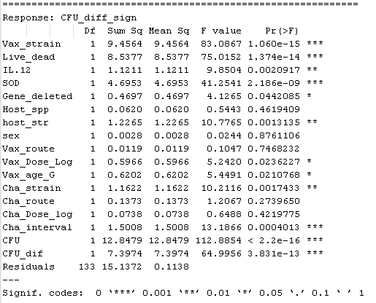
Output Results for ANOVA Analysis
ANOVA output results are presented by p-value and other values (e.g. F value).
6 parameters are not significant (P value > 0.05):
  Mouse sex
  IL-12 vaccine adjuvant
  Vaccination route
  Mouse age
  Vaccination-challenge interval
  Challenge dose
11 yes (P value < 0.05).
The ANOVA output results are also represented in ontology

Slide 30
Outline
Introduction of OBI, VO, and vaccine protection use case
Ontological representation of ANOVA
Ontological representation of Brucella vaccine protection investigation
Ontology-based ANOVA analysis of Brucella vaccine protection investigation
Conclusion and Discussion
√

Slide 31
Summary
Ontological representation of ANOVA in OBI framework
Ontological representation of Brucella vaccine protection investigation
Ontology-based ANOVA analysis of Brucella vaccine protection investigations

Slide 32
Advantages of Ontology-based Statistical Analyses
Allow data consistency checking
  e.g., RB51 is a Brucella vaccine
  BCG is a TB vaccine but not a Brucella vaccine
Data sharing in Semantic Web
Advanced data analysis in Semantic Web
Automated reasoning

Slide 33
Future Work
To replicate the statistical analysis, we will need to know which software and its version
  Software Ontology SWO may be used
Represent the null hypothesis
Represent different ANOVA
  e.g., one-way, factorial ANOVA
  e.g., linear model, randomization-based ANOVA
Analyze more vaccine and other data
Represent other statistical methods

Slide 34
Acknowledgements
Univ. of Michigan: Zuoshuang Xiang, Thomas Todd
OBI: Melanie Courtot, Ryan Brinkman, Jie Zheng, Christian J. Stoeckert Jr., James Malone, Philippe Rocca-Serra, Susanna-Assunta Sansone, Jennifer Fostel,
Larisa N. Soldatova, Bjoern Peters, Alan Ruttenberg
The OBI Consortium, VO, IAO, PRIRN
NIH-NIAID Grant: R01AI081062

