Slide 1
Assays and Designs
Philippe Rocca-Serra
Susanna-Assunta Sansone
http://www.ebi.ac.uk/bioinvindex

Slide 2
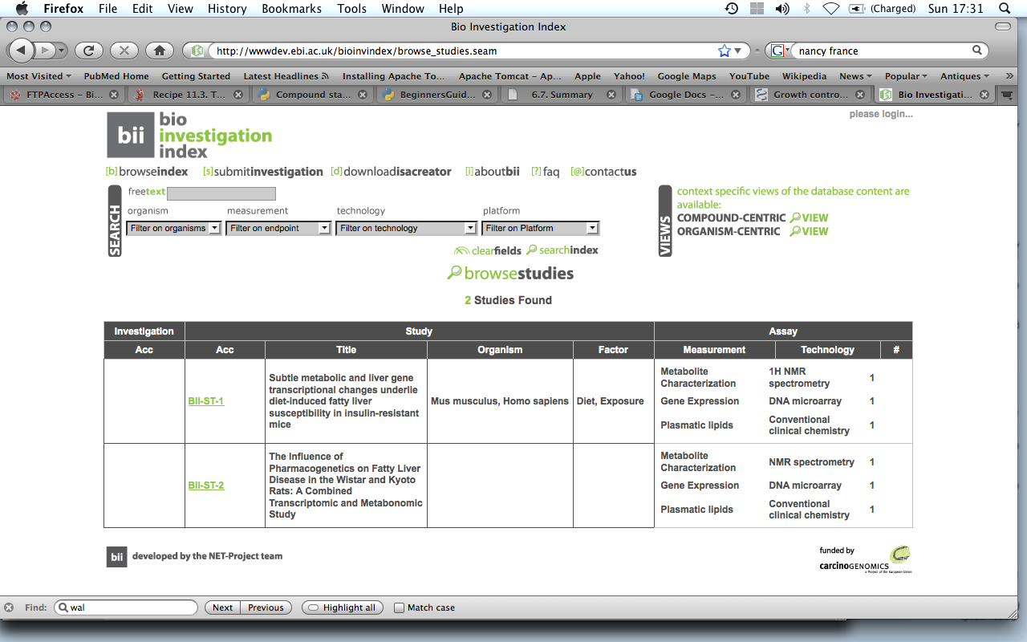
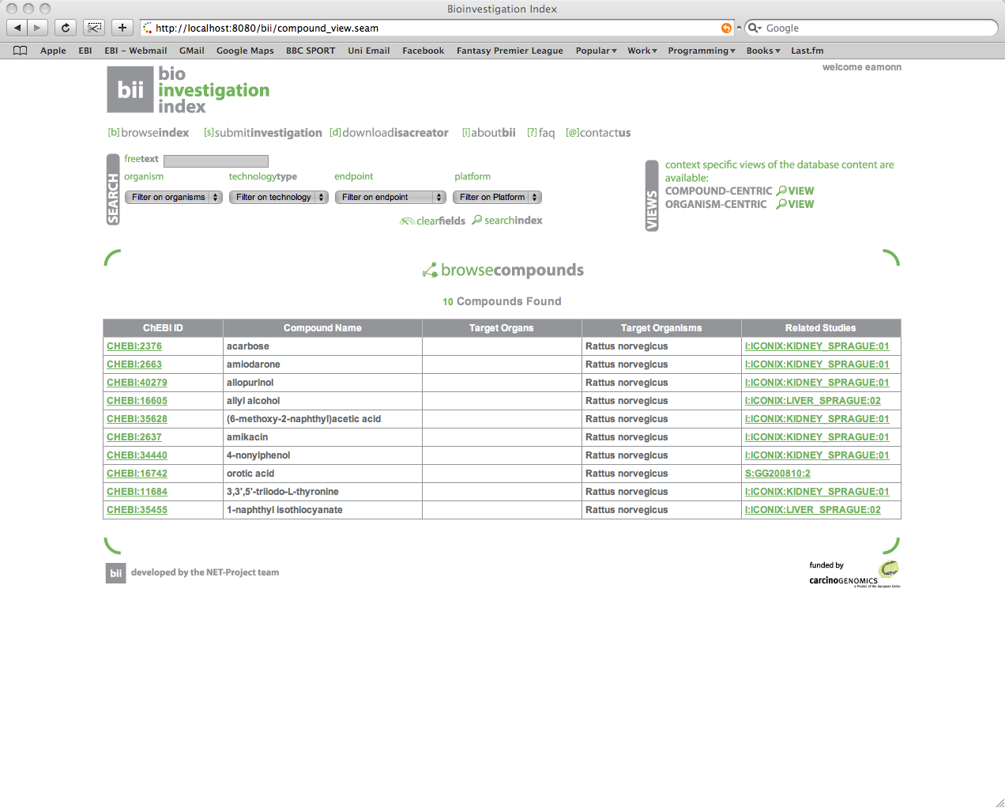
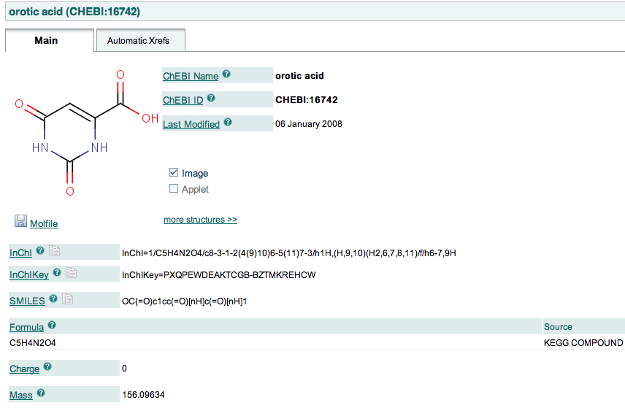

Slide 3
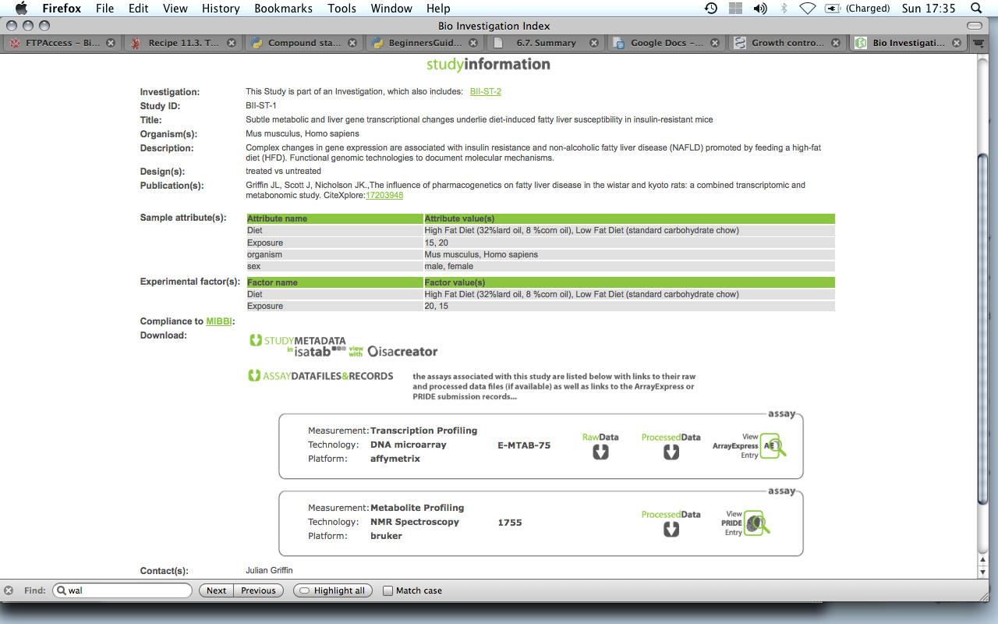

Slide 4
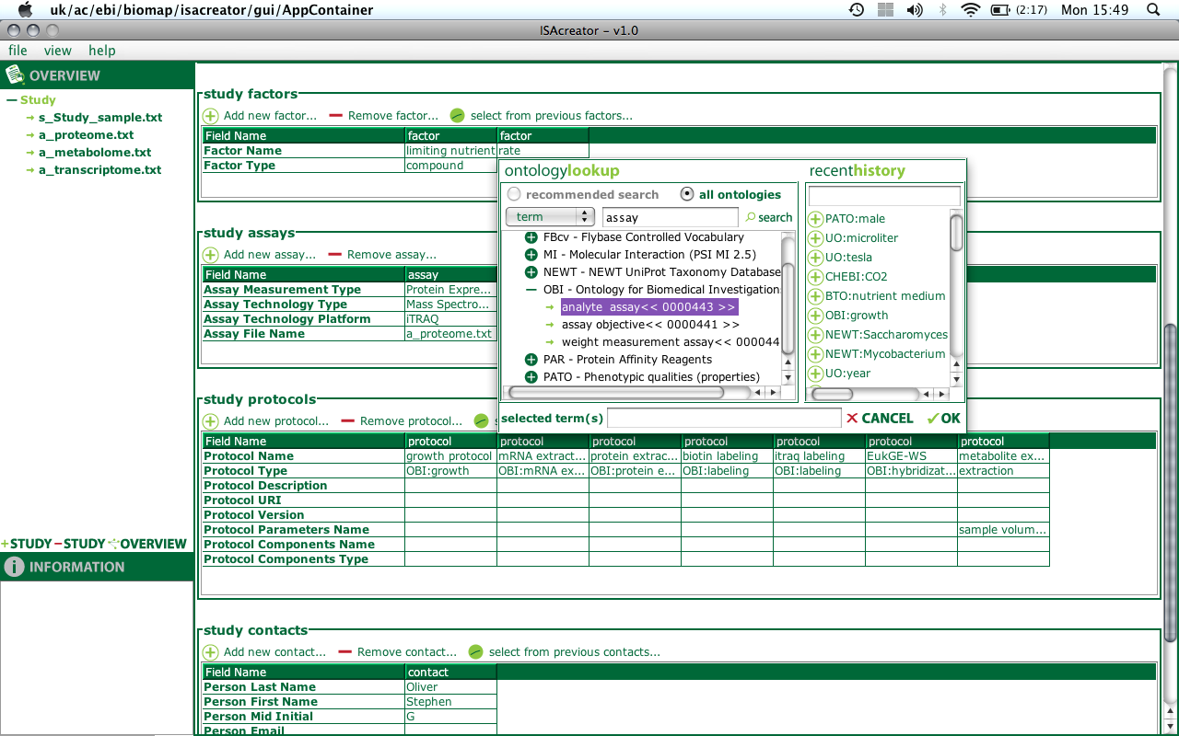
Description of experimental metadata

Slide 5
UC1: Classification of assays
Competency questions:
  List all assays allowing to assess liver function
  List all assays relying on mass spectrometry
  List all assays which can be performed on "saliva"
Not just our needs:
  Phenotypers (feedback from EU-CASIMIR meeting in September in Cambridge: mouse communities, e.g. Empress, RGD, Jax...)

Slide 6
UC2: Experimental design driven data acquisition
ensure minimal information capturing
ideally, optimal information capturing
  Declaration of Experimental Factor => Independent Variables
Declaration of Assays => Dependent variables
  Allow to link design, measurements to data analysis via the variables
  Allow to set dependent variables during analysis steps (e.g. to test the contributions of a variable to the modeling of signal)

