Slide 1

Modelling biomedical experimental processes with OBI
Bio-ontologies SIG/ ISMB'2009
June 28, 2009
The OBI consortium
presenter: Dr Larisa Soldatova, Aberystwyth University, Wales, UK

Slide 2
The OBI consortium (in alphabetical order):
Ryan Brinkman¹, Bill Bug², Helen Causton³, Kevin Clancy, Christian Cocos, Mélanie Courtot¹, Dirk Derom⁴, Eric Deutsch⁵, Liju Fan⁶, Dawn Field⁷, Jennifer Fostel⁸, Gilberto Fragoso³, Frank Gibson⁹, Tanya Gray, Jason Greenbaum¹⁰, Pierre Grenon, Jeff Grethe⁷, Yongqun He¹¹, Mervi Heiskanen, Tina Hernandez-Boussard⁷, Philip Lord, Allyson Lister¹², James Malone, Elisabetta Manduchi, Luisa Montecchi, Norman Morrison³, Chris Mungall¹³, Helen Parkinson³, Bjoern Peters¹⁰, Matthew Pocock, Philippe Rocca-Serra³, Daniel Rubin, Alan Ruttenberg¹⁴, Susanna-Assunta Sansone³, Richard Scheuermann¹⁵, Daniel Schober¹⁶, Barry Smith¹⁷, Larisa N. Soldatova¹⁸, Holger Stenzhorn, Chris Stoeckert¹⁹, Chris Taylor³, Randi Vita¹⁰, John Westbrook, Joe White, Patricia L. Whetzel⁷, Stefan Wiemann, Jie Zheng¹⁹
¹BC Cancer Agency, Vancouver, Canada; ²National Center for Microscopy Imaging Research, UCSD, CA, USA; ³The European Bioinformatics Institute, Cambridge, UK; ⁴Victoria University of Wellington, New Zealand; ⁵ISB, Seattle, WA, USA; ⁶Ontology Workshop, LLC, Columbia, MD, USA; ⁷Stanford University Medical School, Stanford, CA, USA; ⁸SRA Global Health Sector, Durham, NC, USA; ⁹Abcam plc, Cambridge, UK; ¹⁰La Jolla Institute for Allergy and Immunology, La Jolla, CA, USA; ¹¹University of Michigan, Ann Arbor, USA; ¹²Newcastle University, Newcastle upon Tyne, UK; ¹³Lawrence Berkely National Lab, Berkely, CA, USA;¹⁴Science Commons, Cambridge, MA, USA; ¹⁵Southwestern Medical Center, USA; ¹⁶IMBI, University Medical Center, Freiburg, Germany; ¹⁷University at Buffalo, Buffalo, NY, USA; ¹⁸Aberystwyth University, Wales, UK; ¹⁹University of Pennsylvania School of Medicine, Philadelphia, PA, USA

Slide 3
Motivation for the project:
OBI (the Ontology for Biomedical Investigations)
The existence of multiple domain-specific formats (MGED, PSI, ...);
The increase in cross-disciplinary investigations;
The need for consistent annotation of investigations over the entire biomedical domain;
The need for a standardised vocabulary;
The integration of public data repositories.

Slide 4

Introduction to OBI
An open community driven project:
19 communities – participants;
A candidate ontology for the OBO Foundry;
Complementary to existing bio-ontologies;
Reusing existing ontologies and integrating them;
Using BFO, RO, IAO for interoperability.

Slide 5
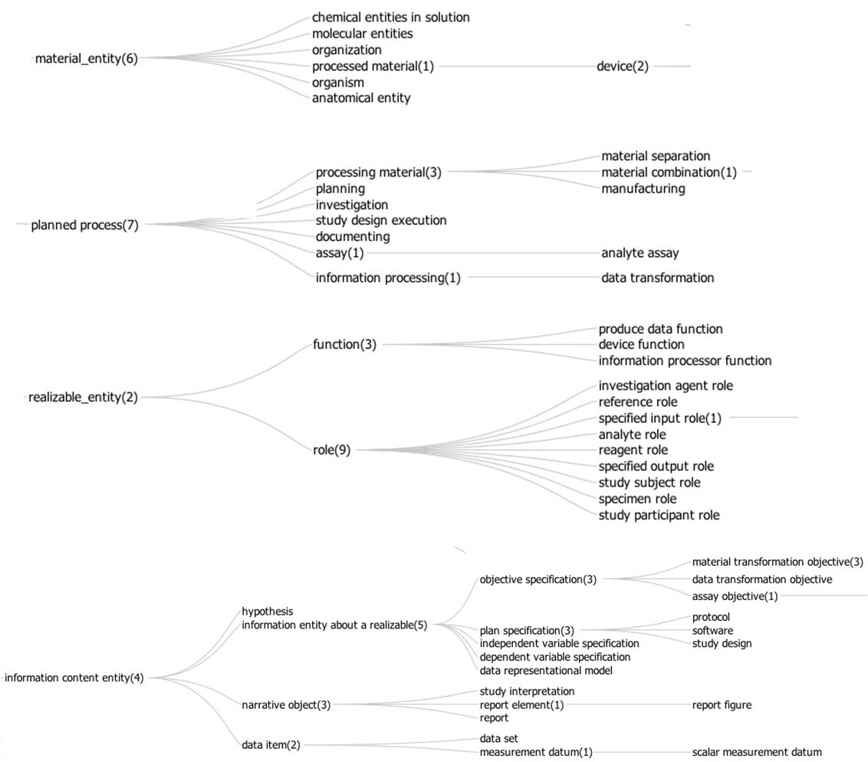


Slide 6
The relations
BFO relations (is a, part of, realises; has quality, has function);
RO relations (has participant, has agent; located in);
IAO relations (is about; is proxy for; represents);
OBI relations (is manufactured by; has supplier; achieves planned objective; has specified participant, has specified input/output).

Slide 7

Use case I: analyte measuring assay - draw blood from a mouse and determine the concentration of glucose in it
A material separation - to obtain a blood specimen from a mouse.
Devices: a syringe, a glucometer dipstick.
The specified output: blood specimen.
A glucose measuring assay.
Device: a glucometer.
The specified output: the measurement datum giving the glucose concentration in the evaluant.

Slide 8
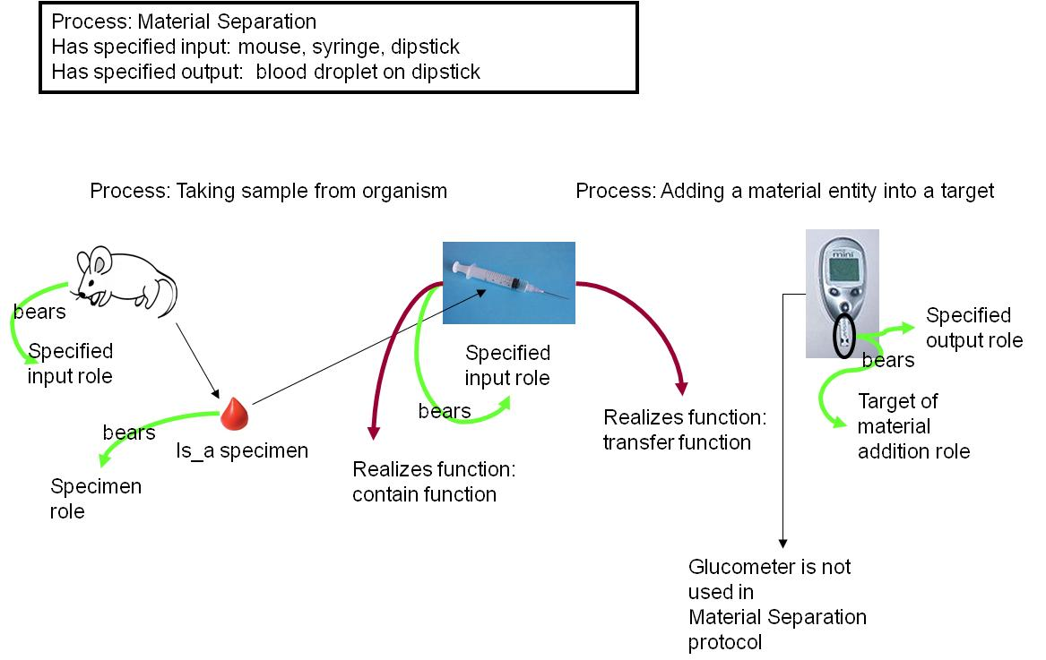

Slide 9
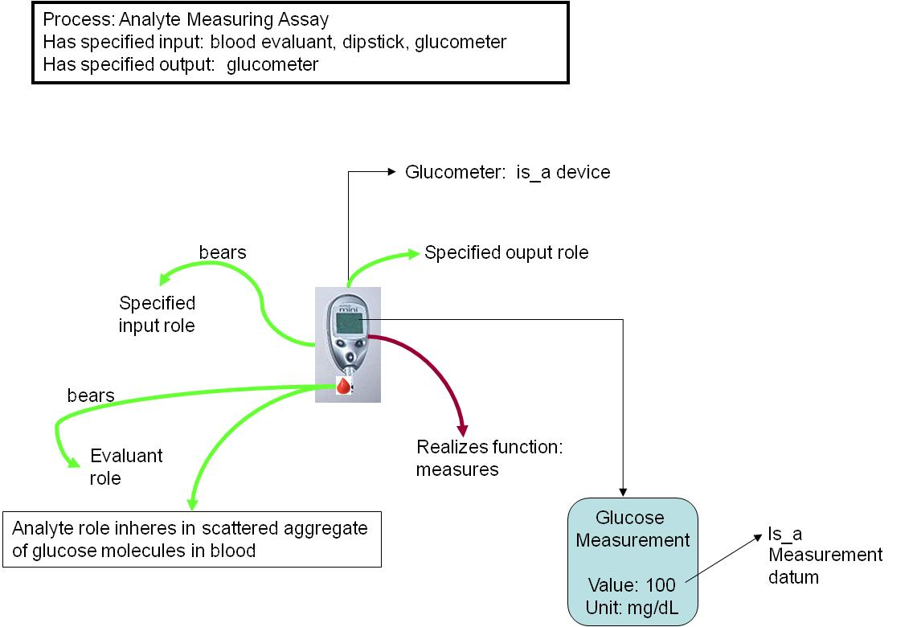
glucose measurement

Slide 10

Use case II: vaccine protection study - how efficiently a vaccine induces protection against virulent pathogen infection in vivo
Vaccination – a vaccine is added to a host organism.
Pathogen challenge – a pathogen is added to the host organism.
Survival assessment - measures survival from the pathogen
challenge.

Slide 11
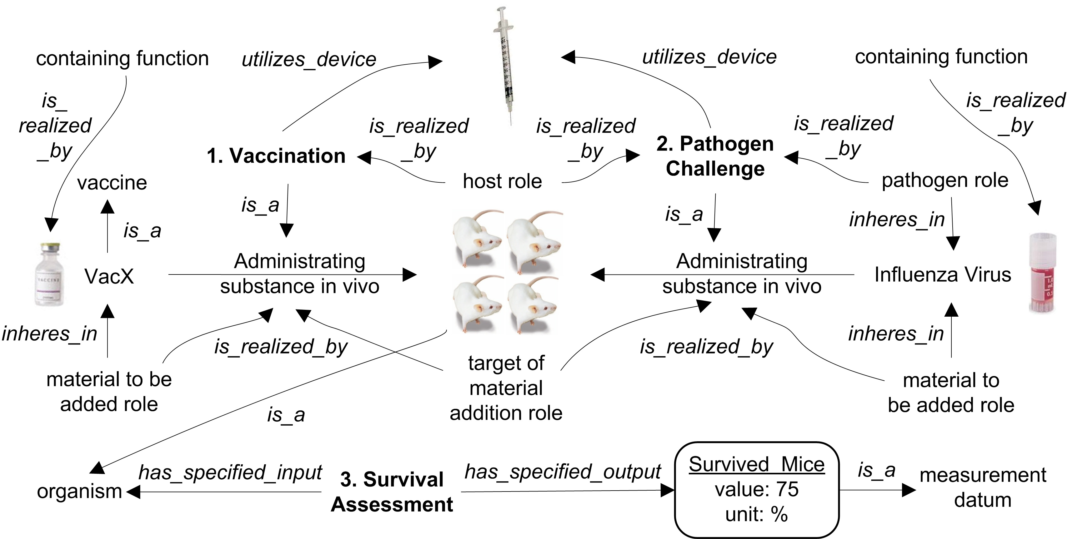

Slide 12
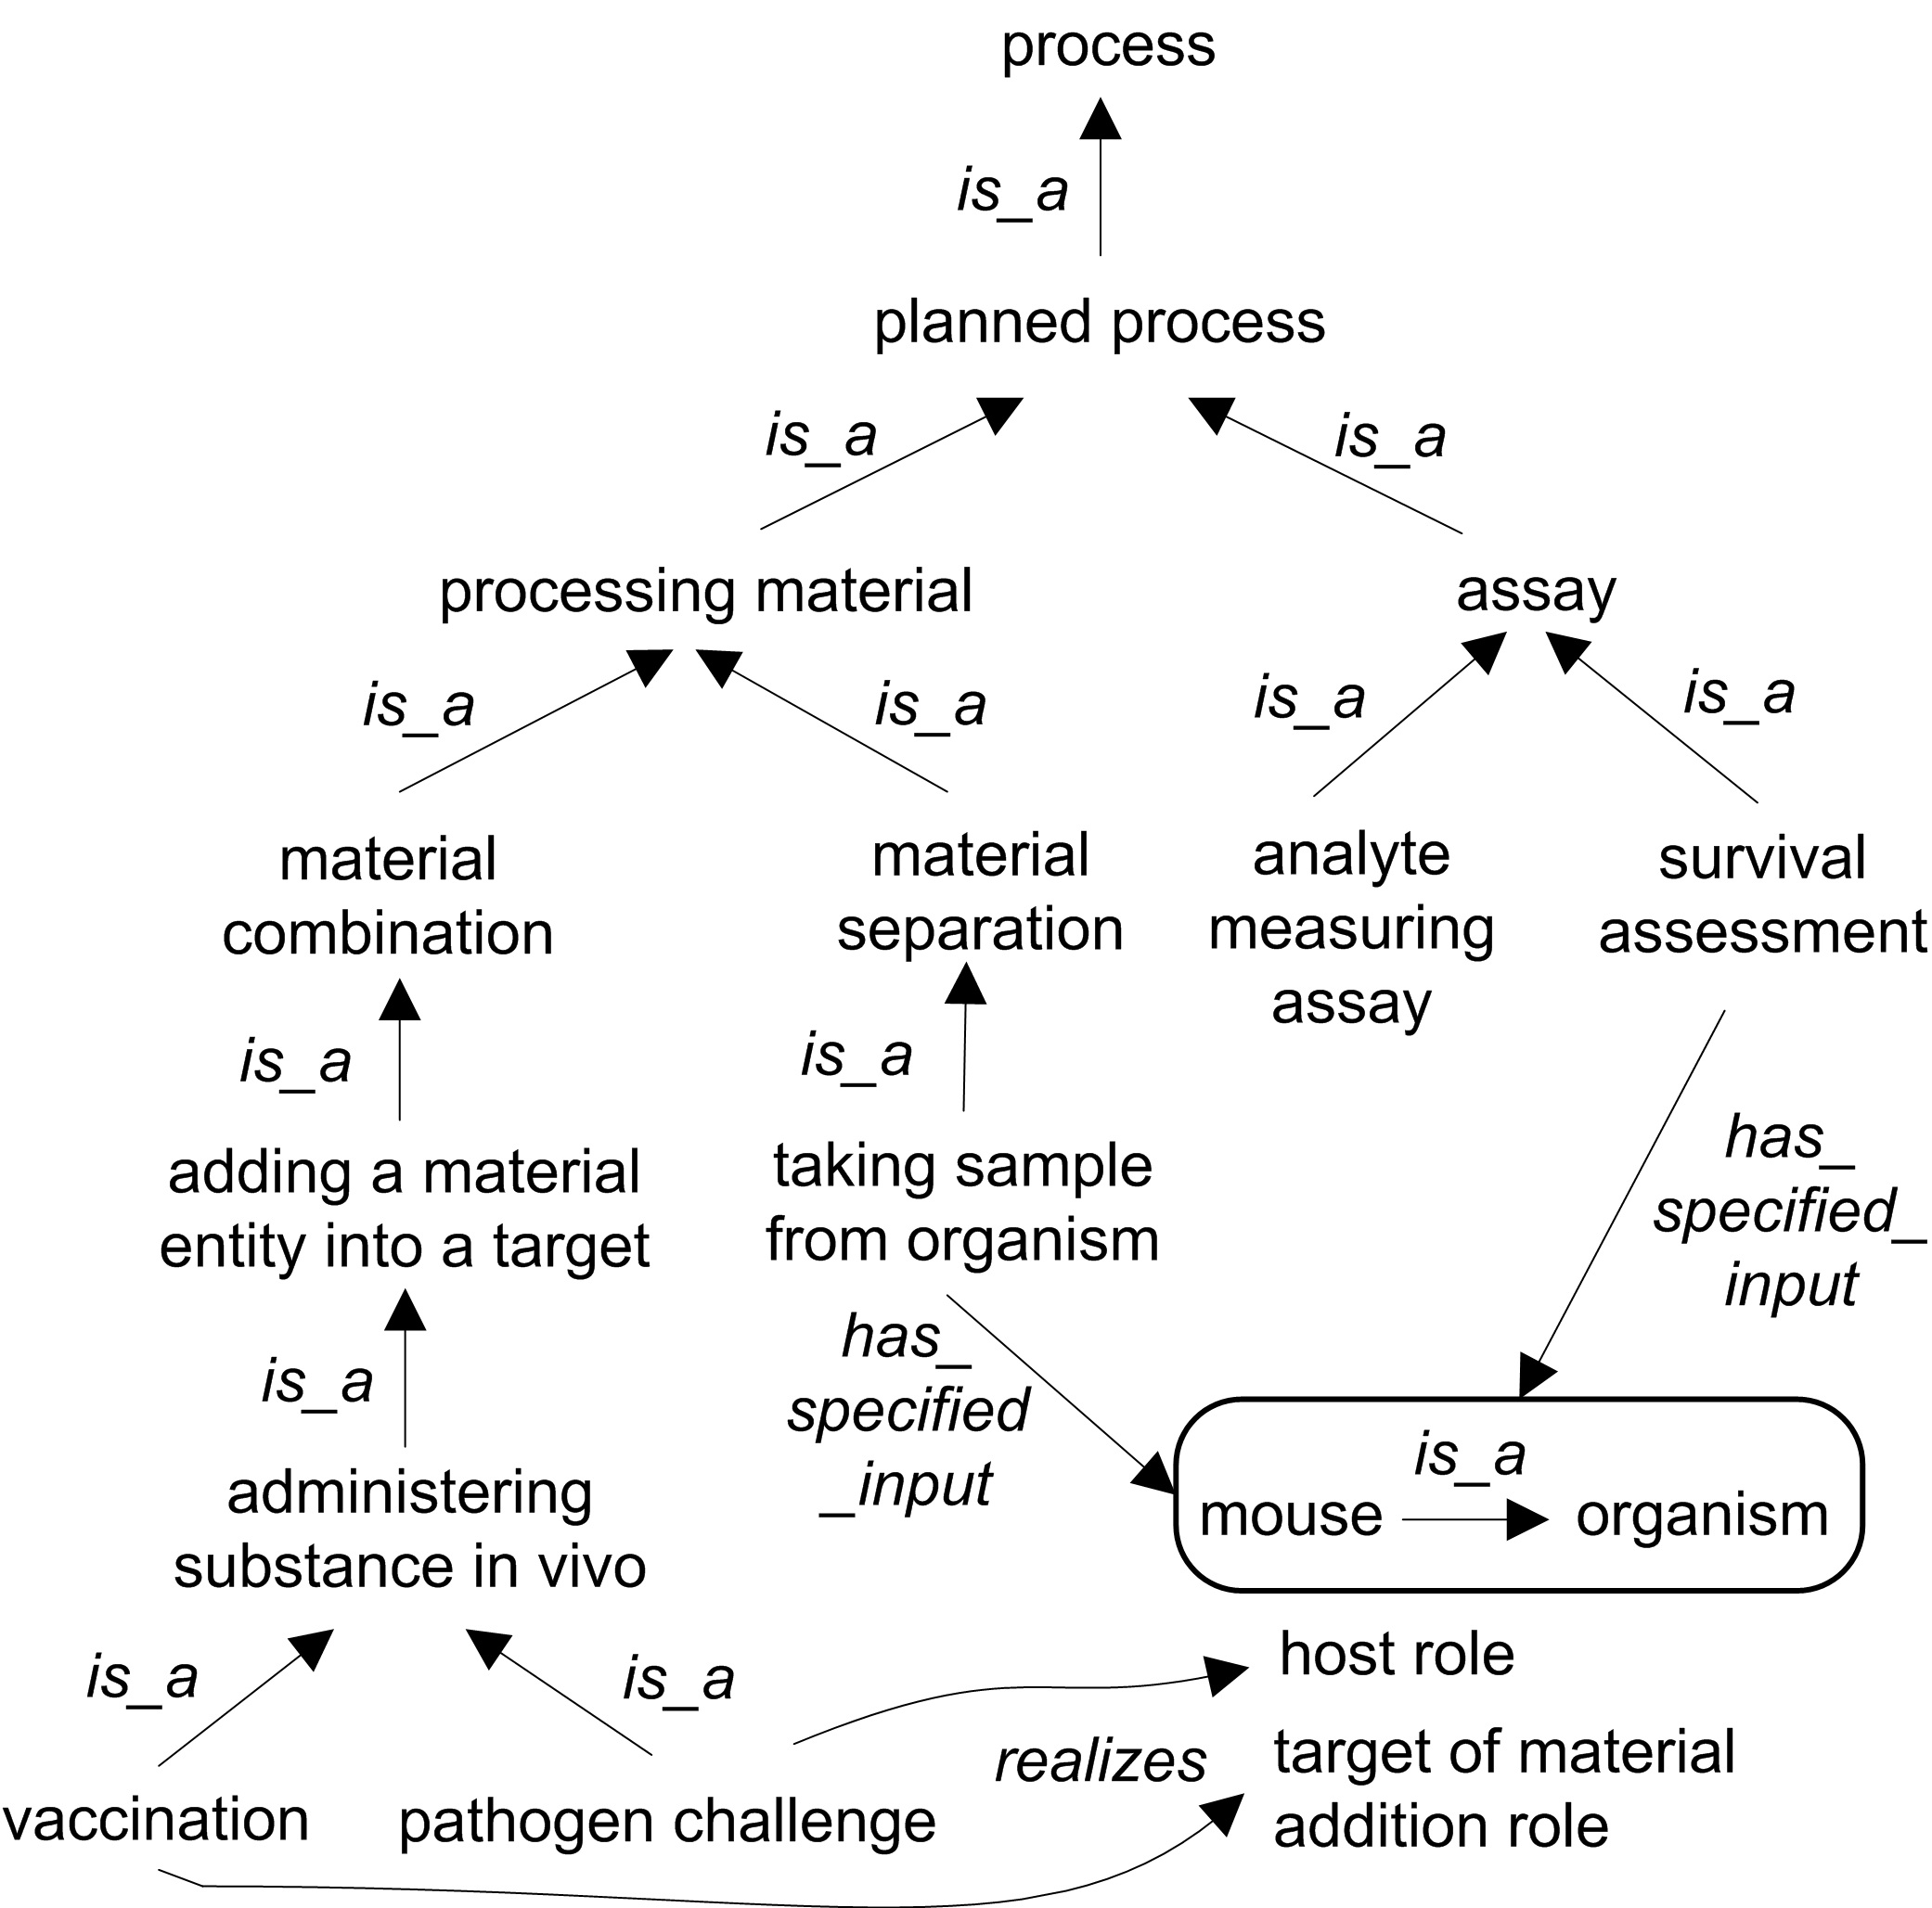

Slide 13
Discussion
The use of OBI by the scientific community to annotate their investigations will facilitate:
Semantic web searches;
Text mining;
Reasoning;
Data and knowledge integration;
Data and knowledge reuse and sharing;
LIMS (laboratory management systems).

Slide 14
OBI is available at:
http://purl.obofoundry.org/obo/obi.owl
OBI welcomes broad community participation

Slide 15
Acknowledgments
This work is partially supported by grant funding from the National Institute of Biomedical Imaging and Bioengineering, National Human Genome Institute, NIH (R01EB005034, NIH P41 HG003619), EC EMERALD project (LSHG-CT-2006-037686), EC FELICS, MUGEN, BBSRC (BB/E025080/1, BB/C008200/1), NERC-NEBC, EU IP CarcinoGenomics (PL 037712), EU NoE NuGO (NoE 503630), CARMEN project EPSRC (EP/E002331/1), the Michael Smith Foundation for Health Research, RCUK.

