Slide 1
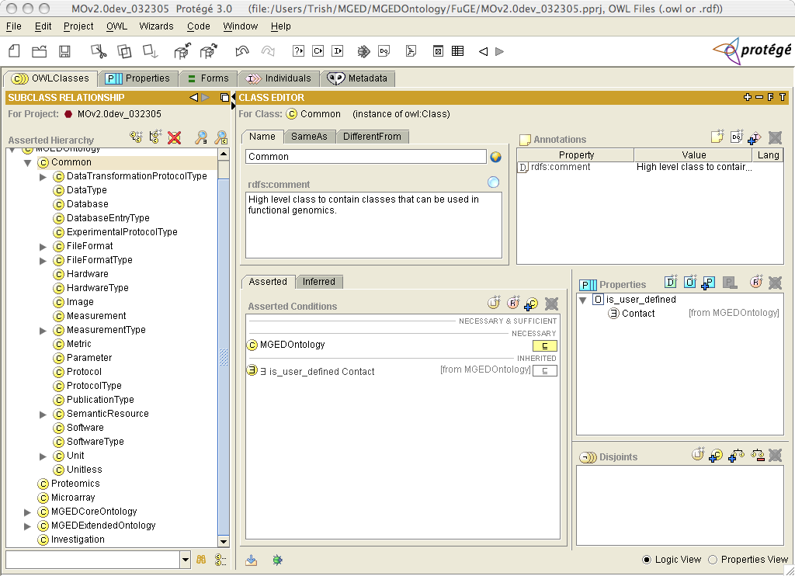
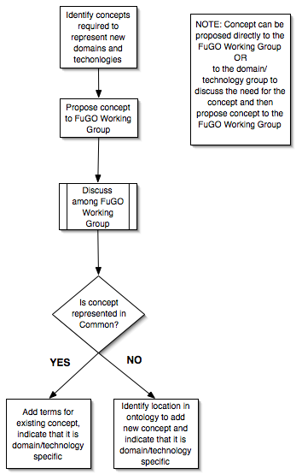
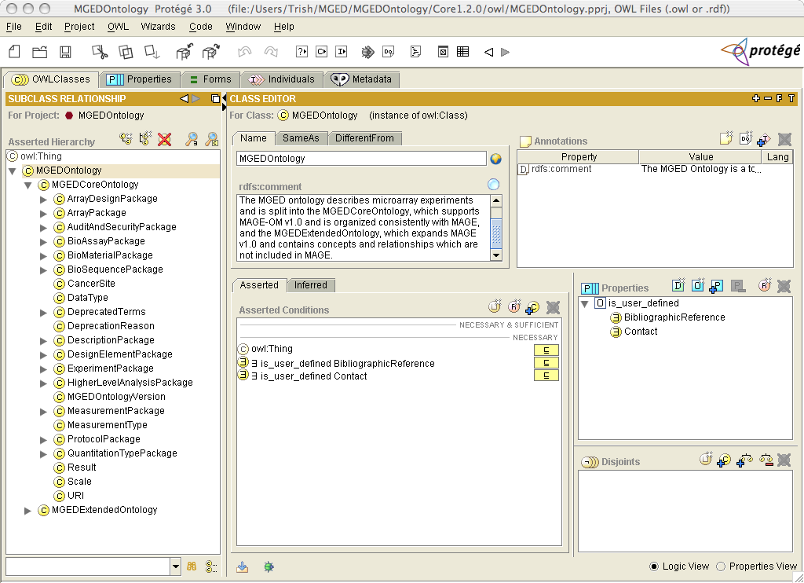
FuGO: Development of a Functional Genomics Ontology (FuGO)
Patricia L. Whetzel¹, Helen Parkinson², Assunta-Susanna Sansone²,Chris Taylor², and Christian J. Stoeckert Jr.¹
Center for Bioinformatics, University of Pennsylvania, Philadelphia, PA^{1,} EMBL-European Bioinformatics Institute, Hinxton, Cambridge, UK²
Data standards and object models are being developed for a variety of functional genomics domains. Many of these object models include a reference to an ontology concept in order to provide a rich set of terms for annotation. The MGED Ontology (MO) was developed to provide terms to be used with the MicroArray and Gene Expression (MAGE) Object Model and has been successfully implemented in production annotation applications. This work is being used as the foundation to develop a Functional Genomics Ontology (FuGO), intended to model additional functional genomics technologies such as Proteomics, Metabol/nomics as well as Transcriptomics and their applications in biological domains, including Nutrigenomics, Toxicogenomics and Environmental Genomics.
Implementation
FuGO Class Hierarchy
Rules for Adding Terms
Rearrange the class hierarchy of the MGED Ontology
  Classes that can be used by more than one domain/technology will be located under the class Common
  Classes that are domain/technology specific will be located within a branch for the domain/technology
Remove references to the MAGE object model within the ontology
  Term definitions do not reference an object model class
Promote individuals to classes
  Why? Reasoning can be performed over classes
Develop a workflow for FuGO development and maintenance
  Shared Term Tracker
  Identify a Domain/Technology Contact Person to work with Ontology Working Group
Case 1: Common concept that can be applied to more than one domain or technology
  Example concept: Data Analysis
    - Definition: Statistical procedure(s) applied to the data
  Location in Ontology: Common
  Provenance: Term is discussed and approved by entire ontology email list
Case 2: Term belongs to a Common concept, but the term is strictly domain or technology specific
  Example term: GeographicLocation
    - Definition: A descriptor of the location from which a BioMaterial was obtained, e.g. country, region, grid reference
  Location in Ontology: Extend the Common class that the term belongs to
    - Mechanism: add term to Common class, then use a property to indicate the technology or domain that the term belongs to (Environment, in our example)
  Provenance: Term is discussed and approved by the domain group (Environment)
Case 3: Concept is unique to the domain or technology
  Example term: AnalyzerType
    - Definition: The common name of a particular mass analyzer stage in a mass
spectrometer; e.g. Quadrupole, TOF, IonStorage
Location in Ontology: Add a new class to the Ontology for this concept
    - Mechanism: add class to ontology with a parent class for the domain or technology
  Provenance: Term is discussed and approved by the domain or technology group
FuGO Overview
Work in progress!
Purpose
  To provide a common vocabulary to annotate Functional Genomics Experiments
Scope
  Transcriptomics
  Proteomics
  Metabol/nomics
Collaborative development
  MGED Ontology Working Group (OWG)
  MGED Reporting Structure for Biological Investigations (RSBI)
  HUPO Proteomics Standards Initiative (PSI)
  Standard Metabolic Reporting Structure (SMRS)
Extensions to RSBI communities
  Toxicology, environment and nutrition studies
FuGO Development
MO Class Hierarchy
FuGO Development
Technical aspects
    Protégé/OWL
Level of granularity
    Application driven
    What does user want to query on?
    What parameters effect the analysis of the experiment?
MGED Ontology Working Group
http://mged.sourceforge.net/ontologies
MGED RSBI Working Group
http://www.mged.org/Workgroups/rsbi
HUPO PSI Ontology Working Group
http://psidev.sourceforge.net/
SMRS Group
http://www.smrsgroup.org/
Functional Genomics Project
http://fuge.sourceforge.net/
Common Concepts

