Slide 1
Merging existing resources in OBI
The namespace issue

Slide 2
The Problem
  According to the OBO Foundry best practices, there should be only one ontology in a given domain, e.g. OBI for expertimental descriptors
  How to give credit to those resources - (initially) developed outside and independently from OBI- that need to be integrated into OBI?
    For example:
      MSI-NMR and chromatography terminologies
      PSI-MS
      SEP-CV
      any other resource sharing scope/domain with OBI (e.g. FIX, REX)

Slide 3
Constraints
  Give an OBI identifier under the OBI namespace
  Give credit to the original source
    Retain original identifier
    Retain source
    Retain some of the metadata
    This metadata need to be visible in both OWL and OBO versions of OBI

Slide 4
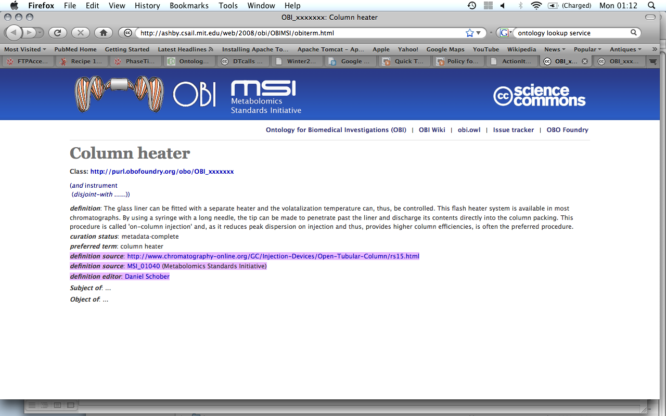
Current proposal
  reliance of 'Definition Source' metadata to
    reference: original accession number
  creation of dedicated html pages, for example:

Slide 5
Current Proposal
  Pros
    accepted by MSI, SEP
    to be discussed with PSI?
  Cons
    OBO version of OBI, in OLS, does not display "Definition Source" metadata crediting original source
  Solutions
    modify lisp script to rely on OBO dbxref
    modify OLS to recognize OBI.obo representation

Slide 6
Common OBO Foundry 'Policy'?
  Is this just our/OBI need or others under the OBO Foundry would need to credit original source(s) too?
  Should the use of the "Definition Source" metadata become part of the Foundry best practices?

