Slide 1

Functional Genomics
Experiment Ontology
Goals
  Unambiguous description of how the investigation was performed
  Consistent annotation, powerful queries and data integration
Details
  NOT model biology
  BUT provide terminology for describing functional genomics experiments
    Investigation (organization, intent, design etc)
    Material (biological and chemical, manipulation and transformation)
    - Protocols and instrumentations
    - Data generated and types of analysis performed on it
  Set of ‘universal’ terms
    - Regardless of specific biological/technological domain described
  Biological and technological domain-specific terms
    - To meet the annotation requirements of any given domain

Slide 2
Functional Genomics
Experiment Ontology
Interoperability with existing bio-ontology
  Mechanisms to refer to those and avoid overlapping
NO dependency on any Object Model
  Can be mapped to any object model, e.g. FuGE, MAGE etc.
Open source tool
  Protégé tool and OWL format
Open source approach
  Shared environment on sourceforge and mailing lists
  Bi-weekly calls
  Face-to-face workshop, according to funds
Funds
  Individual funding sources, but no central support

Slide 3
Functional Genomics
Experiment Ontology
Organization
  Coordination Committee
  Advisory Board
  Working Group
Current community representations – technology domains
  Flow Cytometry
  HUPO-PSI Ontology WG (proteomics)
  MGED Society Ontology WG (transcriptomics)
  Metabolomics Society Ontology WG
  Polymorphism community
Current community representations – biological domains
  Crop sciences
  MGED RSBI WGs (biological investigations)
    - Toxicogenomics
    - Nutrigenomics
    Environmental genomics

Slide 4
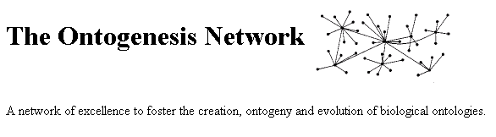
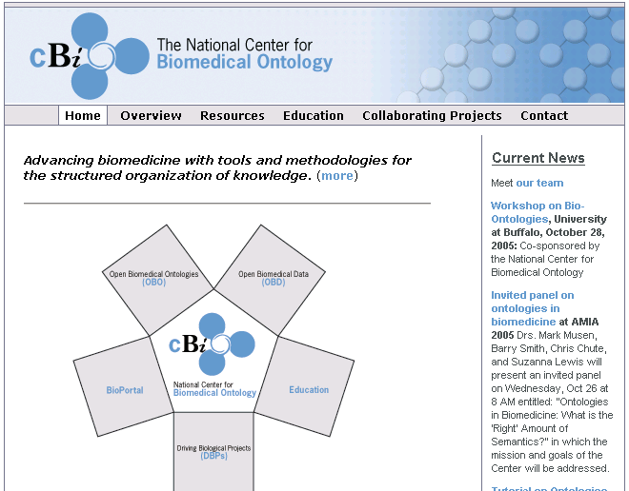










FuGO Advisory Board (FAB)
Current members
  Barry Smith, University of Buffalo, Institute for Formal Ontology and Medical Information Science
  Frank Hartel, Center for Bioinformatics, National Cancer Institute, NIH
  Mark Musen, Stanford University
  Robert Stevens, University of Manchester
  Steve Oliver, University of Manchester
  Suzi Lewis, University of California, Berkeley
Role
  Advise on high level design and best practices
    - Unified vs modular development
  Link to other key efforts
Barry Smith
Image Bioinformatics Research Group, Un of Oxford
Mark Musen
Northwest Institute for Bio-Health Informatics, Un of Manchester
Robert Stevens
Computer Science,
Un of Manchester
Suzi Lewis
European Bioinformatics Institute
CCLRC
e-Science Centre
FreshwaterLife
CancerGrid
Computing Laboratory, Un of Oxford
W3C Semantic Web Interest Group

Slide 5
Preliminary Work
Gather Use Cases for Functional Genomics Investigations
Identify terms needed by each community
  MGED Ontology (MO) working group
    - Review MO, separate general terms from microarray specific terms
  HUPO-PSI Ontology working group
  - Compile controlled vocabularies (CVs) lists
    - Molecular interaction, Mass Spectrometry and General Proteomics
  Metabolomics Society Ontology working group
  - Compile controlled vocabularies (CVs) lists
    - NMR and reconcile Mass Spectrometry terms with PSI group
  RSBI Toxico- Nutri- and Environmental Genomics groups
  - Agree on a ‘core set of top level common terms’
Identify Top Level Nodes of FuGO
Review how Top Level Nodes fit in with the Upper Level Ontologies

Slide 6
Future Plans
First FuGO Face-to-Face Workshop
  February 13-15, Philadelphia, PA
OMICS Special Issue on Data Standards
  Includes papers on FuGO, FuGE, MGED, HUPO-PSI, RSBI, Metabolomics Society Standard initiatives and many other papers…..
  Free, online issue in Mar/Apr
  http://fugo.sourceforge.net

Slide 7
Acknowledgments
Community Coordinator Representatives
  Ryan Brinkman, Terry Fox Laboratory
  Tina Boussard, Stanford University
  Helen Causton, MRC Clinical Sciences Centre
  Liju Fan, Ontology Workshop LLC
  Gilberto Fragoso, NCI
  Jennifer Fostel, NIEHS-NCT
  Mervi Heiskanen, NCI
  Norman Morrison, University of Manchester
  Helen Parkinson, EBI
  Philippe Rocca-Serra, EBI
  Susanna-Assunta Sansone, EBI
  Daniel Schober, EBI
  Chris Stoeckert, University of Pennsylvania
  Chris Taylor, EBI
  Trish Whetzel, University of Pennsylvania
  Joe White, Dana Farber Cancer Center

