Slide 1
Functional Genomics Ontology (FuGO) Workshop
MGED 8
Bergen, Norway
Sept. 14, 2005

Slide 2
What is an ontology?
From the Stanford Knowledge Systems Lab: "An ontology is an explicit specification of some topic. For our purposes, it is a formal and declarative representation which includes the vocabulary (or names) for referring to the terms in that subject area and the logical statements that describe what the terms are, how they are related to each other, and how they can or cannot be related to each other. Ontologies therefore provide a vocabulary for representing and communicating knowledge about some topic and a set of relationships that hold among the terms in that vocabulary.”
Example:
  Age has_measurement Measurement
    Measurement has_value thing
    Measurement has_unit Unit
  Age has_initial_time_point InitialTimePoint
    birth is_a InitialTimePoint

Slide 3
Workshop Agenda
FuGO background and participants
Discussion of policies and approaches for developing FuGO
FuGO development
Future plans and meetings

Slide 4
FuGO Background and Participants
The goal of the Functional Genomics Ontology is to provide a common set of terms for use by different communities studying a wide variety of biological systems using a variety of technologies.
Current participants include:
  The MGED Ontology Working Group (microarray)
  The MGED RSBI Working Group (toxicogenomics, environmental genomics, nutrigenomics)
  PSI General Proteomics Standards
  Metabolomics Society Ontology Working Group
  Flow cytometry

Slide 5
MGED Ontology (MO)
Purpose
  Provide standard terms for the annotation of microarray experiments
  Not to model biology but to provide descriptors for experiment components
Benefits
  Unambiguous description of how the experiment was performed
  Structured queries can be generated
Ontology concepts derived from the MIAME guidelines/MAGE-OM
  Also incorporating concepts from Transformations and RSBI

Slide 6
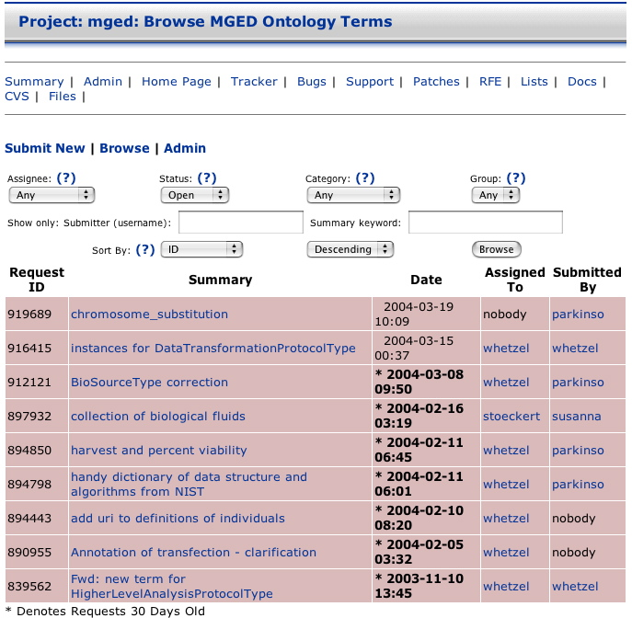
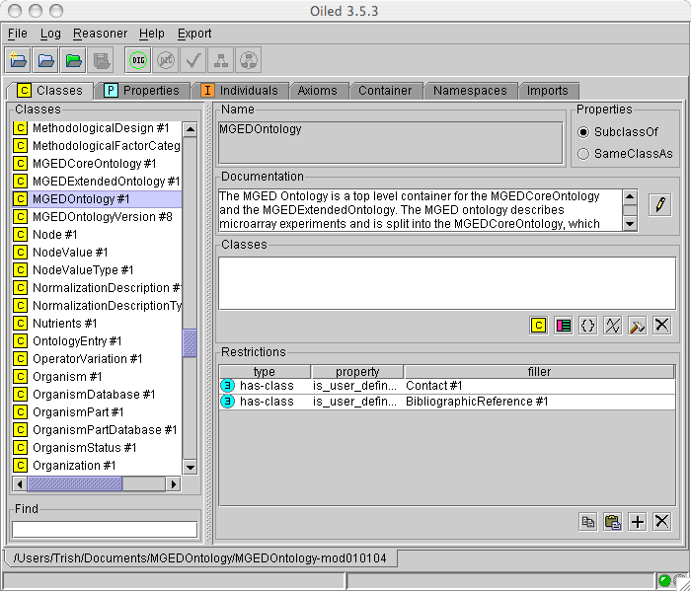
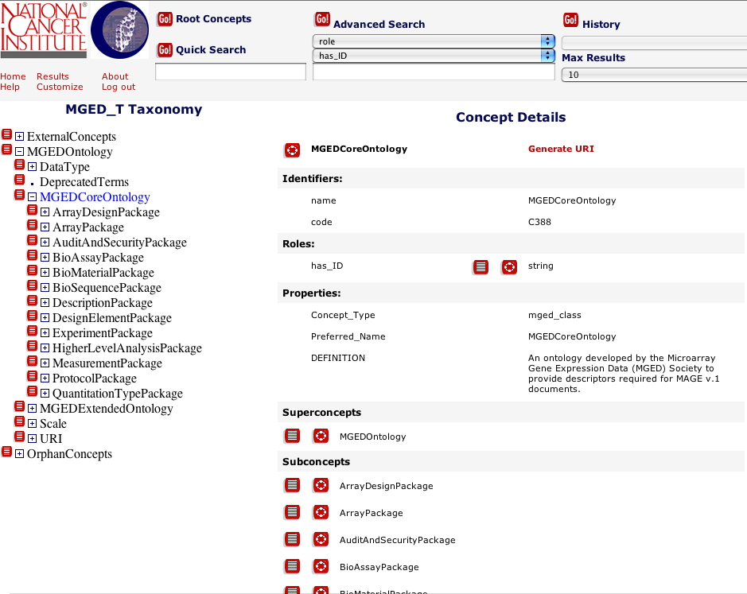
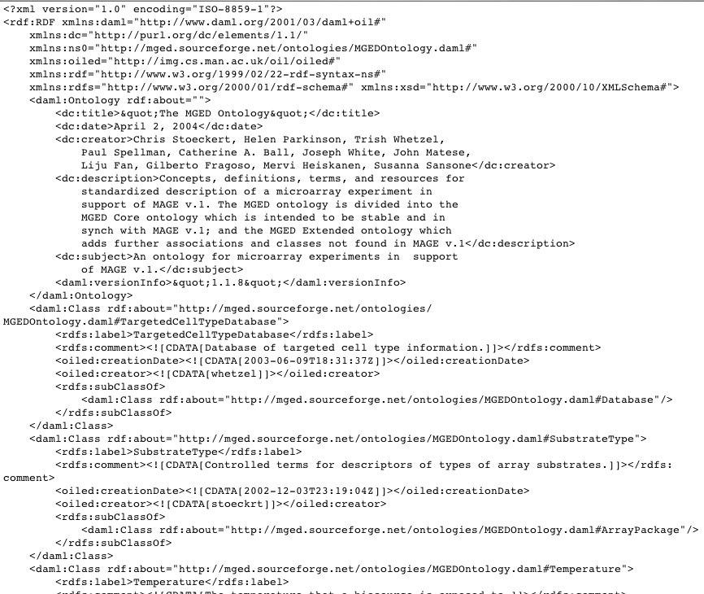
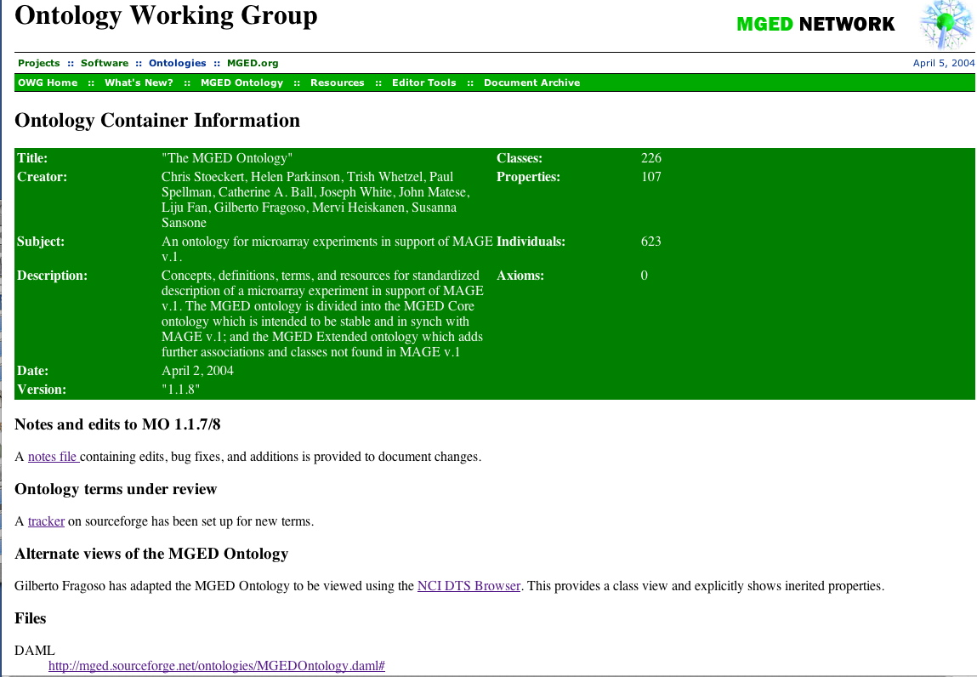
MGED Ontology development http://mged.sourceforge.net/ontologies/MGEDontology.php
OilEd/ Protege
File formats
  DAML file
  OWL file
  HTML file
  NCI DTS Browser
Changes
  Notes
  Term Tracker
Notes:
Future: OWL protégé
Update images

Slide 7
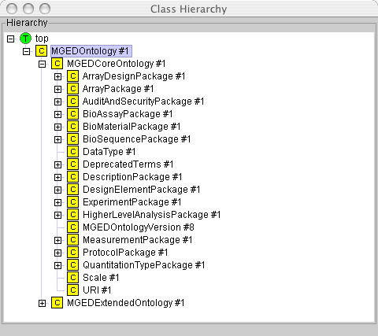
MGED Ontology
Class Hierarchy
MGED CoreOntology
  Coordinated development with MAGE-OM
  Ease of locating appropriate class to select terms from
MGED ExtendedOntology
  Classes for additional terms as the usage of genomics technologies expand

Slide 8
Relationship of
MO to MAGE-OM
MO class hierarchy follows that of MAGE-OM
  Association to OntologyEntry
MO provides terms for these associations by:
  Instances internal to MO
  Instances from external ontologies
    Take advantage of existing ontologies

Slide 9
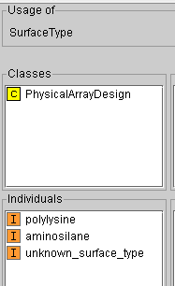
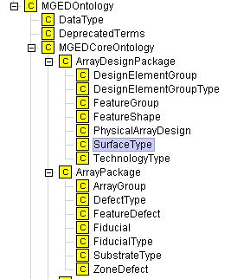
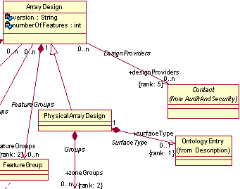
MO and MAGE

Slide 10
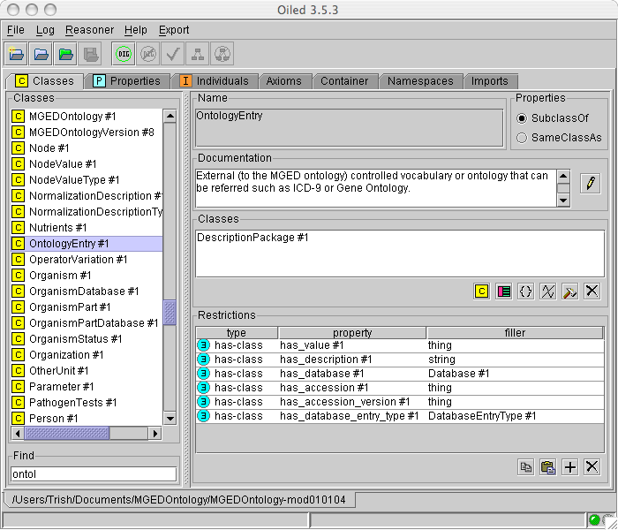
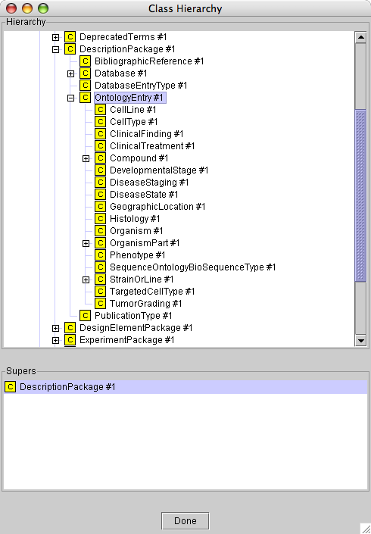
MO and References to
External Ontologies

Slide 11
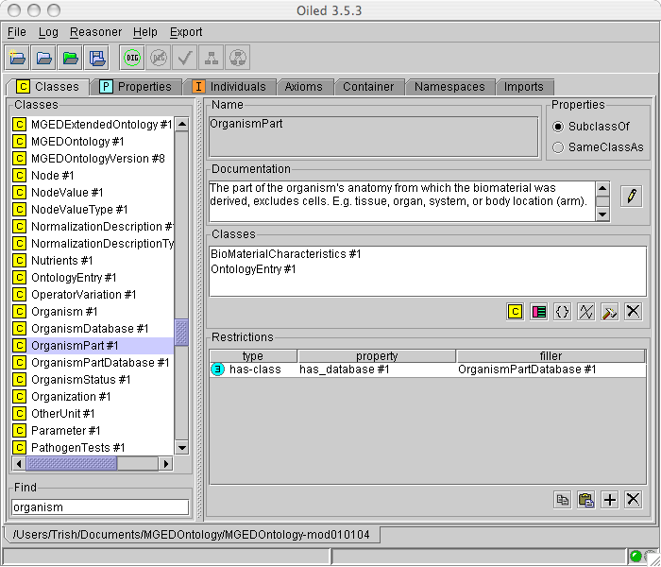
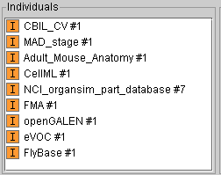
MO and references to External Ontologies
Notes:
Add SOFG stuff

Slide 12
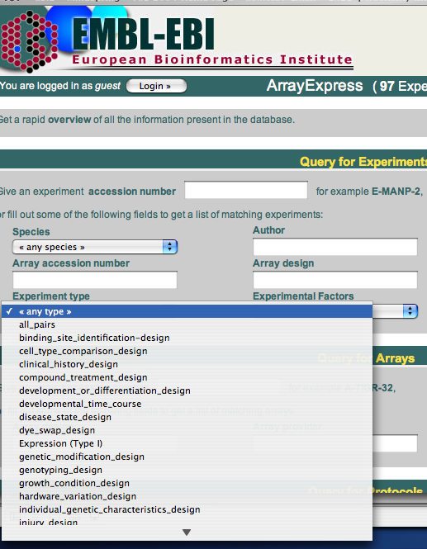
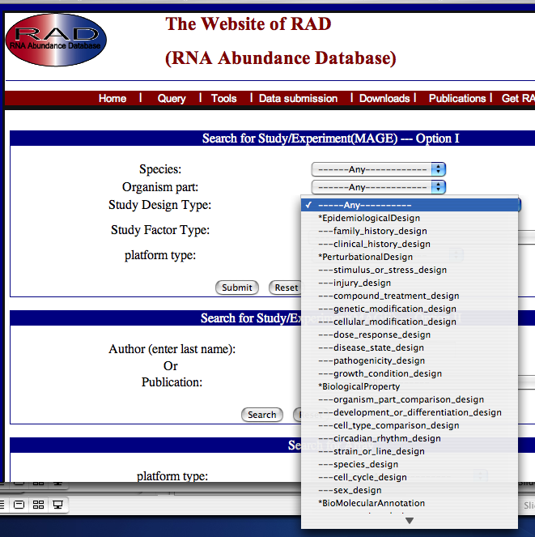
MO and Structured Queries

Slide 13
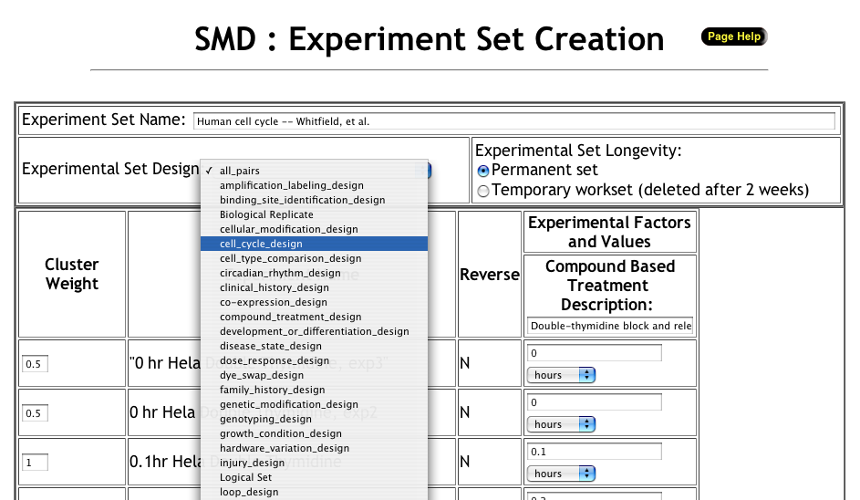
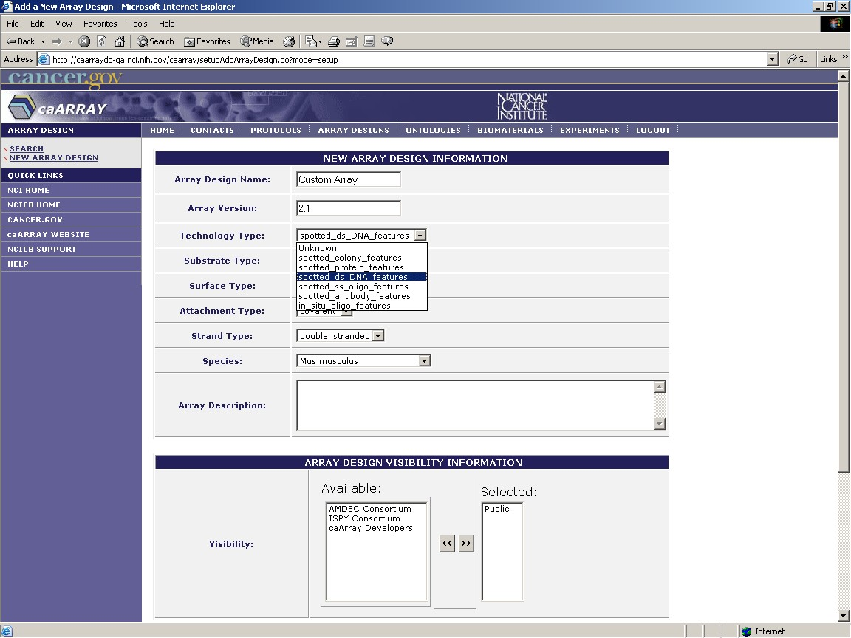
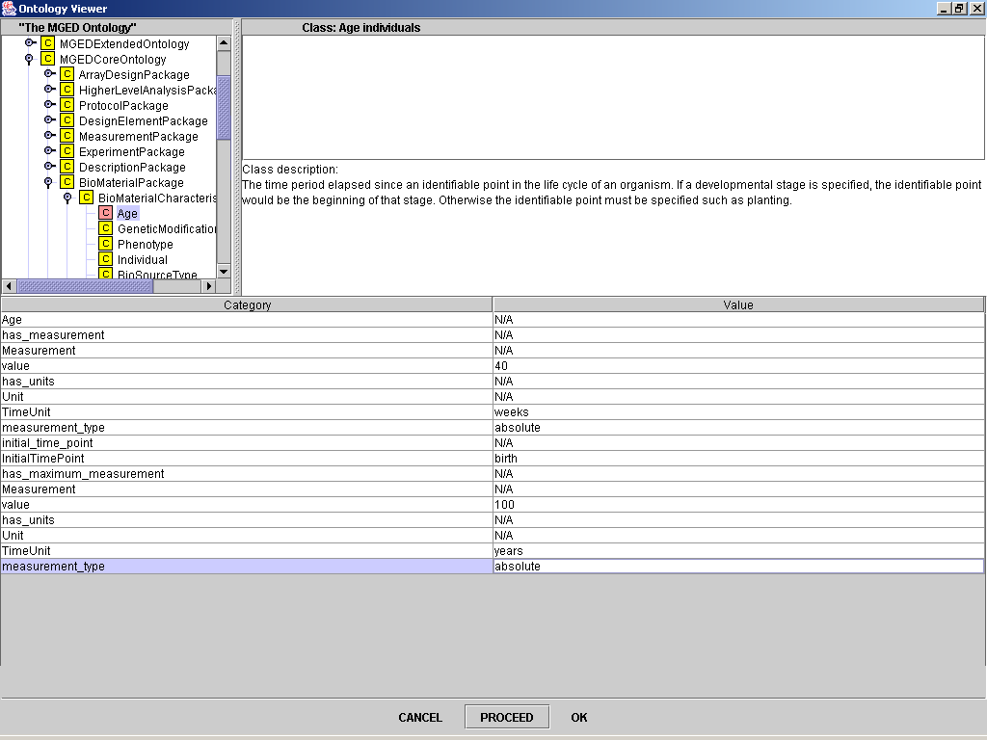
Other Sites Using MO

Slide 14
Status of the MGED Ontology
The MGED Ontology is still actively in use and available from: http://mged.sourceforge.net/ontologies/MGEDontology.php
We will continue to add terms and improve definitions but no major changes that will significantly affect current usage.
Contribute terms to the tracker (link from MGED Ontology page).
MO remains tied to MAGE and microarrays; FuGO will leverage work from MO but NOT be a strictly MGED effort.

Slide 15
Relationship to FuGE-OM
A Functional Genomics Object Model is under development.
  An unifying object model for different types of functional genomics experiments
  http://fuge.sourceforge.net
FuGO will provide ontology terms for FuGE wherever needed but not be dependent on the FUGE-OM
  FuGO will NOT emulate FuGE.
  True for other object models as well

Slide 16
FuGO and the FuGE-OM

Slide 17
FuGO Mission Statement
Develop a functional genomics experiment ontology in collaboration with the special interests groups representing the different technologies and domains that constitute functional genomics.
Efforts will be made to make FuGO compatible with other established bio-ontologies.
An open source approach will be taken for the development process.
A goal is to create a valuable resource for the functional genomics communities while following established ontological principles.

Slide 18
FuGO Working Group
Ryan Brinkman, Terry Fox
Helen Causton, ICL
Liju Fan, Kevric
Jennifer Fostel, NIEHS
Gilberto Fragoso, NCICB
Laurence Game, ICL
Mervi Heiskanen, NCICB
Norman Morrison, Manchester
Helen Parkinson, EBI
Philippe Rocca-Serra, EBI
Susana Sansone, EBI
Chris Stoeckert, Penn
Chris Taylor, EBI
Trish Whetzel, Penn
Joe White, Dana-Farber

Slide 19
Proposed FuGO Board
Robert Stevens, Manchester
Mark Musen, Stanford
Frank Hartel, NCI
OBO representative

Slide 20
Policies and Approaches for Developing FuGO
Is FuGO just a top-level structure that other ontological domains can interact with and extend?
  FuGO does provide this but is more than a top-level structure. Depth will depend on contributors.
What are the boundaries of FuGO?
  FuGO will provide descriptors for all common aspects of experiments (Material, Data, Documentation, Investigation, Protocol)
  FuGO will also provide descriptors for different types of technologies (Instrumentation)
  FuGO will provide instances of types of objects but NOT of objects

Slide 21
Unified Development Approach
High level general class
Types of specific domains
More specific class
(common)
Domain 1
Domain 2
Common term
Domain ..
Domain-specific term

Slide 22
Unified Development Approach
ProtocolDescriptor
TechnologyDescriptor
ProtocolType
microarray
mass_spectrometry
image_acquisition
Domain ..
hybridization

Slide 23
Unified Development Approach
High level general class
Types of specific domains
More specific class
(common)
Domain 1
Domain 2
Common term
Domain ..
Domain-specific term
More specific class
(just used by domain 2)

Slide 24
Modular Development Approach
FuGO
High level general class
Ontology for Domain 1
More specific class
(common)
More specific class
(just used by domain 1)
Common term
Domain-specific term

Slide 25
Ontology Development Mechanisms
Unified development
  Pros
    Ease of maintenance, domain owns their terms, changes propagate downward
    Entire structure can be reasoned over
  Cons
    Buy in from other groups, e.g. build within existing structure
    Others …
Modular development
  Pros
    Groups can work independently, e.g. content and style
  Cons
    Ontologies must be merged to use in an application
    May repeat concepts in domains, e.g. synonyms

Slide 26
Policies and Approaches for Developing FuGO (cont)
Should the Transcriptomic concepts be developed in a different namespace?
As a user, if I were describing an investigation looking at the environmental impact of certain toxins on a sentinel species using proteomics should I be using a combination of ontologies, linked by FuGO, but covering the domains of Proteomics, Toxicogenomics and Environmental Genomics? ...or is FuGO the only ontology I need?
  Need other ontologies such as NCBI taxon, Foundational Model of Anatomy, Sequence Ontology, etc.
  Should not need other domain-type ontologies for most cases
    E.g., FuGO will contain instances of SubstrateType for microarrays

Slide 27
Policies and Approaches for Developing FuGO (cont)
Is FuGO representing experiments or simply providing terms to describe types of experiments? Why?
  FuGO is not an object model. It is an ontology of descriptors for use in annotating functional genomics experiments
FuGO has top level disjoint categories for all terms.
  Start off general and extend to provide domain specific terms
  The domain specific terms can be further extended by different communities (biological and technical) for sub-specialization.

Slide 28
Policies and Approaches for Developing FuGO (cont)
Everything is a FunctionalGenomicsExperimentDescriptor
Primary use is for annotation so retain MO policy of not overdoing subclassing as this can be form navigation and term relationships unwieldy.
Still need mechanism to refer to other existing ontologies for terms for species, anatomies, chemical compounds, etc.
Use Protégé and OWL

Slide 29
FuGO Development
Proposed timeline
  Establish an appropriate basic structure (Oct. 2005) consider alternative approaches
    Advised by FuGO Board
  Evaluate existing MO terms for reusability in FuGO (Jan. 2006)
    Which terms are good
  Add in terms from other groups (on going)

Slide 30
FuGO Development
Web site and mailing list:
  http://fuge.sourceforge.net/fugo/index.php
  https://lists.sourceforge.net/lists/listinfo/fuge-ontologies
Root class:
  FunctionalGenomicsExperimentDescriptor
Highest level classes:
  MaterialDescriptor
  DataDescriptor
  DocumentationDescriptor
  InstrumentationDescriptor
  InvestigationDescriptor
  ProtocolDescriptor
  TechnologyDescriptor

Slide 31
Future Meetings and Plans
Conference calls
FuGO mail list
Next FuGO workshop?
  Philadelphia in January 2006 (9-13?)

Slide 33
Referencing MO Terms in MAGE-ML
<MAGE-ML>
…
<Database name="The MGED Ontology" identifier="MO"
URI="http://mged.sourceforge.net/ontologies/MGEDontology.php" />
…
<OntologyEntry category="SomeMOClass" value= "some_MO_instance">
<OntologyReference_assn>
<DatabaseEntry accession="#some_MO_instance"
URI="http://mged.sourceforge.net/ontologies/MGEDontology.php#some_MO_instance">
<Database_assnref>
<Database_ref identifier="MO"/>
</Database_assnref>
</DatabaseEntry>
</OntologyReference_assn>
</OntologyEntry>
…
</MAGE-ML>

