Slide 1
Functional Genomics Ontology - FuGO
Goals
  Unambiguous description of how the investigation was performed
  Consistent annotation, powerful queries and data integration
Details
  NOT model biology
  BUT provide descriptors for experiment components
    Investigation (organization, intent, design etc)
    Material (biological and chemical, manipulation and transformation)
    - Protocols and instrumentations
    - Data generated and types of analysis performed on it
  Core of ‘universal’ descriptors
    - Regardless of specific biological/technological domain described
  Biological and technological domain-specific terms
    - To meet the annotation requirements of any given domain

Slide 2
Functional Genomics Ontology - FuGO
Interoperability with existing bio-ontology
  Mechanisms to refer to those and avoid overlapping
NO dependency on any Object Model
  Can be mapped to any object model, e.g. FuGE OM
Open source tool
  Protégé tool and OWL format
Open source approach
  Shared environment on sourceforge and mailing lists
  Bi-weekly calls
  Face-to-face workshop, according to funds
Funds
  Individual funding sources, but no central support

Slide 3
Functional Genomics Ontology - FuGO
Organization
  Coordination Committee
  Development group
  FuGO Advisory Board (FAB)
Current community representations – technology domains
  HUPO-PSI Ontology WG (proteomics)
  MGED Society Ontology WG (transcriptomics)
  Metabolomics Society Ontology WG
  Flow Cytometry
Current community representations – biological domains
  Crop sciences
  MGED RSBI WGs (biological investigations)
    - Toxicogenomics
    - Nutrigenomics
    - Environmental genomics

Slide 4
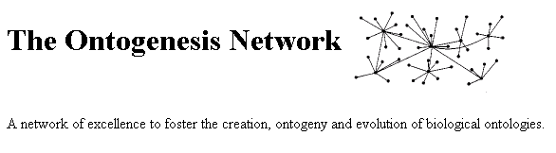











FuGO - Advisory Board (FAB)
Current members
  Barry Smith, Buffalo
  Frank Hartel, NIH-NCI
  Mark Musen, Stanford
  Robert Stevens, Manchester
  Steve Oliver, Manchester
  Suzi Lewis, Berkeley
Role
  Advising on high level design and best practices
    - Unified vs modular development
  Linking to other key efforts
Barry Smith
Image Bioinformatics Research Group, Un of Oxford
Mark Musen
Robert Stevens
Northwest Institute for Bio-Health Informatics, Un of Manchester
Computer Science,
Un of Manchester
Suzi Lewis
European Bioinformatics Institute
CCLRC
e-Science Centre
FreshwaterLife
CancerGrid
Computing Laboratory, Un of Oxford
W3C Semantic Web Interest Group

Slide 5
FuGO - Preliminary Works
Identify 50 ‘Top Level Concepts’ in each group
  MGED Ontology working group
    - Review and refactor MGED Ontology
    - Separate general concepts from microarray specific one
  HUPO-PSI Ontology working group
  - Compile controlled vocabularies (CVs) lists
    - Molecular interaction, Mass Spectrometry and General Proteomics
  Metabolomics Society Ontology working group
  - Compile controlled vocabularies (CVs) lists
    - NMR and reconcile Mass Spectrometry terms with PSI group
  RSBI Toxico- Nutri- and Environmental Genomics groups
  - Agree on a ‘core set of top level common terms’
Gathering real use cases of functional genomics investigations
Identify Top Level Nodes

Slide 6
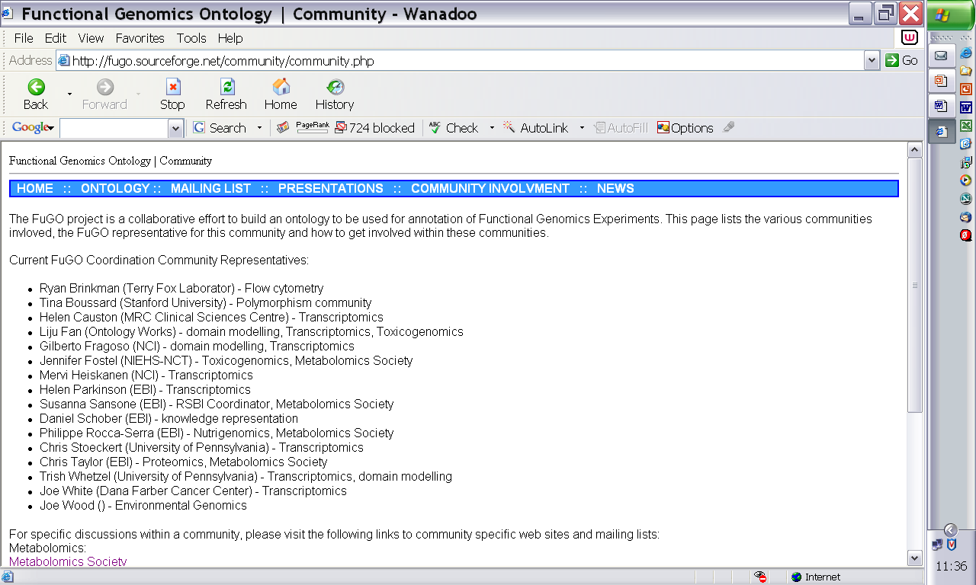
FuGO - http://fugo.sourceforge.net
First FuGO face-to-face workshop
  February 13-15, Philadelphia, PA
OMICS journal, special free, on-line issue in Mar/Apr
  FuGO, FuGE, MGED, HUPO-PSI, RSBI, Metabolomics Society Standard initiatives and many other papers…..

