Slide 1
FuGO
An Ontology for
Functional Genomics Investigation
Susanna-Assunta Sansone (EBI): Overview
Trish Whetzel (Un of Pen): Microarray
Daniel Schober (EBI): Metabolomics
Chris Taylor (EBI): Proteomics
On behalf of the FuGO working group
http://fugo.sourceforge.net

Slide 2
FuGO - Rationale
Standardization activities in (single) domains
  Reporting structures, CVs/ontology and exchange formats
Pieces of a puzzle
  Standards should stand alone BUT also function together
    - Build it in a modular way, maximizing interactions
Capitalize on synergies, where commonality exists
  Develop a common terminology for those parts of an investigation that are common across technological and biological domains
Source and Characteristics
Sample Preparation
Investigation
Design
Instrumental Analysis
(MS, NMR, array, etc.)
Computational
Analysis
Treatments
Collection
Data Pre-Processing

Slide 3
FuGO - Overview
Purpose
  NOT model biology, NOR the laboratory workflow
  BUT provide core of ‘universal’ descriptors for its components
    To be ‘extended’ by biological and technological domain-specific WGs
  No dependency on any Object Model
    - Can be mapped to any object model, e.g. FuGE OM
Open source approach
  Protégé tool and Ontology Web Language (OWL)
Source and Characteristics
Sample Preparation
Investigation
Design
Instrumental Analysis
(MS, NMR, array, etc.)
Computational
Analysis
Treatments
Collection
Data Pre-Processing

Slide 4
FuGO – Communities and Funds
List of current communities
  Omics technologies
    HUPO - Proteomics Standards Initiative (PSI)
    Microarray Gene Expression Data (MGED) Society
    Metabolomics Society – Metabolomics Standards Initiative (MSI)
  Other technologies
    Flow cytometry
    Polymorphism
  Specific domains of application
    Environmental groups (crop science and environmental genomics)
    Nutrition group
    Toxicology group
    Immunology groups
List of current funds
  NIH-NHGRI grant (C. Stoeckert, Un of Pen) for workshops and ontologist
  BBSRC grant (S.A. Sansone, EBI) for ontologist

Slide 5

FuGO – Processes
Coordination Committee
  Representatives of technological and biological communities
    - Monthly conferences calls
Developers WG
  Representatives and members of these communities
    - Weekly conferences calls
Documentations
  http://fugo.sourceforge.net
Advisory Board
  Advise on high level design and best practices
  Provide links to other key efforts
    Barry Smith, Buffalo Un and IFOMIS
    Frank Hartel, NIH-NCI
    Mark Musen, Stanford Un and Protégé Team
    Robert Stevens, Manchester Un
    Steve Oliver, Manchester Un
    Suzi Lewis, Berkeley Un and GO
-> cBiO will also oversee the Open BioMedical Ontology (OBO) initiative

Slide 6
FuGO – Strategy
Use cases -> within community activity
  Collect real examples
Bottom up approach -> within community activity
  Gather terms and definitions
    - Each communities in its own domain
Top down approach -> collaborative activity
  Develop a ‘naming convention’
  Build a top level ontology structure, is_a relationships
  Other foreseen relationships
    - part_of (currently expressed in the taxonomy as cardinal_part_of)
    - participate_in (input) and derive_from (output),
    - describe or qualify
    located_in and contained_in
Binning terms in the top level ontology structure
  The higher semantics helps for faster ‘binning’

Slide 7
FuGO – Status and Plans
Binning process - ongoing
  Reconciliations into one canonical version
  Iterative process
Common working practices - established
  Each class consists of: term ID, preferred term, synonyms, definition and comments
  Sourceforge tracker to send comments on terms, definitions, relationships
Timeline for completion of core omics technologies
  Two years and several intermediate milestones
  Interim solution
    - Community-specific CVs posted under the OBO
Ultimately FuGO will be part of the OBO Foundry (Core) Ontology
Overview paper – “Special Issue on Data Standards” OMICS journal

Slide 8
Transcriptomics Community Contributions to FuGO
Trish Whetzel

Slide 9
Transcriptomics Community
Represented by the MGED Society
  consists of those performing microarray experiments (technological domain)
Current source of annotation terms for microarray experiments is the MGED Ontology
  scope includes experiment design, biomaterials, protocols (actions, hardware, software), and data analysis

Slide 10
Work Towards FuGO
MGED Ontology (MO) will be used as the source of terms to propose for inclusion in FuGO
  Bin all terms according to high level containers of FuGO (bottom-up)
    identify those that are universal and those that are community specific
  Modify all term names and definitions to adhere to FuGO naming conventions
  Propose universal terms to FuGO developers for review of term name, definition and location in FuGO by members of other communities (top-down)
  Propose technology specific terms to FuGO developers for review of the location of the term in FuGO AND ensure that the terms are community specific

Slide 11
Additional Community Specific Work
Add numeric identifiers to the MGED Ontology
Generate a mapping file of terms from the MGED Ontology to FuGO
Modify applications to account for numeric identifiers AND to identify the annotation source (MO vs FuGO)
Result: Ability to retrieve data annotated with either MO or FuGO.

Slide 12
Metabolomics Standardization Initiative
Ontology Working Group
(MSI-OWG)
Daniel Schober

Slide 13
MSI OWG - Activities
Newly established group
Develop our roadmap
  Compile list of agreed controlled vocabularies (CVs)
    - Leveraging on existing resources and efforts (incl. PSI)
  Identify suitable ontology engineering method
    Engage with FuGO
Establish group infrastructure
  Set up SF website and mailing lists
  Ontology web-access
    - WebProtege
  Collaborative ontology development & editing
    - pOWL

Slide 14
MSI OWG - CVs
Develop CVs for instrument-dependant domains (NMR, MS, chromatography)
  Resuse terms from existing resources, e.g.:
    - ArMet model and CVs
    - NMR-STAR group
    - PSI MS CVs
    - Human Metabolome Project (HMP), HUSERMET, MeT-RO
    - IUPAC terminology for analytical chemistry
  Initiate collaboration for chromatography component
    - PSI Sample Processing WG
  Enriching the initial term list
    - Swoogle, Ontosearch and LexGrid for finding Ontologies
    - Applied DTB-Schemata (Vendors)
    - Pubmed textmining

Slide 15
Naming Conventions for CV terms
Evaluate OBO- and GO style guide
Guidance document to name Knowledge Representation (KR) idioms
  SYNONYM and ACRONYM REPRESENTATION
  KR IDIOM IDENTIFIERS
  PROPER CLASS DEFINITIONS
  CROSS-REFERENCING OTHER TERMINOLOGIES
  ONTOLOGY FILE NAMES (VERSIONING)
  NAMING TERMS and CLASSES
    - Capitalisation (lower case), underscore word separator
    - Singular instead of plural
    - No ellipses (be explicit)
    - Allowed character set
    - Consistent affix usage (prefix, suffix, infix and circumfix)
    - Avoid “taboo" words

Slide 16
CV engineering approach
Strategy
  Use existing CV as initial start
  Apply naming conventions (normalize),
  identify synonyms and definitions
  Collect relationships (for later phase)
  Discuss CV within OWG
  Circulate to practitioners, refine, add missing terms (Iterative)
  Integrate further CVs
  Determine completeness and remove redundancy
Challenges
  Modelling Mathematics/Numbers
  Atomic terms vs compound terms
    ‘Sample temperature in autosampler
    ‘Sample’ (object), ‘Temperature’ (characteristic), ‘in’ (located_in relation) and ‘Autosampler’ (object)

Slide 17
PSI Ontology
Chris Taylor

Slide 18




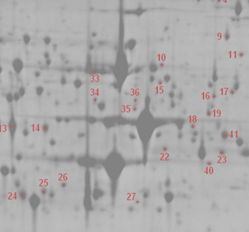

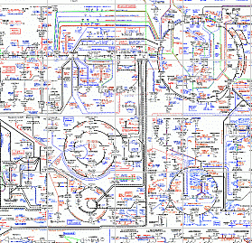

Synergy for (not so) Dummies™
Diverse community-specific extensions
Generic Features (origin of biomaterial)
Generic Features (experimental design)
Transcriptomics
Proteomics
Metabolnomics
Gels
MS
MS
Arrays
NMR
Columns
FTIR
Scanning
Arrays &
Scanning
Columns

Slide 19
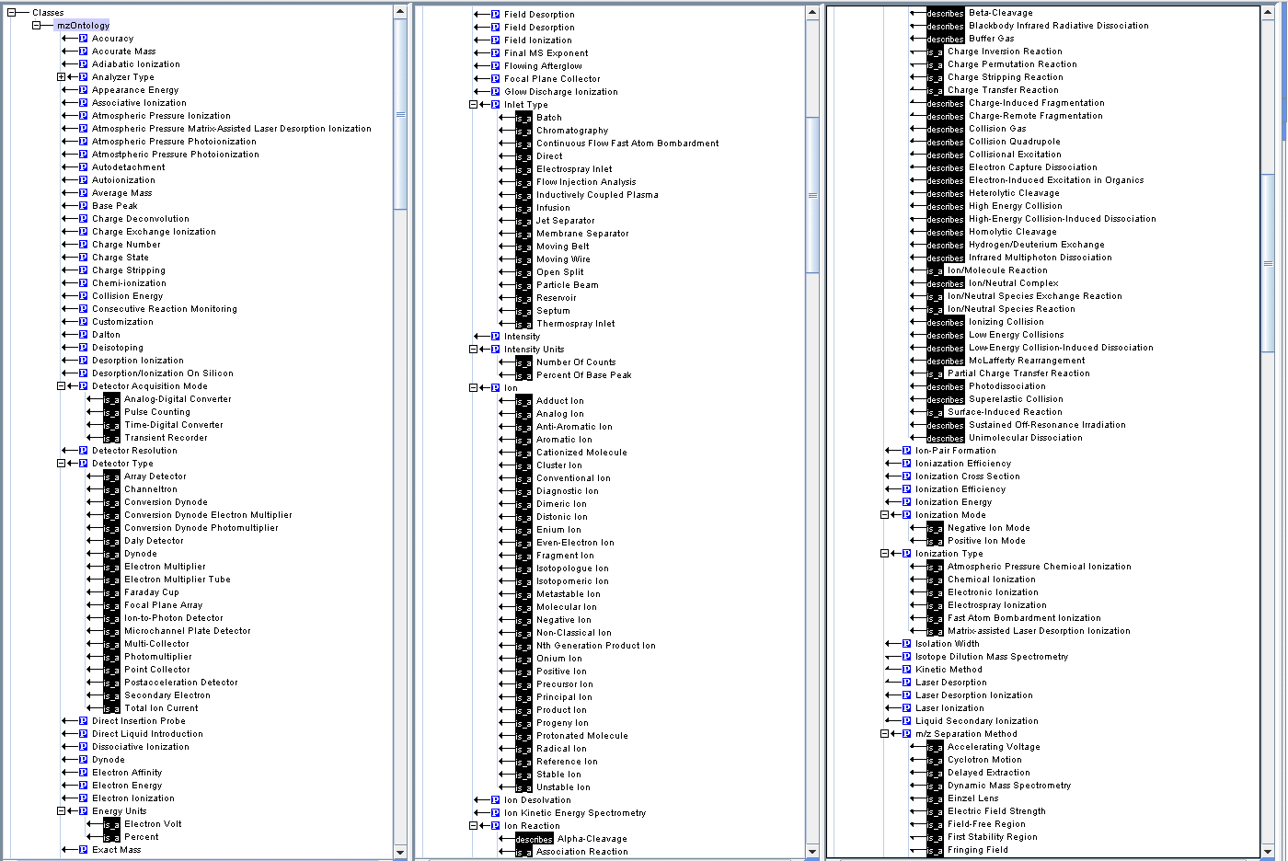
PSI — CVs and FuGO
PSI: MS controlled vocabulary generation
  Term collection began some time ago
  CV now available in OBO format
  Includes IUPAC terms
The next steps
  Rebinning of the MS controlled vocabulary (in Excel)
  Tracking the evolution of the ‘live’ OBO format
Where we are going:
1) CVs that support the use/implementation of formats
  mzData, analysisXML, GelML, +++
    Tied explicitly to the elements in the format
2) Full-blown ontological structuring of those same terms
  Insertion into FuGO
  Linking through accessions back to the format-linked CV
    Allows re-use of terms by other communities

Slide 20















