Slide 1
MGED
Reporting Structure for Biological Investigations
RSBI Working Group
Outline
Introduction – Relationship with proteomics/metabolomics
Susanna-Assunta Sansone
****
Knowledge elicitation and contribution to FuGE
Philippe Rocca-Serra
****
Proposal to encode metadata
Norman Morrison

Slide 2
MGED RSBI
Inter-omics, cross domains collaborations (Susanna Sansone, EBI)
  Communities endorsing omics standards
  Databases development ongoing
  Large user-base to support
Current Working Groups
  Nutrigenomics WG (Philippe Rocca-Serra, EBI)
    - European Nutrigenomics Organization (NuGO), EBI
  Toxicogenomics WG (Jennifer Fostel, NIEHS-NCT)
    NIEHS-NCT, NCTR-FDA, ILSI-HESI Committee, EBI
  Environmental genomics WG
    - Norman Morrison, NERC Data Centre
      -> NERC Genomics and Post-Genomics Programmes
Collaborators
  Robert Stevens (Un of Man), Chris Taylor (HUPO-PSI)
  Karim Nashar (student: Un of Man), Alex Garcia (student: EBI)
    - BBSRC funded post-doc position open (2 years at EBI)

Slide 3
MGED RSBI - Objectives
Optimize interoperability
  Common syntactical and semantic description of investigations
    - Ontologically grounded high level, common features
Contribute to functional genomics standards
  FuGE Object Model
  FuGO Ontology
Synergize with other efforts
  Technology-driven standardization efforts
  - MGED WGs, PSI and SMRS group
  Domains of applications
    - Nutrition, toxicology and environmental communities
  (HL7-CDISC-I3C) PGx Standard Group, OECD (Eco)TGx Taskforce, ECVAM TGx Taskforce (EU REACH Policy)
  Ontogenesis Network

Slide 4
Functional Genomics Context
Pieces of the omics puzzle
  Standards should stand alone
  Standards should also function together
    - Build it in a modular way
    - Maximize interactions
    Share common modules
Benefits
  Facilitate integration of omics data
    - Data producers, miners, reviewers
  Optimize development of tools (time and costs)
    - Manufactures and vendors covering in multiple technologies
Extensive community liaisons required!

Slide 5




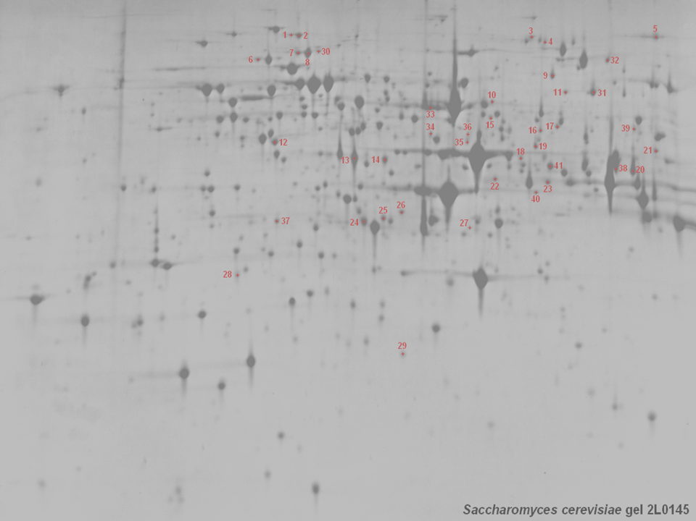
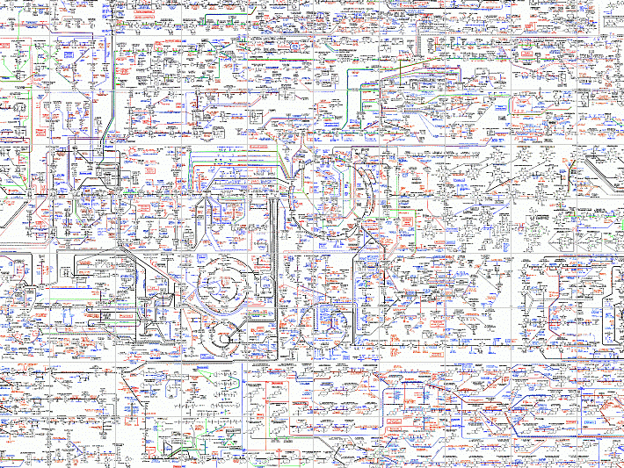
Functional Genomics Context
  Diverse community-specific extensions
  (e.g. toxicology, nutrition, environment)
Biology
Generic
features
      -> Design of investigations
      -> Sample descriptors
Technology
MGED
Society
HUPO
PSI
Metabolomics
Society (?)
Transcriptomics
Proteomics
Metabol/nomics
Gels
MS
MS
Arrays
Columns
NMR
FTIR
…
Scanning
Arrays &
Scanning
…
  Significantly affect structure and content of each standards
  More than just ‘Generic Features’ in common

Slide 6
HUPO-PSI Group
Human Proteome Organization
  Coordination of public proteome initiatives
PSI focus is generation of data standards
  Academia, vendors, database developers and journal editors (Proteomics)
Working groups, meetings, jamborees and training
MI - WG
MS - WG
GPS - WG
H. Hermjakob
EBI
R. Julian
Eli Lilly
C. Taylor
EBI
Standards for molecular interaction
Standards for mass spectrometry
Standards for general proteomics

Slide 7
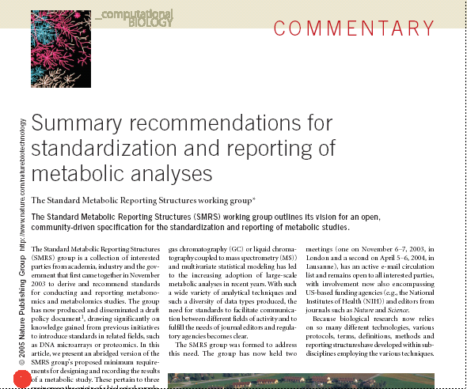
The SMRS Group - Reporting
April 2004, Nestle’, Geneva
Standard Metabolic Reporting Structures (SMRS) group:
John C Lindon¹, Jeremy K Nicholson¹, Elaine Holmes¹, Hector C Keun¹, Andrew Craig¹, Jake T M Pearce¹, Stephen J Bruce¹, Nigel Hardy², Susanna-Assunta Sansone³, Henrik Antti⁴, Par Jonsson⁴, Clare Daykin⁵, Mahendra Navarange⁶, Richard D Beger⁷, Elwin R Verheij⁸, Alexander Amberg⁹, Dorrit Baunsgaard¹⁰, Glenn H Cantor¹¹, Lois Lehman-McKeeman¹¹, Mark Earll¹², Svante Wold¹³, Erik Johansson¹³, John N Haselden¹⁴, Kerstin Kramer¹⁵, Craig Thomas¹⁶, Johann Lindberg¹⁷, Ina Schuppe-Koistinen¹⁷, Ian D Wilson¹⁸, Michael D Reily¹⁹, Donald G Robertson¹⁹, Hans Senn²⁰, Arno Krotzky²¹, Sunil Kochhar²², Jonathan Powell²³, Frans van der Ouderaa²³, Robert Plumb²⁴, Hartmut Schaefer²⁵ & Manfred Spraul²⁵

Slide 8
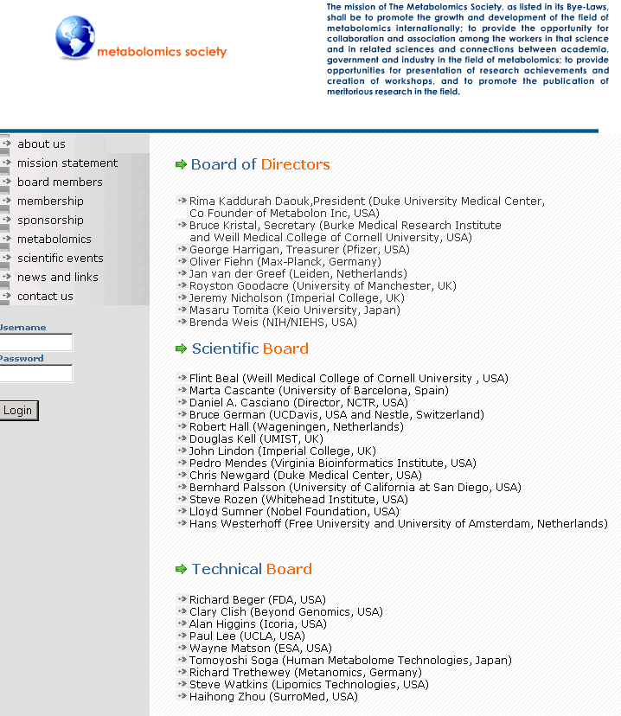

The Metabolomics Society - Journal

Slide 9






Our Attempt - Foster Collaborations
80 attendees
Academia
Vendors/Sofware
  Applied Biosystems, Bruker BioSpin & Daltonic GmbH, Thermo Corp., Varian, Advanced Technologies (Cam), BioWisdom, GenoLogics Life Sciences Software, Umetrics
Industry
  AstraZeneca, GSK, Novo Nordisk, Pfizer, Scynexis, Syngenta
Gov bodies
  BBSRC, NERC, National Measurement System Directorate (DTI)
MetaboMeeting (s)
March and July 2005,
Cambridge
Organising Committee:
Julian Griffin (Un of Cambridge)
Chris Taylor (EBI and HUPO-PSI)
Susanna-Assunta Sansone (EBI and MGED)
Sponsors

Slide 10
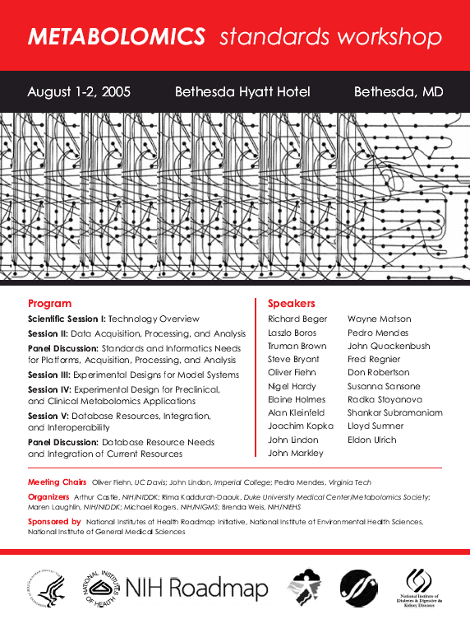
Presenting our Proposal
150 attendees, 2 days
Academia
Vendors/Sofware
  Agilent, Bruker, GenoLogics
Industry
  GSK, Nestle, Pfizer, Merk, Invitrogen, Oxford Biomedical, Lipidomics, Metanomics, Chemomx
Reg bodies
  FDA institutes
Gov bodies
  NIH institutes
Metabolomics Society
NIH Roadmap

Slide 11
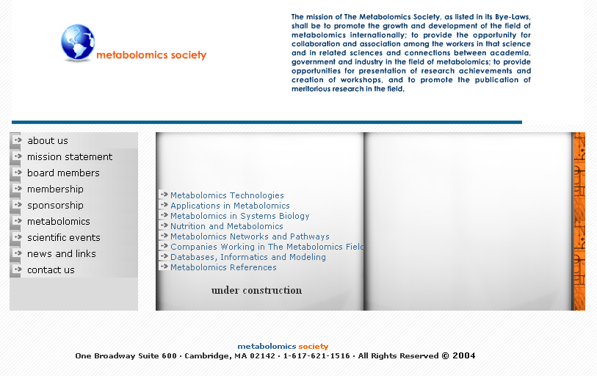
Towards a Coordinated Effort…..
Oversight
Committee
Working
Groups
Chair - O. Fiehn
Members
R. Kaddurah-Daouk,
SA Sansone,
P Mendes,
B Kristal,
N Hardy,
L Sumner,
J Lindon
Ex-officio
J Quakenbush, A Castle
Data communication
  Reporting structure
    - SMRS wg
  Storage and exchange formats
    - NMR, MS and L/GC wgs
  Semantic
    - Ontology wg
  Integration / Functional Genomics
    MGED and HUPO-PSI
Others (QMs, ref samples, nutrition, etc.)

Slide 12
MGED
Reporting Structure for Biological Investigations
RSBI Working Group
Outline
Introduction – Relationship with proteomics/metabolomics
Susanna-Assunta Sansone
****
Knowledge elicitation and contribution to FuGE
Philippe Rocca-Serra
****
Proposal to encode metadata
Norman Morrison

Slide 13
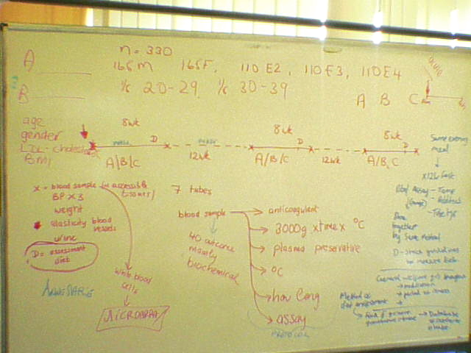
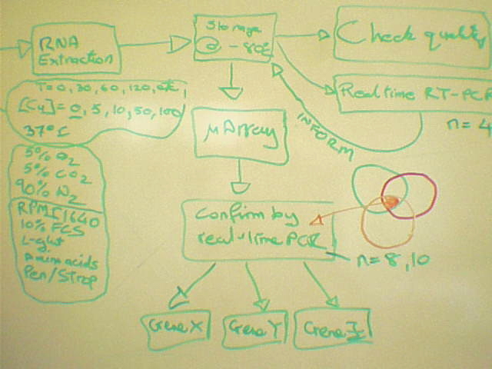
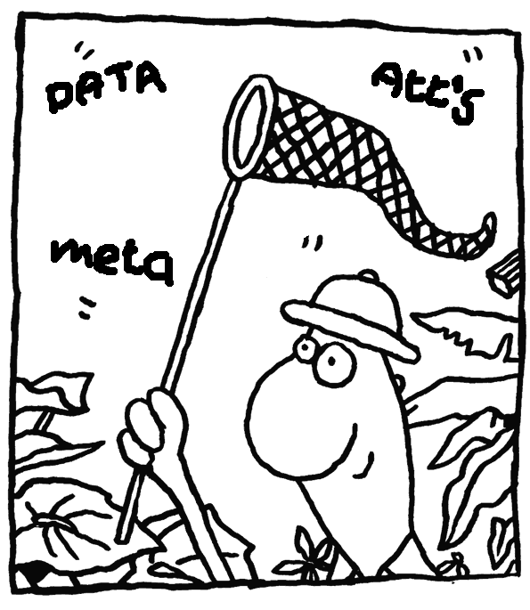
Knowledge Safari
1 – Knowledge
elicitation
2 – Define the
concepts
Users interaction
1:1 or 1: many interactions
  Interviews
  Conceptual MAPS (cMAP)
  Informal representation of knowledge like diagrams
  Survey forms
  Email
3 – Model the
concepts
Hunting the ‘big game’
  Basic understanding “how do you represent an investigation”
  Minimal information (concepts) so investigation can be shared
  Relationship between these concepts

Slide 14
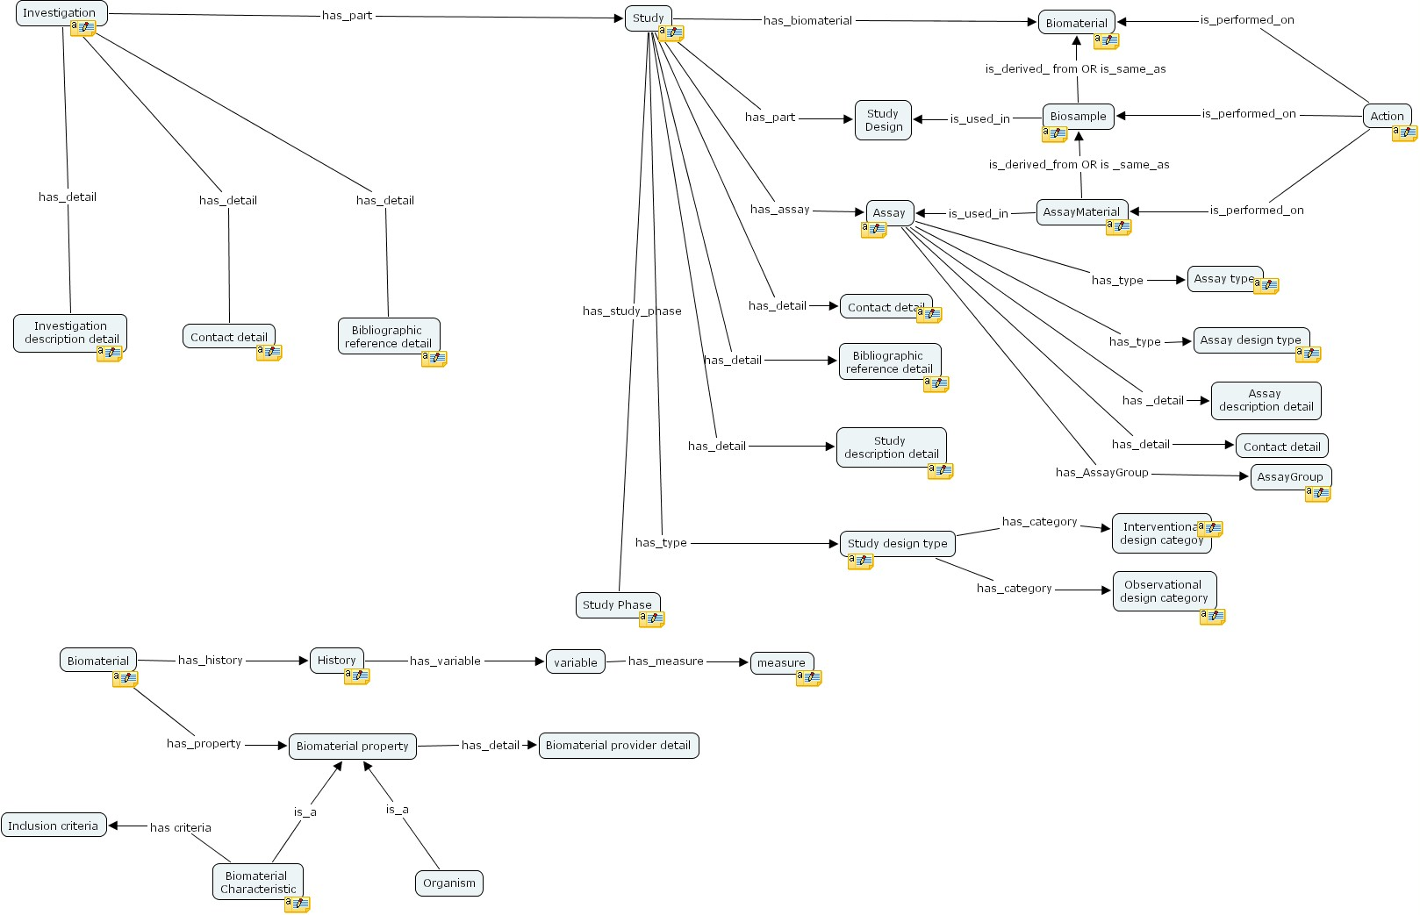
Cons -> Semantic free
  No way to validate the representations
Pros -> Intuitive, sharable, informal
  One to one or one to many interaction

Slide 15
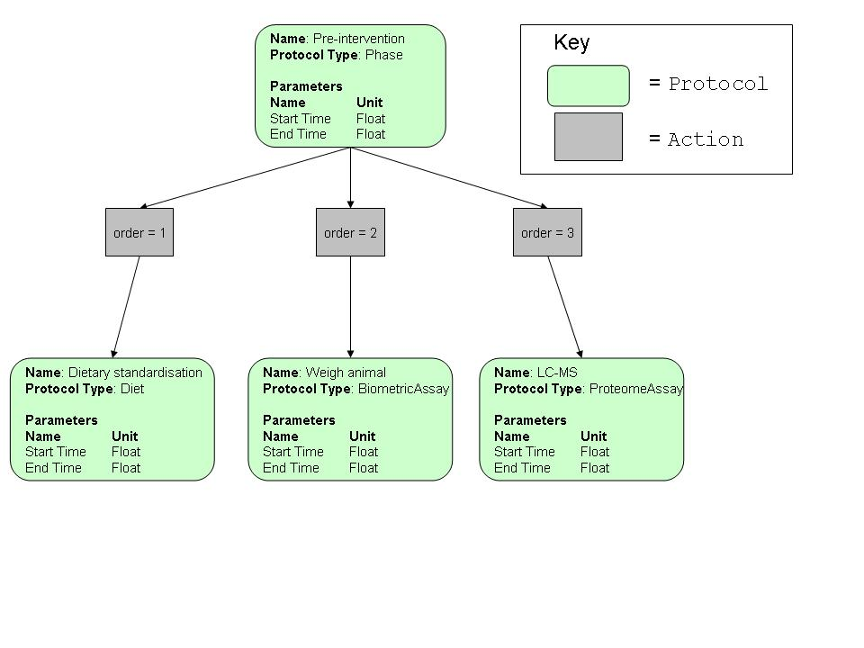
Contributing to FuGE
RSBI use cases and FuGE
  Providing real examples and terminology that bench researchers believe should be reported in a data model
Example
  Investigation-> Study -> StudyPhase -> Assay

Slide 16
MGED
Reporting Structure for Biological Investigations
RSBI Working Group
Outline
Introduction – Relationship with proteomics/metabolomics
Susanna-Assunta Sansone
****
Knowledge elicitation and contribution to FuGE
Philippe Rocca-Serra
****
Proposal to encode metadata
Norman Morrison

Slide 17
Generic Attribute Construct
Entity or Thing
Property or Modifier
Value
Unit
Assay
Entity or Thing
  A concept that represents an entity that exists, potentially described in another ontology
Property or Modifier (Measure)
  A characteristic of the entity that is measured, for example, size, weight, loudness, gestation period.
Value
  The value - not necessarily quantitative.
Unit
  Unit – where appropriate.
Assay
  The assay used to measure the property of the entity

Slide 18
Simple Characteristics
Phenotypic ‘Characteristic’
  Calipers were employed to measure the length of the dorsal fin of a Stickleback. The fin was measured to be 1.2 cm
Environment ‘Characteristic’
  The sample was taken at a depth of 60m in the Sargasso Sea. The sampling depth was measured using sonar
Nutritional Characteristic
  The body weight was measured to be 45kg using bathroom scales
Etc…
NOTE
  Can also be applied to relative characteristics, ie dissolved oxygen content in mg/l

Slide 19
Decomposing Free Text
Entity or Thing
Property or Modifier
Value
Unit
Assay
Dorsal Fin
Length
0.012
m
Calipers
Sargasso Sea
Depth
60
m
Sonar
Body
Weight
45
kg
Bathroom
Scales

Slide 20
Entity Derived from Ontology
Environment
  AquaticEnvironment
    - MarineEnvironment
      Sea
        Instance: Sargasso

Slide 21
Mechanisms for FuGO structure
2 Models
  1 Ontology that facilitates representation of concepts from multiple distinct domains, both technological and biological
  Multiple ontologies brought together in a federated structure by a common ontology

