Slide 1


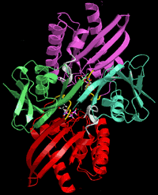
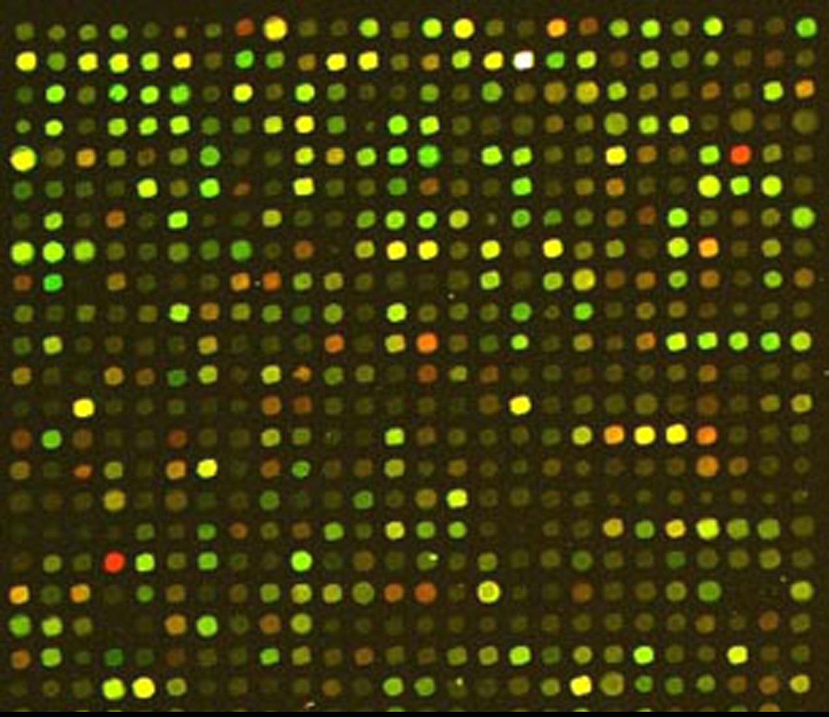
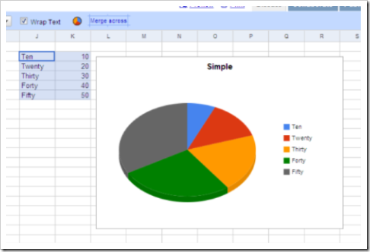


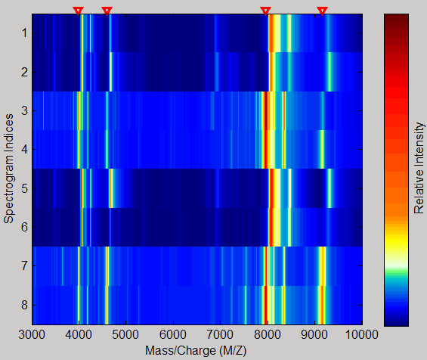
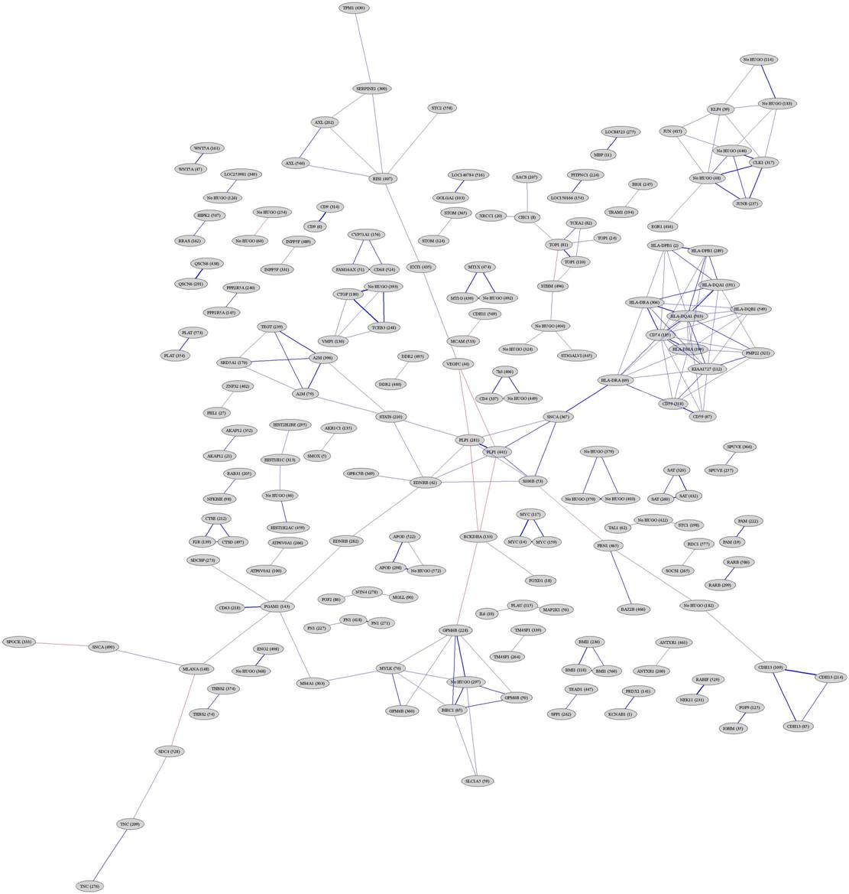

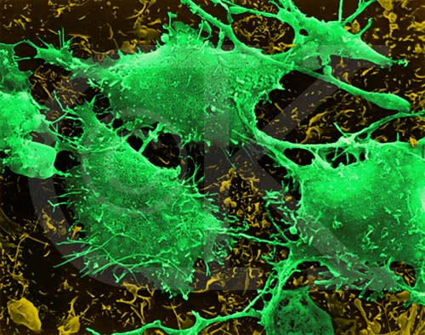

OBI: The Ontology for Biomedical Investigations
OBI Communities
Melanie Courtot and James Malone on behalf of The OBI Consortium*
The OBI project is an international, collaborative effort to build an ontology to be used for annotation of Biomedical Investigations.
It comprises more than 40 scientists representing 18 biological communities, including Flow Cytometry, Immunology, Transcriptomics…
http://obi.sourceforge.net
What is an ontology and why do I need one?
Standards for data representation and minimum information enhance the value of experiments. However, even if all researchers and clinicians who generate data agree on what details are required, it is not possible for a computer to recognize this information unless the terms that are used are also standardized. Ontologies, by providing a common vocabulary to annotate data, are essential to facilitate the interchange of flow cytometric analyses between software packages, investigators and laboratories.
Why is it important for computers to be able to recognize this information?
By using ontologies, scientists will be able to compare results that might have seemed irreconcilable before, by adding the missing biological context to the data file. By tackling the semantics of the information it is possible to integrate and distribute data, therefore allowing complex queries across systems.
The solution
The Ontology for Biomedical Investigations, OBI (formerly known as the Functional Genomics Investigation Ontology, FuGO) is developing an integrated ontology that can be applied to the description of Flow Cytometry (FCM) data. OBI is an international- open collaborative effort by several groups representing technological and biological domains. It seeks to develop an integrated ontology that provides both a set of universal terms and domain-specific extensions for terms relevant only to a given domain. The purpose of this ontology is to support the consistent annotation of biomedical investigations, regardless of the particular field of study. The ontology will model the design of an investigation, the protocols and instrumentation used, the material used, the data generated and the type analysis performed on it.
Example of an OBI Term?
The Ontology for Biomedic
Coordinating Committee
Developers Working Group
Community Representatives
The Developers Working Group consists of all developers within the communities collaborating in the development of OBI.
The representives of the communities participating in the development of OBI.
Core Developers
Advisory Group
Core Developers are considered key to the evolution of the ontology, but may or may not be members of any single community.
The Advisory Group consists of individuals invited by the Coordination Committee to provide expert advice in areas such as ontology best practices and technical implementation issues.
OBI: Connecting the pieces…
Design & Inputs:
OBI covers inputs to experiments such as your materials, your plans and protocols
Experimental Data:
OBI covers data formats, pre-processing
Data Analysis:
OBI covers data transformations, analysis methods
Data sharing:
OBI aids integration, consistent representation and data sharing
OBI examples:
digital entity
eMedical record
binary executable
data transformation
loess transformation
logistic-log curve fitting
OBI examples:
data transformation
similarity calculation
replicate analysis
k-means clustering
report figure
dot plot
OBI examples:
study design
clinical study design material
blood serum
OBI integrates with:
ChEBI
Cell Ontology
……..
*OBI Consortium (in alphabetic order): Ryan Brinkman, Bill Bug, Kevin Clancy, Christian Cocos, Melanie Courtot, Liju Fan, Jennifer Fostel, Gilberto Fragoso, Frank Gibson, Mervi Heiskanen, Tina Hernandez-Boussard, Allyson Lister, James Malone, Elisabetta Manduchi, Chris Mungall, Helen Parkinson, Bjoern Peters, Matthew Pocock, Philippe Rocca-Serra, Daniel Rubin, Alan Ruttenberg, Susanna Sansone, Richard Scheuermann, Daniel Schober, Barry Smith, Chris Stoeckert, Trish Whetzel
http://obi.sourceforge.net
Join our mailing list
obi-users@googlegroups.com

