Slide 1
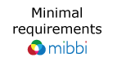

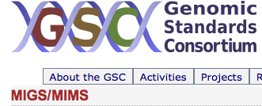



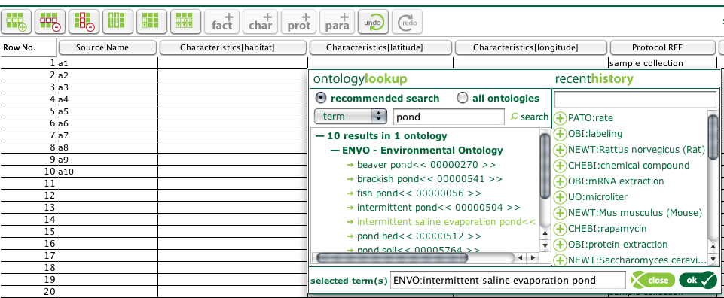
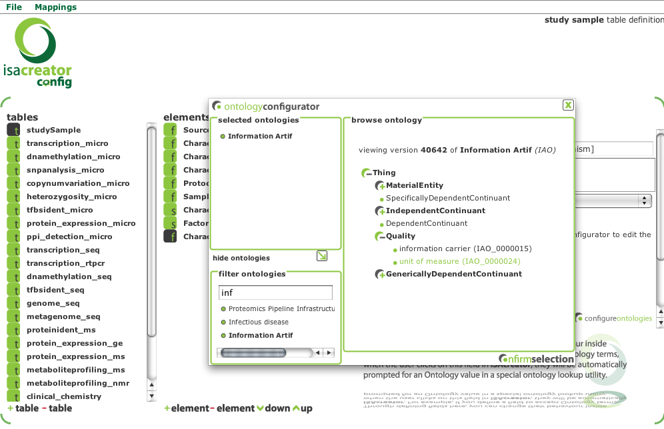
Community of users
Spelling out Minimal Annotation Requirements
Deliver Annotation Tool back to the community of users for annotating experimental data
Mapping MIGS Annotation Requirements to ISATAB syntax elements and to public Ontology Resources from available servers (OLS & Bioportal) for labels and ranges of possible values.
The Open Biomedical Ontologies
ISAcreator Annotation to allow logging of term requests
ISAcreator Annotation Tool running a MIGS compliant configuration, enabling consistency checks and annotation compliance
ISAconfigurator tool used to generate a MIGS compliant configuration within ISA-TAB syntax framework

