Slide 1
Instrument Branch
Core representational units

Slide 2
The instrument branch
Tasked with the representation of material entities that are manufactured with the intent to provide an intended function, used within a biomedical investigation.
  e.g scientific equipment
Daniel Schober used to be the Branch leader – currently leaderless – Nominations welcome…

Slide 3
artifact_object
  is_specified_output_of some ‘artifact material creation’
  Apparently we changed the label…

Slide 4
Device
  material_entity
  has_function some function
  is_manufactured_by some (organisation or ‘homo sapiens’)
  is_specified_output_of some ‘artifact material creation’

Slide 5
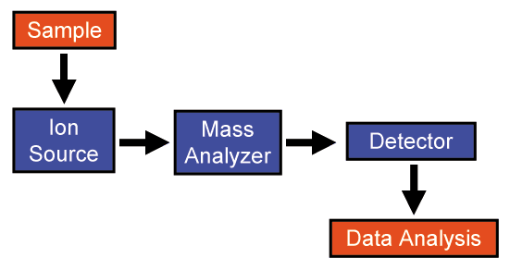
Example: A mass spectrometer
has_part some ion_source
has_part some mass analyzer
has_part some detector

Slide 6
Instrument
  is_manufactured_by some organisation or ‘homo sapiens’
  is_specified_output_of some ‘material artifact creation’
  has_function some ‘produce data function’

Slide 7
Platform
  has_part some device
  has_part some software
  is_manufactured_by some (organisation or ‘homo sapiens’)
  is_specified_output_of some ‘artifact material creation’

Slide 8
Issues
We were waiting for the MSI namespace issue to be resolved – now we have to curate the crap terms and duplication that have been imported
Begin to move device terms from under device and under material entity
How do we define the inputs and outputs of a device?
  e.g materials and data

Slide 9
Device relations

Slide 10
Proposal
Device_setting_specification = Is a relation between a device and an setting_datum (information content entity) which specifies how a device can be controlled or configured as a participant in a process
Is this actually different from parameters/variables?
Above accounted for by the following proposal;
  Device_setting inheres_in some device and is concretisation of some (device_setting_specification and is_about a quality of the device)
  Device_setting – directly under dependent continuants Editornote: this may be a quality although who knows?
  Examples, 300V for 4 hours, 200mvolts, 37degrees.A knob set a 300 V is the device setting, the protocol stating to set the instrument to 300V is a device setting specification

Slide 11
utlizes_device
Another case of “its in my head and not in the file”
The def in file
  Relationship between protocol application and an instrument in which it participates
What is actually is meant to mean
  Realizes some (function is_function_of some device)

Slide 12
utilizes_device
Do we really need it?

Slide 13
Function arc
function
has_function
realised_by
device
process

Slide 14
The long way to do it
Some_process
  Realizes some (function is_function_of some device)

Slide 15
How to represent the intended meaning
process
has_part some canonical_realisation_of_device_function
Device_function
-is_function_of some device
has_part
realizes
Canonical_realisation_of_device_function
has_participant some device
Realizes some device_function

Slide 16
Decisions
Utilzes_device is depreciated and accounted for by the function arc
Utilizes_reagent is depreciated

Slide 17
Acknowledgements
The instrument branch
Daniel Schober
Melanie Courtot
Ryan Brinkman
Frank Gibson

Slide 18
License
licensed under a Creative Commons Attribution 3.0 License_x000b_

