Slide 1


Top Level Ontologies
Daniel Schober
(EBI, Metabolomics Society O-WG)
FuGO Workshop, Philadelphia, February 13th-15th 2006

Slide 2
Talk Structure
Top level Ontologies
  Whats that ?
  Why that ?
  Which one ?
  TLO_KB.pprj
  Naming Conventions ?

Slide 3
Top Level Ontologies (TLO)
TLO → Reference O., Generic O. Core O., Foundational O.,
High-level O, Upper O.
describe very general concepts like space, time, event, which are independent of a particular problem or domain
describe the vocabulary related to a generic task or activity by specializing the top-level ontologies.
domain ontology
task & problem-solving ontology
describe the vocabulary related to a generic domain by specializing the concepts introduced in the top-level ontology.
the most specific ontologies. Concepts in application ontologies often correspond to roles played by domain entities while performing a certain activity.
application ontology
[Guarino, 98]

Slide 4
TLO
Attributes: KR-Format, granularity, axiomatisation, extension of conceptual coverage, reused, soundness,..., others....
TLO-Library→TLO-KB.pprj (28 TLO´s)
Requirements:
Domain independent (general)
Language independent (not dictated by the lexicalisation patterns of a particular language)
Consistent
Understandable accd. to common sense (vs)
Well-formed (axiomatic)
Set of mutually disjoint notions (e.g.cont vs occur)
Hard to define border to domain top level.
(Some TLOs contain quite specific things...)

Slide 5
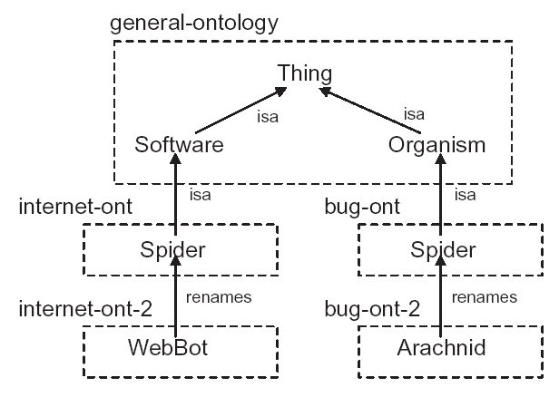
TLO goals/usage
Quality assurance: (Hopefully) Clear classification principles and definitions derived from TLO
Taxonomic guidance (10 Questions):
  Help domain experts rate their starting points and patterns.
  Classes that are related to disjoint top-level concepts cannot be matched & confused
  Attribute inheritance makes misclassifications
  obvious
Ontology Alignment, Mapping
  (Re-use, integration, interoperability)
Ontol Library schemata
Homonym disambiguation
(NLP, see picture)
Synonym detection
  (Avoid Redundancies)
[Hefflin and Hendler 2000]

Slide 6
How to get a useful TLO ?
3 ways:
Look at existing TLO´s
Look at Ontology Library Schemata (OBO Core) & Ontology Alignment Mappings
Build own TLO bottom up: which TLO classes are implied by collected Bioontology upper level classes?
  Done so by FuGo (e.g. „Characteristic“, Fugo-devel- email Barry 18Jan06)

Slide 7
TLO
(Size/Precision vs. Formality)
Cyc
WordNet
SUMO
UMLS
Yahoo!
DOLCE
Taxonomy
Lexicons
Formal
Ontology
Size
Formality

Slide 8
Self-standing vs Refining
(A. Rector, GALEN-ULO)
Self-standing
    Hand, Person, Computer, Idea…
Refining
    Left, Size, severity, …
Self_standing_entity is_refined_by Refining_entity
  Establishes the domain & range of a top property distinction
Does it make sense on its own? Yes→ Self_standing

Slide 9
Continuant vs Occurrent
Thing vs Process
  Organ vs Metabolism
Physical (material) vs Non_physical
  Non_physical is_manifested_by Physical
Continuants participate_in Occurrents
  “Things participate in Processes”
  “Processes happen to Things”
Continuants (“perdurants”)
  Things that retain their form over time
    People, books, desks, water, ideas, universities, …
Occurrents
  Things that occur during time
    Living, writing a book, sitting at a desk, the flow of water, thinking, building the university, ...
Question: Do things happen to it? → Continuant
Does it happen or occur? → Occurrent

Slide 10
Material vs Non-material
Within Physical:
Chest vs Chest_cavity
  The problem of holes:
    Material defines non_material (things define “holes”)
      The intersection of the walls defines the corner

Slide 11
Discrete vs Mass
Discrete_entities are constituted of Mass_entities
  Organ made_of Tissue
Discrete things can be counted
Mass things can only be measured
  Guarino calls them “Amount of matter”
Questions:
    Can I count it? Yes→Discrete
    If I make a plural, is it odd or something different?
    e.g. “waters”, “papers”, “thinkings”
    Do I say pieces/drops/lumps of it? Yes→Mass

Slide 12
Taxonomic Guidance
10 Questions→What is an “Organelle”?
Is it Continuant or Occurrent? Continuant
  Does it happen or do things happen to it?
Is it physical? Yes
Is it Discrete or mass? Discrete
  (Can you count it?)
Is it material or non-material ? Material
Is it part of something? Yes
Has it a definite number or not? Yes
    Collectives of Organels are part of Cytoplasm`
→”Organelle” is_a “Cell_part” is_a “Biological_object”

Slide 13
What is “Digestion”?
Is it Continuant or occurrent? occurrent
Is it physical? Yes
Is it discrete or mass? ???
Is it biological? Yes
If so is it pathological No
→ “Digestion” is_a “Biological_physical_occurrent”

Slide 14
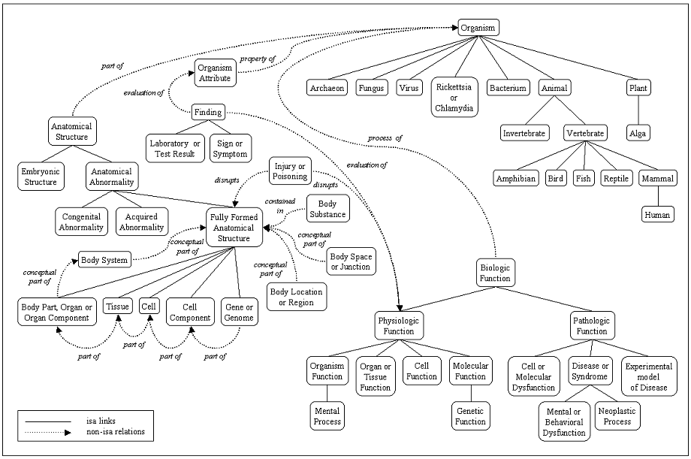
UMLS Semantic Net

Slide 15
UMLS Inconsistencies
Idea or Concept
Functional Concept
Qualitative Concept
Quantitative Concept
Spatial Concept
Body Location or Region
Body Space or Junction
Geographic Area
Molecular Sequence
Amino Acid Sequence
Carbohydrate Sequence
Nucleotide Sequence
“Philadelphia”→ Idea or Concept ???

Slide 16
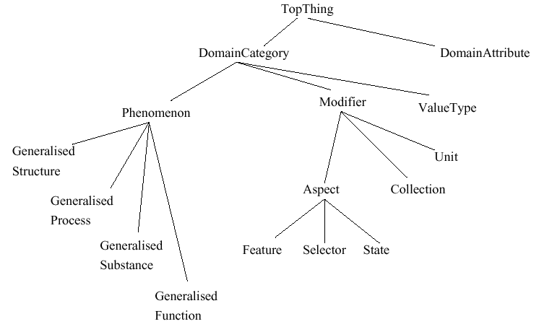
TAMBIS Upper Level

Slide 17
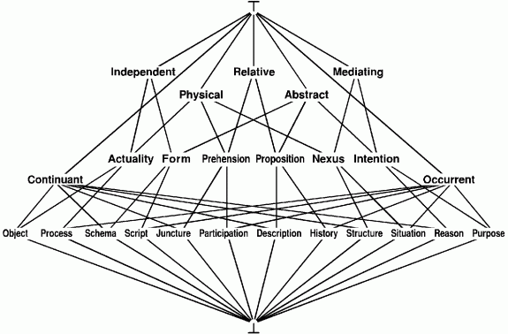
Sowa´s TLO

Slide 18
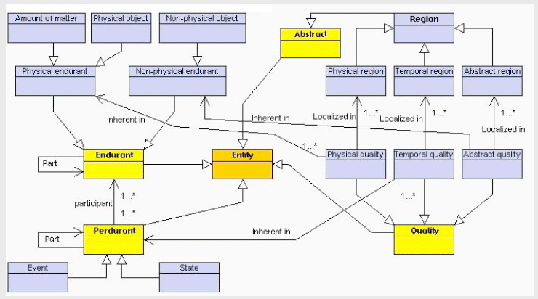
DOLCE (WonderWeb, EU)

Slide 19
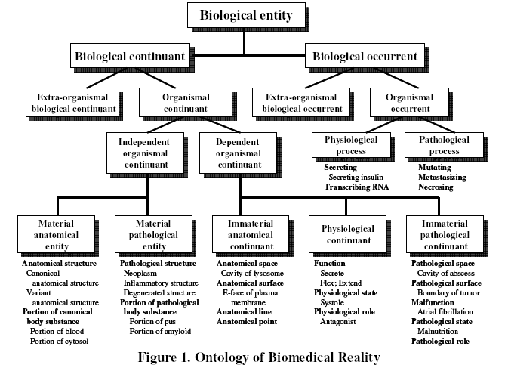
OBR (Barry Smith)

Slide 20
SUMO (IEEE-SUO-WG)
entity
physical (things which have a position in space/time)
object → FuGo top level (indept cont)
selfconnected object
process → FuGo top level (dept occur)
abstract (don´t have a position in space/time)
quantity
number
attribute → FuGo top level „Characteristic“ (dept cont)
set or class
relation
proposition
+ FOL Axioms

Slide 21
“Blood” in the UMLS
Entity
Physical Object
Anatomical Structure
Fully Formed Anatomical Structure
An aggregation of similarly specialized cells
and the associated intercellular substance.
Tissues are relatively non-localized in comparison to
body parts, organs or organ components
Tissue
Body Fluid
Soft Tissue
Body Substance
Blood

Slide 22
“Blood” in WordNet
Entity
Physical Object
Substance
Body Substance
Body Fluid
the four fluids in the body whose balance was believed to determine our emotional and physical state
Humor
Blood
As well as phlegm, yellow and black bile

Slide 23
“Blood” in GALEN
DomainCategory
Phenomenon
GeneralisedSubstance
SubstanceorPhysicalStructure
Substance
Tissue
SoftTissue
As well as Lymphoid Tissue,
Integument, and Erectile Tissue
Blood
Blood has two states, LiquidBlood and CoagulatedBlood

Slide 24
“Blood” in SNOMED
Substance
Substance categorized by physical state
Body Substance
Liquid Substance
Body fluid
As well as lymph, sweat, plasma, platelet rich plasma, amniotic fluid, etc
Blood

Slide 25
“Blood” in Digital Anatomist
Anatomical Entity
Physical Anatomical Entity
a physical anatomical entity and a substance in gaseous, liquid, semisolid or solid state, with or without the admixture of cells, which is produced by anatomical structures or derived from inhaled and ingested substances that become modified by anatomical structures as they pass into or through the body
Body Substance
As well as saliva, semen, growth hormone,
inhaled air, feces, lymph
Blood
Tissue is an Organ Part.

Slide 26
„Conclusions“
Diverse TLO´s.
All have Pros & Cons, many have inconsistencies
Different „Time“ representation (... if any)
„There is no one way! No matter how much some people want to make it a matter of dogma“ (Alan Rector)
Current Fugo TLO is quite in accordance to most TLOs, but misses „middle level“
Has to be expanded
Maybe build our own (bottom up) as needed?

Slide 27
Next Steps
TLO_KB
Naming Conventions
Textmining:
  Co-op with Inhouse NLP-Groups
    Ontology refinement
    Harvest PubMed and WWW
    Morpheme & Lexical Analysis

Slide 28
Of Advantage for “Binning“...
Higher semantics (more info)→Easier Binning
TLP & Naming Conventions help
  also for Domain CVs (MIAXXXX)
Similarity metric of OWL-L Ontologies exploitable for O. Merging/alignment:
e.g. [Euzenat, Volchev 04]
KR-Idioms harvestable:
Hierarchy (Sub & Superclasses), classes/
Defs (DL Expr), properties incl. Ranges, Facets & restrictions on these properties
Others: Instance similarities, Defs (NL)

Slide 29
Acknowledgements
Gilberto Fragoso
Barry Smith & Alan Rector
...from which many slides shown „Inherited“
Susanna Sansone, Phillipe Rocca-Serra
Project Website
http://www.ebi.ac.uk/microarray/Projects/tox-nutri/

Slide 30
KR-Naming Conventions
Conventions: Completeness vs pragmatics
No Problems arosed from „KR-semantics name heterogenity“ so far
Few, if any, Problems arosed from KR-Metaidiom Name heterogenity
→concentrate on KR-Naming

Slide 31
Naming Conventions
Different communities → Different notions
AI: Frame
DL: Concept name
OOM: Class

Slide 32
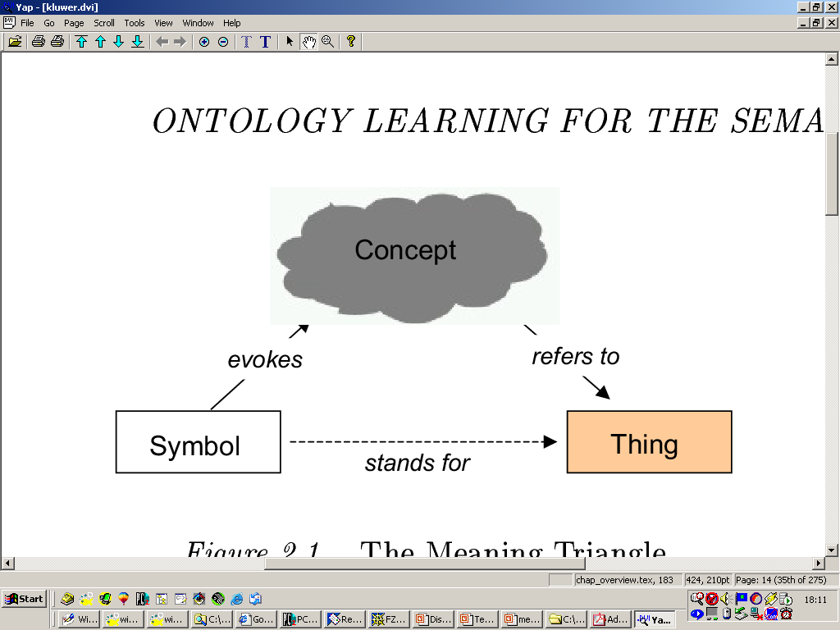
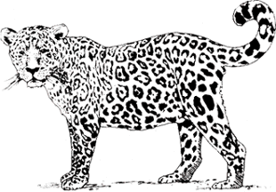
Semantic Triangle
Concept
“Jaguar“
[Ogden, Richards, 1923]

Slide 33
Nonphysical entities (complicated)
What is “Faust” ?
    The script for Faust in the library?
    The historic person Dr. Faustus ?
    A performance?
  Faust has_manifestation Book_of_Faust
  Performance_of_Faust ?

Slide 34
Top-Level
Ontology
Middle
Ontology
Domain
Ontology

Slide 35
General Problems
(From Barry`s tutorial)
Don’t confuse entities with concepts
Don’t confuse domain entities with logical structures
Don’t confuse ontology with epistemology
Don’t confuse is_a with has_role→
Unintuitive rules for classification lead to coding errors, difficulties in training of curators, in ontology and in harvesting content in automatic reasoning systems

Slide 36
Collective vs Individual
Collectives of discrete entities at one level of granularity form mass entities at the next
  Cells form Tissue
Collectives
  Object is_grain_of Collective
    Red_blood_cell is_grain_of Blood_cell_fraction
  The concern is with the collective as a whole not its ‘grains’
  Loss or gain of grains does not affect identity of multiple
  Grains are always smaller than the multiples they make up

Slide 37
Hard to define (perspective dependent)
"On those remote pages it is written that animals are divided into:
a. those that belong to the Emperor
b. embalmed ones
c. those that are trained
d. suckling pigs
e. mermaids
f. fabulous ones
g. stray dogs
h. those that are included in this classification
i. those that tremble as if they were mad
j. innumerable ones
k. those drawn with a very fine camel's hair brush
l. others
m. those that have just broken a flower vase
n. those that resemble flies from a distance"
From: The Celestial Emporium of Benevolent Knowledge, Borges

Slide 38
OWL-S
  A TLO for Services
provides
Resource
Service
presents
supports
What it does
describedBy
Service profile
Service grounding
Service model
How to access it
description
How it works
functionalities
functional
attributes
Notes:
Domain coverage
What does this service do?
Service capability
How does it do it?
Inter-service relationships
How can I combine services successfully and meaningfully?

Slide 39
Ontology Libraries
WebOnto (http://eldora.open.ac.uk:3000/webonto):
  Knowledge Media Institute, Open University, UK,
Ontolingual (http://www-ksl-svc.stanford.edu:5915/):
  Knowledge Systems Laboratory, Stanford University, USA)
DAML Ontology library system (http://www.daml.org/ontologies/):
  DAML, DAPAR, USA
SHOE (http://www.cs.umd.edu/projects/plus/SHOE/):
  University of Maryland, USA
Ontology Server (http://www.starlab.vub.ac.be/research/dogma/OntologyServer.htm):
  Vrije Universiteit, Brussels, Belgium
IEEE Standard Upper Ontology (http://suo.ieee.org/refs.html):
  IEEE
OntoServer (http://ontoserver.aifb.uni-karlsruhe.de/):
  AIFB, University of Karlshruhe, Germany
ONIONS (http://saussure.irmkant.rm.cnr.it/onto/):
  Biomedical Technologies Institute (ITBM) of the Italian National Research Council (CNR), Italy

Slide 40
The Ontology Pyramid
FoL /
HoL
Meta Ontologies
Top Level Ontologies
Top Domain
Ontologies
OWL
classes
Domain Content
Ontologies
Information
systems &
resources
Databases, RDF
Instance stores, …
(“individuals”)

Slide 41
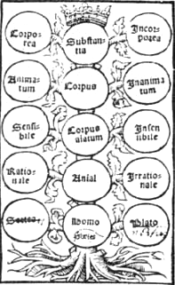
Aristotle’s Categories
From Porphyry’s Commentary on Aristotles’s Categories

Slide 42
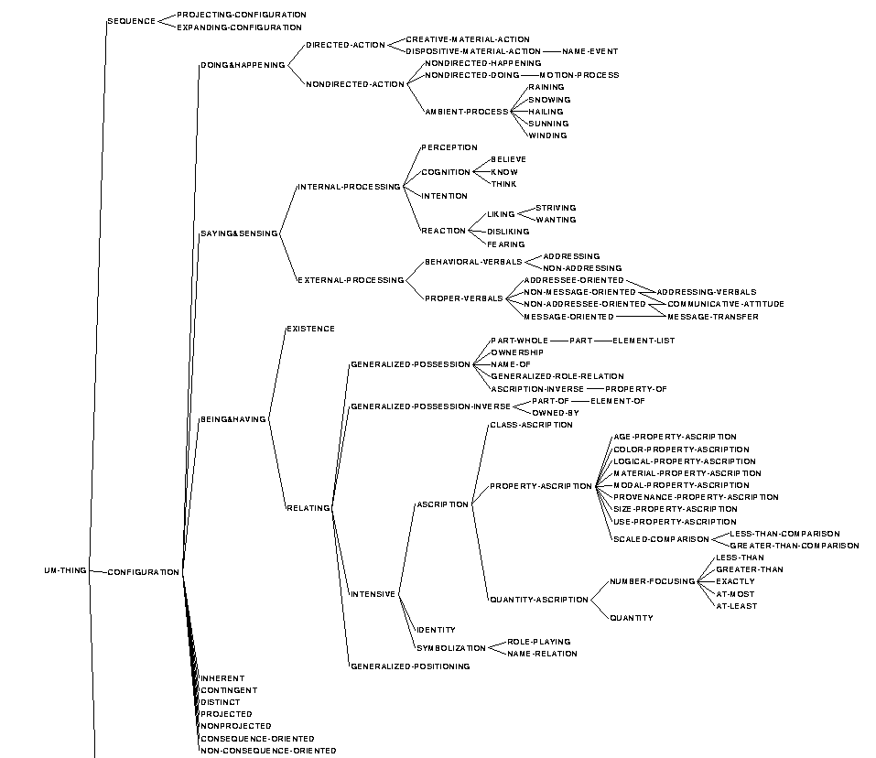
GUM

Slide 43
TLO-Representation examples:
“Blood” in Cyc
ExistingStuffType
TangibleThing
A tangible stuff composed of two or more different constituents which have been mixed. These constituents do not form chemical bonds, and later the mixture may be resolved by some separation event.
A mixture has a composition but not a structure
#$isa
#$genls
Mixture
#$genls
Blood
As well as mud, air and carbonate beverage
The function Separation-Event can apply to it.

Slide 44
Domain Top Level Ontologies
Synonymes: Task O., Application O., Middle level Ontologies
Experiment Ontology, Tambis Upper Level O., MBO

Slide 45
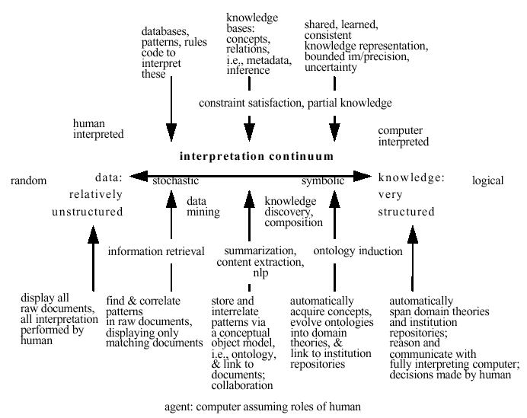
Interpretation Continuum

