Slide 1
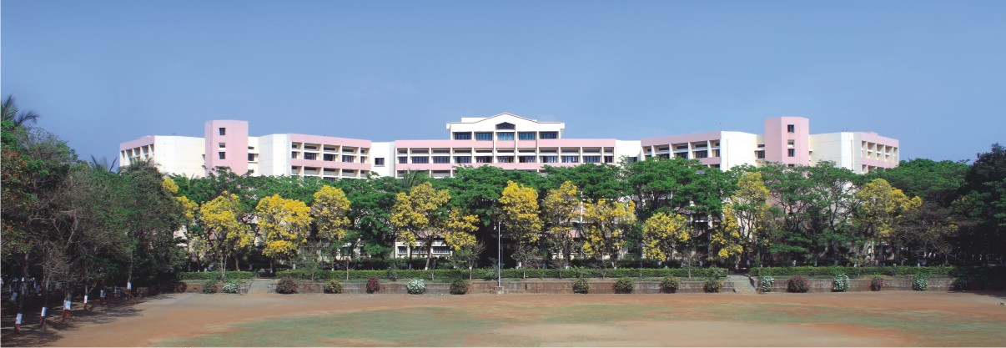

K.K.Wagh Institute of Engineering Education & Research Astronomical image colourisation and super-resolution using GANS
Project Stage -II
Group Id 23
Internal Guide Prof. Dr. S. M. Kamalapur
Notes:
NOTE:
To change the image on this slide, select the picture and delete it. Then click the Pictures icon in the placeholder to insert your own image.

Slide 2
Team members
Division./ Roll No. | Exam Seat No. | Name of the student
17 | B150134261 | Shreyas Kalvankar
18 | B150134296 | Hrushikesh Pandit
19 | B150134299 | Pranav Parwate
20 | B150134303 | Atharva Patil

Slide 3

Content
Revised Final Design
Tools and Techniques Used
Implementation Status
Modular Testing
Results
Conclusion and Future Scope
Cost Analysis

Slide 4
Problem Definition
The problem can be divided into two sub-problems:
Create an efﬁcient model to colorize grayscale images
Take a colorized image and upscale it n times the original size
Keywords: GAN, Neural Network, NodeJS, puppeteer, Convolutional Neural Network, Upscaling, Colorization.

Slide 5
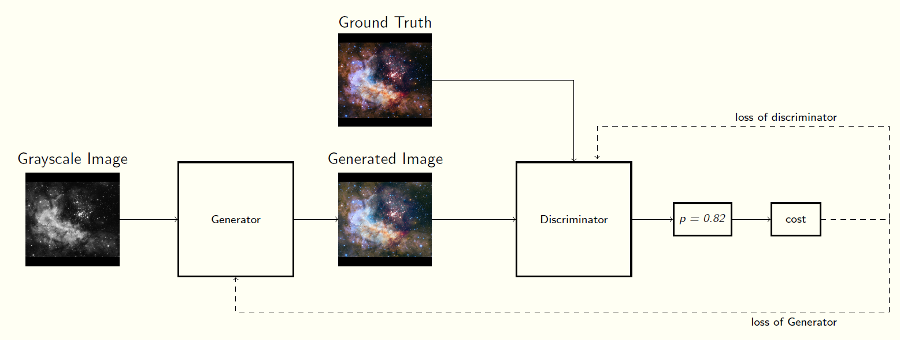
Revised Final Design
P value is arbitrary
Fig 1: Basic GAN architecture

Slide 6
Tools
Tensorflow
Pytorch
Pandas
Fastai
Numpy
Matplotllib
Google Colaboratory

Slide 7
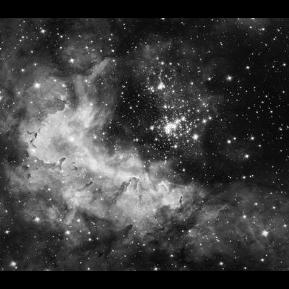
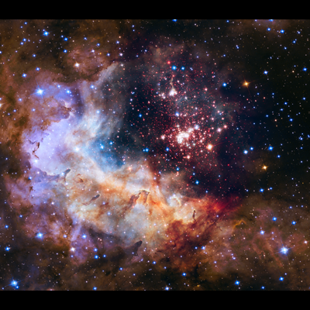
Image Colorization Technique
Image Colorization with residual encoders using the Resnet-18 architecture
Initially, we use create a U-net architecture with ResNet18 as it’s backbone
Training the U-net generator independently over L1 loss
Finally, training in an adversarial fashion to further optimize the outputs with patchy discriminator
Fig 2a: Black & White image
Fig 2a: Colorized output

Slide 8
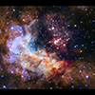
Image Upscaling Technique
SR-GAN works well with for single image super-resolution as it also uses an intelligent content loss function that uses pre-trained VGG-net layers.
We use a perceptual loss function which consists of an adversarial loss and a content loss.
It contains eight convolutional layers with an increasing number of 3 × 3 filter kernels, increasing by a factor of 2 from 64 to 512 kernels as in the VGG network
Fig 11a: Blurred image
Fig 11a: Upscaled output

Slide 9
Implementation Status
Image Colorization
We are try different models to find the most efficient methodology to colorize the images
Different U-net architectures have been trained over the COCO dataset so as to generalize the model to a greater extent.
We explore the model performance in RGB as well as L*a*b color space
A study of different architectures namely basic U-net, ResNet18 U-net has been implemented and tested
Image Upscaling implementation is successful and has shown promising results. We are still trying to fine tune the model to get better results

Slide 10
Implementation Status
Image Upscaling
Image Upscaling has been successfully demonstrated using transferred learning and has shown promising results.
We used Ledig’s VGG-based SRGAN architecture to implement the same.
We fine tuned Ledig’s SRGAN’s weights on our cherry picked image dataset.
We compared the pre-trained and post-trained output with Wide Activation SRGAN (WDSR GAN) and Enhanced Deep Learning SR GAN (EDSR GAN)

Slide 11
Results
The testing pipeline has been set up to evaluate the model performance by calculating distance metrics, i.e. L1 and L2 loss of the predictions and target
We evaluate the outputs in RGB and L*a*b color spaces
GANs are particularly hard to evaluate quantitatively. Having said that, we have achieved visually appealing results which, when evaluated qualitatively, are quite convincing

Slide 12
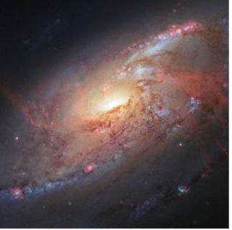
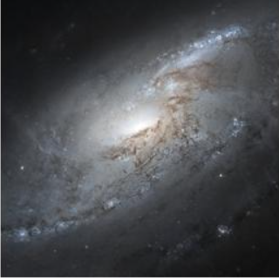
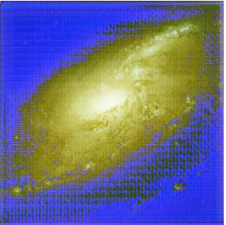
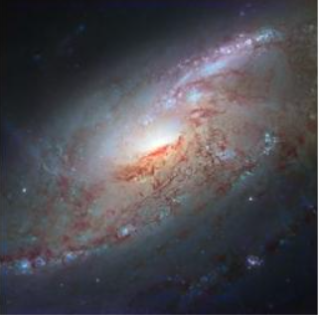
Results
Ground Truth
Pre trained Resnet-18
Trained on COCO Dataset
Full trained Resnet 18

Slide 13
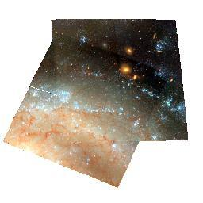
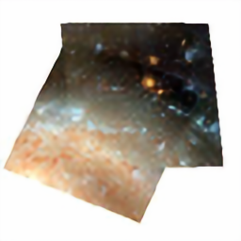

Results
Results of SRGAN (Upscaling):
Ground Truth
Pre trained SRGAN
SRGAN Fine tuned

Slide 14


Results
Results of SRGAN (Upscaling):
SRGAN Fine tuned
WD SRGAN
ED SRGAN

Slide 15
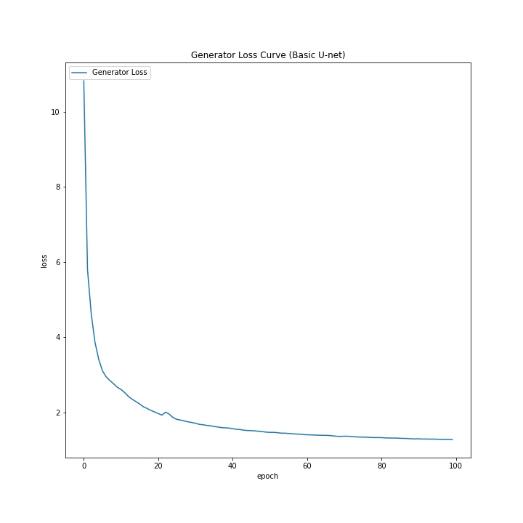
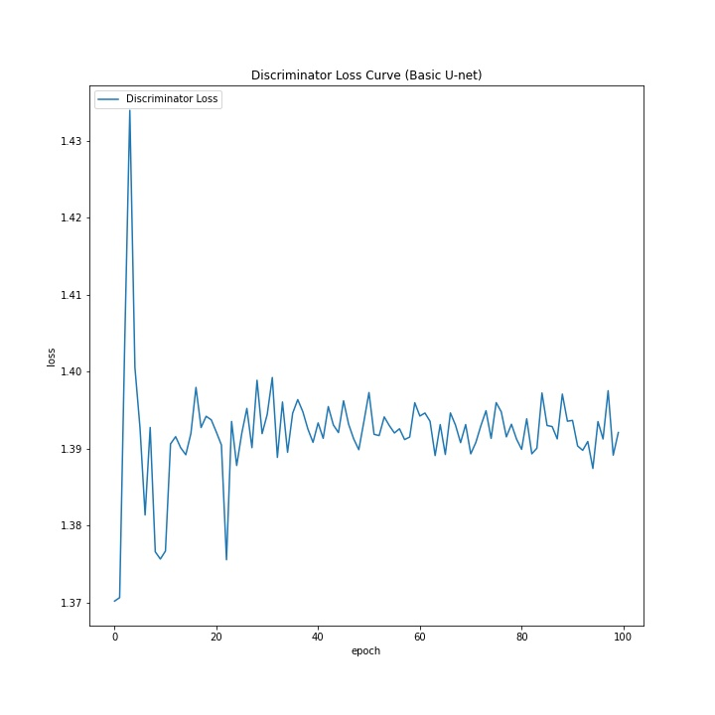
Results

Slide 16
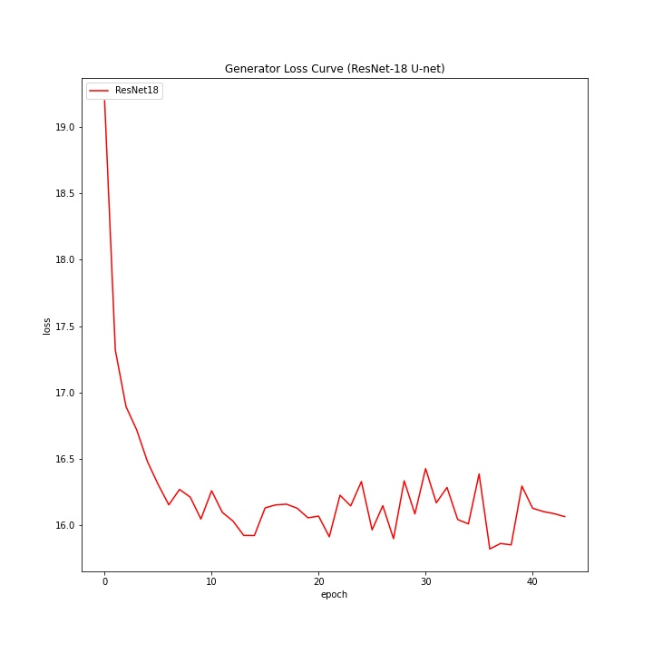
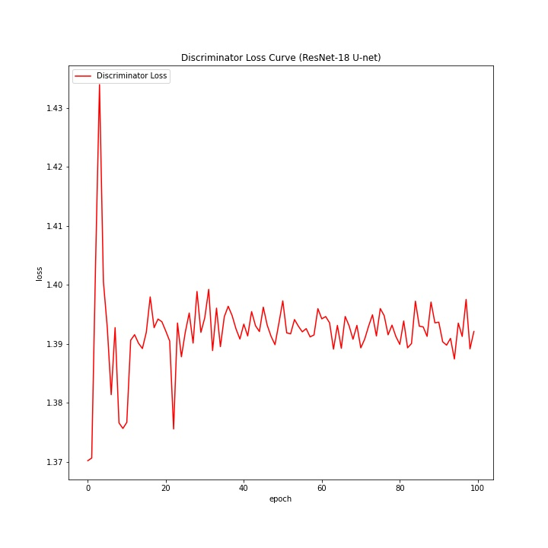
Results

Slide 17
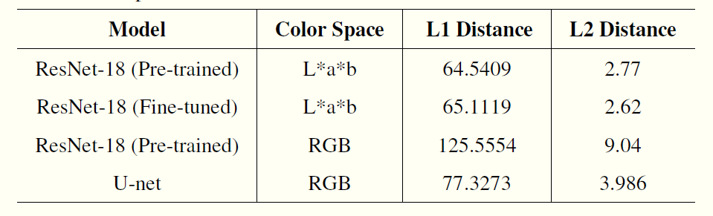
Results
Pixel wise mean:

Slide 18
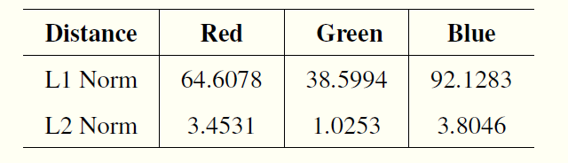
Results
Channel wise mean of fine-tuned ResNet18 U-net:

Slide 19
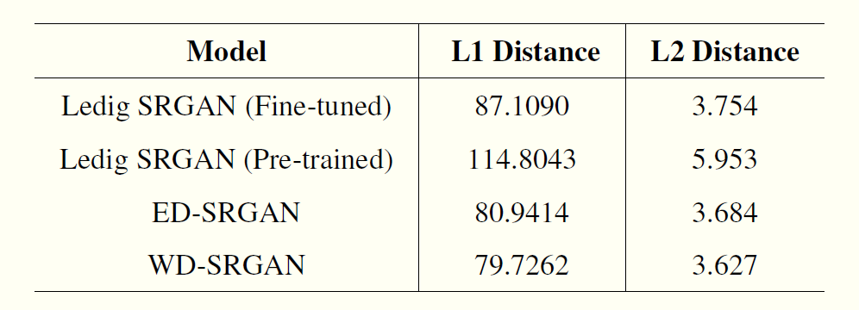
Results
Per pixel mean of SR-GAN networks:

Slide 20
Cost Estimation
Cost Estimate: The model following is the semi detached Constructive Cost Model (COCOMO) for estimating the efforts required in the completion of the project.
Object Point
Function Point
Lines of Source Code (KLOC)
For our project, sizing information in the form of Lines of Source Code is used.
The total lines of code,
KLOC = 1000
Note: KLOC is arbitrary, change if necessary
Equations: The initial effort(Ei) in man-months is calculated using equations: E = ax(KLOC) b where,
Astronomical image colourisation and super-resolution using GANS

Slide 21
Cost Estimation
a = 3.0, b = 1.12, for a semi-detached project
E = Efforts in person-hours E = 4.5 PM
D = ax(E) b Where, a = 2.5, b = 0.35, for a semi-detached project
D = Duration of Project in months D = 12 Months
Astronomical image colourisation and super-resolution using GANS

Slide 22
Cost Estimation
C = D∗Cp ∗ hrs = 12 * 40 * 160 = Rs 76,800
Where, C = Cost of project
D = Duration in Hours
Cp = Cost incurred per person-hour
hrs = hours
Astronomical image colourisation and super-resolution using GANS

Slide 23
Conclusion and Future Scope
U-net architectures are still a widely unexplored domain for ensemble learning and could be implemented with numerous methodologies
A more powerful model such as SE-ResNext, EfficientNet and more state-of-the-art models can be implemented and trained over millions of images from the Imagenet.
The performance of GAN can be improved by implementing it in a cyclic fashion, i.e. Cycle GAN, with the Pix2Pix colorization approach
Colorization can be improved by the virtue of exploring different loss functions using weighted losses to reduce loss problem for low saturation regions.

Slide 24
References
Cheng, Z., Yang, Q. and Sheng, B. (2016). Deep colorization.
Dahl, R. (2016). Automatic colorization.
Dong, C., Loy, C. C., He, K. and Tang, X. (2014). Learning a deep convolutional network for image super-resolution, in D. Fleet, T. Pajdla, B. Schiele and T. Tuytelaars (eds), Computer Vision – ECCV 2014, Springer International Publishing,
Cham, pp. 184-199.
Goodfellow, I. J., Pouget-Abadie, J., Mirza, M., Xu, B., Warde-Farley, D., Ozair, S., Courville, A. and Bengio, Y. (2014).
Generative adversarial networks.
He, K., Zhang, X., Ren, S. and Sun, J. (2015). Deep residual learning for image recognition.
Huang, Y.-C., Tung, Y.-S., Chen, J.-C., Wang, S.-W. and Wu, J.-L. (2005). An adaptive edge detection based colorization algorithm and its applications, pp. 351–354.
Isola, P., Zhu, J.-Y., Zhou, T. and Efros, A. A. (2018). Image-to-image translation with conditional adversarial networks.
Jianchao Yang, Wright, J., Huang, T. and Yi Ma (2008). Image super-resolution as sparse representation of raw image patches,
2008 IEEE Conference on Computer Vision and Pattern Recognition, pp. 1–8.

Slide 25
References
Kim, J., Lee, J. K. and Lee, K. M. (2016). Accurate image super-resolution using very deep convolutional networks,
2016 IEEE Conference on Computer Vision and Pattern Recognition (CVPR), pp. 1646–1654.
Ledig, C., Theis, L., Huszar, F., Caballero, J., Cunningham, A., Acosta, A., Aitken, A., Tejani, A., Totz, J., Wang, Z. and Shi, W. (2017).
Photorealistic single image super-resolution using a generative adversarial network.
Levin, A., Lischinski, D. and Weiss, Y. (2004). Colorization using optimization, ACM SIGGRAPH 2004 Papers, pp. 689–694.
Long, J., Shelhamer, E. and Darrell, T. (2015). Fully convolutional networks for semantic segmentation,
2015 IEEE Conference on Computer Vision and Pattern Recognition (CVPR), pp. 3431–3440.
Mirza, M. and Osindero, S. (2014). Conditional generative adversarial nets.
Pressman, R. S. (1992). Software Engineering (3rd Ed.): A Practitioner’s Approach, McGraw-Hill, Inc., New York, NY, USA.
Qu, Y.,Wong, T.-T. and Heng, P.-A. (2006). Manga colorization, ACM Transactions on Graphics (TOG) 25(3): 1214–1220.
Radford, A., Metz, L. and Chintala, S. (2016). Unsupervised representation learning with deep convolutional generative adversarial networks.
Shi, W., Caballero, J., Husz´ar, F., Totz, J., Aitken, A. P., Bishop, R., Rueckert, D. and Wang, Z. (2016).
Real-time single image and video super-resolution using an efficient sub-pixel convolutional neural network,
2016 IEEE Conference on Computer Vision and Pattern Recognition (CVPR), pp. 1874–1883.

Slide 26
References
Simonyan, K. and Zisserman, A. (2015). Very deep convolutional networks for large-scale image recognition.
Tola, E., Lepetit, V. and Fua, P. (2008). A fast local descriptor for dense matching, Proc. CVPR .
Tom and Katsaggelos (1996). Reconstruction of a high-resolution image by simultaneous registration, restoration, and interpolation of low-resolution images, in Anon (ed.), IEEE International Conference on Image Processing, Vol. 2, IEEE, pp. 539–542. Proceedings of the 1995 IEEE International Conference on Image Processing. Part 3 (of 3) ; Conference date: 23-10-1995 Through 26-10-1995.
TSAI, R. (1984). Multiframe image restoration and registration, Advance Computer Visual and Image Processing 1: 317–339.
Welsh, T., Ashikhmin, M. and Mueller, K. (2002). Transferring color to greyscale images, ACM Trans. Graph. 21: 277–280.
Yatziv, L. and Sapiro, G. (2006). Fast image and video colorization using chrominance blending,
IEEE Transactions on Image Processing 15(5): 1120–1129.
Zhu, J.-Y., Krahenbuhl, P., Shechtman, E. and Efros, A. A. (2018). Generative visual manipulation on the natural image manifold.
Arjovsky, M., Chintala, S. and Bottou, L. (2017). Wasserstein gan.
Yu, J., Fan, Y., Yang, J., Xu, N., Wang, Z., Wang, X. and Huang, T. (2018). Wide activation for efficient and accurate image super-resolution

Slide 27
Thank You !!

