Slide 1
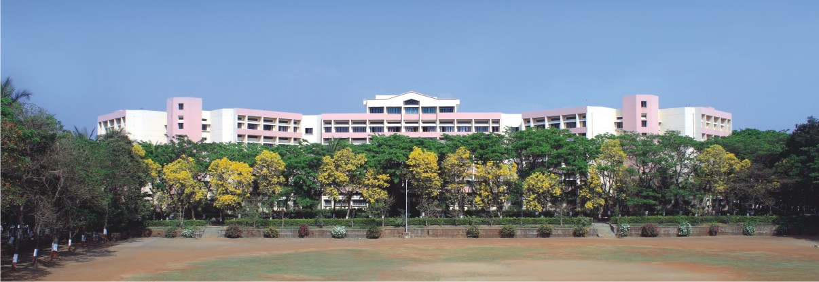

K.K.Wagh Institute of Engineering Education & Research Astronomical image colourisation and super-resolution using GANS
Project Stage -II
Group Id 23
Internal Guide Prof. Dr. S. M. Kamalapur
Notes:
NOTE:
To change the image on this slide, select the picture and delete it. Then click the Pictures icon in the placeholder to insert your own image.

Slide 2
Team members
Division./ Roll No. | Exam Seat No. | Name of the student
17 | B150134261 | Shreyas Kalvankar
18 | B150134296 | Hrushikesh Pandit
19 | B150134299 | Pranav Parwate
20 | B150134303 | Atharva Patil

Slide 3

Content
Revised Final Design
Tools and Techniques Used
Implementation Status
Modular Testing
Results
Conclusion and Future Scope
Cost Analysis

Slide 4
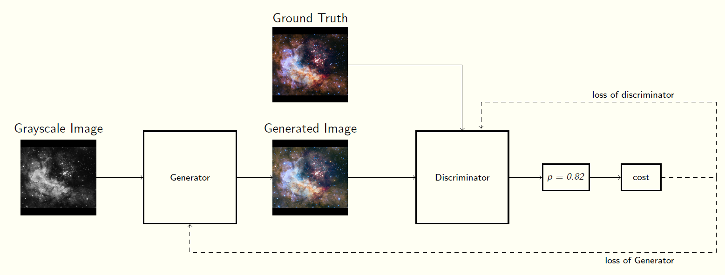
Revised Final Design
P value is arbitrary
Fig 1: Basic GAN architecture

Slide 5
Tools
Tensorflow
Numpy
Matplotllib
Google Colaboratory

Slide 6
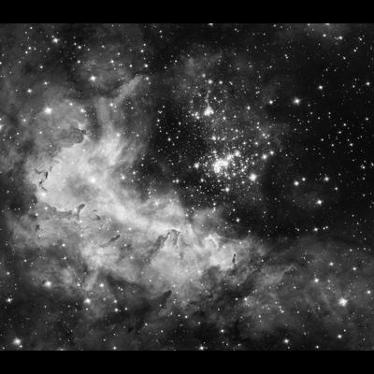
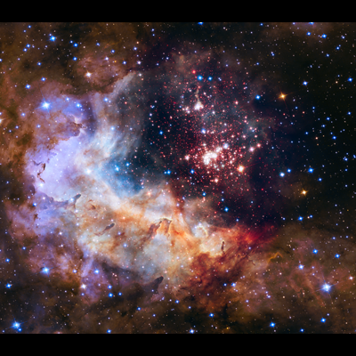
Image Colorization Technique
Image Colorization with residual encoders using the Resnet-18 architecture
Initially, we use create a U-net architecture with ResNet18 as it’s backbone
Training the U-net generator independently over L1 loss
Finally, training in an adversarial fashion to further optimize the outputs with patchy discriminator
Fig 2a: Black & White image
Fig 2a: Colorized output

Slide 7
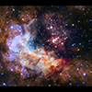
Image Upscaling Technique
SR-GAN works well with for single image super-resolution as it also uses an intelligent content loss function that uses pre-trained VGG-net layers.
Fig 11a: Blurred image
Fig 11a: Upscaled output

Slide 8
Implementation Status
Image Colorization is still in process, we are trying different models trying to find the most efficient methodology to colorize the images
Different U-net architectures have been trained over the COCO dataset so as to generalize the model to a greater extent
Image Upscaling implementation is successful and has shown promising results. We are still trying to fine tune the model to get better results

Slide 9
Results
A proper testing pipeline has yet to be set up that will compare the output images with the ground truth
The images will be evaluated over L2 loss
GANs are particularly hard to evaluate quantitatively. Having said that, we have achieved visually appealing results which, evaluated qualitatively, are quite convincing

Slide 10




Results
Results of Pix2Pix U-net (Colorizing):
Samples: (from left) 1. Input grayscale image, 2. Generated output, 3. Ground Truth image

Slide 11
Conclusion and Future Scope
U-net architectures are still a widely unexplored domain for ensemble learning and could be implemented with numerous methodologies
The performance of GAN can be improved by implementing it in a cyclic fashion, i.e. Cycle GAN, with the Pix2Pix colorization approach
Generative Models are getting better day by day and these architectures could essentially be used to generalize image colorization and super-resolution over any dataset with negligible fine-tuning

Slide 12
Cost Analysis
Most of the code is executed on google colab so there were no expenses to implement the GANS

Slide 13
Thank You !!

