Slide 1
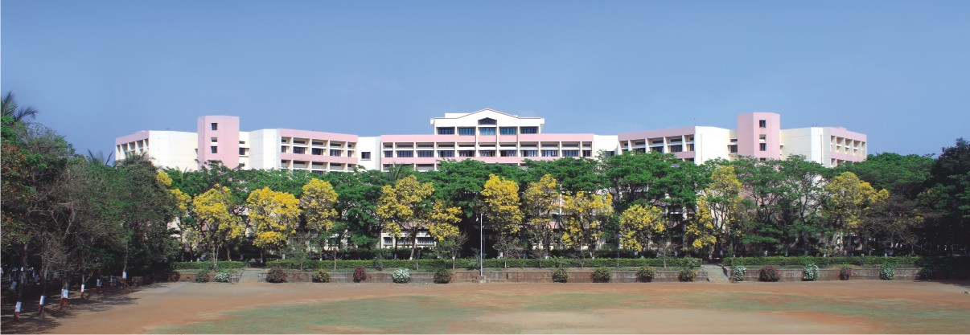

K.K.Wagh Institute of Engineering Education & Research Astronomical image colourisation and super-resolution using GANS
Project Stage -II
Group Id 23
Internal Guide Prof. Dr. S. M. Kamalapur
Notes:
NOTE:
To change the image on this slide, select the picture and delete it. Then click the Pictures icon in the placeholder to insert your own image.

Slide 2
Team members
Division./ Roll No. | Exam Seat No. | Name of the student
17 | B150134261 | Shreyas Kalvankar
18 | B150134296 | Hrushikesh Pandit
19 | B150134299 | Pranav Parwate
20 | B150134303 | Atharva Patil

Slide 3

Content
Revised Final Design
Tools and Techniques Used
Implementation Status
Modular Testing
Results
Conclusion and Future Scope
Cost Analysis

Slide 4
Problem Definition
The problem can be divided into two sub-problems:
Create an efﬁcient model to colorize grayscale images
Take a colorized image and upscale it n times the original size
Keywords: GAN, Neural Network, NodeJS, puppeteer, Convolutional Neural Network, Upscaling, Colorization.

Slide 5
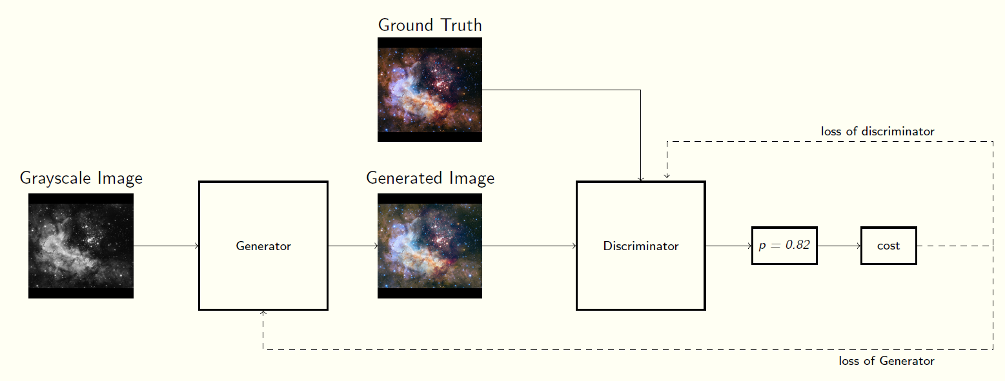
Revised Final Design
P value is arbitrary
Fig 1: Basic GAN architecture

Slide 6
Tools
Tensorflow
Numpy
Matplotllib
Google Colaboratory

Slide 7
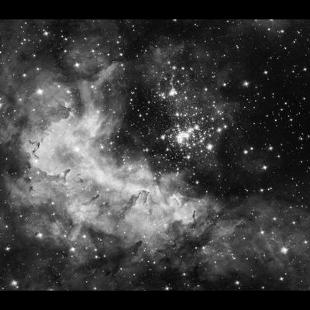
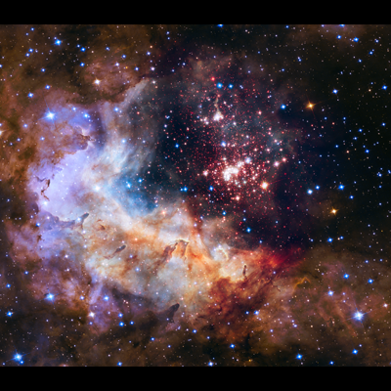
Image Colorization Technique
Image Colorization with residual encoders using the Resnet-18 architecture
Initially, we use create a U-net architecture with ResNet18 as it’s backbone
Training the U-net generator independently over L1 loss
Finally, training in an adversarial fashion to further optimize the outputs with patchy discriminator
Fig 2a: Black & White image
Fig 2a: Colorized output

Slide 8
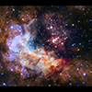
Image Upscaling Technique
SR-GAN works well with for single image super-resolution as it also uses an intelligent content loss function that uses pre-trained VGG-net layers.
We use a perceptual loss function which consists of an adversarial loss and a content loss.
It contains eight convolutional layers with an increasing number of 3 × 3 filter kernels, increasing by a factor of 2 from 64 to 512 kernels as in the VGG network
Fig 11a: Blurred image
Fig 11a: Upscaled output

Slide 9
Implementation Status
Image Colorization
We are trying different models trying to find the most efficient methodology to colorize the images
Different U-net architectures have been trained over the COCO dataset so as to generalize the model to a greater extent
Image Upscaling implementation is successful and has shown promising results. We are still trying to fine tune the model to get better results

Slide 10
Implementation Status
Image Upscaling
Image Upscaling has been successfully demonstrated using transferred learning and has shown promising results.
We used Ledig’s VGG-based SRGAN architecture to implement the same.
We fine tuned Ledig’s SRGAN’s weights on our cherry picked image dataset.
We compared the pre-trained and post-trained output with Wide Activation SRGAN (WDSR GAN) and Enhanced Deep Learning SR GAN (EDSR GAN)

Slide 11
Results
A proper testing pipeline has yet to be set up that will compare the output images with the ground truth
The images will be evaluated over L2 loss
GANs are particularly hard to evaluate quantitatively. Having said that, we have achieved visually appealing results which, evaluated qualitatively, are quite convincing

Slide 12
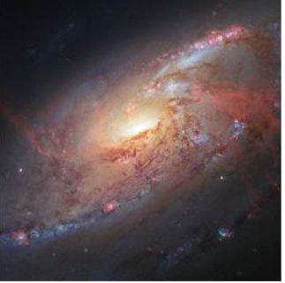
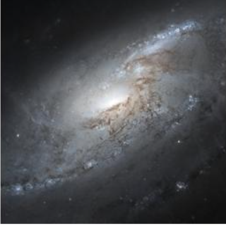
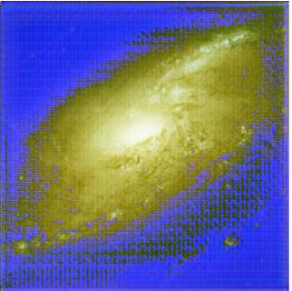
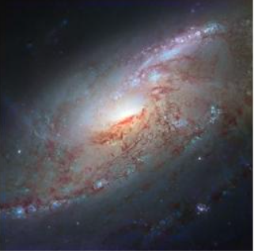
Results
Ground Truth
Pre trained Resnet-18
Trained on COCO Dataset
Full trained Resnet 18

Slide 13
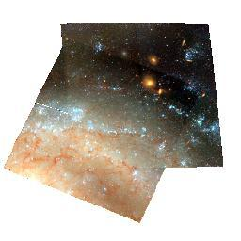
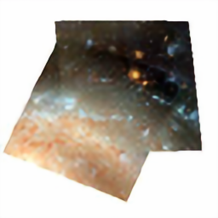

Results
Results of SRGAN (Upscaling):
Ground Truth
Pre trained SRGAN
SRGAN Fine tuned

Slide 14


Results
Results of SRGAN (Upscaling):
SRGAN Fine tuned
WD SRGAN
ED SRGAN

Slide 15
Cost Estimation
Cost Estimate: The model following is the semi detached Constructive Cost Model (COCOMO) for estimating the efforts required in the completion of the project.
Object Point
Function Point
Lines of Source Code (KLOC)
For our project, sizing information in the form of Lines of Source Code is used.
The total lines of code,
KLOC = 750
Note: KLOC is arbitrary, change if necessary
Equations: The initial effort(Ei) in man-months is calculated using equations: E = ax(KLOC) b where,
Astronomical image colourisation and super-resolution using GANS

Slide 16
Cost Estimation
a = 3.0, b = 1.12, for a semi-detached project
E = Efforts in person-hours E = 4.5 PM
D = ax(E) b Where, a = 2.5, b = 0.35, for a semi-detached project
D = Duration of Project in months D = 4 Months
Astronomical image colourisation and super-resolution using GANS

Slide 17
Cost Estimation
C = D∗Cp ∗ hrs = 4 * 40 * 160 = Rs 25,600
Where, C = Cost of project
D = Duration in Hours
Cp = Cost incurred per person-hour
hrs = hours
Astronomical image colourisation and super-resolution using GANS

Slide 18
Conclusion and Future Scope
U-net architectures are still a widely unexplored domain for ensemble learning and could be implemented with numerous methodologies
The performance of GAN can be improved by implementing it in a cyclic fashion, i.e. Cycle GAN, with the Pix2Pix colorization approach
Generative Models are getting better day by day and these architectures could essentially be used to generalize image colorization and super-resolution over any dataset with negligible fine-tuning

Slide 19
Thank You !!

