Slide 1
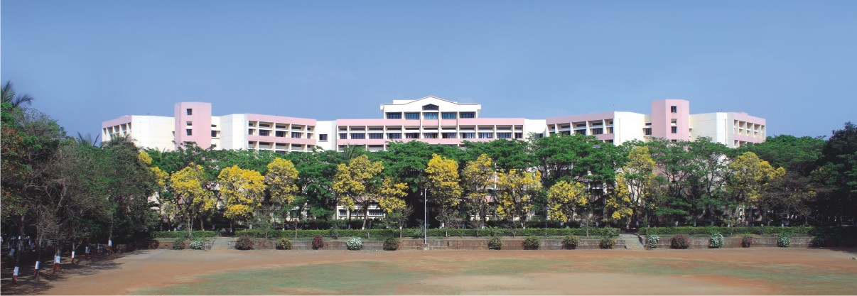

K.K.Wagh Institute of Engineering Education & Research Astronomical image colourisation and super-resolution using GANs
Group ID: 23
Internal Guide: Prof. Dr. S. M. Kamalapur
Notes:
NOTE:
To change the image on this slide, select the picture and delete it. Then click the Pictures icon in the placeholder to insert your own image.

Slide 2
Team members
Division./ Roll No. | Exam Seat No. | Name of the student
17 | B150134261 | Shreyas Kalvankar
18 | B150134296 | Hrushikesh Pandit
19 | B150134299 | Pranav Parwate
20 | B150134303 | Atharva Patil

Slide 3

Content
Problem Definition
Requirement Specification
Literature Survey
Motivation of the Project
Objectives
Block diagram of Project/Architecture
Methodology
Mathematical Model
Experimental Set Up
Performance Parameter
Efficiency Issues
References

Slide 4
Problem Definition
The problem can be divided into two sub-problems:
Create an efﬁcient model to colorize grayscale images
Take a colorized image and upscale it n times the original size
Keywords: GAN, Neural Network, NodeJS, puppeteer, Convolutional Neural Network, Upscaling, Colorization.

Slide 5
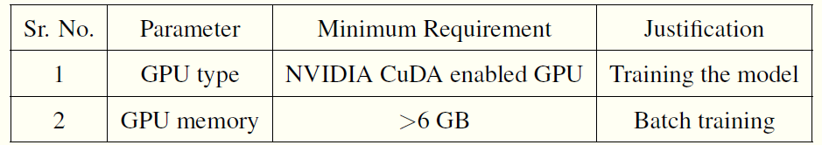
Requirement Specifications
The following table showcases the minimum hardware requirements:
The following are the software requirements:
Operating System: Windows/Linux
IDE: Jupyter Notebook
Programming Languages: python3, javascript
Frameworks: Node.js, Tensorflow, Sci-kit learn, plotting libraries, OpenCV
Table 1: Hardware Requirements

Slide 6
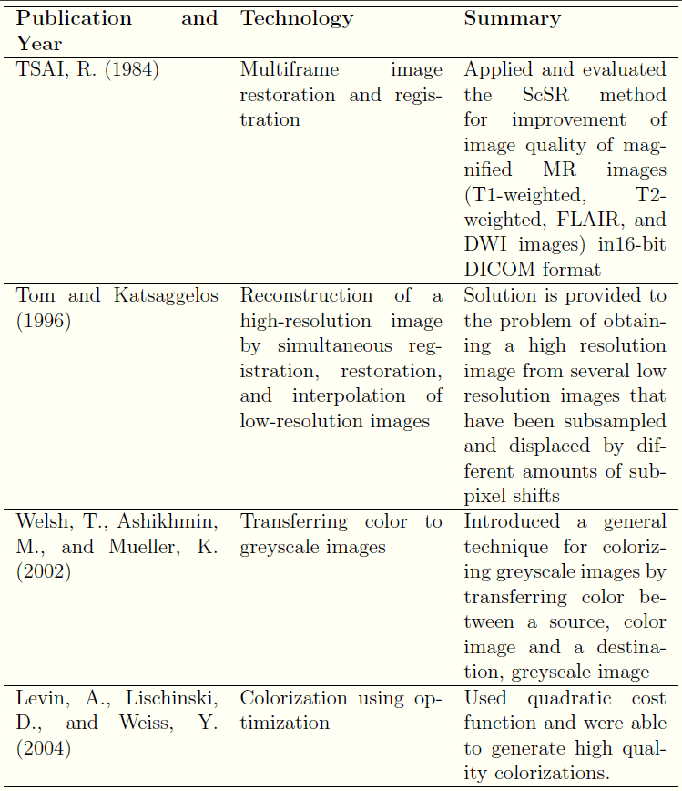
Literature Review

Slide 7
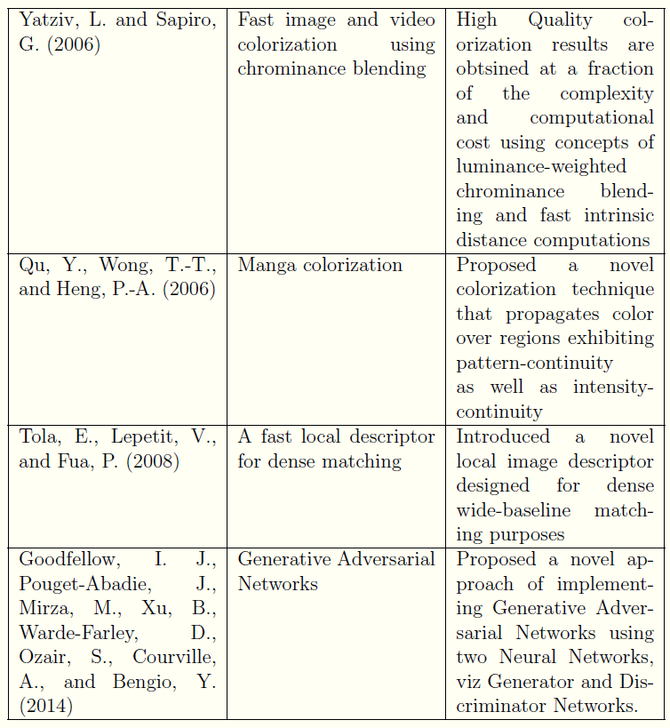
Literature Review

Slide 8
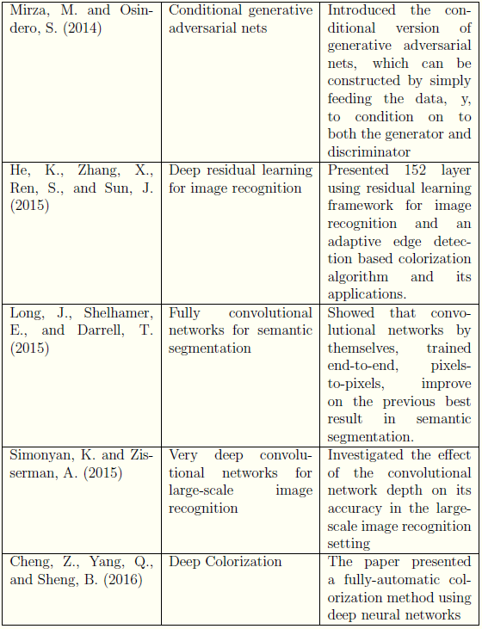
Literature Review

Slide 9
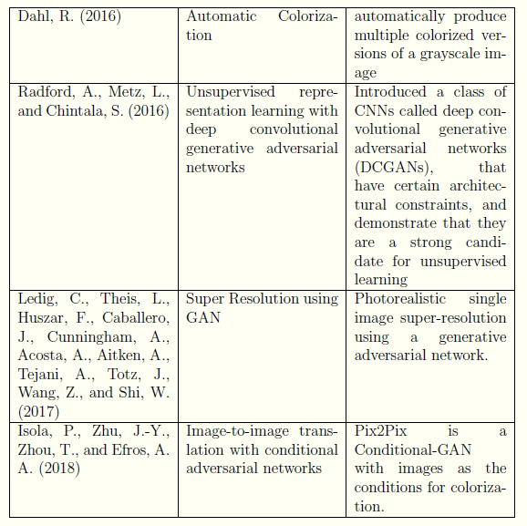
Literature Review

Slide 10
Motivation of the Project
Application of GANs has successfully improved the performance and computers are getting better and better at predicting accurate missing pixel values and upscaling images many folds the original size.
All this computation power can be used for astronomical research by processing large data archives.

Slide 11
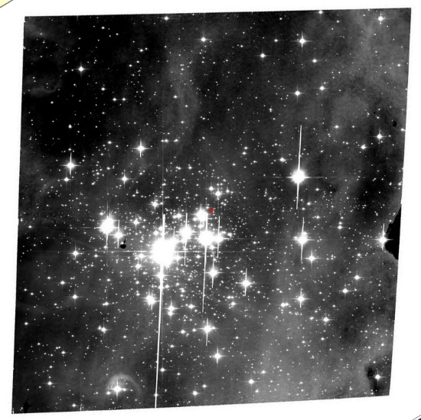
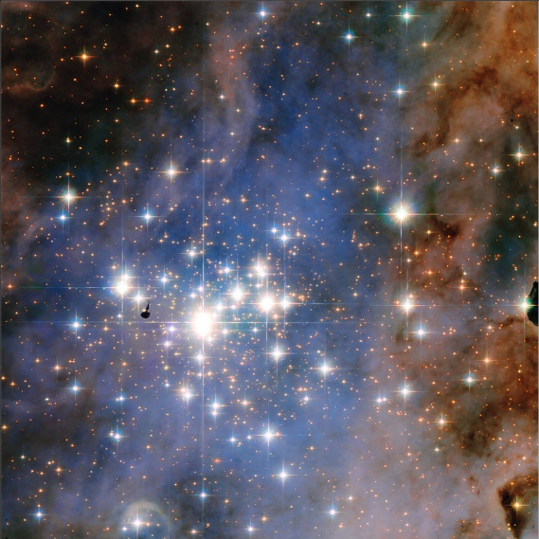
Motivation of the Project
A large number of images lie dormant in most of the space survey data archives which never go through any kind of processing and are low resolution and black & white.
These images could be processed automatically by an algorithm that will colorize and super-resolve the images which can make it easier for astronomers to visually inspect the images.
Fig 1a: Black & White image from space archive
Fig 1b: Subsequent colored version of Fig 1a

Slide 12
Objectives
Auto-Colorization
Upscaling/super-resolution
The models may be combined to form a single model that will take a low resolution, grayscale image as its input and produce a high resolution, colorized image as its output.

Slide 13
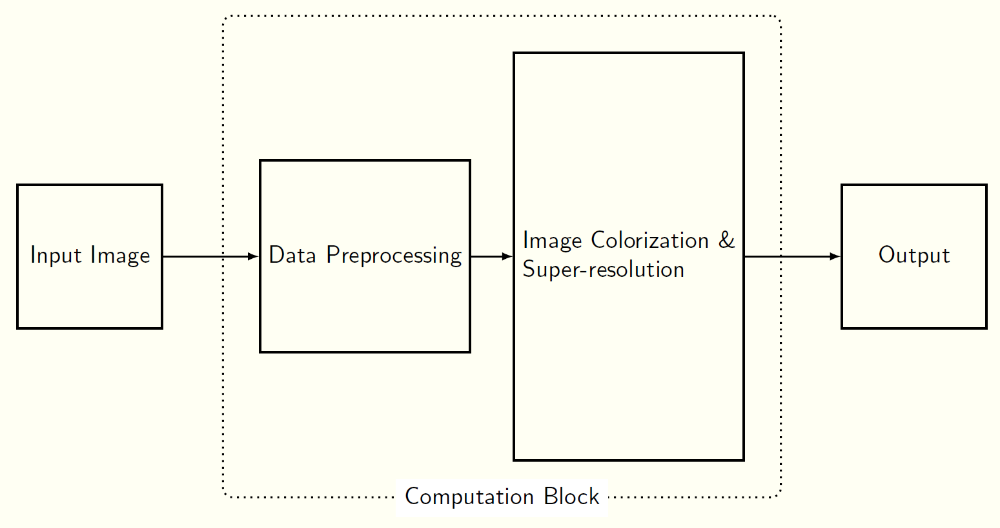
Block diagram of Project
Figure 2: Basic Block diagram

Slide 14
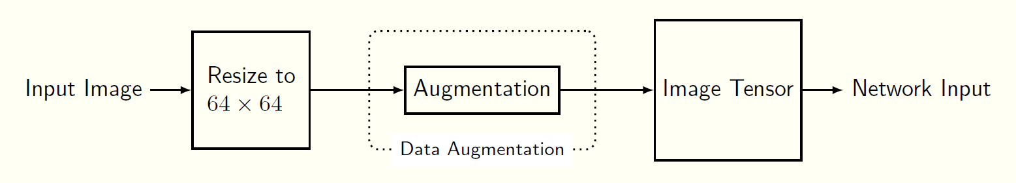
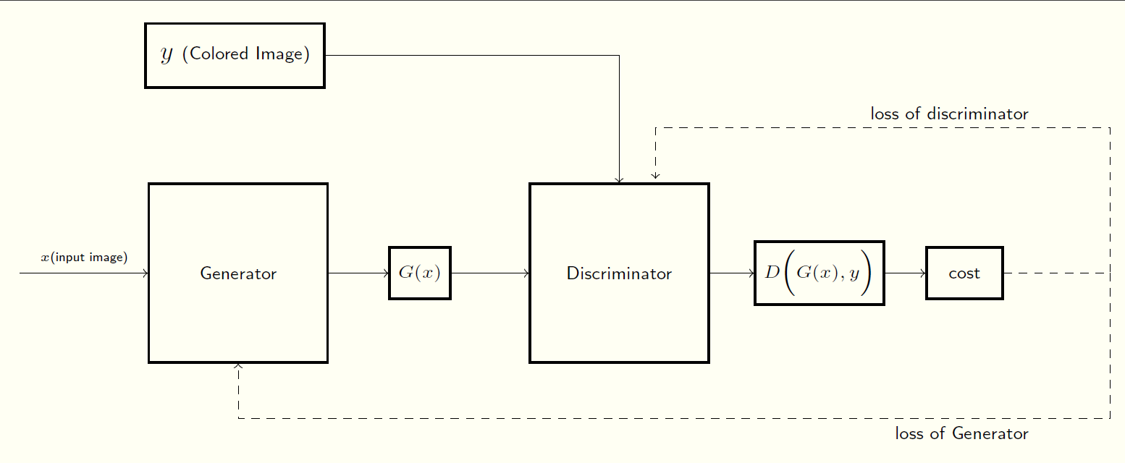
Block diagram of Project
Figure 3: Data Preprocessing
Figure 4: Basic GAN architecture

Slide 15
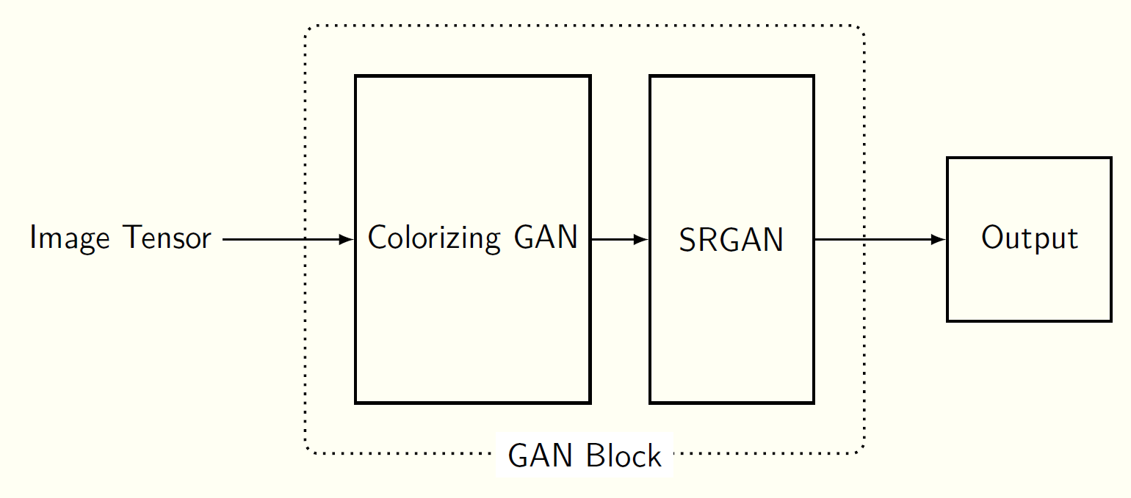
Block diagram of Project
Figure 5: GAN Block Summary

Slide 16
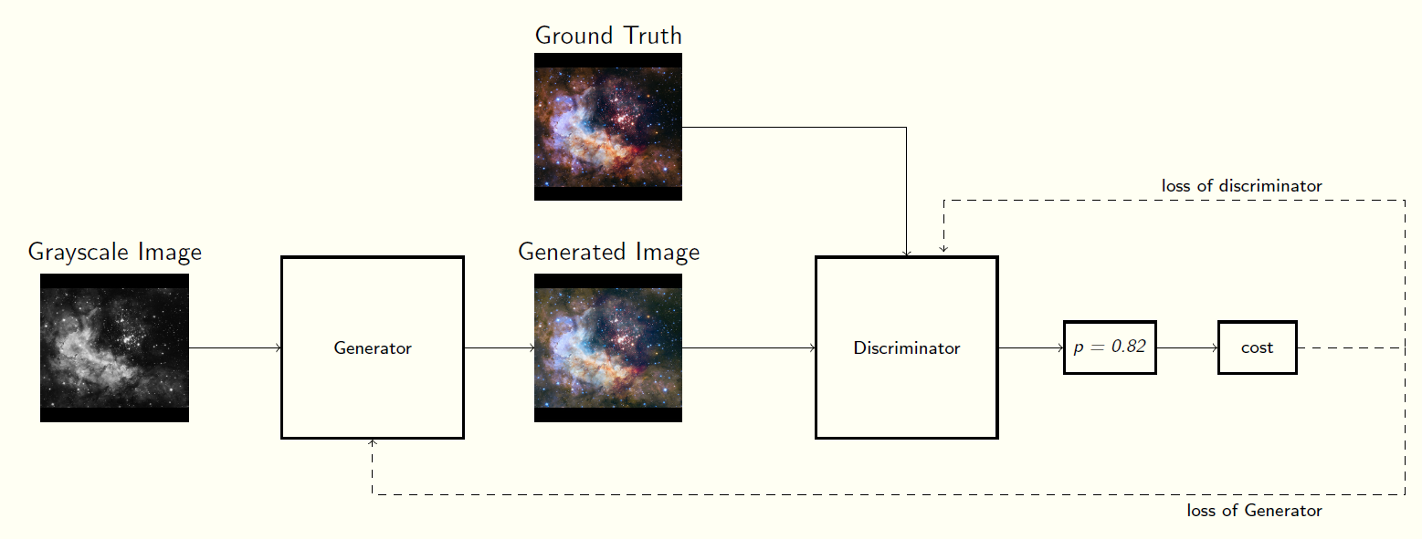
Block diagram of Project
Figure 6: Image conversion by GAN

Slide 17
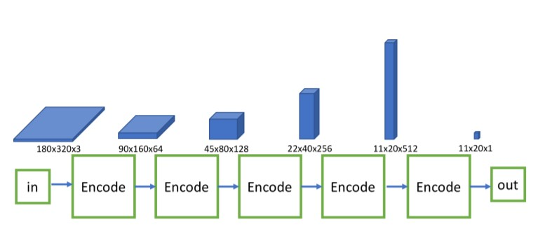
Block diagram of Project
Figure 7: Discriminator (Ronneberger et al., 2015)

Slide 18
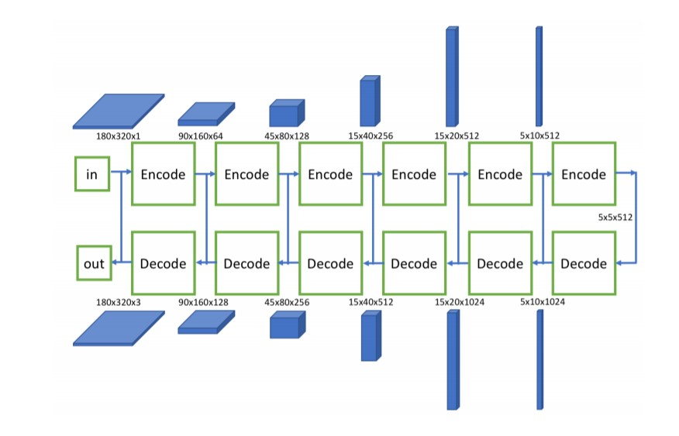
Block diagram of Project
Figure 8: Encoder Decoder Generator (Ronneberger et al., 2015)

Slide 19
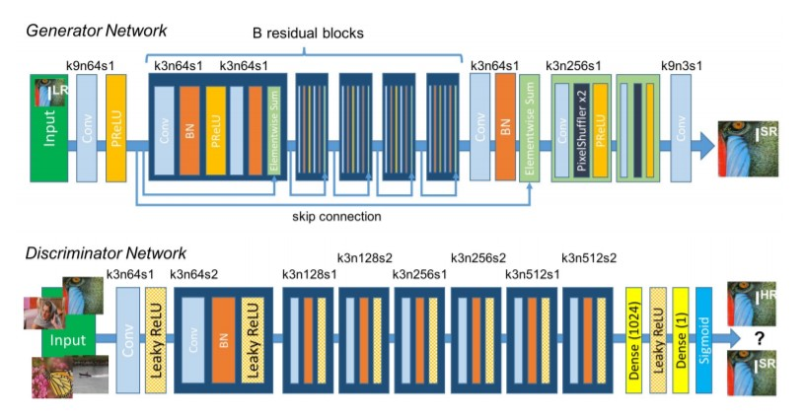
Block diagram of Project
Figure 9: Ledig SRGAN Architecture (Ledig et al., 2017)

Slide 20
Methodology
Data gathering and processing:
Data Scraping
Data Cleaning
Model Building
Model Training
Cost Optimization and tuning
Performance Evaluation and Documentation

Slide 21
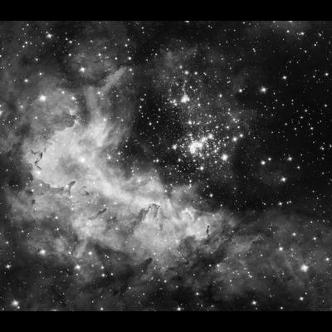
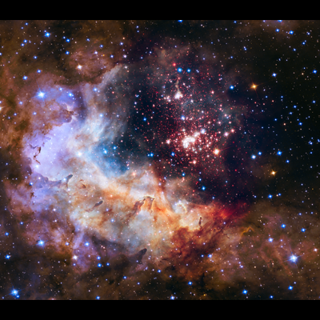
Image Colorization
Image Colorization convolutional neural networks with residual encoders using the VGG16 architecture will be used.
Generative Adversarial Networks use a minimax loss which is different than the L2 loss as it will choose a color to ﬁll an area rather than averaging. This is similar to a classiﬁcation based approach.
Fig 10a: Black & White image
Fig 10a: Colorized output

Slide 22
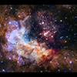
Image Upscaling
SR-GAN works well with for single image super-resolution as it also uses an intelligent content loss function that uses pre-trained VGG-net layers.
Fig 11a: Blurred image
Fig 11a: Upscaled output

Slide 23
Mathematical Model
A generative network, G, is supposed to learn the underlying distribution of a latent space, Y.
The Discriminator network D takes in both the fabricated outputs generated by G and real inputs from the underlying distribution Y.
The network produces a probability of the image belonging to the real or fabricated space.

Slide 24
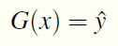
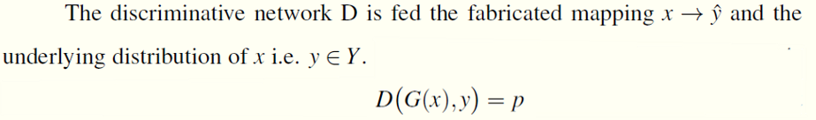
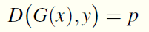
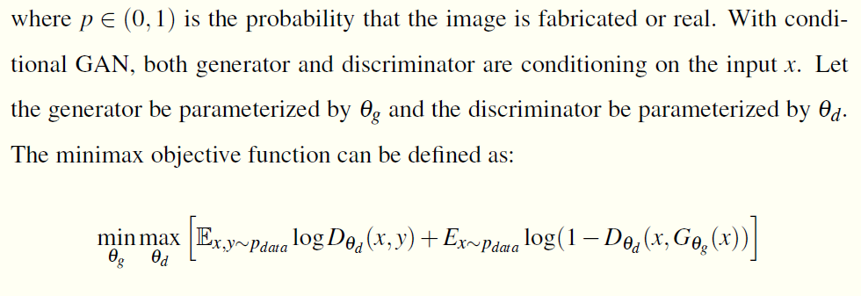

Mathematical Model

Slide 25
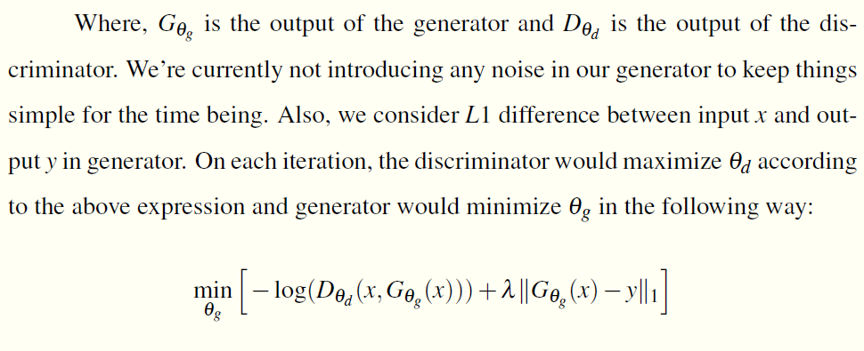
Mathematical Model

Slide 26
Experimental Setup
We aim to implement the neural network models in Tensorflow using Jupyter Notebook and python
As deep learning models require huge computational power for training, we plan to use Google Colab which provides a Tesla K80 GPU with memory ranging between 8GB to 16GB
The dataset has been scraped off the Hubble Heritage project and Hubble Legacy Archive
The processing on the dataset will be done using OpenCV and other image libraries in python and will be fed into the network

Slide 27
Performance Parameters
To evaluate the performance of the coloring model quantitatively, we propose averaging the L1 and L2 distance (per pixel-channel) between the generated images and the ground truth images
Another evaluation method is to calculate the Perceptual loss. It is critical for the performance of the Generator network
The perceptual loss is defined as the weighted sum of the content loss and the adversarial loss component

Slide 28
Efficiency Issues
The data gathered had to be scraped off websites such as the Hubble Legacy archive and Hubble main website
This yielded in more images than were useful. So we focused on a particular section of the sky where we could get the images of galaxy M101
This still yielded in about 400,000 images which had to be manually filtered
Even with all the images available, the network training will require huge computational resources to perform efficiently
The network parameters exceed the available training data and will require augmentation to avoid overfitting
A quantitative evaluation of a GAN is considerably difficult even with the availability of the ground truth images

Slide 29
References
Cheng, Z., Yang, Q. and Sheng, B. (2016). Deep colorization.
Dahl, R. (2016). Automatic colorization.
Dong, C., Loy, C. C., He, K. and Tang, X. (2014). Learning a deep convolutional network for image super-resolution, in D. Fleet, T. Pajdla, B. Schiele and T. Tuytelaars (eds), Computer Vision – ECCV 2014, Springer International Publishing,
Cham, pp. 184-199.
Goodfellow, I. J., Pouget-Abadie, J., Mirza, M., Xu, B., Warde-Farley, D., Ozair, S., Courville, A. and Bengio, Y. (2014).
Generative adversarial networks.
He, K., Zhang, X., Ren, S. and Sun, J. (2015). Deep residual learning for image recognition.
Huang, Y.-C., Tung, Y.-S., Chen, J.-C., Wang, S.-W. and Wu, J.-L. (2005). An adaptive edge detection based colorization algorithm and its applications, pp. 351–354.
Isola, P., Zhu, J.-Y., Zhou, T. and Efros, A. A. (2018). Image-to-image translation with conditional adversarial networks.
Jianchao Yang, Wright, J., Huang, T. and Yi Ma (2008). Image super-resolution as sparse representation of raw image patches,
2008 IEEE Conference on Computer Vision and Pattern Recognition, pp. 1–8.

Slide 30
References
Kim, J., Lee, J. K. and Lee, K. M. (2016). Accurate image super-resolution using very deep convolutional networks,
2016 IEEE Conference on Computer Vision and Pattern Recognition (CVPR), pp. 1646–1654.
Ledig, C., Theis, L., Huszar, F., Caballero, J., Cunningham, A., Acosta, A., Aitken, A., Tejani, A., Totz, J., Wang, Z. and Shi, W. (2017).
Photorealistic single image super-resolution using a generative adversarial network.
Levin, A., Lischinski, D. and Weiss, Y. (2004). Colorization using optimization, ACM SIGGRAPH 2004 Papers, pp. 689–694.
Long, J., Shelhamer, E. and Darrell, T. (2015). Fully convolutional networks for semantic segmentation,
2015 IEEE Conference on Computer Vision and Pattern Recognition (CVPR), pp. 3431–3440.
Mirza, M. and Osindero, S. (2014). Conditional generative adversarial nets.
Pressman, R. S. (1992). Software Engineering (3rd Ed.): A Practitioner’s Approach, McGraw-Hill, Inc., New York, NY, USA.
Qu, Y.,Wong, T.-T. and Heng, P.-A. (2006). Manga colorization, ACM Transactions on Graphics (TOG) 25(3): 1214–1220.
Radford, A., Metz, L. and Chintala, S. (2016). Unsupervised representation learning with deep convolutional generative adversarial networks.
Shi, W., Caballero, J., Husz´ar, F., Totz, J., Aitken, A. P., Bishop, R., Rueckert, D. and Wang, Z. (2016).
Real-time single image and video super-resolution using an efficient sub-pixel convolutional neural network,
2016 IEEE Conference on Computer Vision and Pattern Recognition (CVPR), pp. 1874–1883.

Slide 31
References
Simonyan, K. and Zisserman, A. (2015). Very deep convolutional networks for large-scale image recognition.
Tola, E., Lepetit, V. and Fua, P. (2008). A fast local descriptor for dense matching, Proc. CVPR .
Tom and Katsaggelos (1996). Reconstruction of a high-resolution image by simultaneous registration, restoration, and interpolation of low-resolution images, in Anon (ed.), IEEE International Conference on Image Processing, Vol. 2, IEEE, pp. 539–542. Proceedings of the 1995 IEEE International Conference on Image Processing. Part 3 (of 3) ; Conference date: 23-10-1995 Through 26-10-1995.
TSAI, R. (1984). Multiframe image restoration and registration, Advance Computer Visual and Image Processing 1: 317–339.
Welsh, T., Ashikhmin, M. and Mueller, K. (2002). Transferring color to greyscale images, ACM Trans. Graph. 21: 277–280.
Yatziv, L. and Sapiro, G. (2006). Fast image and video colorization using chrominance blending,
IEEE Transactions on Image Processing 15(5): 1120–1129.
Zhu, J.-Y., Krahenbuhl, P., Shechtman, E. and Efros, A. A. (2018). Generative visual manipulation on the natural image manifold.
Arjovsky, M., Chintala, S. and Bottou, L. (2017). Wasserstein gan.
Yu, J., Fan, Y., Yang, J., Xu, N., Wang, Z., Wang, X. and Huang, T. (2018). Wide activation for efficient and accurate image super-resolution

Slide 32
Thank You !!

Slide 33
Annexure

Slide 34


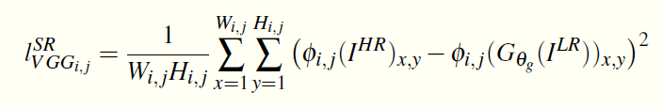
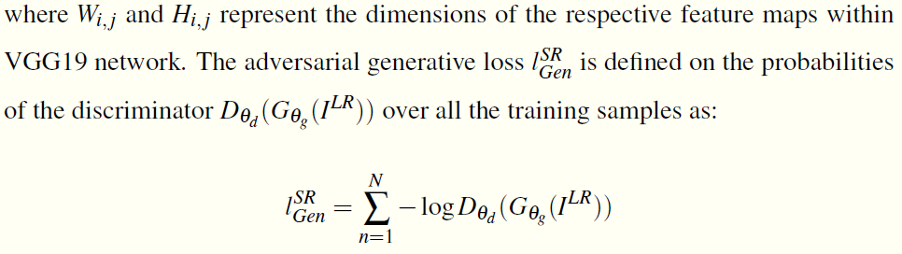
Annexure : Performance Parameters
We define the content loss as the L2 distance between the feature representations of the reconstructed image and the reference image

Slide 35
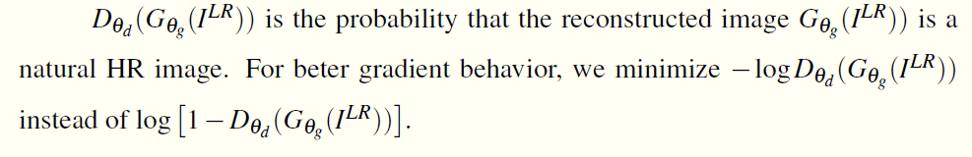
Annexure: Performance Parameters

