Slide 1

Astronomical image colourisation and super-resolution using GANS
K. K. Wagh Institute of Engineering Education and Research, Nashik
Department of Computer Engineering
PID 23
Group Members:
Shreyas Kalvankar B150134261 Hrushikesh Pandit B150134296 Pranav Parwate B150134299
Atharva Patil B150134303
Guided By: Prof. Dr. S. M. Kamalapur

Slide 2
Contents
Problem Definition, Technical Keywords
Literature Survey
Motivation of the Project
Objectives
Block diagram of Project
Methodology
Mathematical Model

Slide 3
Problem Definition
The problem can be divided into two sub-problems:
Create an efﬁcient model to colorize grayscale images
Take a colorized image and upscale it n times the original size
Keywords: GAN, Neural Network, NodeJS, puppeteer, Convolutional Neural Network, Upscaling, Colorization.

Slide 4
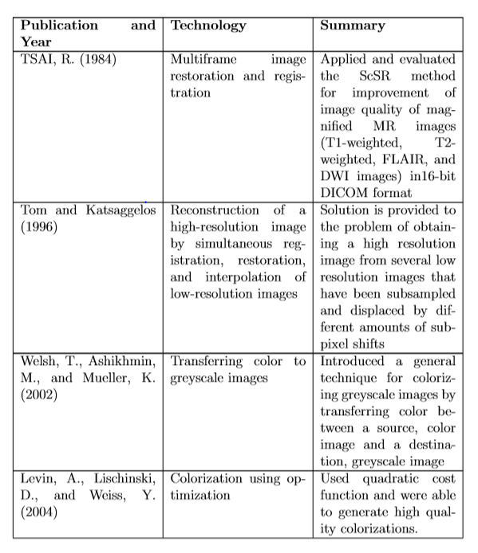
Literature Review

Slide 5
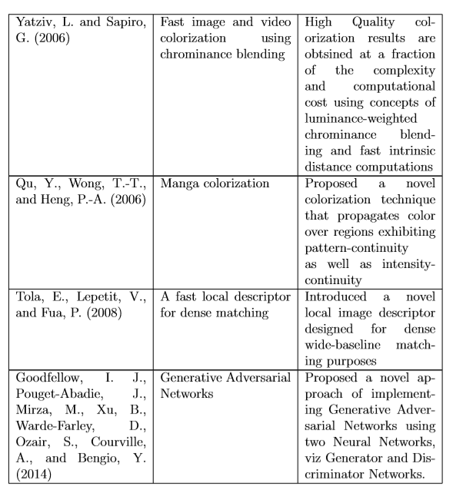

Slide 6
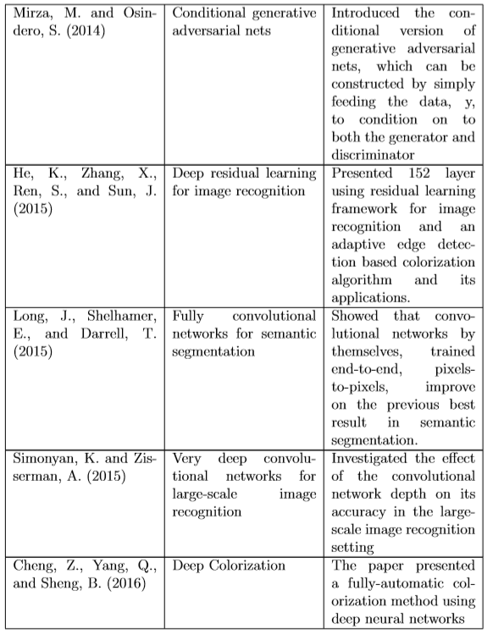

Slide 7
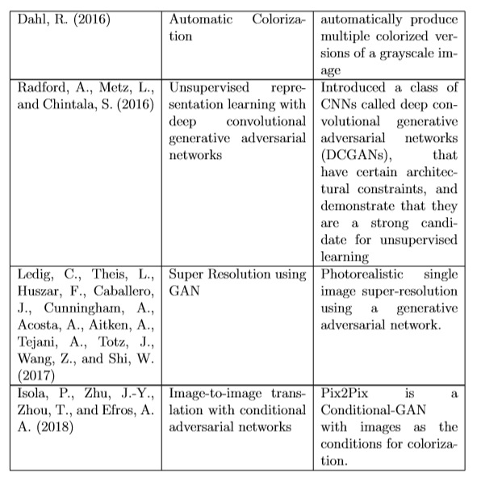

Slide 8
Motivation of the Project
Application of GANs has successfully improved the performance and computers are getting better and better at predicting accurate missing pixel values and upscaling images many folds the original size.
All this computation power can be used for astronomical research by processing large data archives.

Slide 9
Motivation of the Project
A large number of images lie dormant in most of the space survey data archives which never go through any kind of processing and are low resolution and black & white.
These images could be processed automatically by an algorithm that will colorize and super-resolve the images which can make it easier for astronomers to visually inspect the images.

Slide 10
Objectives
Auto-Colorization
Upscaling/super-resolution
The models may be combined to form a single model that will take a low resolution, grayscale image as its input and produce a high resolution, colorized image as its output.

Slide 11
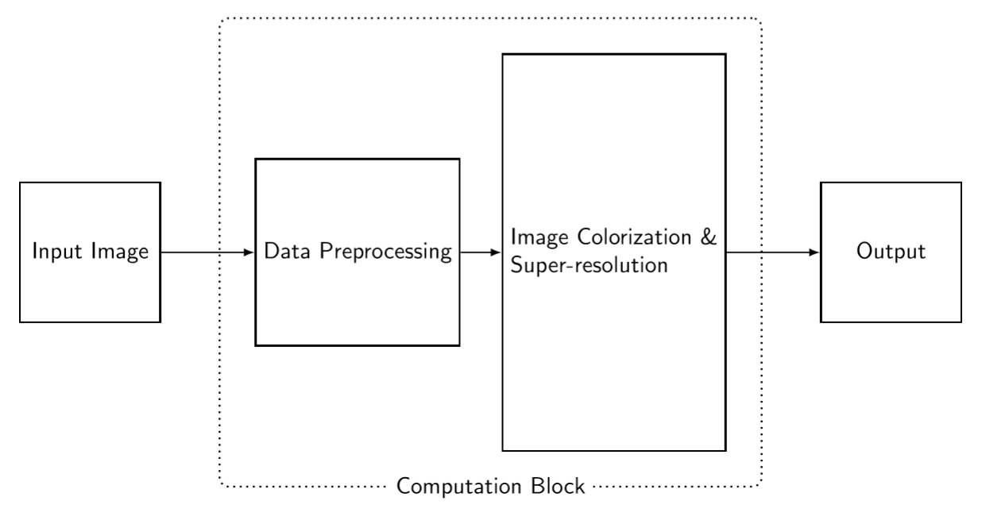
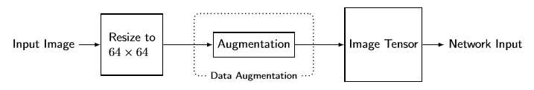
Block diagram of Project
Data Preprocessing

Slide 12
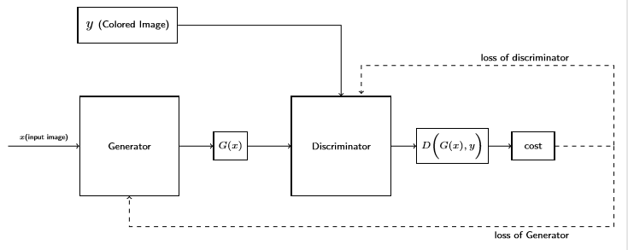
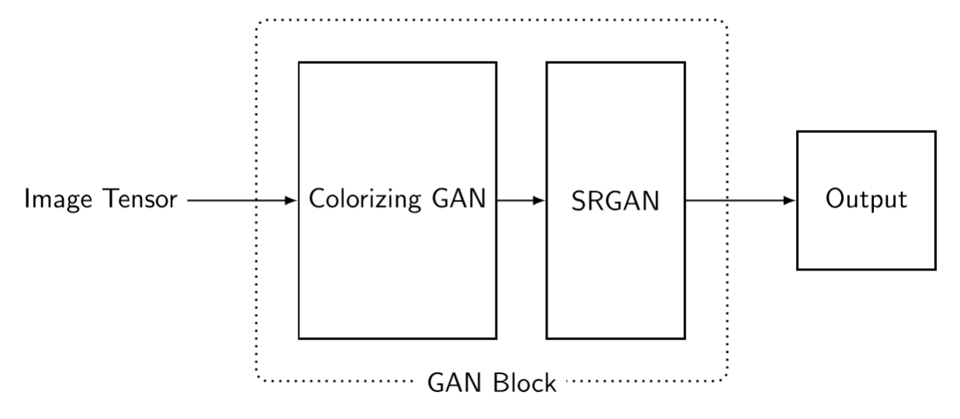
GAN
GAN Block Summary

Slide 13
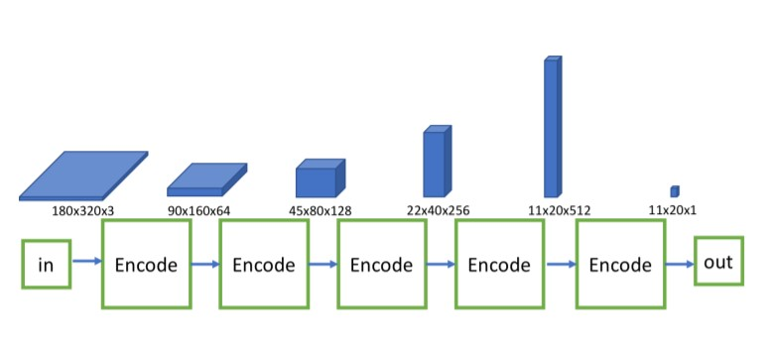
Discriminator

Slide 14
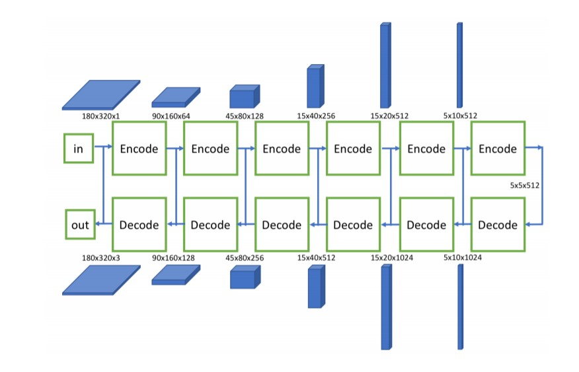
Encoder Decoder Generator

Slide 15
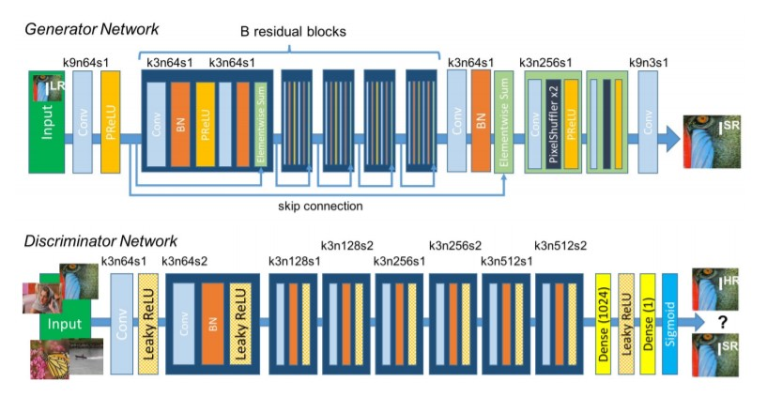
Ledig SRGAN Architecture

Slide 16
Methodology
Data gathering and processing
- Data Scraping
Data Cleaning
Model Building
Model Training
Cost Optimization and tuning
Performance Evaluation and Documentation

Slide 17
Image Colorization
Image Colorization convolutional neural networks with residual encoders using the VGG16 architecture will be used.
System will consists of L2 loss which is a function of the Euclidean distance between the pixel’s blurred color channel value in the target and predicted image.
Generative Adversarial Networks use a minimax loss which is different than the L2 loss as it will choose a color to ﬁll an area rather than averaging. This is similar to a classiﬁcation based approach.

Slide 18
Image Upscaling
SR-GAN works well with for single image super-resolution as it also uses an intelligent content loss function that uses pre-trained VGG-net layers.

Slide 19
Mathematical Model
A generative network, G, is supposed to learn the underlying distribution of a latent space, Y.
The Discriminator network D takes in both the fabricated outputs generated by G and real inputs from the underlying distribution Y.
The network produces a probability of the image belonging to the real or fabricated space.

Slide 20
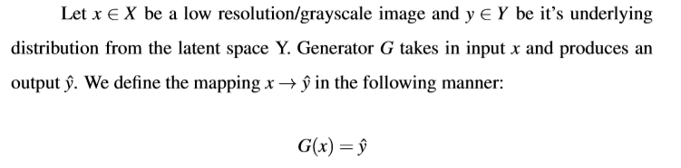
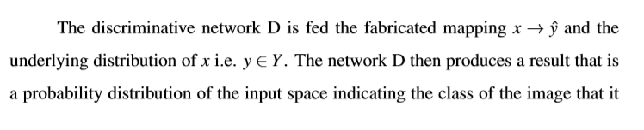
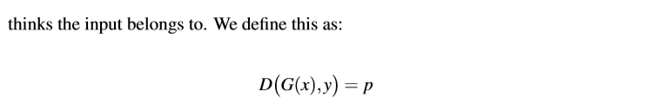
Mathematical Model

Slide 21
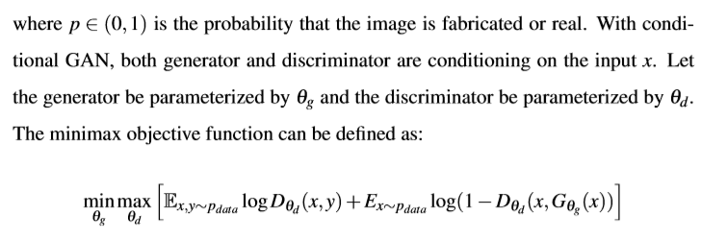
Mathematical Model

Slide 22
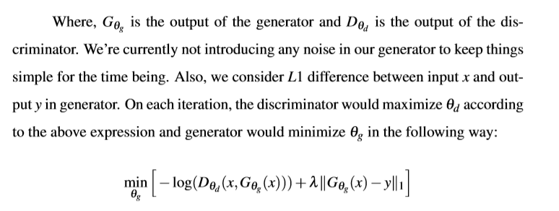
Mathematical Model

Slide 23
Thank You

