Slide 1

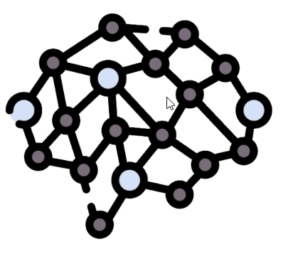
1
Retrieval Agent
Query
2
System Prompt
Disease Symptoms
3
Chat Memory
FAISS Index
Symptom
Severity
FAISS Index
4
5
Disease
Descriptions
Disease Precautions
Response
6
LLM
Agentic RAG : Medical Assistant Bot / Symptom Diagnosis

