Slide 1

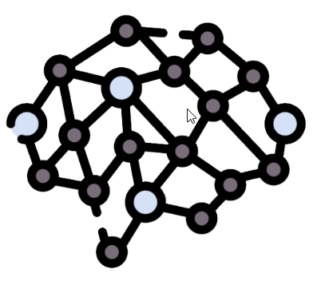
1
Agent
Query
2
System Prompt
Disease Symptoms
3
Chat Memory
FAISS Index
Symptom
Severity
FAISS Index
4
5
Disease
Descriptions
Disease Precautions
Response
6
Vision Tools
LLM
Agentic RAG: Multi-modal/Multi-agent Medical AI

