Slide 1
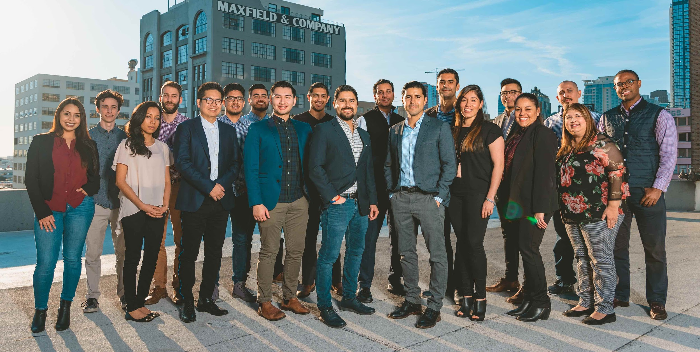

How to (gracefully) jump start data science initiatives at a start-up
Cho-Nan Tsai, CTO @ Camino Financial

Slide 2

About Me
CTO @
Fortune 500
Online lender
Start-ups
Hispanic Market

Slide 3
Data Science initiatives are hard!!!!

Slide 4
87% of data science projects never make it into production.
- Venture Beat
77% of businesses report that "business adoption" of big data and AI initiatives continues to represent a big challenge for business. - New Advantage Survey
85% of data science projects fail. - Gartner

Slide 5
What can we do about it?

Slide 6

The 5 Golden Pillars of Data Science

Slide 7
Culture
Data
Goal
People
AI/ML Stack

Slide 8

The Future

Slide 9

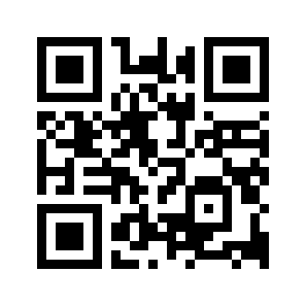
Thank you
https://www.linkedin.com/in/michaeltsai/
https://obicho.github.io/talks/

Slide 10

Goal
Don’t do moonshot projects on day one
Early initiatives should be tangible, low hanging fruits
Leadership should have a good understanding of capabilities of ML/AI
Iterate always but never stall
Goals should be clearly stated and yet not too broad
Contribute to marketing goals:
Decrease user acquisition cost by X% through better targeting
Increase funnel conversion by X% by offering actionable and personalized call-to-action messages
Contribute to data-driven process:
Combine various data sources to deliver more customer insight
Set up BI dashboards

Slide 11

People
Your first hire should
wear many hats
Have an open mind
Wear many hats
Have a good business sense
Can draw conclusions and
Do cause-effect analysis
Setting proper expectations up front: Employer wants beautiful dashboards and useful insights right away but the data scientist wants to build large scale machine learning clusters using complex algorithms -- almost never happens at an early stage startup

Slide 12

Culture
Treat data as your first class citizen
Build an organizational culture that encourages to bring on ideas with the support of data
Don’t operate on a hunch
If there is a bigger fish to fry (other than data), you must go for it (like existential threat or finding your product-market fit)
Data is not the CEO or the President; deprioritize when necessary

Slide 13

Data
Watch out for data starvation
Be creative where you get your data
Open data initiatives
Buy data may be OK, but as a last resort. Validate your source
Embed event tracking and user tracking early on in your product
Don’t use production database to do work

Slide 14
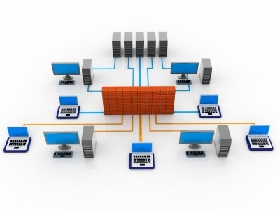
AI/ML Stack/Infrastructure
Spend the time to set up the right infrastructure first
Approach open source alternative first:
R Studio - Analysis and base plots
R Markdown - Reports
R Shiny - Interactive visualization
Python (PANDAS) - data frames
d3.js - visualization
Do’s before data science analysis
Create data pipeline
Data instrumentation
Data catalog
ETL (extract-transform-load)
Data engineering 80% ; Data Science 20% only!
Protect your bank roll - don’t turn on data science services unless you are ready

