Slide 1
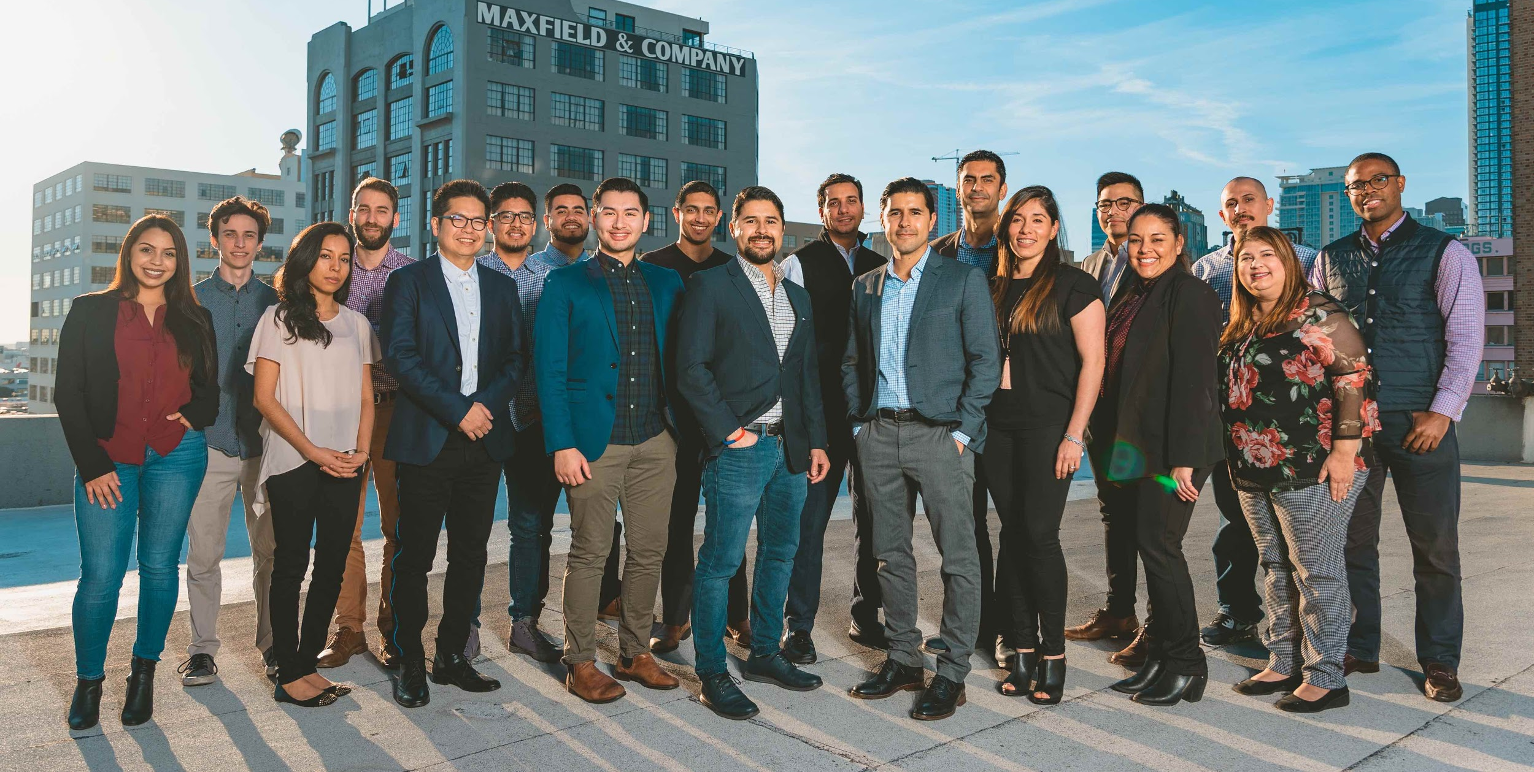

How to (gracefully) jump start data science initiatives at a start-up
Cho-Nan Tsai, CTO @ Camino Financial

Slide 2

About Me
CTO @
Fortune 100
Start-ups

Slide 3
Data Science initiatives are hard!!!!

Slide 4
87% of data science projects never make it into production.
- Venture Beat
77% of businesses report that "business adoption" of big data and AI initiatives continues to represent a big challenge for business. - New Advantage Survey
80% of analytics insights will not deliver business outcomes through 2022 and 80% of AI projects will “remain alchemy, run by wizards” through 2020 - Gartner

Slide 5
What can we do about it?

Slide 6

The 5 Golden Pillars of Data Science

Slide 7
Culture
Data
Goal
People
AI/ML Stack

Slide 8

Goal
Early initiatives should be tangible, low hanging fruits
Leadership should have a good understanding of capabilities of ML/AI
Iterate always but never stall
Goals should be clearly stated and yet not too broad
Digital marketing goal examples:
Decrease user acquisition cost by X% through better targeting
Increase funnel conversion by X% by offering actionable and personalized call-to-action messages

Slide 9

People
Your first hire should
wear many hats
Have an open mind
Wear many hats
Have a good business sense
Can draw conclusions and
Do cause-effect analysis
Setting expectations up front

Slide 10

Culture
Treat data as your first class citizen
Don’t operate on a hunch
If there is a bigger fish to fry (other than data), you must go for it (like existential threat or finding your product-market fit)

Slide 11

Data
Watch out for data starvation
Be creative where you get your data
Open data initiatives
Buy data may be OK, but as a last resort. Validate your source.

Slide 12
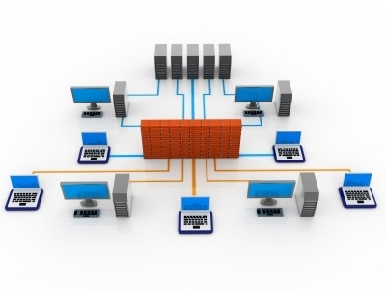
AI/ML Stack/Infrastructure
Spend the time to set up the right infrastructure first
Do’s before data science analysis
Data instrumentation
Data catalog
Have a ETL pipeline in place (extract-transform-load)
Data engineering 80% ; Data Science 20% only!
Protect your bank roll - don’t turn on data science services unless you are ready

Slide 13


Thank you
https://www.linkedin.com/in/michaeltsai/
https://obicho.github.io/talks/

