Slide 1
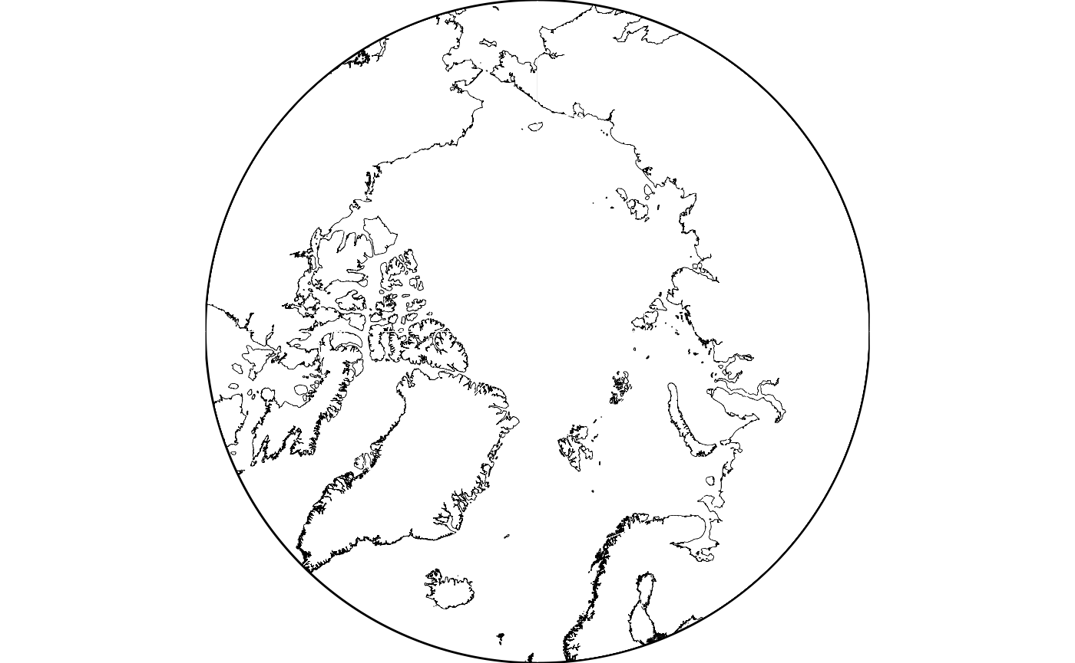
Project 7: Future arctic sea ice change
Ewen Cottour, Edgard Dabier, Julie Descloitres, Adam Lagssaibi

Slide 2
Summary
Context
Our data
Objective
Methods
Results
Perspectives

Slide 3
Context
Why monitor sea ice ?
Essential climate variable : warming, albedo, currents [1]
Global activity : CMIP → Better understanding of past, present and future climate
1 model : CMCC-ESM2 → Atmospheric, oceanic, land interactions
4 scenarios : 1pctCO2, historical, abrupt-4xCO2 & piControl[2]

Slide 4
Our Data
Extraction of surface coverage of ice (sea ice concentration in % - or siconc in the dataset)
from one model, and for each scenario
formating dataset -> one line per location, every season of every year is a feature
(lon, lat) | winter, year 1 | spring, year 1 | summer, year 1 | autumn, year 1 | winter, year 2 | … | autumn, year Ny
Pixel 1 | 49.857426 | 85.757378 | 1.356595 | 91.907387 | 12.012276 |  | 20.202364
…
Pixel Np | 20.202364 | 0.000313 | 72.987999 | 63.450939 | 99.638741 |  | 25.049150

Slide 5
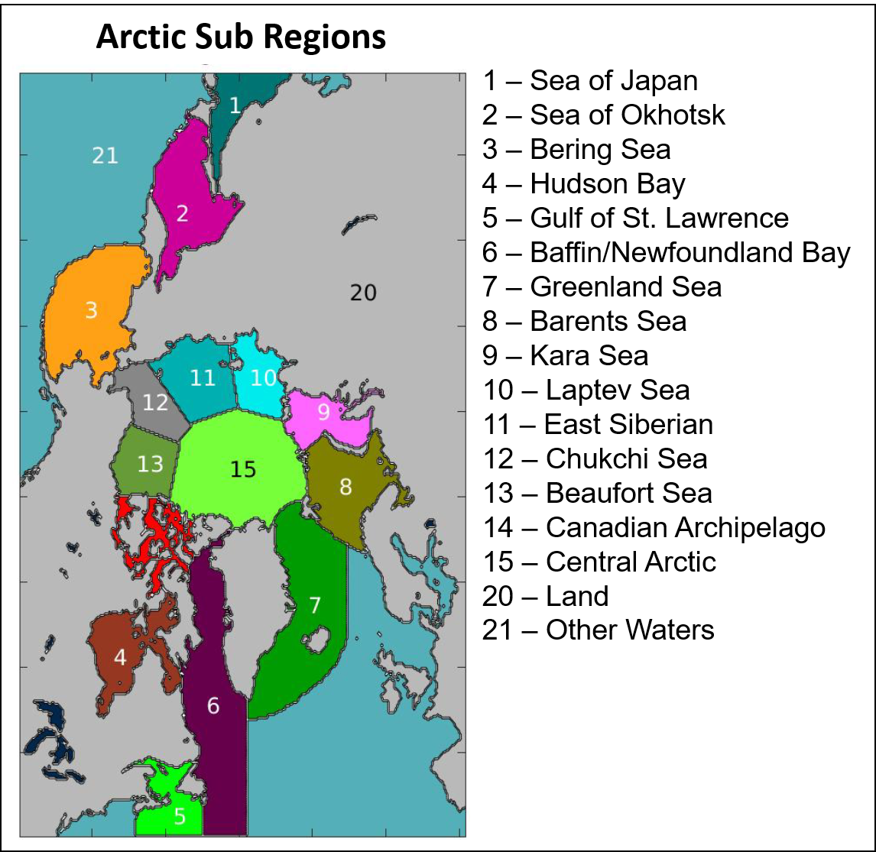
Objective
Withdraw from arbitrary cartography of the arctic

Slide 6
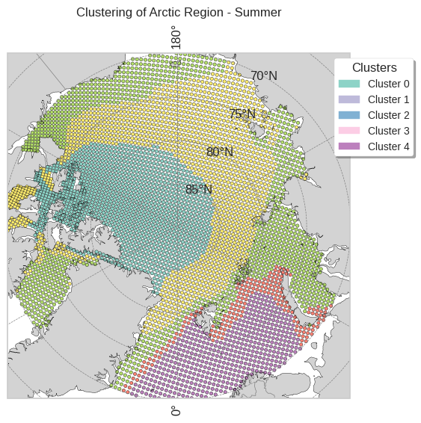
Objective
Create a physical driven cartography, based on seasonal evolution of surface coverage of ice
Cluster the regions with a similar time evolution of the siconc

Slide 7
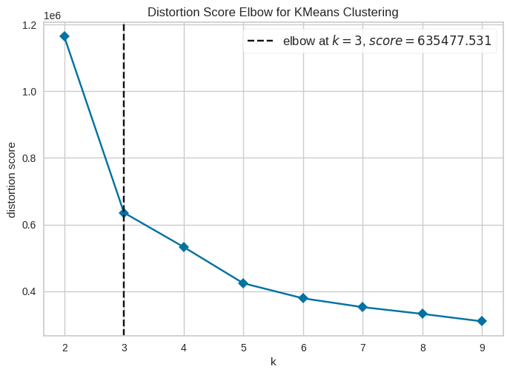
Methods
Selection of best model based on silhouette score
4 clustering methods tested:
K-Means
DBScan
Gaussian Mixture
Agglomerative
Clustering based on seasonal similarities
Selection of the number of clusters based on elbow method

Slide 8
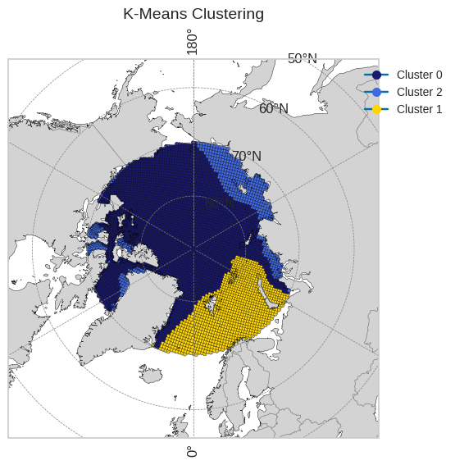
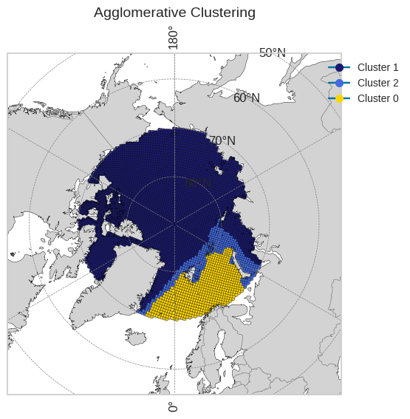
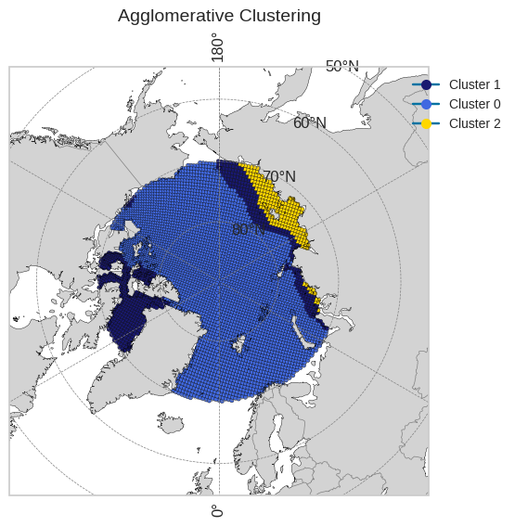
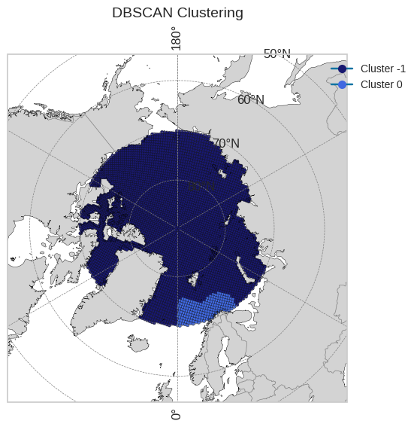
Results
annual clustering for each scenario
1pctCO2 | historical | abrupt-4xCO2 | piControl
silhouette score
0.561 | 0.622 | 0.628 | 0.589

Slide 9
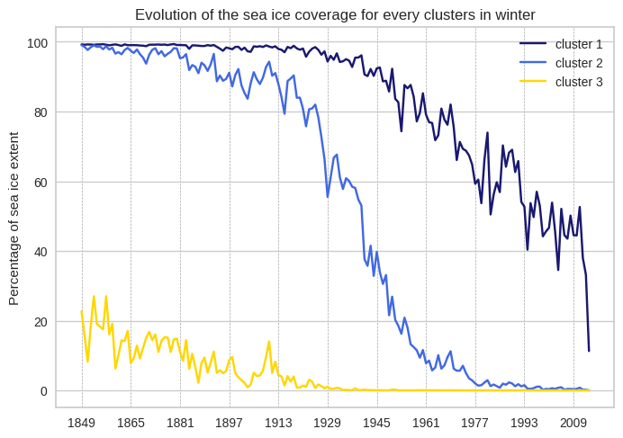
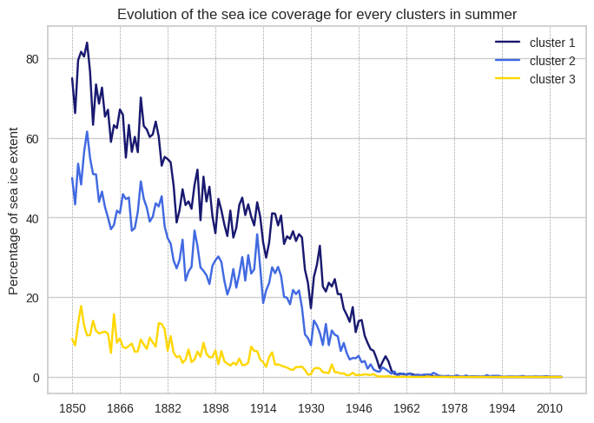
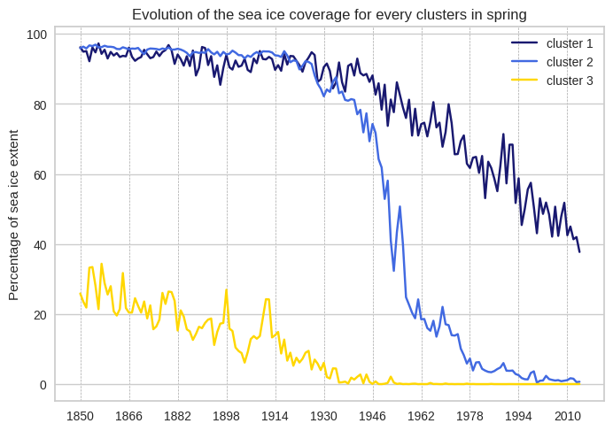
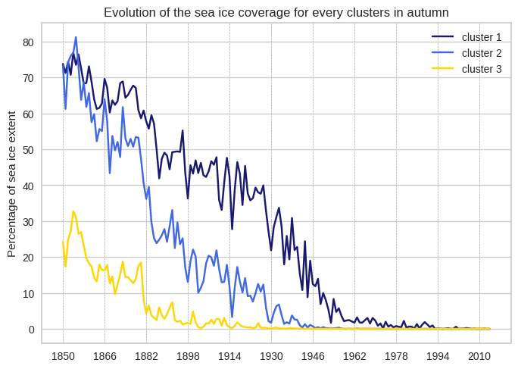
Results
Focus on scenario 1pctCO2
Type of ice : Young ice, 1 year ice, old ice [3]
seasonal clustering
winter | spring | summer | autumn

Slide 10
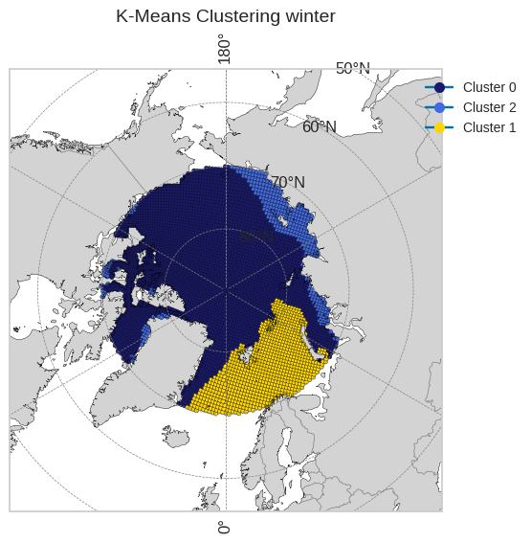
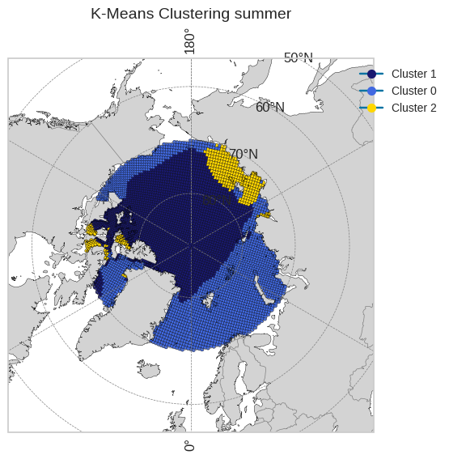
Results
Focus on winter
variation of clusters between summer and winter

Slide 11
Perspectives
Cluster validation :
Same clusters with different models ?
Compare with sea ice volume.
Time evolution :
Arctic should be ice-free during summer in 2047 [4].
In high emissions scenario, Arctic will be ice free in winter too [5].
Create clusters on a 10-years period.

Slide 12
Bibliography
[1] GCOS: Essential Climate Variables – Sea Ice, Global Climate Observing System, World Meteorological Organization (WMO), available at: https://gcos.wmo.int/site/global-climate-observing-system-gcos/essential-climate-variables/sea-ice, last accessed: January 2025.
[2] WCRP: CMIP Model and Experiment Documentation, World Climate Research Programme, available at: https://wcrp-cmip.org/cmip-model-and-experiment-documentation/, last accessed: January 2025.
[3] WMO: WMO-No. 574 – Guide to Climate Services, 2024 edition, World Meteorological Organization, available at: https://library.wmo.int/viewer/31442/download?file=574-2024-edition_en.pdf&type=pdf&navigator=1, last accessed: January 2025.
[4] Selivanova, J., Iovino, D., and Cocetta, F.: Past and future of the Arctic sea ice in High-Resolution Model Intercomparison Project (HighResMIP) climate models, The Cryosphere, 18, 2739–2763, https://doi.org/10.5194/tc-18-2739-2024, 2024.
[5] ESA: Simulations Suggest Ice-Free Arctic Summers by 2050, European Space Agency – Climate Office, available at: https://climate.esa.int/nl/projecten/sea-ice/news-and-events/news/simulations-suggest-ice-free-arctic-summers-2050/, last accessed: January 2025.

