Slide 1

Analyses of key player stats for the 2020/2021 season

Slide 2
About data
Number of players: 532
Columns: 18
Number of Clubs: 20
Number of Nationalities: 56

Slide 3
Columns and Descriptions:
Names - The player's first and last name.
Club - The soccer team that the player plays for.
Nationality - The player's nationality.
Position - Each player has a certain position, in which he plays regularly. The position in this dataset are:
FW - Forward
MF Midfield
DF - Defensive
GK - Goalkeeper
Starts - The number of times the player was named in the starting 11 by the manager.
Mins - The number of minutes played by the player.
Goals - The number of Goals scored by the player.
Assists - The number of times the player has assisted another player in scoring the goal.
Passes_Attempted - The number of passes attempted by the player.
PercPassesCompleted - Percentage of passes that the player successfully passed to his teammate.
xG - Expected number of goals from the player in a match.
xA - Expected number of assists from the player in a match.
Yellow_Cards - The players get a yellow card from the referee for indiscipline, technical fouls, or other minor fouls.
Red Cards - The players get a red card for accumulating 2 yellow cards in a single game, or for a major foul.

Slide 4
Questions:
Did foriegn (Non-English) players perform better than English players? I will break that down into 3 questions based on the stats available in this dataset.
Did foriegn (Non-English) players contribute more goals than English players?
Did foriegn (Non-English) players make more passes than English players?
Did foriegn (Non-English) players make more accurate passes than English players?
Were foreign (Non-English) more disciplined than English players? In other words, which group received more or less yellow and red cards?
Note: I will focus on players that played at least 5 games in the season for both analyses. However, Goalkeepers (GK) will be excluded from the performance analysis but not the discipline analysis.

Slide 5
Key Metrics
Performance:
Goal_Contribution (sum of Goals and Assists)
Passes_attempted
Perc_Passes_Completed
Discipline:
Total_Cards (sum of yellow cards and red cards)

Slide 6
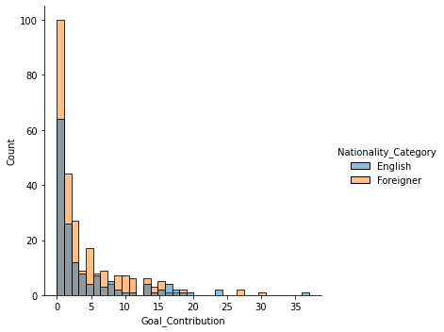
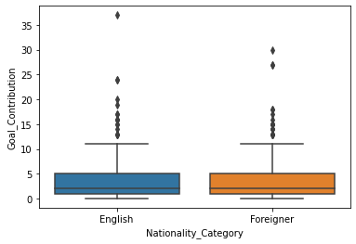
English vs Foreign (non-English) Players - Goal_Contribution
Players count:
English - 151
Foreign - 259
Statistical Tests
Means (goal_contribution):
English players - 4.17
Foreign players - 3.97
Normality check:
Not bell curve.
Shapiro test for normality → both p-value > 0.05
→ Not normally distributed
Null hypothesis: no significant difference between the means of goal contribution of English players and foreign players.
Kruskal-Wallis test results:
H-value = 0.35
pvalue = 0.56 ( > 0.05)
Interpretation: Null is true; no significant difference between the means of goal contributions of English players and foreign players.

Slide 7
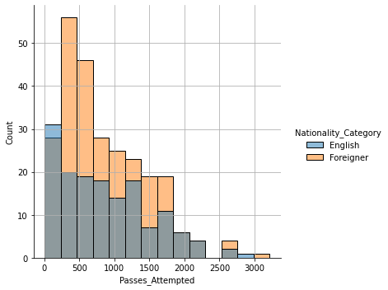
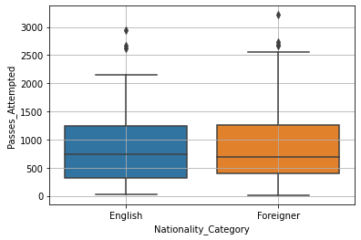
English vs Foreign (non-English) Players - Passes_Attempted
Statistical Tests
Means (passes):
English players - 876.03
Foreign players - 860.10
Normality check:
Not bell curve.
Shapiro test for normality → both p-values > 0.05
→ Not normally distributed
Null hypothesis: no significant mean difference between the passes attempted by English players vs foreign players.
Kruskal-Wallis test results:
H-value = 0.004
pvalue = 0.95 ( > 0.05)
Interpretation: Null is true; no significant difference between the means of passes attempted by English players and foreign players.

Slide 8
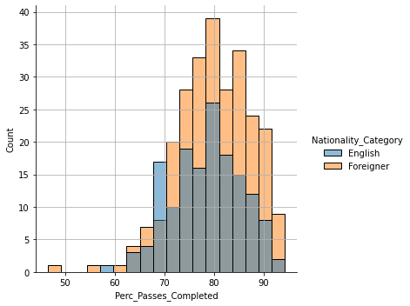
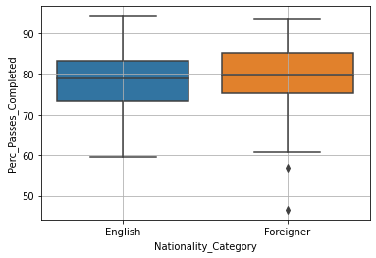
English vs Foreign (non-English) Players - Perc_Passes_Completed
Statistical Tests
Means (%):
English players - 78.44
Foreign players - 80.00
Normality check:
Bell curve.
→ Normally distributed
Null hypothesis: no significant mean difference between the percentage of passes completed by English players and foreign players.
T test results:
t-value = -2.11
pvalue = 0.03 ( < 0.05)
Interpretation: Null does not stand; there is significant difference between the percentage of passes completed by English players and foreign players.
With 95% confidence interval, foreign players on average completed between 0.14% and 3.00% more passes than English players.

Slide 9
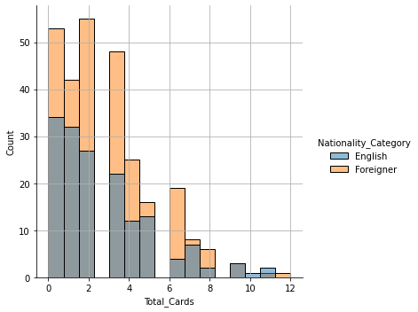
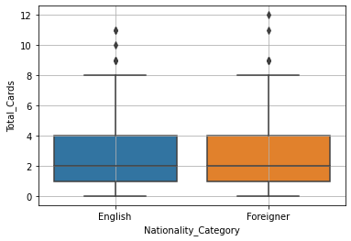
English vs Foreign (non-English) Players - Total_Cards
Statistical Tests
Means (cards):
English players - 2.60
Foreign players - 2.69
Normality check:
Not bell curve.
Shapiro test for normality → both p-values > 0.05
→ Not normally distributed
Null hypothesis: no significant mean difference between the total cards received by English players and foreign players.
Kruskal-Wallis test results:
H-value = 0.74
pvalue = 0.39 ( > 0.05)
Interpretation: Null is true; no significant difference between the means of total cards received by English players and foreign players.

Slide 10
Conclusion
Based on the key metrics I chose from the dataset at hand:
English players are statistically performing on the same level as the foreign players.
Pass completion rate of foreign players on average 3% better (at most).
Fans' hypothesis (myself included) that foreign players perform better than English players is statistically inaccurate.
English players are statistically not more or less disciplined than foreign players.

Slide 11
Sources
dataset: https://www.kaggle.com/rajatrc1705/english-premier-league202021
Official EPL website link - https://www.premierleague.com/tables?co=1&se=363&ha=-1

