Slide 1
_
+
Ground Truth
_
+
False negatives
True negatives
+
True positives
False positives
True positives
False positives
Prediction
_
False negatives
True negatives
Notes:
Training set

Slide 2
TP
TP
+
TN
Recall/
Sensitivity =
Accuracy =
FN
+
+
+
TP
TP
TN
FP
FN
TP
TN
Precision =
Specificity =
TN
TP
FP
FP
Notes:
Precision or the positive predictive value is the percentage of all positively predicted samples that are in fact positive.
Sensitivity or recall is the percentage of positive cases that was correctly classified as positive cases (In medicine, how many patients that have a specific disease will be detected with the model)
Specificity is the percentage of negative cases that are correctly classified as negative cases. (In medicine, the percentage of healthy patient that are detected as healthy by the model.

Slide 3
ROC: Receiver Operating Characteristic Curve
AUC: Area Under the ROC Curve
TPR: True Positive Rate
ROC
FPR: False Positive Rate
Decision
threshold
TPR
Random
Prediction
AUC
FPR
Notes:
Precision or the positive predictive value is the percentage of all positively predicted samples that are in fact positive.
Sensitivity or recall is the percentage of positive cases that was correctly classified as positive cases (In medicine, how many patients that have a specific disease will be detected with the model)
Specificity is the percentage of negative cases that are correctly classified as negative cases. (In medicine, the percentage of healthy patient that are detected as healthy by the model.

Slide 4

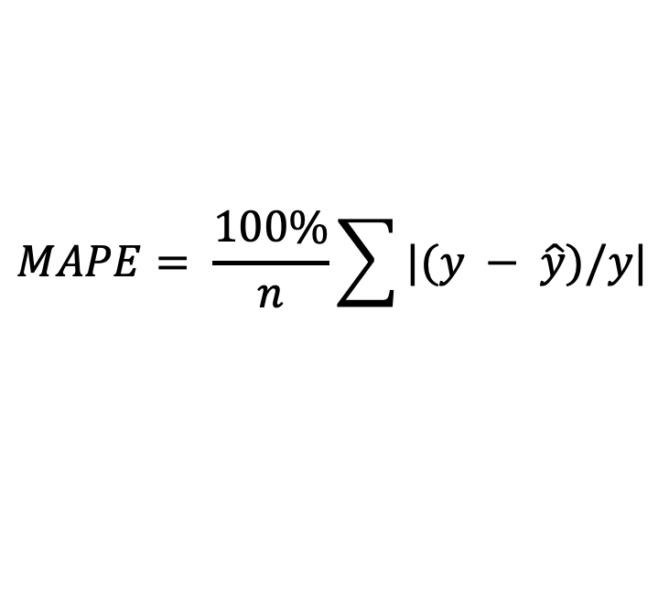


Max Absolute Percentage Error
Sum of
Predicted
value
Absolute
value of…
$$MAPE= \frac{100\%}{n}\sum{|(y − \hat{y})/y|}$$
Ground
truth
Average of…
$$\hat{y}$$
$$y − \hat{y}$$
$$y$$
Notes:
MAE

Slide 5

Max Error
Predicted
value
$$ME=\max{|y_{j}−{\hat{y}}_{j}|}$$
Ground
truth
ME
Notes:
MAE

Slide 6
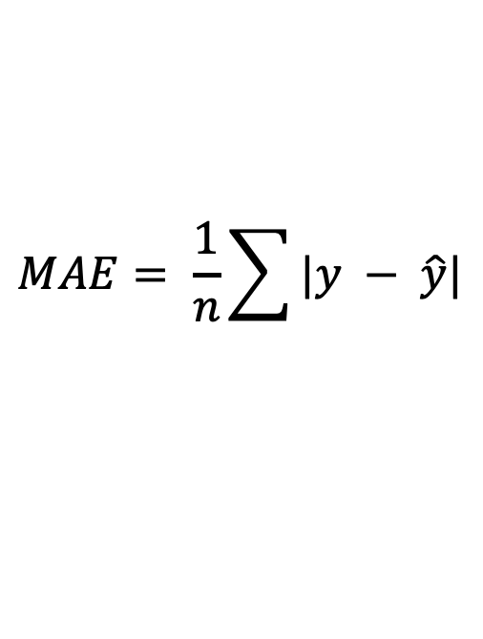
Mean Absolute Error
Sum of
Predicted
value
$$MAE= \frac{1}{n}\sum{|y − \hat{y}|}$$
Absolute
value of…
Average of…
Ground
truth
MAE
Notes:
MAE

Slide 7
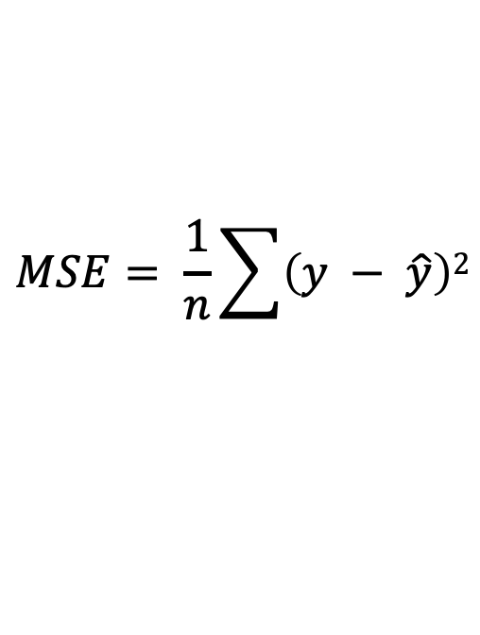
Mean Square Error
Sum of
Predicted
value
$$MSE= \frac{1}{n}\sum{\left(y − \hat{y}\right)2}$$
Squared
of…
Average of…
Ground
truth
MSE
Notes:
MAE

Slide 8
Decision tree
Parent Visiting
Yes
No
Go to Cinema
Weather
Rainy
Cloudy
Stay in
Go Shopping
Notes:
Decision tree

Slide 9
Entropy description
0.97
0.82
0
Entropy Decreases

Slide 10
Decision tree
root node
internal node
Outcast
leaves
leaves
Sunny
Rainy
Cloudy
Humidity
Wind
Yes
High
Normal
Strong
Weak
No
Yes
No
Yes

Slide 11
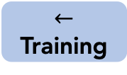
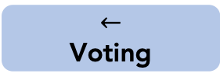
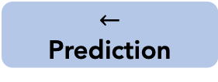
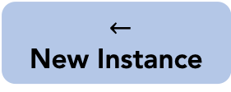
Voting classifier
Training
samples
$←$
Training
k-NN
Decision Tree
SVM
Others
Classifiers
. . .
$←$
New Instance
$←$
Prediction
$←$
Voting
Olatomiwa Bifarin

Slide 12
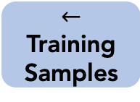
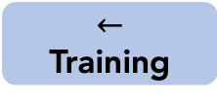
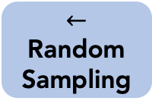
bagging
$←$
Training Samples
$←$
Random Sampling
. . .
$←$
Training
Classifier 1
Classifier 2
. . .
Classifier n
Olatomiwa Bifarin

Slide 13
AdaBoost
1
2
3

Slide 14
PCA illustration
A
B

Slide 15
SVM
Margin
Support Vector
Optimal hyperplane

Slide 16
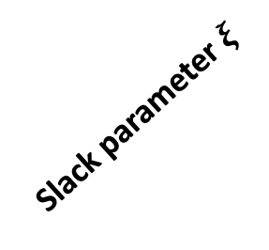
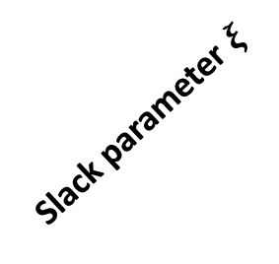
SVM with slack.
Slack parameter $ξ$
Slack parameter $ξ$

Slide 17
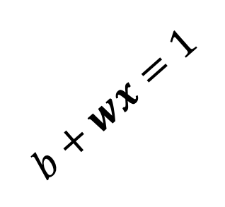

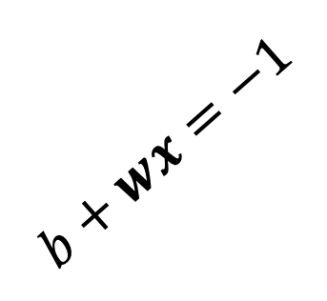
SVM + equations
$$b+wx=1$$
$$b+wx=−1$$
$$w$$

Slide 18
SVM kernel
map
Notes:
map

Slide 19

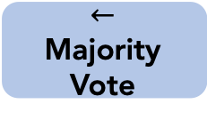

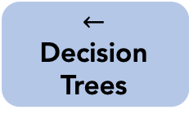
Random forest
M_{x}
$←$
Instance
$←$
Decision
Trees
$←$ Prediction
Class A
Class A
Class B
$←$
Majority Vote
Class A
Olatomiwa Bifarin

Slide 22
Likelihood
Likelihood
Likelihood
Notes:
Gaussian Naïve Bayes

