Slide 1

Discussion materials
V
28/10/2026

Slide 2
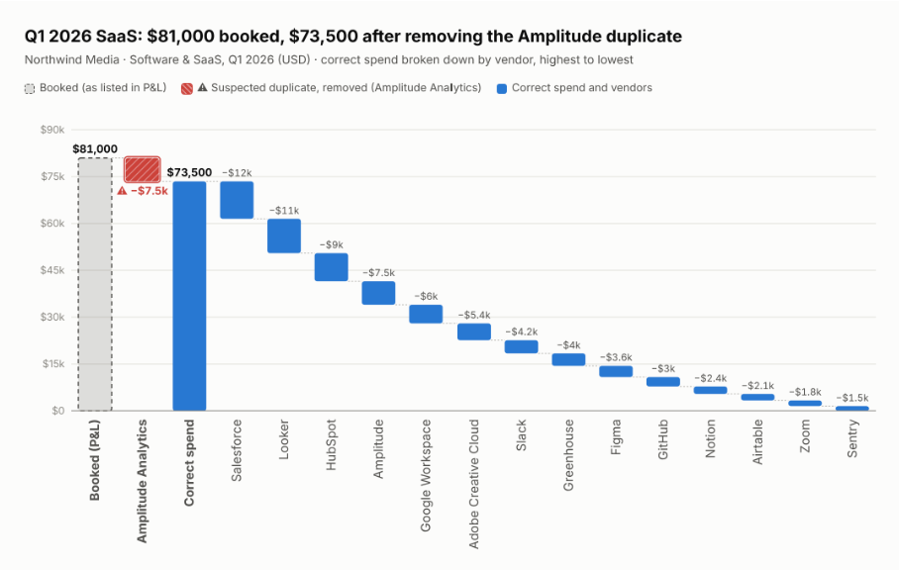
Q1 — SaaS spend | $81,000 booked; actual spend is likely $73,500
$81,000 booked
Actual spend is likely $73,500
($7,500) Amplitude Analytics booked twice; finance flagged it as a likely double-count, but the invoice hasn't been checked
Infrastructure costs excluded
Link

Slide 3
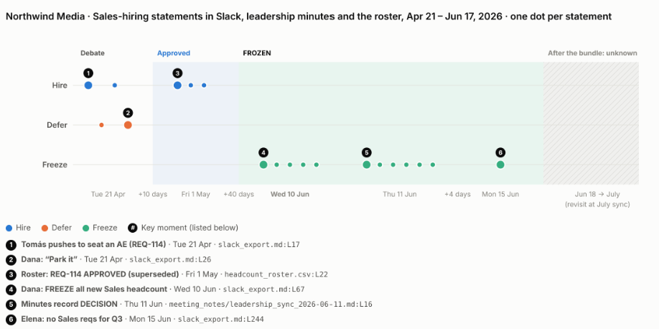
Q2 — Sales hiring frozen since June 10, decision owner Dana, CEO
New sales hiring frozen since 10 Jun; backfills need sign-off.
  Owner: Dana Whitfield (CEO)
  Enforcer: Priya Raman (CFO)
  REQ-114 paused (late-stage candidate; offer risk)
  Review: July meeting (notes not available)
  Other roles not affected
Link

Slide 4
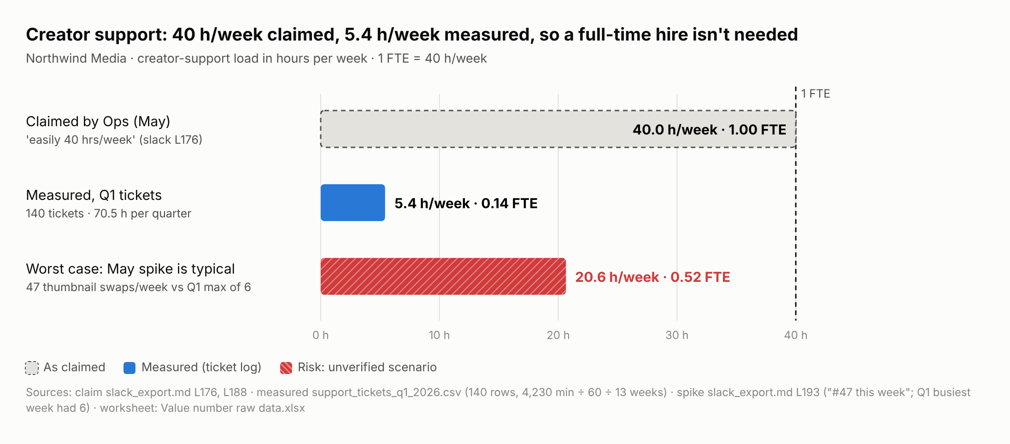
Q3 — Value number | $41,600/yr: support hire not needed
$41,600/yr support hire avoided
5.4 h/week measured vs 40 claimed (0.14 FTE)
Cost avoidance, not a cut: the hire was waiting on ticket data
Risk (medium confidence): May spike → 0.52 FTE, floor $20,129/yr; confirm with Q2 tickets
Link

Slide 5
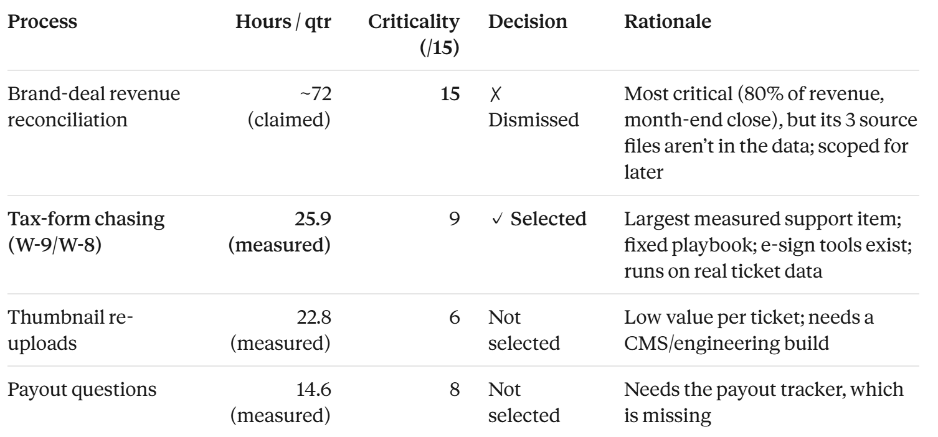
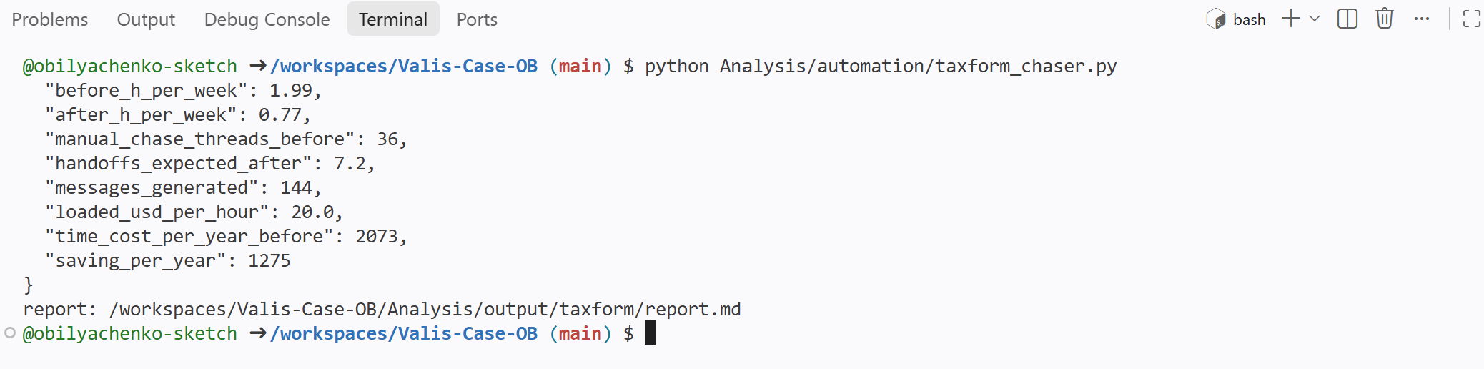
Q4 —Automation | Tax-form chasing workflow selected for automation
Brand-deal revenue reconciliation is most critical for automation; however, it is missing data
source files missing; scoped for later
Tax-form chasing workflow (W-9/W-8) automated
−61% time: 25.9 → 10.0 h/qtr
36 chases → ~7 hand-offs
Break-even < $1,275/yr
Runs on real Q1 data, 25 tests pass
Link

Slide 6
Sources
GitHub -> link
Claude session -> link

