Slide 1
LOANPAY · RISK & MARKETING ANALYTICS
Who Did the Creditly Campaign Attract?
Obinna Muonanu | TeSA AI Specialization

Slide 2
BUSINESS CONTEXT
A Surge in Applications Means
Nothing on Its Own
THE DATASET
981
The situation: LoanPay launched Creditly, its digital loan platform, behind an aggressive marketing push to drive applications.
applicants in the post-launch pool
Credit history (good / bad)
Gender, marital status, education
Self-employment status
Applicant & co-applicant income
Loan amount & repayment term
Property area (Urban / Semiurban / Rural)
The risk: volume is dangerous if the campaign disproportionately pulled in high-risk profiles rather than the financially sound customers LoanPay intended to reach.
The question: before any lending decisions or further campaign spend, “Who did we actually attract?”
~8% of records were missing Credit History; incomplete rows were excluded rather than imputed to avoid distorting the observed pool.
Creditly Applicant Pool Analysis | LoanPay Risk & Marketing
2

Slide 3
SECTION 1 · OVERALL CREDIT QUALITY
The Pool Skews Strongly Toward Good Credit
INSIGHT The team projected at least 80% good-credit history going in. The pool landed at 83.6% — beating the benchmark by roughly 3.6 points, with 16.4% flagged bad credit.
The overall pool is healthy and beat the risk benchmark the campaign was targeting. This supports continuing to invest in the current campaign and channels rather than pausing spend on quality grounds.
Creditly Applicant Pool Analysis | LoanPay Risk & Marketing
3

Slide 4
SECTION 2 · WHO DID THE CAMPAIGN ATTRACT?
A Married, Graduate, Salaried, Male-Leaning Pool
Creditly Applicant Pool Analysis | LoanPay Risk & Marketing
4

Slide 5
SECTION 2 · SEGMENT CREDIT RISK
Two Segments Skew Above the 16.4% Risk Baseline
INSIGHT Not-Graduate applicants (21% bad credit) and applicants with unidentified gender (22%, n=24) sit above the 16.4% pool average. Marital status and self-employment barely move the needle — salaried, married, and self-employed applicants all track close to the overall mix.
Creditly Applicant Pool Analysis | LoanPay Risk & Marketing
5

Slide 6
SECTION 3 · GEOGRAPHIC COMPOSITION
Applicants Are Spread Evenly And So Is Risk
INSIGHT Semiurban (35.6%) and Urban (34.9%) applicants lead, with Rural close behind (29.6%). Good-credit share is nearly flat across regions (82–84%). Rural is only marginally riskier.
No region is disproportionately driving risk, so there is no case for geographic exclusions or a region-specific underwriting overlay. The campaign's broad geographic reach can continue as-is.
Creditly Applicant Pool Analysis | LoanPay Risk & Marketing
6

Slide 7
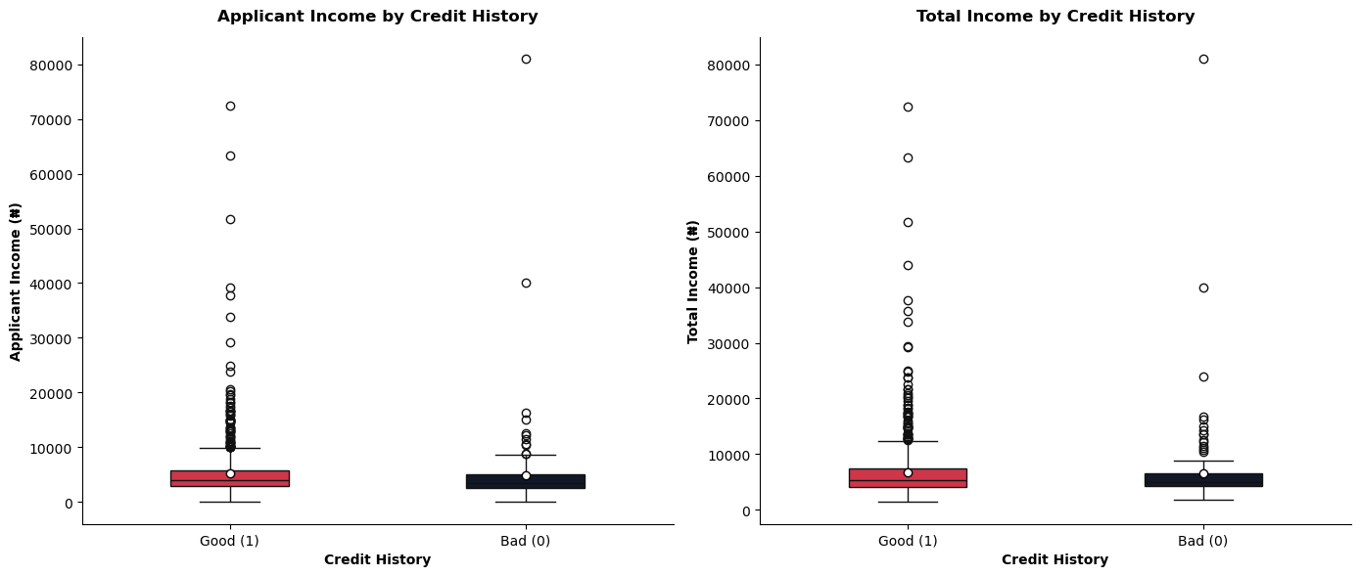
SECTION 4 · INCOME & LOAN SIZING BEHAVIOR
Income Alone Doesn't Separate Good From Bad Credit
INSIGHT Applicant and total-income distributions are nearly identical for good- and bad-credit applicants (both medians ~₦5-6k, same long right-tail outliers). Average total income runs ₦6,583 for bad credit vs. ₦6,772 for good credit, this is ~3% gap that is not meaningfully discriminating.
Creditly Applicant Pool Analysis | LoanPay Risk & Marketing
7

Slide 8
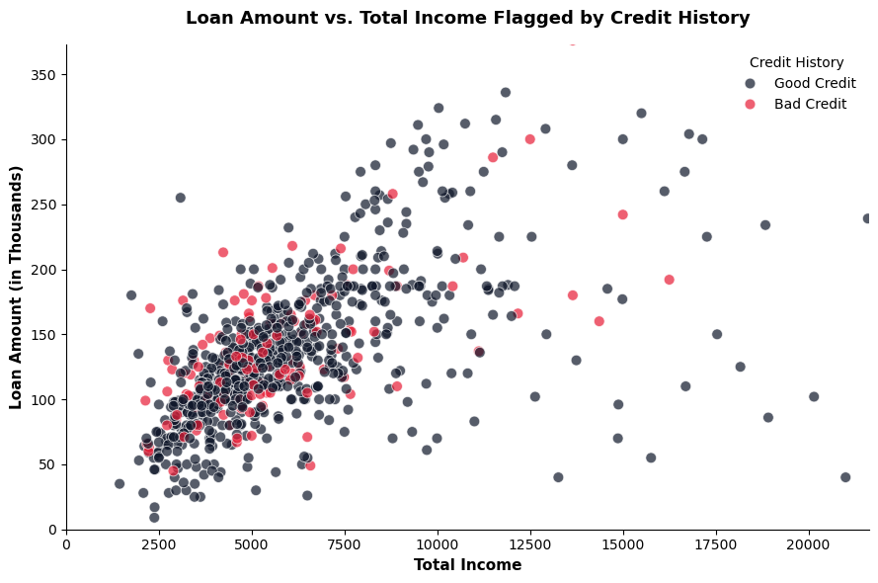
SECTION 4 · INCOME & LOAN SIZING BEHAVIOR
Loan Size and Term Are Standardized, Not Risk-Driven
INSIGHT Loan amount scales with income for both groups, and bad-credit applicants (red) are scattered uniformly across every income and loan-size band. No cluster where risk concentrates. Typical loan size (~₦140-143k) and term (360 days) are nearly identical for good vs. bad credit.
Income, loan amount, and term carry little risk signal in this pool. Underwriting should not lean on income thresholds or loan-size caps to screen risk. Pull in behavioral/bureau signals (repayment history, existing credit score) to sharpen the risk model.
Creditly Applicant Pool Analysis | LoanPay Risk & Marketing
8

Slide 9
SYNTHESIS
Who Did We Attract? A Healthy, Well-Spread Pool
KEY INSIGHTS
RECOMMENDED BUSINESS DECISIONS
Pool quality beat plan: 83.6% good credit vs. an 80% benchmark.
Demographics mirror a lending pool where married, graduate, salaried applicants dominate.
Only Not-Graduate (21%) and unidentified-gender (22%, small n) applicants skew above the 16.4% risk baseline.
Geographic spread is broad and credit quality is consistent (82–84%) across Urban, Semiurban, and Rural.
Income and loan size do not discriminate credit risk, Good and bad credit applicants look alike financially.
1
Scale the campaign. Pool quality clears the risk benchmark. LoanPay should continue current marketing campaign
2
Tighten intake on two segments. Add light-touch verification for Not-Graduate applicants and require gender capture at intake to close the “Unknown” gap.
3
Keep geographic targeting open. No region is riskier enough to warrant exclusion or a regional pricing overlay.
4
Don't underwrite on income or loan size alone. Bring in bureau/repayment-history data. The current pool shows income isn't a risk signal.
Creditly Applicant Pool Analysis | LoanPay Risk & Marketing
9

